Slide 1
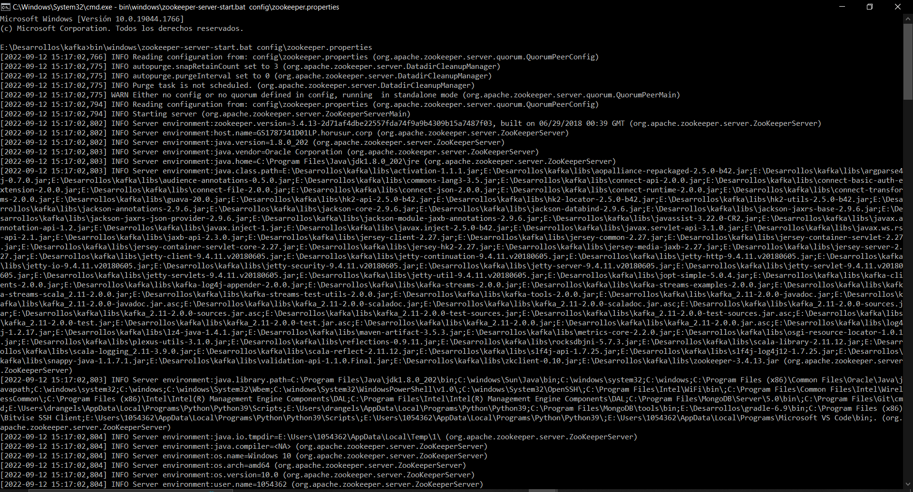
bin\windows\zookeeper-server-start.bat config\zookeeper.properties

Slide 2
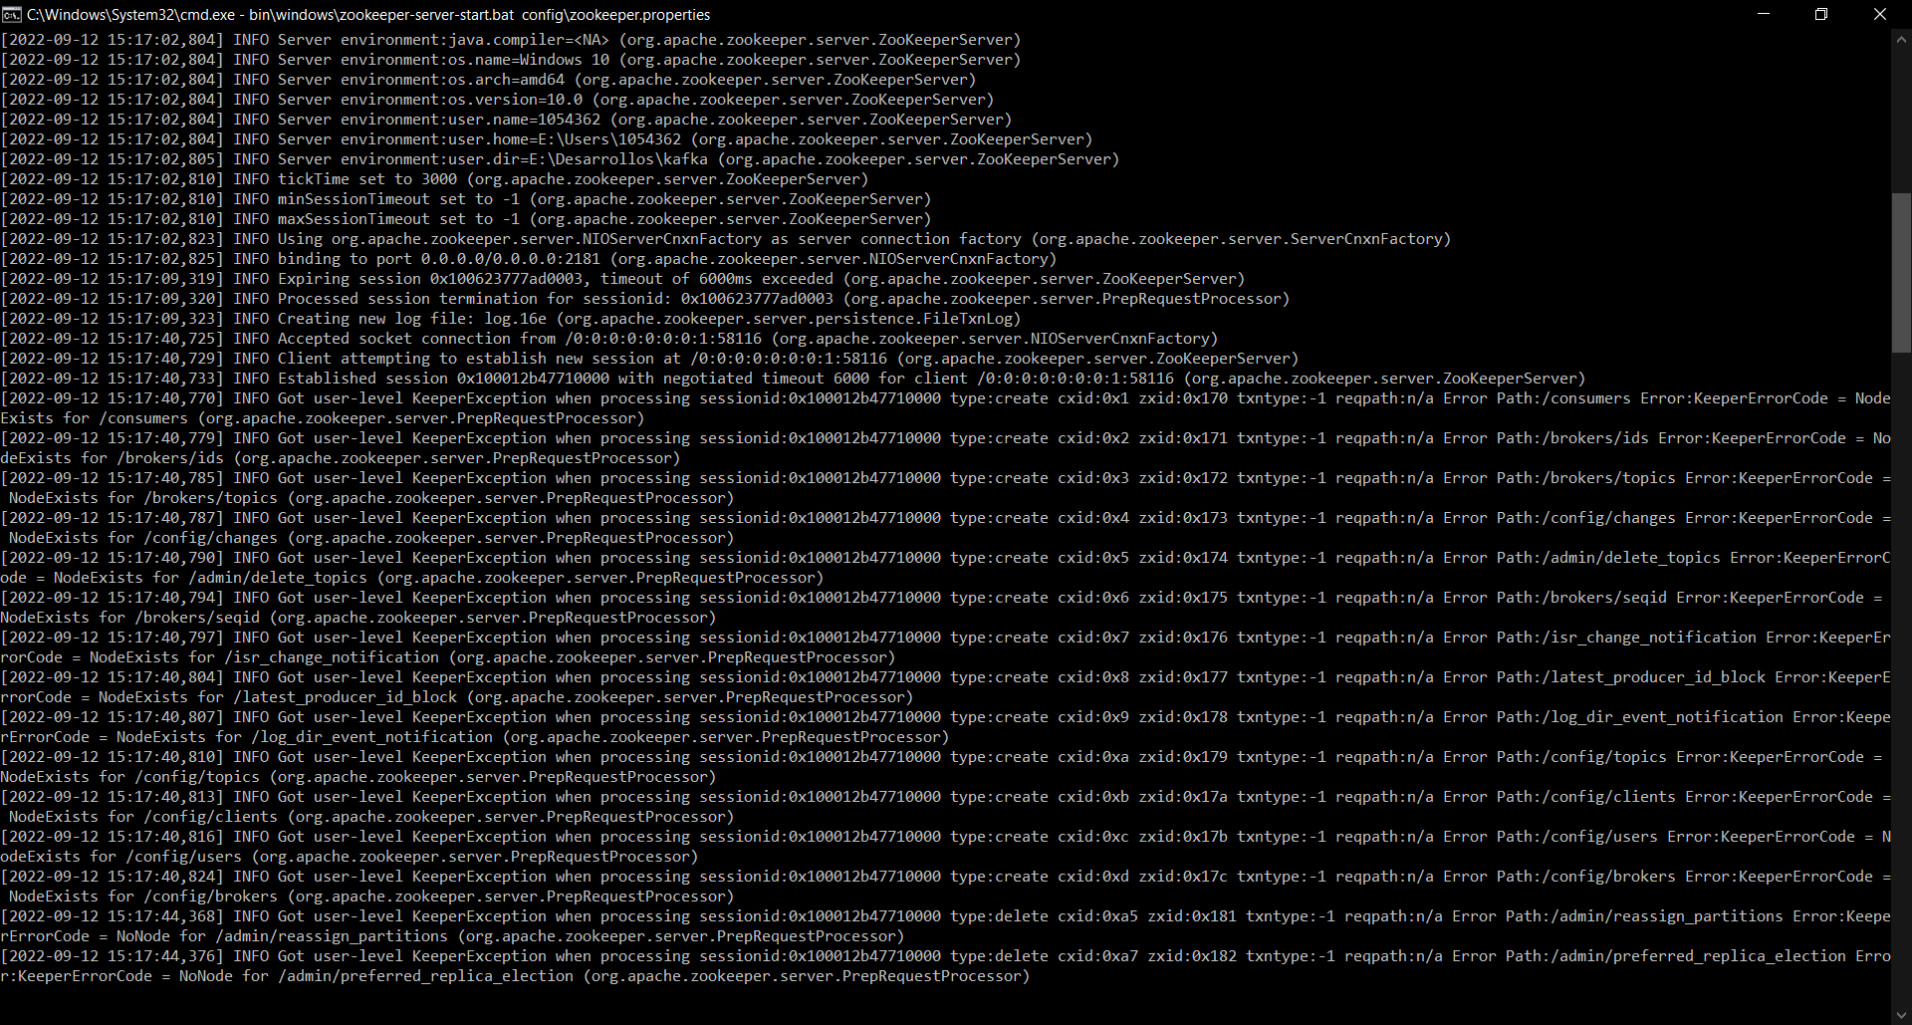

Slide 3
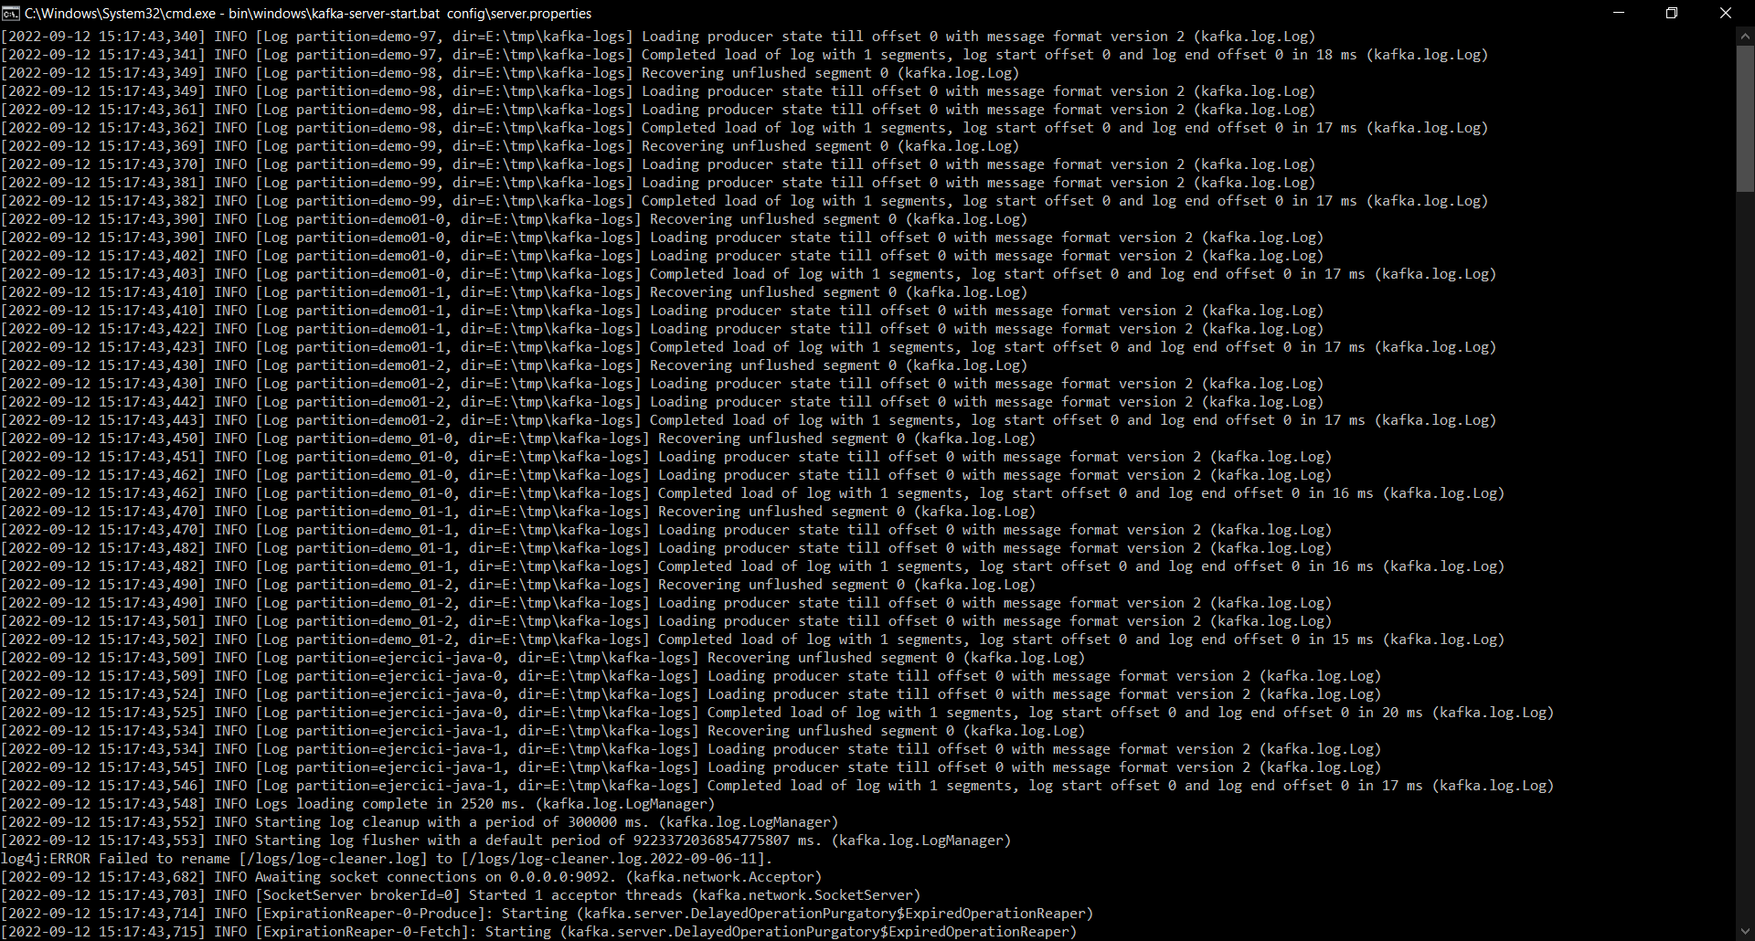
bin\windows\kafka-server-start.bat config\server.properties

Slide 4
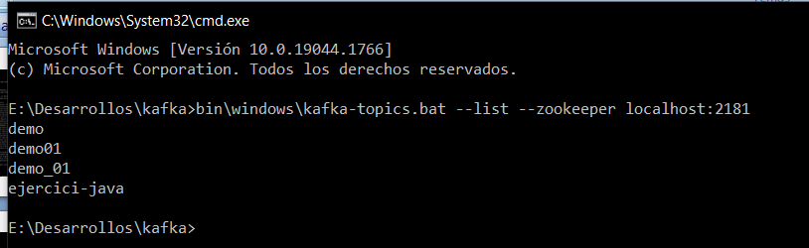
bin\windows\kafka-topics.bat --list --zookeeper localhost:2181
bin\windows\kafka-topics.bat --describe --zookeeper localhost:2181 --topic ejercici-java

Slide 5
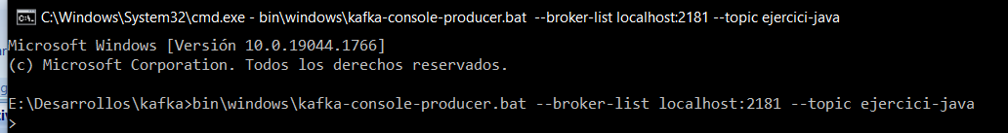
bin\windows\kafka-console-producer.bat --broker-list localhost:2181 --topic ejercici-java

