Slide 1
PENTHUAURA
Design and Implementation of a Non-Invasive IoT Health Monitoring System with Machine Learning for Advanced Vitals Prediction
Diaa Ahmed Hussien
Yehia Mohamed Mahmoud
Mohanad Tarek Saad
Abdulrahman Nageh Abdulrahman
Under Supervision of
Dr. Omar Mahmoud Sabry
Communications & Electronics Engineering Department
Canadian International College
2025

Slide 2
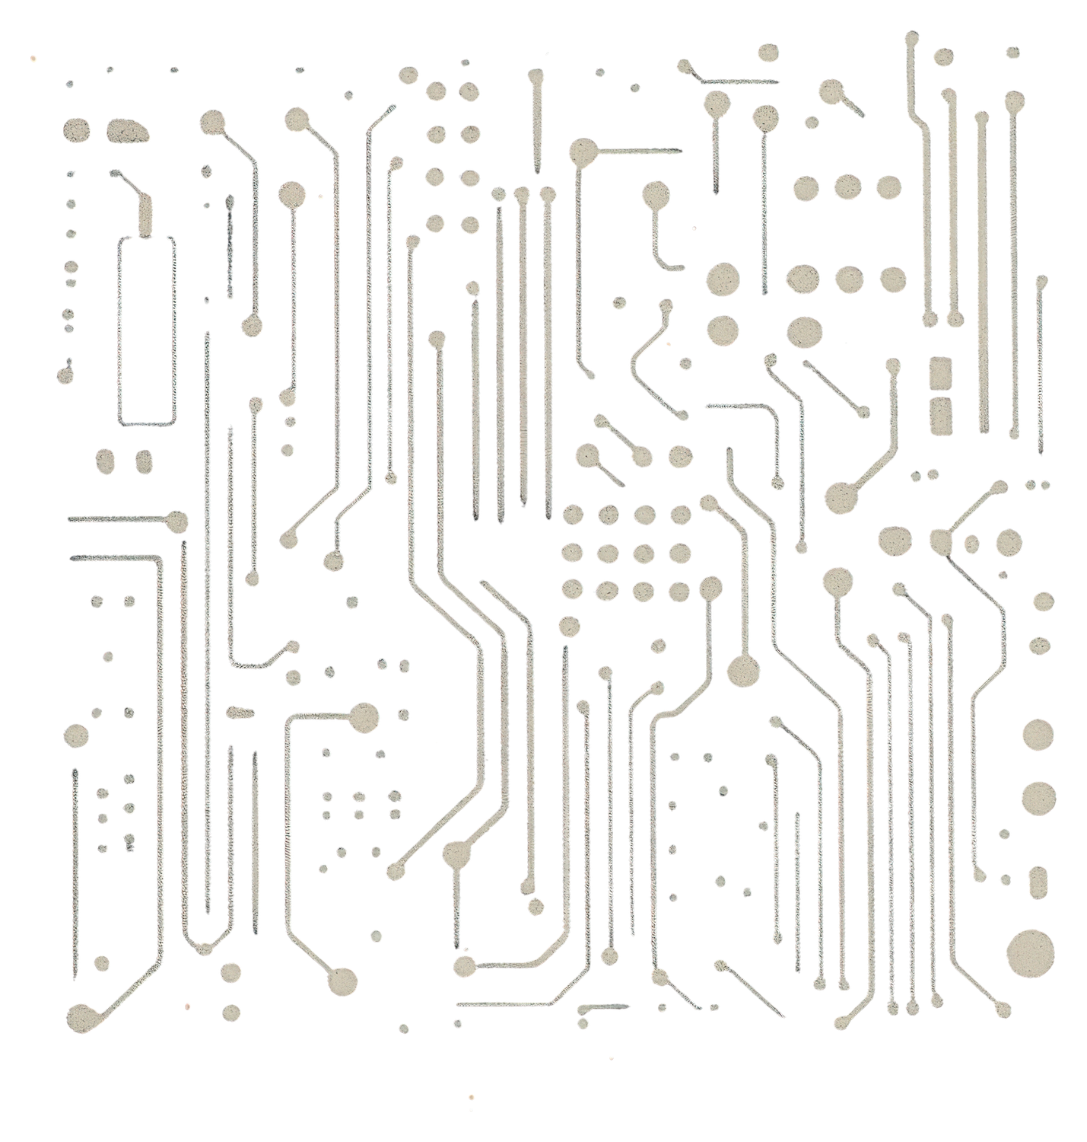
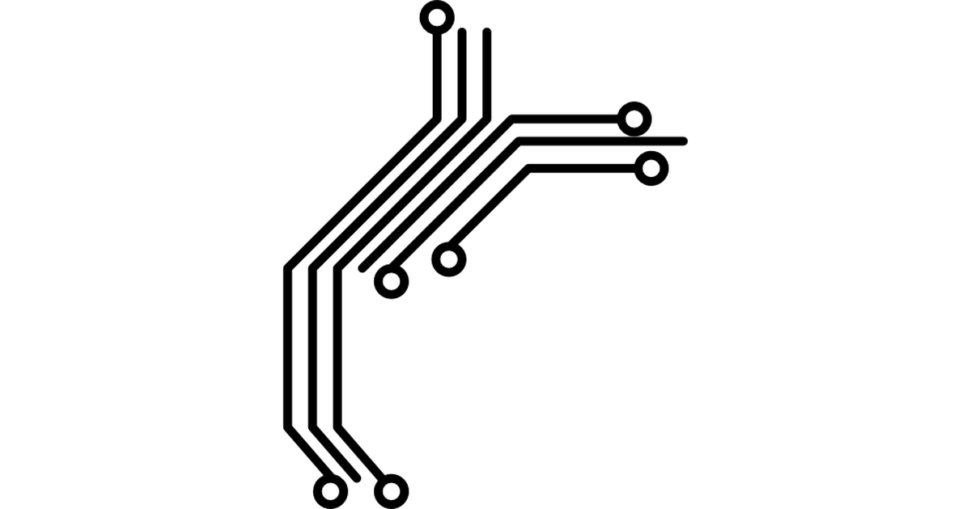
Agenda
1
2
3
4
Problem Statement & Objectives
Introduction
Motivation
System Architecture

Slide 3
Agenda
5
6
7
8
Implementation & Results
Discussion of Key Challenges
Conclusion & Future Work
Methodology

Slide 4

Introduction

Slide 5
Project Definition
Introduction
"PenthuAura," a non-invasive IoT health monitoring system.

Slide 6
Core Functionality
Introduction
Predicts cuffless blood pressure, stress levels, and health status from a single PPG signal using machine learning.

Slide 7
Technological Synthesis
Introduction
Integrates IoT, physiological sensing, and a sophisticated ML pipeline.

Slide 8
Primary Outcome
Introduction
A fully functional, end-to-end proof-of-concept prototype.

Slide 9
Healthcare Imperative
Limitations of Conventional Monitoring
Motivation
The Gap in Wearable Technology
The Driving Need

Slide 10
Healthcare Imperative
Limitations of Conventional Monitoring
Motivation
A paradigm shift from reactive to proactive and preventative care.
The Gap in Wearable Technology
The Driving Need

Slide 11
Healthcare Imperative
Limitations of Conventional Monitoring
Motivation
The Gap in Wearable Technology
Infrequent clinical check-ups and the impracticality of cuff-based devices for continuous use.
The Driving Need

Slide 12
Healthcare Imperative
A need for devices that move beyond basic fitness tracking to measure complex clinical parameters
Limitations of Conventional Monitoring
Motivation
The Gap in Wearable Technology
The Driving Need

Slide 13
Healthcare Imperative
Limitations of Conventional Monitoring
Accessible, affordable, and continuous monitoring to empower users and enable early detection of health risks.
Motivation
The Gap in Wearable Technology
The Driving Need

Slide 14
Problem Statement & Objectives
1
Core Problem
To design a low-cost, non-invasive system for predicting advanced health metrics using machine learning.

Slide 15
Problem Statement & Objectives
1
2
Core Problem
Key Sub-Challenges

Slide 16
Problem Statement & Objectives
1
2
Key Sub-Challenges
3
4

Slide 17
Problem Statement & Objectives
Hardware Integration
1
2
Key Sub-Challenges
3
4

Slide 18
Problem Statement & Objectives
Hardware Integration
1
Robust Data Transmission
2
Key Sub-Challenges
3
4

Slide 19
Problem Statement & Objectives
Hardware Integration
1
Robust Data Transmission
2
Key Sub-Challenges
Data Standardization
3
4

Slide 20
Problem Statement & Objectives
Hardware Integration
1
Robust Data Transmission
2
Key Sub-Challenges
Data Standardization
3
Machine Learning Complexity
4

Slide 21
Problem Statement & Objectives
1
2
3
Core Problem
Key Sub-Challenges
Primary Aim
To deliver a fully functional and validated proof-of-concept prototype

Slide 22
High-Level System Architecture
A distributed, multi-layered architecture balances processing load and power.
3
layers

Slide 23
High-Level System Architecture
A distributed, multi-layered architecture balances processing load and power.
3
layers
Backend Processing: Raspberry Pi computational core.
Cloud & Communication: Intelligent bridge using ThingSpeak & Ngrok.
Edge Device: ESP32-based data acquisition.

Slide 24
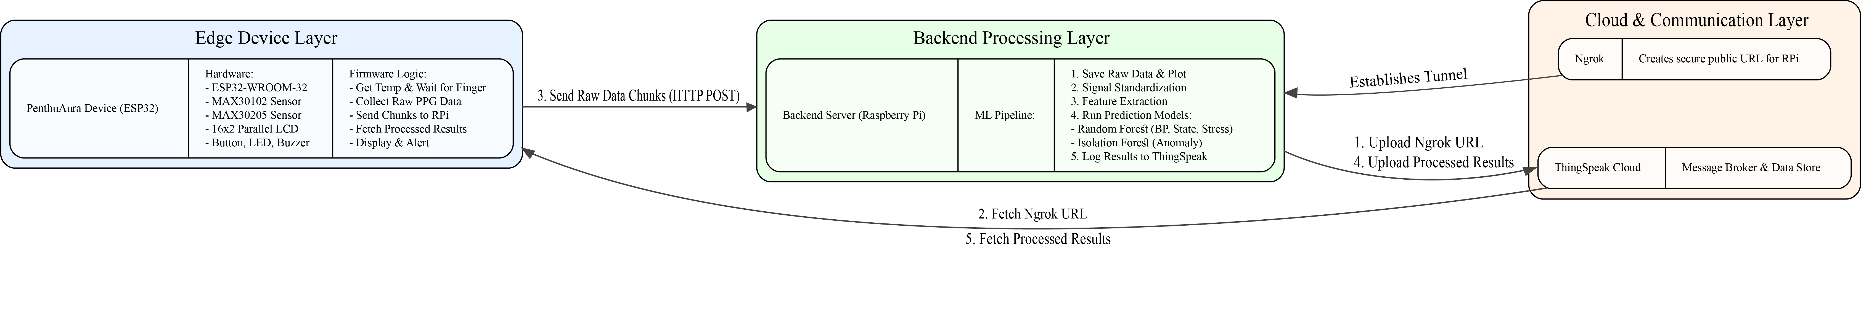
High-Level System Architecture
A distributed, multi-layered architecture balances processing load and power.

Slide 25
Hardware Components
Methodology: Hardware & Communication
Communication Protocol: Dynamic Service Discovery

Slide 26
Methodology: Hardware & Communication
Hardware Components

Slide 27
Methodology: Hardware & Communication
MCU: ESP32-WROOM-32 (Integrated Processor & Wi-Fi)
Hardware Components
Sensors: MAX30102 (PPG/SpO2) & MAX30205 (Clinical-Grade Temperature)

Slide 28
Hardware Components
Methodology: Hardware & Communication
Communication Protocol: Dynamic Service Discovery

Slide 29
Methodology: Hardware & Communication
Communication Protocol: Dynamic Service Discovery

Slide 30
Methodology: Hardware & Communication
A novel solution to handle dynamic IP addresses
Ngrok creates a public URL for the local RPi server
Communication Protocol: Dynamic Service Discovery
The ESP32 fetches the URL from ThingSpeak to establish a connection.
ThingSpeak acts as a message broker for the URL.

Slide 31
Methodology: ML Dataset & Labeling

Slide 32
Dataset
Utilized the VitalDB public clinical dataset.
Methodology: ML Dataset & Labeling

Slide 33
Dataset
Utilized the VitalDB public clinical dataset.
Ground Truth
Methodology: ML Dataset & Labeling
Time-synchronized PPG and invasive Arterial Blood Pressure (ABP) signals.

Slide 34
Dataset
Utilized the VitalDB public clinical dataset.
Ground Truth
Methodology: ML Dataset & Labeling
Time-synchronized PPG and invasive Arterial Blood Pressure (ABP) signals.
Manual Data Labeling
Applied "Stress" and "Health State" (Normal, Moderate, Critical) labels to the dataset.
Labeling rules were derived from an extensive review of medical literature on HRV.

Slide 35
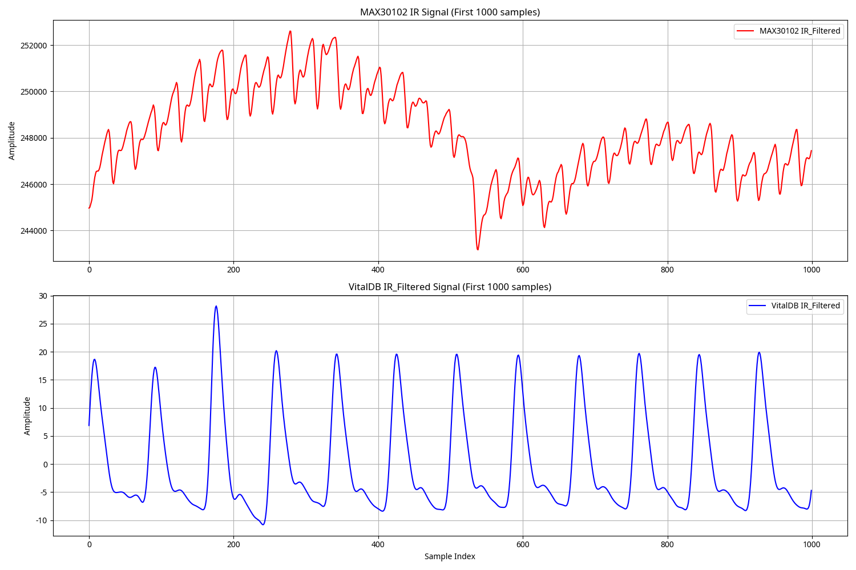
Methodology: Signal Standardization
Objective: To create a comparable format for low-cost sensor data and high-fidelity clinical data.

Slide 36
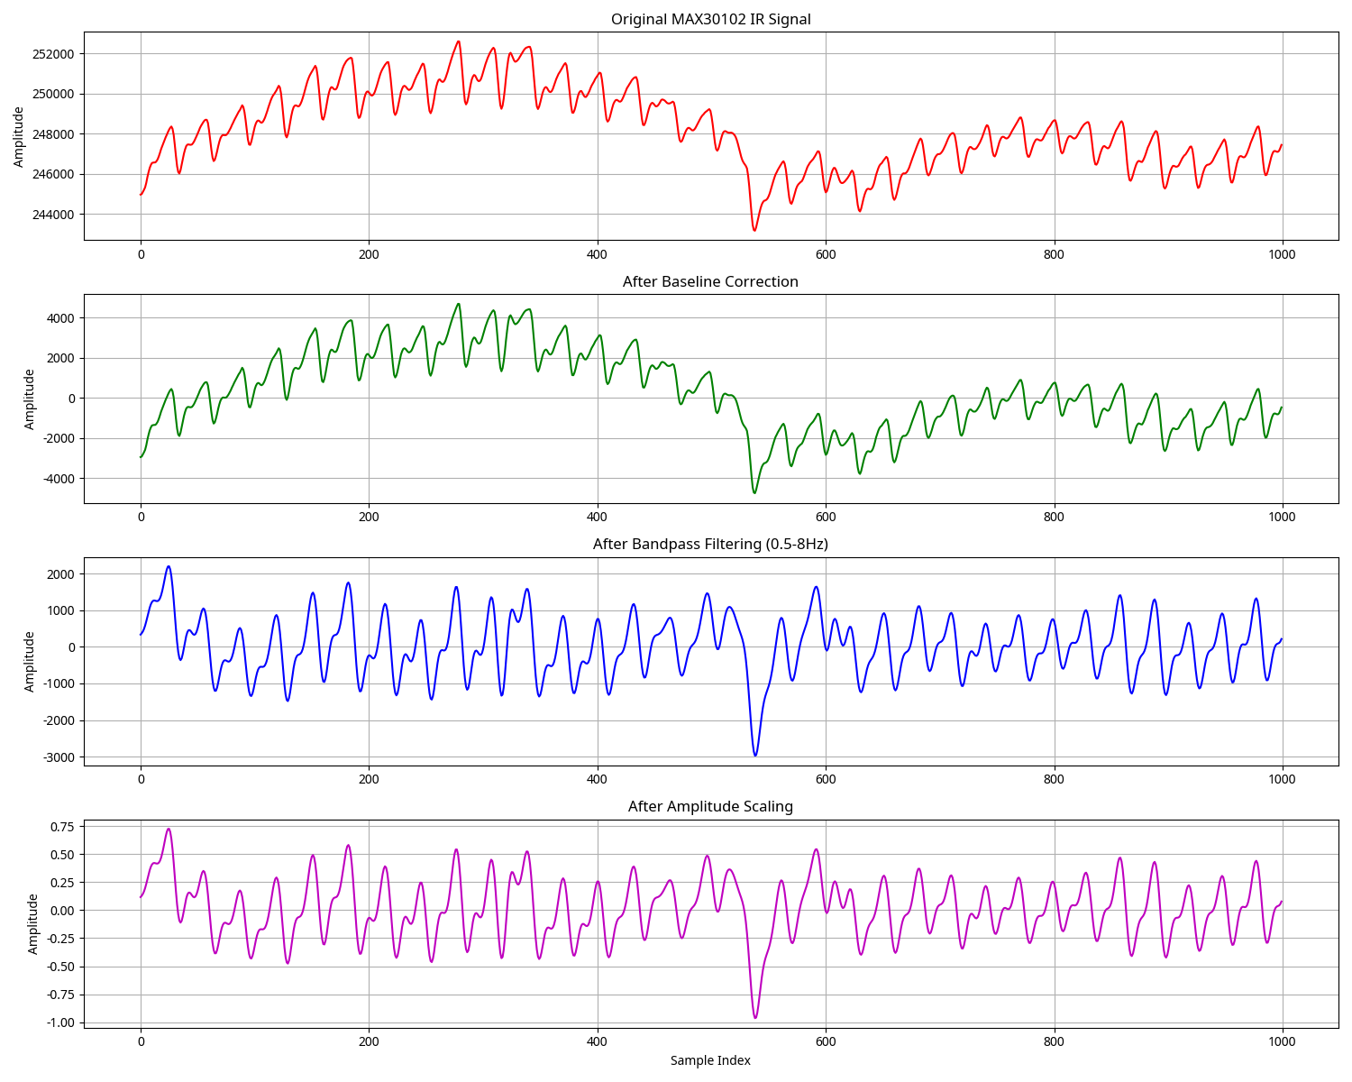
Methodology: Signal Standardization

Slide 37
Methodology: Signal Standardization
Three-Stage Process
1
Amplitude Scaling: Normalize signal amplitude.

Slide 38
Methodology: Signal Standardization
Three-Stage Process
1
2
Amplitude Scaling: Normalize signal amplitude.
Bandpass Filtering: Isolate physiological signal (0.5 - 4.0 Hz).

Slide 39
Methodology: Signal Standardization
Three-Stage Process
1
2
3
Amplitude Scaling: Normalize signal amplitude.
Bandpass Filtering: Isolate physiological signal (0.5 - 4.0 Hz).
Baseline Correction: Remove DC offset.

Slide 40
Methodology: Model Training & Optimization

Slide 41

Methodology: Model Training & Optimization
Feature Engineering
Extracted PPG and HRV features using the NeuroKit2 library.
Final Models

Slide 42
Methodology: Model Training & Optimization
Blood Pressure: Random Forest Regressor.
Health/Stress: Random Forest Classifier.
Anomalies: Isolation Forest.
Feature Engineering
Optimization Techniques
Final Models
Extracted PPG and HRV features using the NeuroKit2 library.

Slide 43
Methodology: Model Training & Optimization
Blood Pressure: Random Forest Regressor.
Health/Stress: Random Forest Classifier.
Anomalies: Isolation Forest.
Feature Engineering
Optimization Techniques
Final Models
SMOTE: To resolve class imbalance for "Critical" state detection.
RandomizedSearchCV: For hyperparameter tuning.22
Extracted PPG and HRV features using the NeuroKit2 library.

Slide 44
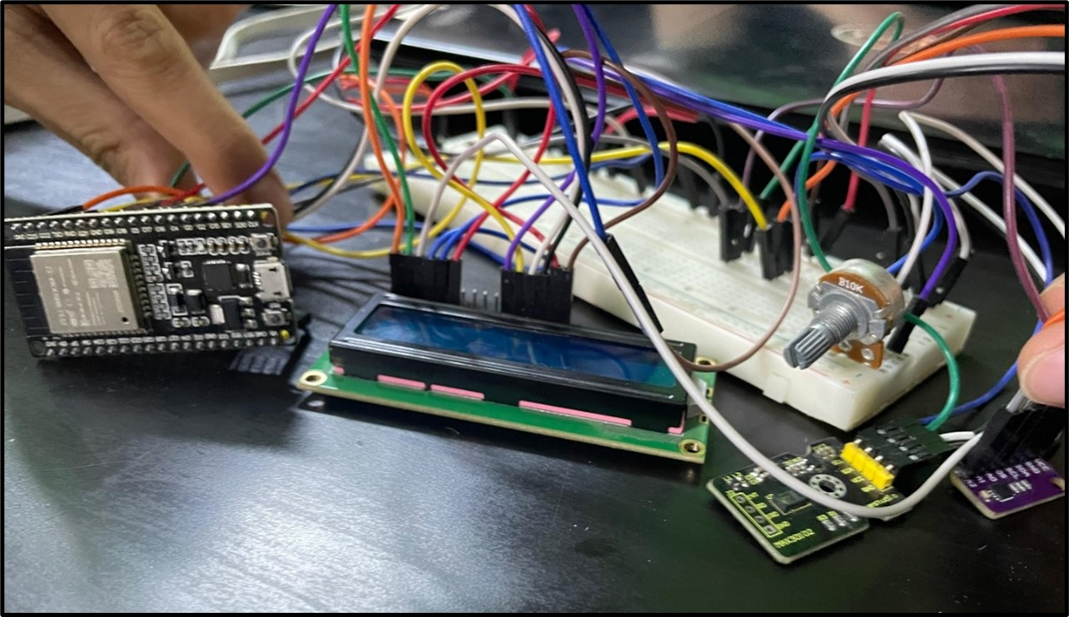
Implementation & User Interface
A fully integrated and assembled prototype.
Dual User Interface
1
2

Slide 45
Implementation & User Interface
A fully integrated and assembled prototype.
Dual User Interface
1
2

Slide 46
Implementation & User Interface
A fully integrated and assembled prototype.
Dual User Interface
1
Device UI: 16x2 LCD for at-a-glance information.
2

Slide 47
Implementation & User Interface
A fully integrated and assembled prototype.
Dual User Interface
1
Device UI: 16x2 LCD for at-a-glance information.
Web Dashboard: For detailed viewing and configuration.
2

Slide 48
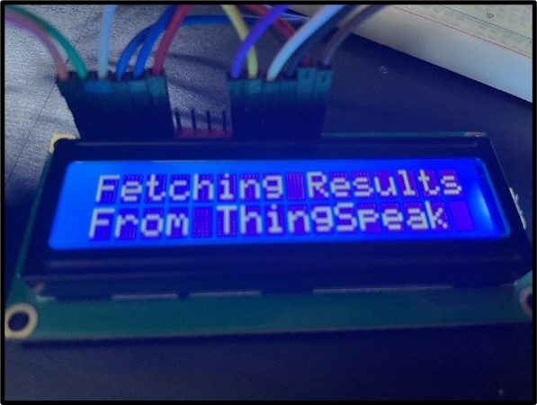
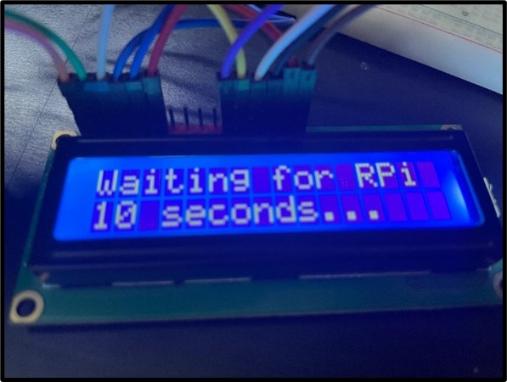
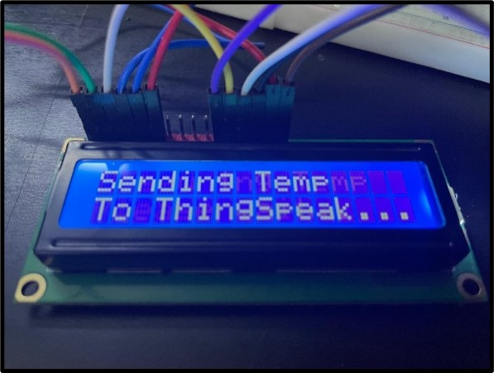
Implementation & User Interface
Dual User Interface
1
Device UI: 16x2 LCD for at-a-glance information.

Slide 49
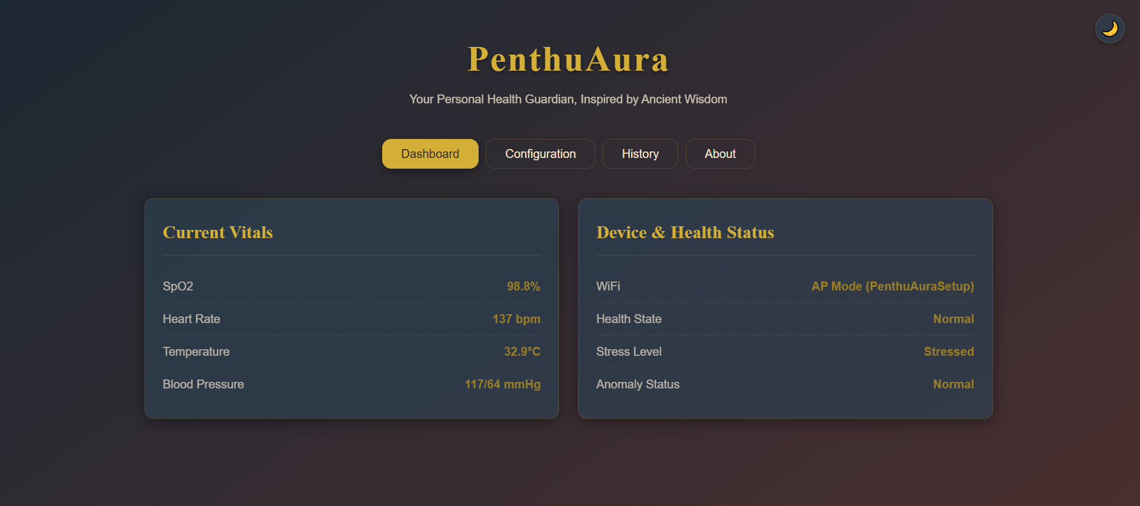
Implementation & User Interface
Dual User Interface
2
Web Dashboard: For detailed viewing and configuration.

Slide 50
Results: Machine Learning Model Performance
Metric | Systolic BP (SBP) | Diastolic BP (DBP)
Mean Absolute Error (MAE) | 7.944 mmHg | 7.944 mmHg
Mean Squared Error (MSE) | 192.978 | 192.978
Mean Absolute Error (MAE): ~7.9 mmHg on test set.

Slide 51
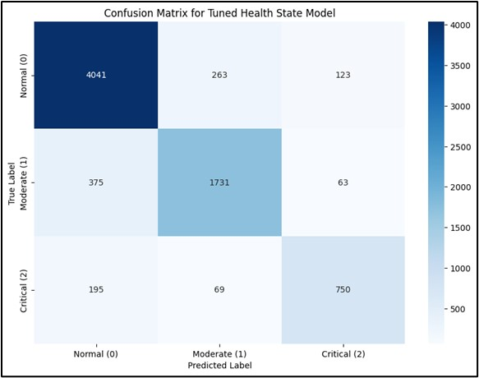
Results: Machine Learning Model Performance
Overall Accuracy: 86%.
Recall for "Critical" state significantly improved by SMOTE.

Slide 52
Results: Machine Learning Model Performance
Class | Precision | Recall | F1-Score
Normal | 0.88 | 0.91 | 0.89
Moderate | 0.84 | 0.80 | 0.82
Critical | 0.80 | 0.74 | 0.77
Accuracy |  |  | 0.86

Slide 53
Discussion of Key Engineering Challenges

Slide 54
Discussion of Key Engineering Challenges
Network Connectivity
ML Classification Accuracy
Hardware Noise
Resolved via backend digital bandpass filtering.
Resolved with the robust Ngrok & ThingSpeak architecture.
Resolved by implementing SMOTE to overcome class imbalance, drastically improving critical state detection.

Slide 55
Conclusion

Slide 56
Conclusion
Primary Achievement
A validated, comprehensive IoT health monitoring system.

Slide 57
Conclusion
Primary Achievement
Key Contributions
A novel and robust communication pipeline.
A sophisticated ML pipeline for cuffless BP prediction.
Demonstrated the critical importance of data standardization and SMOTE.
A validated, comprehensive IoT health monitoring system.

Slide 58
Conclusion
Primary Achievement
Key Contributions
Outcome
A novel and robust communication pipeline.
A sophisticated ML pipeline for cuffless BP prediction.
Demonstrated the critical importance of data standardization and SMOTE.
A validated, comprehensive IoT health monitoring system.
A successful proof-of-concept serving as a strong foundation for future work.

Slide 59
Future Work
1
2
3
4

Slide 60
Future Work
Hardware: Custom PCB and 3D-printed ergonomic enclosure.
1
2
3
4

Slide 61
Future Work
Hardware: Custom PCB and 3D-printed ergonomic enclosure.
1
2
Software: Over-the-Air (OTA) firmware updates.
3
4

Slide 62
Future Work
Hardware: Custom PCB and 3D-printed ergonomic enclosure.
1
2
Software: Over-the-Air (OTA) firmware updates.
Machine Learning: Personalized models via online learning.
3
4

Slide 63
Future Work
Hardware: Custom PCB and 3D-printed ergonomic enclosure.
1
2
Software: Over-the-Air (OTA) firmware updates.
Machine Learning: Personalized models via online learning.
3
4
Ultimate Goal: Pursue clinical validation and adherence to medical device standards.

Slide 64
Thank You

