Slide 1
TRAFFIC COLLISION PREVENTION
Diaa Ahmed Hassan: 2205103
Youssef Mahmoud Mohamed: 2205071
Mohamed Mohab Mohamed: 2205083
Mahmoud Reda Mahmoud: 2205139

Slide 2
Objective!
Find new clusters for different accident severity levels and relations to the existing one’s.

Slide 3
Project steps

Slide 4
1 - Dataset description!
Our dataset talks about accidents in the uk :
Dataset properties
2.05 m rows
34 columns
Source `Kaggle`!
Dataset link: Uk road safety dataset

Slide 5
2 - Data preprocessing?
We started with getting the information of the dataset.
We get the sum of the null values,
The sum of duplicates and we removed them.
Sum columns we needed to fill it’s na instead of removing them.
We excluded the unwanted columns that don’t have an effect on the data or may make the model biased.

Slide 6
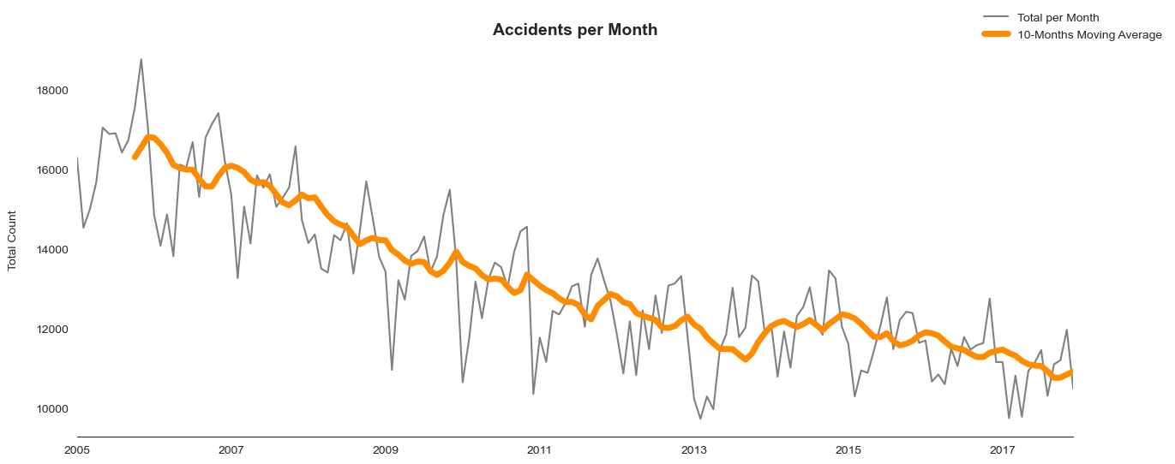
We made the data encoded to successfully fit on the models
Then we started the exploratory data analysis to find the patterns then let’s see the result of our EDA
Here we found the count of the accidents pair months and this is our result

Slide 7
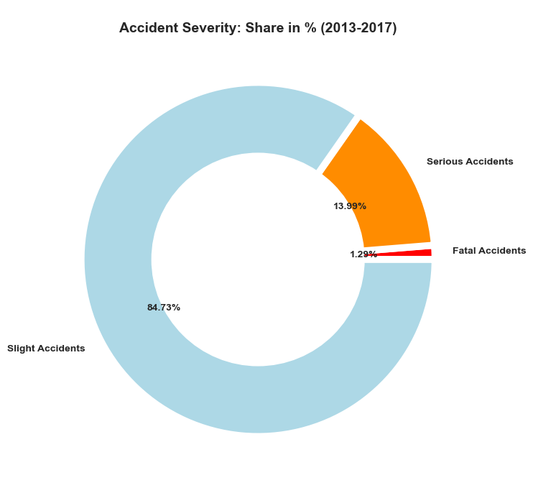
The second pattern we found the following, the pattern of accident severity levels
As we see slight accidents is the most happen before the serious and the least happen was the fatal

Slide 8
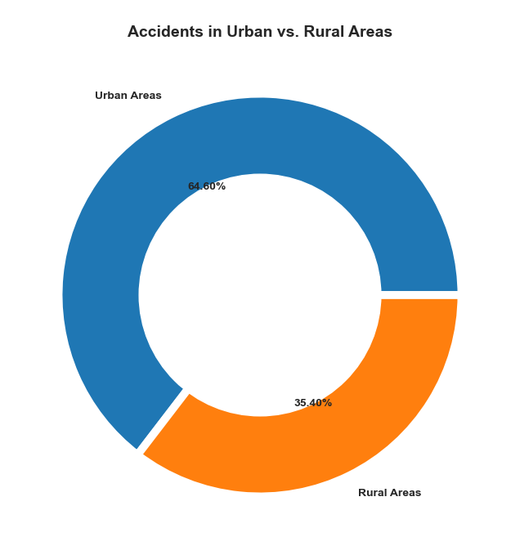
Another pattern is which type of areas this accidents happen
As we see urban areas have more percentage of accidents than the rural areas

Slide 9
3 - Genetic algorithm (First technique)
Of Course we will not use all this features to cluster the dataset.
We need to select some of the features to be used in clustering so we used the genetic algorithm, we created a class for the genetic algorithm that can calculate the fitness of the features using supervised model and calculating the accuracy of these model as the return of the fitness function

Slide 10
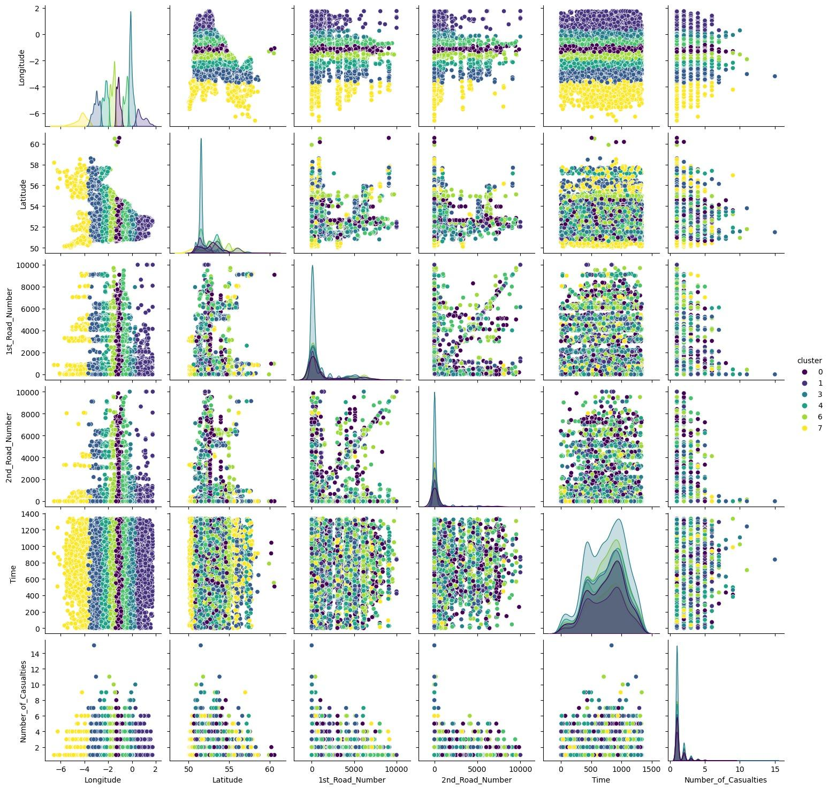
4 - K Medoid (Second technique)
We needed to cluster the accident severity for more than 3 cluster to achieve our objective.
This pair plot shows us the relations between the some of the selected features features in 8 different clusters

Slide 11
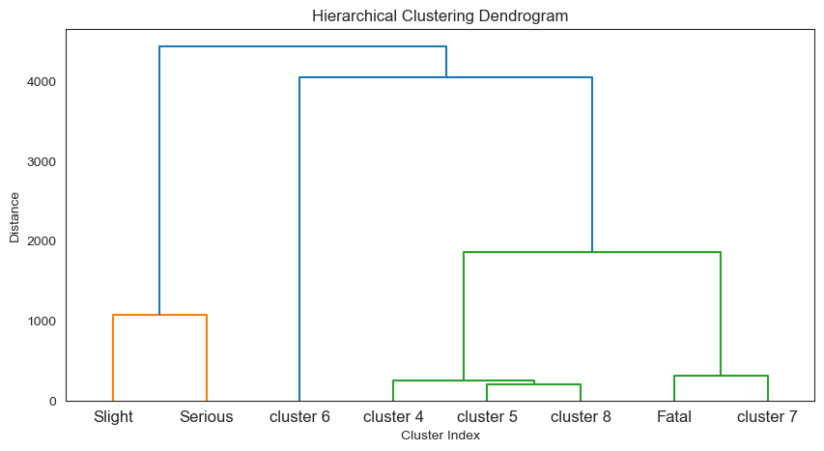
5- hiraricacal (Third technique)
Finally we achieved our objective we found some new clusters between the main three cluster
As we see there is about five levels between the serious and the fatal accidents

Slide 12
Thank you!
© Copyrights : Sides from slides go

