Slide 1

On My Way App
GREEN
HACKATHON

Slide 2
Team Members
Taha
Mawada Arafat
Mariam Ali
Nada Makram
Diaa Magdy

Slide 3
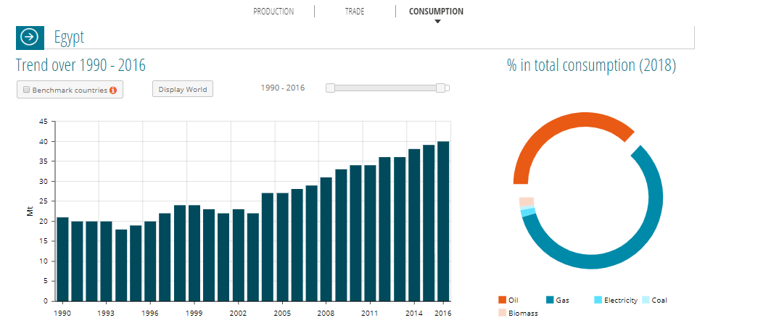
Problem

Slide 4
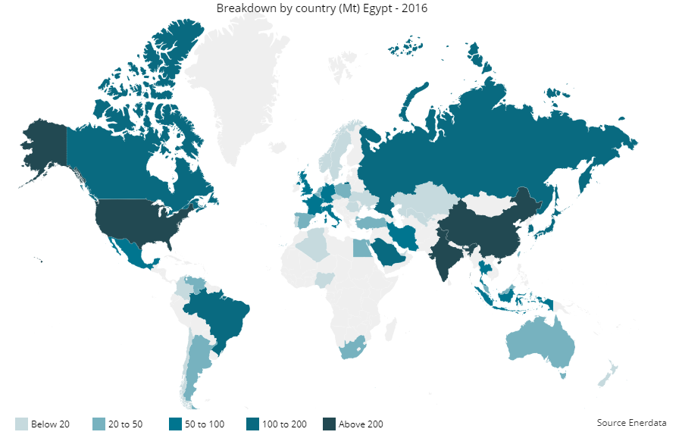
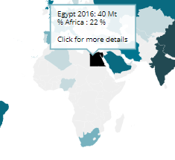

Slide 5


Our idea
Our app is an on-the-way delivery service that connects people with stuff to send to drivers already heading that way.

Slide 6




Slide 7
Market Research
Offline survey
Online survey
Competitors

Slide 8
Offline survey

Slide 9
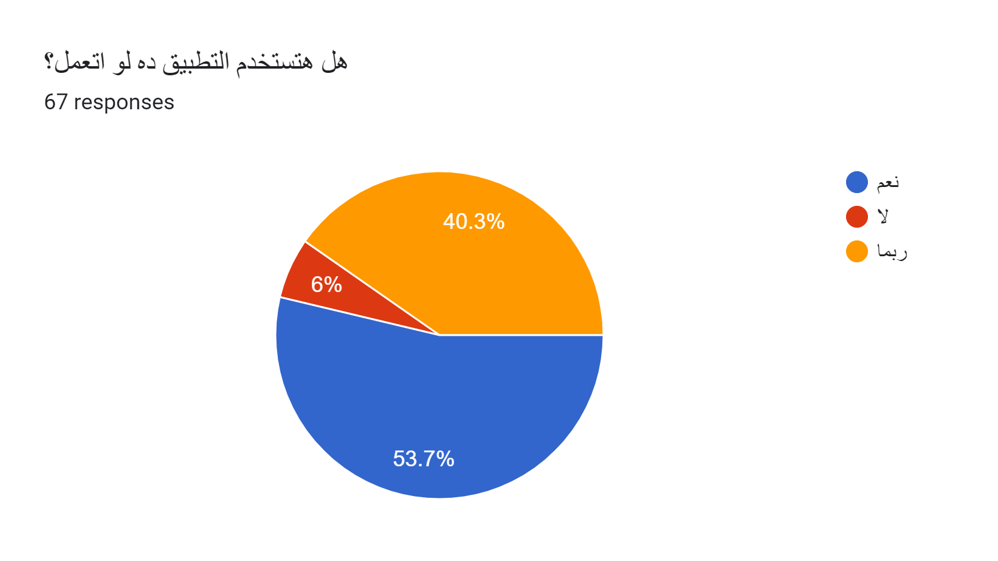
Online survey

Slide 10
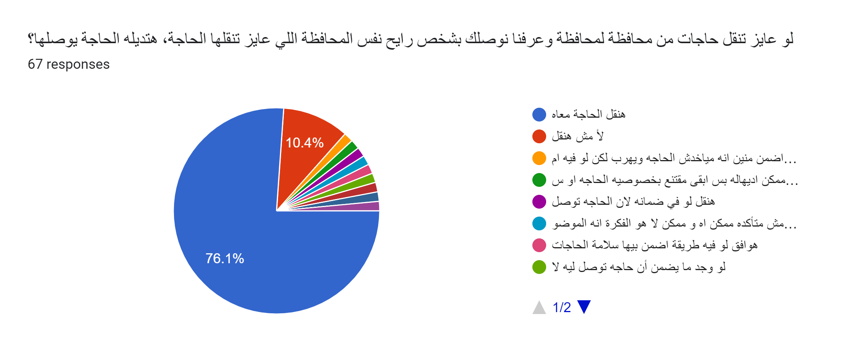
Online survey

Slide 11
Competitors
Shipping companies
Roadie
HitchHiker - Ship with a Traveler
MRSOOL
onPony
dolly Grabr
Golvo

Slide 12
Faster
Cheaper
Eco-friendly

Slide 13
Demo

Slide 14
Thank you

Slide 15
Deputy
Summit 2019
Hackathon

Slide 16
Team Members
Yossra Nour
Mawada Arafat
Khaled El-Bialy
DiaaEldin Magdi
Mera Mamdouh

Slide 17
Problem

Slide 19
Our idea
Our app is an on-the-way delivery service that connects people with stuff to send to drivers already heading that way.

Slide 21
Market Research
Offline survey
Online survey
Competitors

Slide 22
Offline survey

Slide 23
Online survey

Slide 24
Online survey

Slide 25
Competitors
Shipping companies
Roadie
HitchHiker - Ship with a Traveler
MRSOOL
onPony
dolly Grabr
Golvo

Slide 26
Faster
Cheaper
Eco-friendly

Slide 27
Demo

Slide 28
Thank you

