Slide 1



ENTEG

Slide 2

Problem
Monopolism
It is time and money consuming to travel for choosing the clothes and their quality
Money transfer with Instalment though with assurance of transfer completion
Also based on a study made on Egypt, the market growth of clothes is going down due to high cost of clothes

Slide 3
Vision
Gathering up with Valu for making instalment easier and more convenient leading to avail better chance for people who want to open new stores and shops
Connecting factories with the small merchants directly to lower monopolism
Presenting clothes through a user friendly UI|UX experience, also describing clothes material to lower the travel costs to test material and choose clothes
These points lead to lower cloth prices for increasing the clothes market grow.
Gathering up with Voo for making shipments easier

Slide 4
Competitors
سوق الجملة
Disadvantages:
- Bad user experience

Slide 5
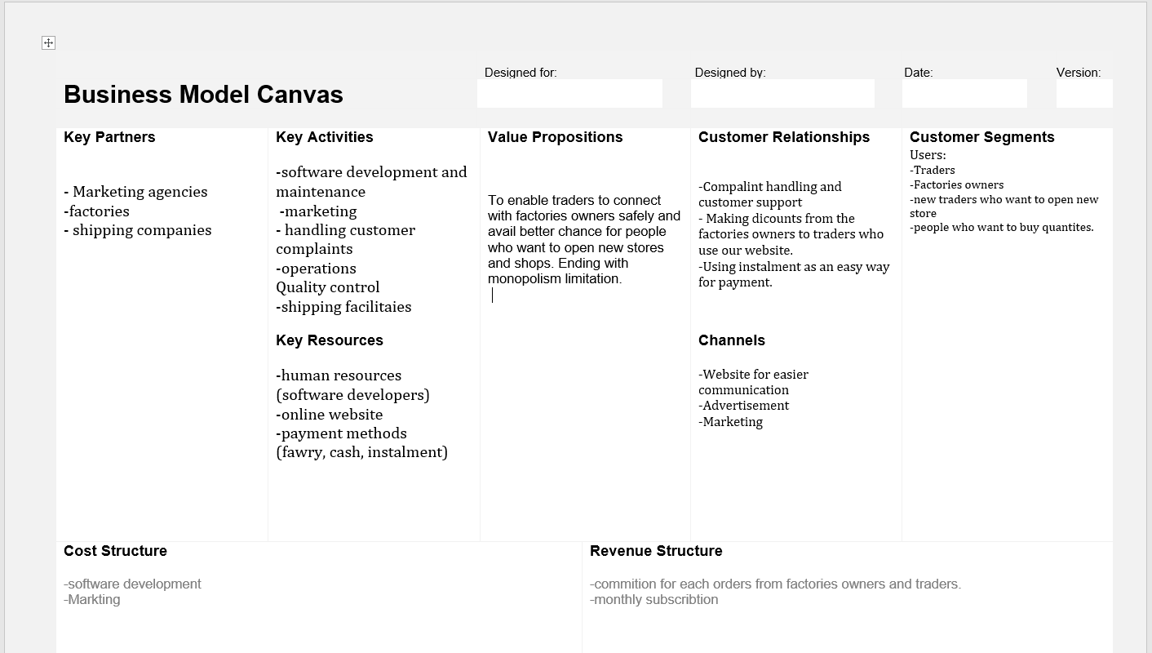
Business model canvas

