Slide 1

Deputy
RiseUp
HACKATHON

Slide 2
Team Members
Taha
Mawada Arafat
Mariam Ali
Nada Makram
Diaa Magdy

Slide 3
Problem

Slide 4


Our idea
Our app is an online service that connects factories owners with traders to make e-commerce more easier and scalable.

Slide 5




Slide 6
Market Research
Offline survey
Competitors

Slide 7
Competitors

Slide 8
Faster
Cheaper
Eco-friendly

Slide 9
Demo

Slide 10
Thank you

Slide 11
Deputy
Summit 2019
Hackathon

Slide 12
Team Members
Yossra Nour
Mawada Arafat
Khaled El-Bialy
DiaaEldin Magdi
Mera Mamdouh

Slide 13
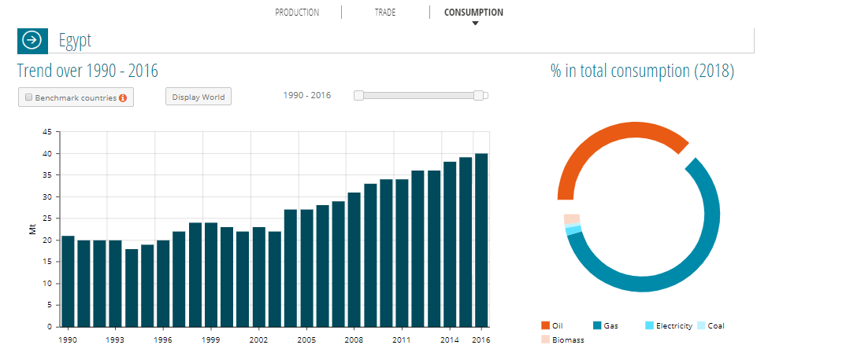
Problem

Slide 14
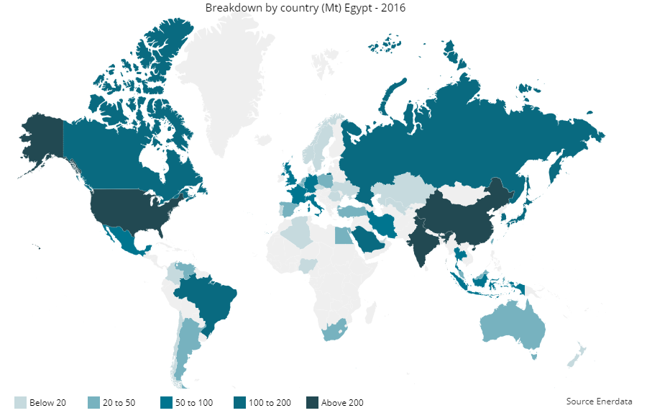
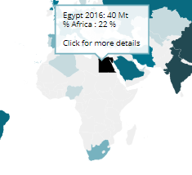

Slide 15
Our idea
Our app is an on-the-way delivery service that connects people with stuff to send to drivers already heading that way.

Slide 17
Market Research
Offline survey
Online survey
Competitors

Slide 18
Offline survey

Slide 19
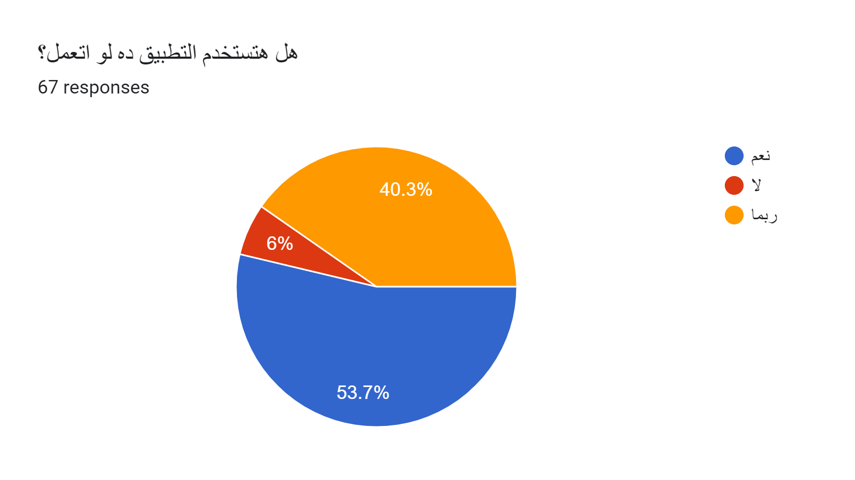
Online survey

Slide 20
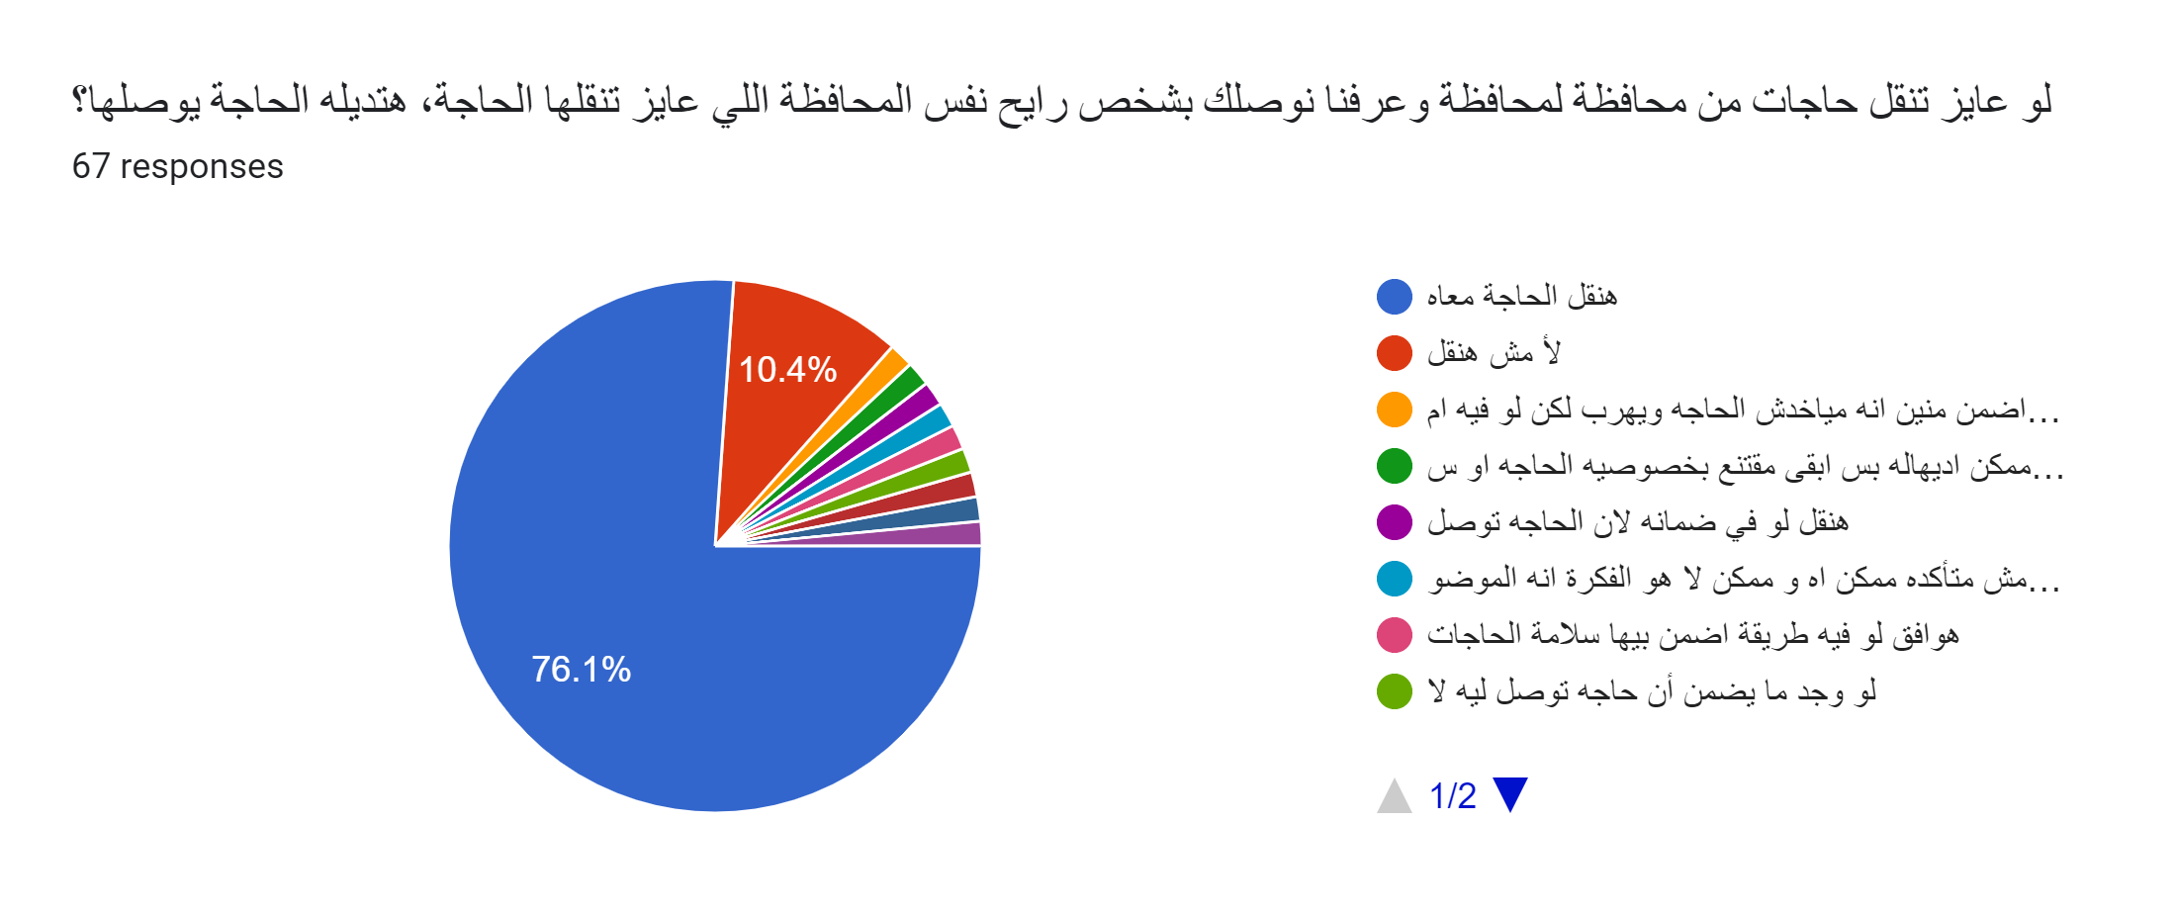
Online survey

Slide 21
Competitors
Shipping companies
Roadie
HitchHiker - Ship with a Traveler
MRSOOL
onPony
dolly Grabr
Golvo

Slide 22
Faster
Cheaper
Eco-friendly

Slide 23
Demo

Slide 24
Thank you

