Slide 1



ENTEG

Slide 2

Problem
Looking for a good clothes factories to deal with, Suffering in shipping process as well.

Slide 3
Vision
To enable traders to connect with factories owners safely and avail better chance for people who want to open new stores and shops. Ending with monopolism limitation.

Slide 4
Milestone
A survey that already made to know how much people accept our website
(acceptance percentage was 50% )

Slide 5
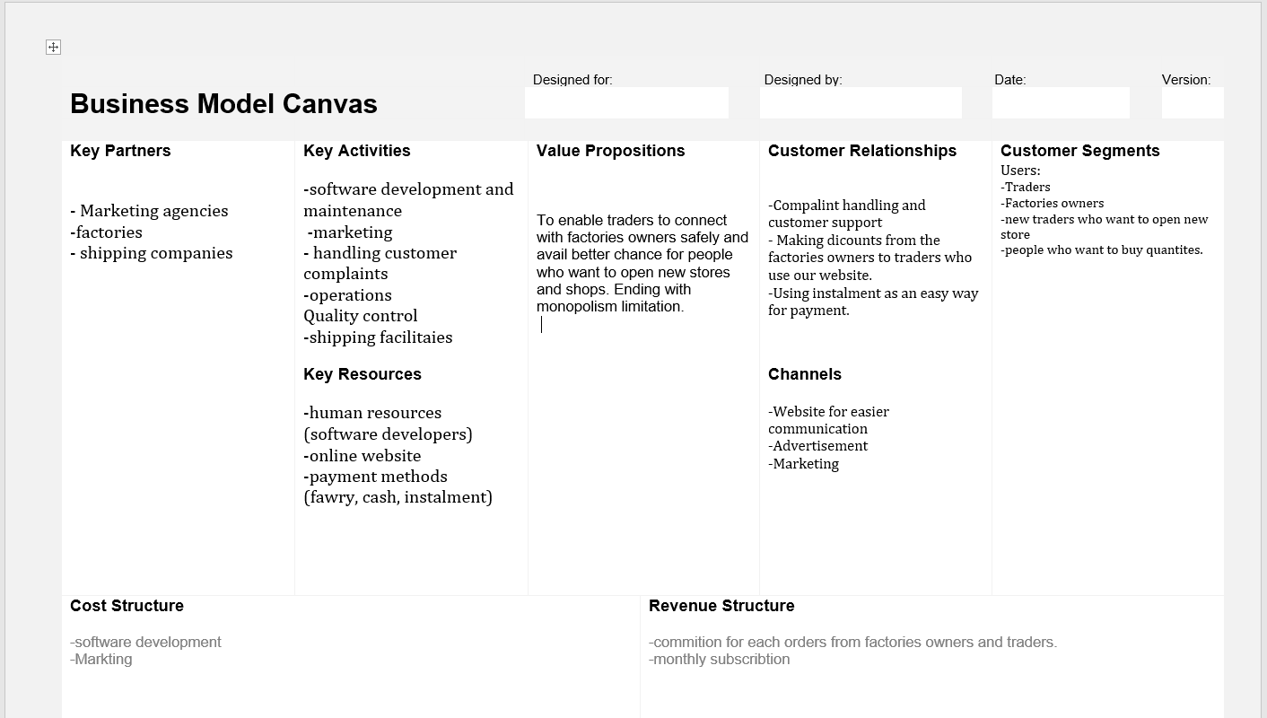
Business model canvas

Slide 6
Competitors
سوق الجملة
Disadvantages:
- Bad user experience

Slide 7
Our advantages:
Good U|X design adapting for customer needs
Easy to make transaction yet safe

