Slide 1
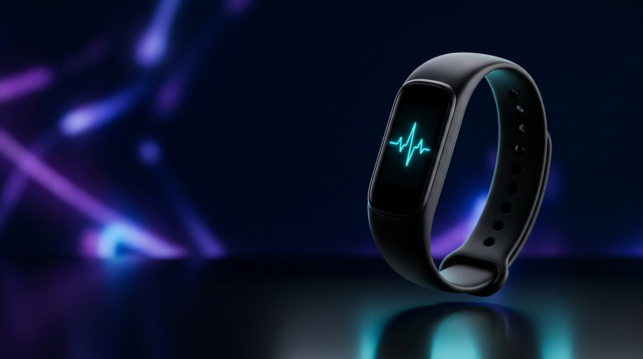
NEUROLINK
WEAR
Predictive health intelligence,
worn every day.
SMART WEARABLE + EDGE & CLOUD AI + CAREGIVER SAFETY
Investor pitch · Prototype stage · Giza, Egypt · 2026
Notes:
Open with the one-liner: NeuroLink Wear is a smart band that watches the vital signs of the people we love and turns them into timely, understandable action — on the wrist, in the cloud and on a caregiver's phone.
Set expectations: this is a prototype-stage company; we will show what is built, what we have learned, and exactly what we need to reach a validated pilot.
Timing: 30 seconds. Do not read the slide — let the product render do the work.

Slide 2
Critical health changes happen
between check-ins
02
WHY IT MATTERS
A wearable can close the gap between an isolated reading and a timely response.
684 000
1
Signals lack context
Heart rate, oxygen, temperature and stress indicators only become meaningful when patterns are tracked together over time.
people die from falls every year worldwide — the second leading cause of unintentional injury death (WHO).
80%+
2
Early warning is difficult
Fatigue, fever, panic and low oxygen begin as subtle deviations — rarely as one obvious event.
of fall deaths occur in low- and middle-income countries such as Egypt (WHO).
3
Emergencies need escalation
A fall or a dangerous reading needs a prompt to the wearer and, if there is no answer, an automatic call for help.
9.3 M
Egyptians are aged 60+ (8.8% of the population) and the share keeps rising (CAPMAS 2024).
PROBLEM | CONTINUOUS CONTEXT AND RESPONSE
Notes:
Three failure modes of today's care: no context (a single number tells you nothing), no early warning (deterioration is gradual), and no escalation (a fall at home is only discovered hours later).
Anchor with the WHO numbers: an estimated 684 000 fatal falls a year, over 80% of them in low- and middle-income countries; 37.3 million falls a year need medical attention. Adults over 60 suffer the greatest number of fatal falls. (WHO fact sheet on falls, 2021.)
Localise: Egypt's 60+ population reached 9.3 million in 2024 — 8.8% of Egyptians — according to CAPMAS. Most live at home with family who work during the day.
Transition: "We built one system that senses, understands and responds."
Source URLs for the appendix: who.int/news-room/fact-sheets/detail/falls; globalissues.org/news/2024/10/24/38051 (CAPMAS figures).

Slide 3

One system senses, explains
and responds
03
1
SENSE
PPG, GSR, motion, skin temperature and GPS create a continuous, multi-signal view of the wearer.
2
UNDERSTAND
Edge features and anomaly models separate a normal day from stress, fever, low oxygen, fatigue — or a fall.
3
RESPOND
The band asks "Are you OK?"; the app explains the signal, advises the next step and escalates danger to caregivers with location.
SOLUTION | DEVICE, INTELLIGENCE AND ACTION
Notes:
The product is a loop, not a gadget: sense → understand → respond.
Sense: five sensors on one wrist give a richer picture than any single metric. Understand: light features are computed on the band itself; anomaly and time-series models run in the cloud. Respond: the band talks to the wearer first — a simple "Are you OK?" — and only then escalates to family with a location link.
Emphasise dignity: the wearer stays in control; escalation happens only when they cannot answer.

Slide 4
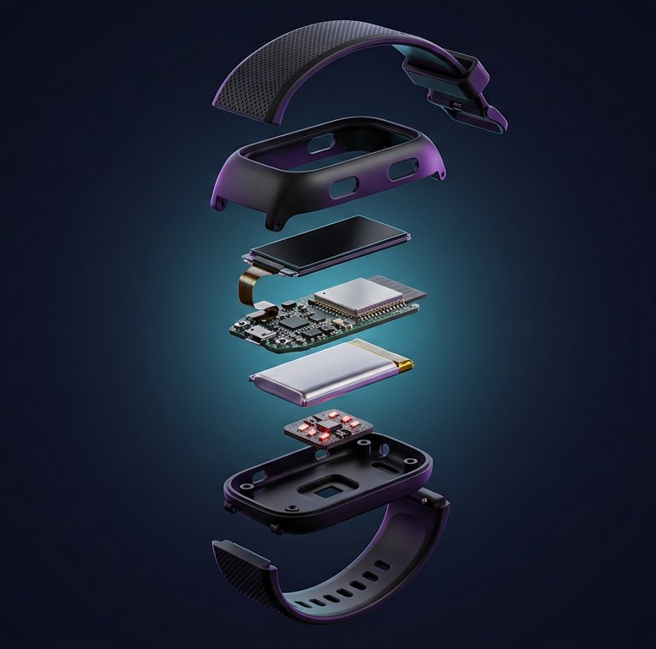
Five sensors, one wrist
04
Each signal answers a different question; the AI layer combines them when one metric is not enough.
SENSOR
MEASURES
ROLE IN THE SYSTEM
MAX30102 PPG
Heart rate · SpO₂ · HRV (RMSSD)
Cardiovascular context, oxygen, recovery
GSR electrodes
Skin conductance (µS)
Stress & sympathetic arousal
MPU6050 IMU
Acceleration · rotation
Steps, tremor, impact & fall detection
MLX90614 IR
Skin & ambient temperature
Fever trend, thermal change
NEO-6M GPS
Position · UTC time
Location for safety escalation
ESP32 DUAL-CORE
OLED PROMPT
ONE BUTTON: I'M OK / SOS
WI-FI · TLS MQTT
LI-PO · USB-C
Wellness and safety insights — not a diagnostic medical device. Off-the-shelf modules today; a custom PCB is part of the roadmap.
HARDWARE | CORE SENSOR STACK
Notes:
Walk the table top to bottom in one breath each: PPG for heart rate, oxygen and heart-rate variability; GSR for arousal; the IMU for steps, tremor and impacts; the IR thermometer for fever trends; GPS for location when it matters.
Everything hangs off a dual-core ESP32 — one core samples sensors and drives the OLED and button, the other handles Wi-Fi, TLS and MQTT.
Be candid: the prototype uses off-the-shelf modules; industrial design and a custom PCB are in the roadmap, and the band is positioned as a wellness/safety product, not a diagnostic device.

Slide 5
System architecture
05
A continuous pipeline turns raw sensor data into understandable guidance and safety actions.
SENSORS
ESP32 EDGE
AI CORE
APP + CAREGIVERS
PPG · GSR · IMU
Temperature · GPS
up to 100 samples / s
HR · HRV · SpO₂ · steps
Fall verification + prompt
Telemetry every 2 s
Isolation Forest + LSTM AE
Rule-based conditions
LLM explanation
Live vitals · trends · advice
Alerts · emergency contacts
GPS link on escalation
MQTT OVER TLS 1.2 · HIVEMQ CLOUD · JSON ≤ 1 KB · EVERY 2 S · ALERTS BACK TO THE BAND
EDGE
FALLBACK
RESILIENCE
RMSSD, motion variance, tremor frequency and impact peaks computed on the wrist
Statistical threshold rules keep working if the cloud or a model is unavailable
Offline outbox: emergency packets are retried for 10 minutes; last-will status for presence
TECHNOLOGY | EDGE-TO-CLOUD DATA PIPELINE
Notes:
Left to right: sensors sample at up to 100 Hz; the ESP32 reduces that to physiologically meaningful features and publishes a compact JSON packet every two seconds over TLS to a managed MQTT broker (HiveMQ Cloud).
The AI core (FastAPI service) runs an Isolation Forest for point anomalies, an LSTM autoencoder for temporal anomalies, a rule-based condition classifier, and an optional LLM layer that writes the explanation and advice. Decisions flow back down the same broker to the band and the dashboard.
Design principle: the time-critical decisions (fall verification, the "Are you OK?" prompt) never depend on the cloud; the cloud adds insight, not safety-critical latency.

Slide 6
The wrist does the time-critical work
06
Firmware v1.0 turns raw samples into clinical-style features and a verified safety prompt — with or without the cloud.
Heart rate & HRV
SpO₂ estimate
Fall detector
FALL DETECTED
Are you OK?
27
Beat-to-beat intervals with artifact rejection; RMSSD over the last 20 beats.
Ratio-of-ratios on rolling red/IR AC-DC with perfusion and contact checks.
Impact > 3 g, free-fall cue, orientation change and a 4 s immobility check → confidence score.
press button = I'm OK · no answer in 30 s → help is called
Motion analytics
Resilient link
Honest data
On-device prompt (SSD1306 OLED)
Pedometer, cadence, variance and dominant tremor frequency from 50 Hz IMU data.
TLS MQTT, retained presence, offline outbox with 10-minute retry for emergencies.
Validity flags for every vital; missing sensors are reported, never faked.
87 automated logic checks
HR ±0.1 bpm · exact RMSSD · fall vs. walking · step counts · JSON contract · prompt → ack / timeout → emergency
FIRMWARE | ESP32 EDGE INTELLIGENCE
Notes:
This is our technical moat at this stage: the band already produces the exact feature vector the models were trained on, and it verifies falls locally — impact, free-fall cue, orientation change and a four-second immobility check — before it ever prompts the wearer.
Everything time-critical is on the wrist; the cloud can be slow or offline and the safety loop still completes (emergency packets are queued and retried for ten minutes).
Validation so far is host-side: the firmware compiles against the real sensor and MQTT libraries and passes 87 automated behavioural checks on synthetic data. Bench and on-body validation is the next milestone — say so before anyone asks.

Slide 7
The intelligence engine combines
anomalies, trends and context
07
CONDITION
SIGNAL PATTERN
DETECTION APPROACH
MODEL STACK
Stress
HRV ↓ · GSR ↑ · temperature ↑
Combined anomaly score
1
Isolation Forest
Panic attack
Heart-rate spike · GSR spike · no motion
Sudden deviation + context
Point anomalies across 23 engineered features
Fever
Temperature rising over time
Continuous trend
2
LSTM autoencoder
Low oxygen
SpO₂ below threshold
Threshold rule (fallback-safe)
Temporal anomalies over rolling windows (threshold 0.33 reconstruction error)
Fatigue
Sustained low HRV
Long-term trend analysis
3
Rule-based classifier
Fall
Impact + immobility (edge-verified)
IMU rule + LSTM motion anomaly
Explainable condition labels; safe fallback if a model is unavailable
4
LLM layer
Trained on 1,875 labelled readings across five activity states (resting, sleeping, walking, exercising, running). Activity intensity, HR deviation, SpO₂ and fever risk scores are derived per reading.
Plain-language explanation and personalised next steps (optional, non-blocking)
AI / ML | ANOMALY DETECTION AND EXPLANATION
Notes:
Each condition maps to a signal pattern and a detection approach — this is why five sensors matter: stress is HRV down plus GSR up plus temperature up, not any one of them.
The stack is layered for robustness: Isolation Forest for point anomalies, an LSTM autoencoder for temporal drift, a rule-based classifier that always produces an explainable label, and an optional LLM that only writes the explanation — it never makes the safety decision.
Data today: 1,875 labelled readings across five activity states, with derived features such as HR deviation from the expected value for the current activity. The pilot will replace synthetic/lab data with real-world wear data — that is the single most valuable asset we will build next.

Slide 8
AI architecture — from sensor to alert
08
A target end-to-end path: wearable signals → context → detection → understandable action.
DESIGN PATH · VALIDATION IN PROGRESS
1
2
3
4
5
6
ESP32 band
Normalize
Activity
Calibrate
Detect
Explain + deliver
5 vital-sign sensors
Motion + GPS
Check units
Build features
Random Forest
Context, not alert
EWMA baseline
Crisis-gated
Clinical floors
Personal σ + ML
Plain-language alert
Live dashboard
DECISION PRINCIPLE
A model may add context; it never replaces a wearer-first safety workflow.
Integration note: align device MQTT topic / cloud broker with the API subscription before live end-to-end demos.
AI ARCHITECTURE | SENSOR-TO-ALERT PATHWAY
Notes:
Walk left to right: the band supplies sensor readings; the backend normalizes and derives features, predicts activity context, updates an intended personal baseline, evaluates the alert paths, and delivers an explanation to the dashboard.
Status matters: the EWMA calibration and fully independent three-tier OR policy on the next slides are the target design and require integration/validation; do not describe them as shipped until wired and tested.
The current repository also has an integration mismatch to resolve before a live demo: firmware publishes to a cloud topic while main.py subscribes to a local broker/topic. The WebSocket dashboard path exists, but the end-to-end broker contract needs alignment.

Slide 9
Two trained models, two different jobs
09
One recognizes movement context; the other looks for unusual multivariate readings.
CONTEXT MODEL
ANOMALY MODEL
Random Forest Activity Classifier
Isolation Forest
MOTION-ONLY INPUTS
UNSUPERVISED · 23 FEATURES
Accelerometer · gyroscope · step count
Vitals · motion · activity intensity
Predicts sleeping, resting, walking, running or exercising. Its prediction is context—not an alert—and helps interpret what is normal for that activity.
Scores each live feature row for unusual combinations. A separate condition-mapping layer can translate a flagged anomaly into an explainable cause.
OUTPUT
Activity label → expected context
OUTPUT
Anomaly label + score
Both score a single live row without a rolling history; the LSTM autoencoder separately handles temporal windows.
AI / ML | MODEL ROLES AND INFERENCE
Notes:
The Random Forest receives seven motion inputs only: accelerometer axes, gyroscope axes and step count. It predicts one of five activity classes. That label informs context; it is not itself an alert.
The Isolation Forest is unsupervised and consumes the 23-feature numeric row (vitals, motion, engineered signals and activity intensity). It returns an anomaly score for a single reading. The condition mapper adds a label after the anomaly decision.
These two models do not need a rolling buffer for inference. Separately, the existing LSTM autoencoder uses a ten-reading window, so avoid claiming that every model is memoryless.

Slide 10
Promising offline results —
with validation still ahead
10
Held-out evaluation: 375 readings from a 1,875-reading dataset.
ACTIVITY CLASSIFIER · HELD-OUT SET
PER-CLASS F1
94%
accuracy
Sleeping + resting
≈0.99
Walking
0.97
0.94
macro F1
Running
0.89
Exercising
0.85
375 test readings · 5 activity classes
ISOLATION FOREST
37 / 375 flagged
35 mapped · 18 low oxygen · 17 fever
2 unresolved
≈10% FLAGGED
Offline dataset metrics only — not clinical validation or a claim of real-world sensitivity.
AI / ML | PRELIMINARY MODEL EVALUATION
Notes:
Use these as preliminary offline results, not a clinical claim. The activity classifier was evaluated on 375 held-out readings: 94% accuracy and 0.94 macro F1. Sleeping and resting are approximately 0.99 F1, walking 0.97, running 0.89 and exercising 0.85.
On the same-size held-out set, the Isolation Forest flagged 37 readings (about 9.9%). The condition mapping assigned 35 a cause: 18 low-oxygen and 17 fever; two remained unexplained.
Before presenting externally, reproduce these metrics from the exact split, verify no leakage between train and test, and state that the dataset evaluation is not an on-body or clinical validation study.

Slide 11
Equation library — documented, not learned
11
Transparent score logic complements the trained models; it does not replace them.
RULES · PILOT VALIDATION
Stress index
Core temperature
Fever score
GSR arousal + HRV drop + resting-HR rise
Tcore ≈ gain × Tskin + offset
Tcore + rate of rise + HR–temperature coupling
Combined signals; no single sensor decides alone.
Calibrated estimate from the skin-temperature reading.
Combines level, trend and physiological context.
Hypoxic burden
Fall signature
Accumulated desaturation over time
Free-fall → impact (≥2.8 g) → tumble (≥2.4 rad/s) → stillness
Temporal accumulation filters single noisy dips.
A sequence of motion cues, not an isolated acceleration peak.
Deterministic by design · formula definitions and thresholds remain subject to bench and on-body validation.
AI / ML | TRANSPARENT HEALTH-SCORE LOGIC
Notes:
These are interpretable score definitions, not learned weights: stress combines electrodermal arousal, HRV drop and resting-HR rise; core temperature estimates from skin temperature through a gain/offset calibration; fever combines level, rate of rise and HR-temperature coupling; hypoxic burden accumulates desaturation over time to ignore isolated noisy dips; fall logic requires a sequence of motion cues.
The repository implements only part of this catalog today (for example, normalized stress, SpO2/fever risk features and local fall verification). Confirm each equation and threshold is wired, tested and clinically reviewed before describing the entire library as deployed.

Slide 12
Personal calibration — learning
each wearer’s baseline
12
A rolling reference makes deviations personal without letting a crisis redefine normal.
PILOT DESIGN
THREE SAFEGUARDS
EWMA UPDATE
Baselineₜ = α · readingₜ + (1 − α) · Baselineₜ₋₁
Automatic
Recent valid readings carry more weight; one spike cannot reset the baseline.
Crisis-gated
Exclude readings during an active alert so illness is not learned as normal.
Each valid reading can refine these resting-state references:
HR
HRV
GSR
TEMPERATURE
SPO₂
Caregiver-anchored
A reference-device measurement can correct a personal sensor offset.
BASELINE CONFIDENCE
Status progresses with reliable wear time; clinical floors remain universal.
warming_up
active
Calibration is a target feature; validate update rate, exclusions and caregiver corrections before pilot use.
AI / ML | PERSONALIZED REFERENCE SIGNALS
Notes:
Explain the EWMA intuitively: each new valid measurement nudges a personal reference, with recent readings weighted more heavily, rather than moving the baseline abruptly. Update HR, HRV, GSR, temperature and SpO2 references separately.
The safeguards are important: active-alert readings are excluded; a caregiver can anchor calibration using a reference device; and a confidence state stays warming_up until enough reliable wear data exist. Fixed clinical floors are never calibrated away.
Implementation status: this calibration policy is not yet wired into the current pipeline.py runtime. Present it as a pilot design/roadmap capability until the update loop, gating, persistence and tests are implemented.

Slide 13
Three independent detection tiers
13
Activity informs context; any one safety path can raise an alert.
TARGET ALERT POLICY
CONTEXT
Activity classifier
01
Clinical floors
02
Personal σ-rules
03
Trained ML model
Fixed medical limits
Per-activity baseline
Isolation Forest
SpO₂ <90% · core temp ≥37.8°C
Fall impact ≥2.8 g
Deviation from the wearer’s
calibrated activity baseline
23-feature anomaly score
with activity as an input
OR gate · any one tier fires → alert
Safety principle: personal calibration cannot suppress a clinical floor. Target architecture · thresholds and independent paths require validation.
AI SAFETY | INDEPENDENT DETECTION PATHS
Notes:
Describe the intended policy as three independent paths. Tier 1 is a fixed clinical floor (examples supplied: SpO2 under 90%, estimated core temperature at or above 37.8°C, fall impact at or above 2.8 g); personalization cannot disable it. Tier 2 evaluates deviation from the wearer’s per-activity baseline. Tier 3 is the Isolation Forest as a third opinion with activity in its feature vector. Any one tier should be sufficient to alert; OR, never AND.
Important implementation caveat: the current pipeline.py does not yet implement this exact independent OR policy. Today the IF anomaly gates the condition mapper, and IF/LSTM labels are combined into a confidence ensemble. Treat this slide as target architecture until the code is changed and threshold behavior is tested. Clinical limits and sensor-derived core temperature also require validation.

Slide 14
A fall triggers a verified
safety workflow
14
DESIGNED EMERGENCY ESCALATION
1
Detect
Impact above 3 g, a free-fall cue, or a dangerous vital pattern from the AI core
2
Verify
Post-impact immobility (4 s), orientation change, severity and GPS fix → confidence
3
Prompt
OLED asks "Are you OK?" — one button press ends it; caregivers see a pre-alert
4
Escalate
No answer within 30 s → emergency packet: event, vitals, timestamp, Google Maps link
5
Notify
Backend dispatches to saved contacts; band shows HELP REQUESTED until acknowledged
Escalation thresholds, consent flows and failure handling are validated in the pilot before any public launch.
SAFETY | DESIGNED EMERGENCY ESCALATION
Notes:
Tell it as a story: the wearer falls in the kitchen at 11 a.m. The band feels a 4 g impact followed by four seconds without movement while lying down. The screen lights up: "Are you OK?" — 30 seconds to press the button. She cannot. The band publishes an emergency packet with her vitals, the time and a maps link; the backend notifies her daughter; the band shows HELP REQUESTED until someone acknowledges.
Two design choices matter to investors: the wearer is asked first (dignity and fewer false alarms), and the whole loop is deterministic and testable — no model in the critical path.
Be transparent about what is not yet validated: thresholds, consent and failure handling will be tuned in the pilot.

Slide 15
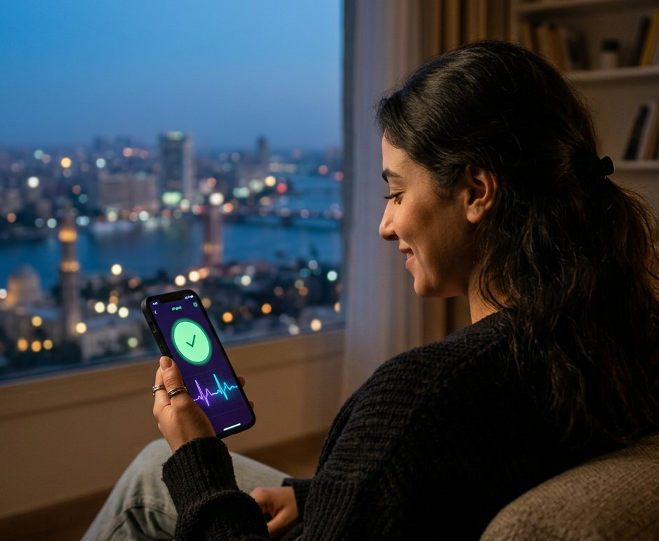
Live data becomes clear action
for families
15
CAREGIVER APP & DASHBOARD
LIVE
Current vitals, activity state and band presence — green means all good
TRENDS
HRV, temperature and anomaly history to catch slow deterioration
ADVICE
LLM-written explanations and personalised next steps for the wearer
ALERTS
Stress, fever, low oxygen and fall notifications, graded by severity
SAFETY
Emergency contacts, GPS context and a full alert timeline
PRODUCT | CAREGIVER APP AND DASHBOARD
Notes:
The buyer is usually the adult child; the wearer is the parent. The app is built for the buyer's anxiety: a green circle that says "all good" is the feature people pay for every month.
Today: a live web dashboard already consumes the pipeline output; the mobile app is the next build item. Show the dashboard live if the demo network allows it.
Alert grading (low / medium / high / critical) maps directly to what the band shows on the wrist, so family and wearer always see the same truth.

Slide 16
What is already built
16
Prototype stage — every layer of the stack exists end to end.
1,875
3 + 1
v1.0
Live
LABELLED READINGS
MODEL PIPELINE
ESP32 FIRMWARE
CLOUD PATH
5 activity states · 14 raw signals · 21 engineered features
Isolation Forest · LSTM autoencoder · rule classifier · optional LLM advice
Full sensor stack, fall/SOS workflow, TLS MQTT — 87 automated checks
HiveMQ Cloud broker · FastAPI service · web dashboard
WE ARE HERE
Concept
Prototype
Pilot
Launch
system design, dataset, models
firmware + cloud + dashboard
30–50 households, 3 months
Egypt, then MENA
TRACTION | PROTOTYPE STATUS
Notes:
No revenue yet — say it plainly — but the whole stack exists: data and trained models, an inference service, a live dashboard, a cloud broker, and firmware for the complete sensor stack including the safety workflow.
That de-risks the next step: the pilot is an integration and validation exercise, not an invention exercise.
Firmware verification is host-side so far (compiles against the real libraries; 87 behavioural checks). On-body validation and battery-life measurements come from the bench phase starting now.

Slide 17
Start with independent aging in Egypt,
expand across MENA
17
FIRST WEDGE
THE BUYER
EXPANSION
Independent aging
Family & caregivers
Wellness & stress
Older adults living at home who benefit from fall detection and proactive monitoring.
Adult children who want alerts, location context and peace of mind while at work.
Professionals who want context on stress, sleep and recovery — not another raw score.
9.3 M Egyptians aged 60+ (8.8%) — CAPMAS 2024
Household decision-maker; subscription payer
Same band, different app mode
684 000
fatal falls per year worldwide (WHO)
37.3 M
falls a year need medical attention (WHO)
80%+
of fall deaths are in low- and middle-income countries
MARKET | ENTRY WEDGE AND EXPANSION
Notes:
Focus wins: the first commercial wedge is independent aging in Egypt — 9.3 million people over 60 (8.8 % of the population, CAPMAS 2024), most living at home, with adult children who work.
The buyer and the wearer are different people; pricing, onboarding and the app are designed for the buyer, the band for the wearer.
Global context: WHO estimates 684 000 fatal falls a year and 37.3 million falls needing medical attention; over 80 % of fall deaths happen in low- and middle-income countries — exactly the markets premium smartwatches under-serve.
TAM/SAM/SOM in currency terms is deliberately left for the appendix until pilot data supports a defensible price point.

Slide 18
Commercial model
18
Hypotheses for a prototype-stage company — pricing and unit economics are validated in the pilot.
REVENUE STREAMS
UNIT ECONOMICS — WORKING ASSUMPTIONS
1
Device sale
LINE
PROTOTYPE
VOLUME TARGET
One-time revenue from the band and charger; target hardware margin ≥ 35 % at volume.
Bill of materials
≈ US$ 45–60 (modules)
< US$ 30 (custom PCB, 5k units)
Device price
—
US$ 79–99 equivalent, local pricing
2
Family subscription
Subscription
—
US$ 3–6 / month per household
Monthly access to AI insights, longer history, multi-caregiver alerts and emergency dispatch.
Gross margin
n/a
≥ 60 % blended after year 1
3
B2B / B2B2C
Pilots with senior-care providers, insurers, employers and remote-care partners; per-seat pricing.
Assumptions to validate: willingness to pay in EGP, churn after the first alert, and B2B2C reimbursement partners.
BUSINESS | COMMERCIAL MODEL
Notes:
Three streams, in order of maturity: a device sale to get the band on the wrist, a family subscription that carries the recurring value (insight, history, escalation), and B2B2C channels where an insurer or care provider pays per seat.
Unit economics are hypotheses: the prototype BOM with off-the-shelf modules is roughly 45–60 dollars; a custom PCB at a few thousand units should bring it under 30. Price points are stated in dollar equivalents but will be set in EGP after the pilot's willingness-to-pay interviews.
Do not defend the numbers — defend the method: the pilot is designed to replace every assumption on this slide with measured data.

Slide 19
Positioned between fitness bands
and medical alert pendants
19
CAPABILITY
FITNESS BANDS
PREMIUM SMARTWATCHES
MEDICAL ALERT PENDANTS
NEUROLINK WEAR
Continuous multi-signal vitals (HR, SpO₂, HRV, temp, GSR)
Predictive anomaly detection (stress, fever, fatigue)
On-device fall verification + wearer prompt
Caregiver escalation with vitals and GPS link
Explains the signal in plain language
Affordable for LMIC families, no smartphone needed to wear
Full
Partial
None
Premium watches do parts of this at 5–10× the price and assume a paired smartphone; pendants react but never predict.
POSITIONING | WHY WE WIN
Notes:
Fitness bands are cheap but blind to safety; premium smartwatches have fall detection but cost several hundred dollars, assume a paired smartphone on the wearer, and are not designed around a caregiver; medical alert pendants react to a button press but never predict anything.
We sit in the gap: continuous multi-signal vitals, prediction, on-device fall verification and caregiver escalation — at a price a family in Cairo can pay, and without the wearer needing a smartphone.
Keep competitor claims general and fair; if asked about a specific brand, compare on price, caregiver features and phone dependence.

Slide 20
Validation roadmap
20
From a working prototype to a validated safety product in 18 months.
01
02
03
04
Bench & on-body
Controlled pilot
Safety & compliance
Scale
Q4 2026
H1 2027
H2 2027
2028
– Sensor accuracy vs. reference devices
– Fall thresholds on 20+ scripted falls
– Battery life, strap & enclosure v1
– 30–50 households in Giza & Cairo
– Detection reliability, false-alarm rate
– Caregiver app, willingness to pay
– Escalation SOPs, consent, privacy
– Regulatory pathway assessment
– Custom PCB, DFM, supplier quotes
– Egypt launch with care partners
– B2B2C insurer / employer pilots
– GCC & MENA expansion
Key risks we track: clinical validity of wrist PPG · false-alarm fatigue · battery life with GPS · data privacy and consent · hardware supply.
ROADMAP | VALIDATION PATH
Notes:
Four phases, each with a measurable exit: bench accuracy against reference devices; a 30–50 household pilot measuring detection reliability, false-alarm rate and willingness to pay; a safety and compliance phase that turns the workflow into SOPs and assesses the regulatory pathway; then scale with care partners in Egypt and B2B2C pilots.
Name the risks before investors do: wrist PPG accuracy, alarm fatigue, battery life with GPS, privacy and consent, supply chain. Each has an owner and a test in the plan.

Slide 21
Team
21
Builders across embedded systems, data science and care — with advisors we are actively recruiting.
DS
ML
CA
GP
[Founder name]
[Co-founder name]
[Clinical advisor]
[Growth lead]
CEO · Product & embedded systems
CTO · AI & data
Geriatrics / family medicine — recruiting
Partnerships & go-to-market — recruiting
Firmware, sensor integration, system architecture.
Anomaly models, pipeline, cloud services and dashboard.
Protocol design, clinical validity, pilot ethics.
Senior-care providers, insurers, distribution.
Replace the bracketed placeholders with names, photos and one proof point each (previous product shipped, publication, clinical role).
TEAM | WHO IS BUILDING IT
Notes:
One proof point per person — what each has shipped or published — beats a list of titles. Highlight the complementary split: embedded/product, AI/data, clinical, growth.
State the open seats as a strength: a geriatrics advisor and a partnerships lead are being recruited for the pilot phase, and part of the raise funds them.

Slide 22
22
Help us close the gap between
a reading and a response.
THE ASK
Pilot partners
Senior-care providers, clinics and insurers in Egypt for a 30–50 household pilot.
Clinical validation support
A geriatrics advisor and access to reference devices for accuracy studies.
Pre-seed funding
[US$ ___ k] for 18 months — bench validation, pilot, custom PCB and the mobile app.
INDICATIVE USE OF FUNDS
40% Hardware & compliance
35% Pilot & validation
25% Team & app
[founder@neurolinkwear.example] · [+20 1xx xxx xxxx] · github.com/DiaaSalah57/Neuro-Link-Wear_SmartBand
NEXT STEP | PILOT, VALIDATION, FUNDING
Notes:
Close on the mission line, then be concrete: three asks — pilot partners, clinical validation support, and a pre-seed round sized for 18 months (fill in the amount before presenting).
Use of funds is indicative: roughly 40 % hardware and compliance, 35 % pilot and validation, 25 % team and app.
End with the next step you want from this room: an introduction to a care provider, a pilot site, or a follow-up meeting on the round.

