Slide 1
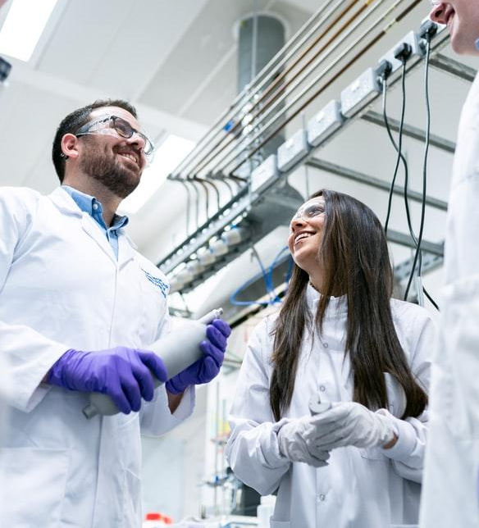
Computational Biology

Slide 2
Introduction
- We use a fixed uniprot fasta file for the Multiple RAWs .
- We convert RAWs files to mzML files .
>sp|Q08954|YP199_YEAST Smr domain-containing protein YPL199C OS=Saccharomyces cerevisiae (strain ATCC 204508 / S288c) OX=559292 GN=YPL199C PE=1 SV=1
MKGTGGVVVGTQNPVRDYNHSTDEEYQRLRRLADEAYKKRDQLSHESQTAYQQGDKKLAH
ELSEKSKAQLKTAEDFNMQAAEYVFVENNADSSSNEIDLHGLYVKEALFILQKRIKFAID
HNEPQLNVIVGKGLHSQNGIAKLKPSIEEFCAKHGIRNHLEKGNSGVLVLELQGVQMQMD
GPAVNAPTNQYNAQPHPQYNNNGGQPQGQAQNYNNSGNDNKDSTLTSIFKIFCNCIQSLA

Slide 3
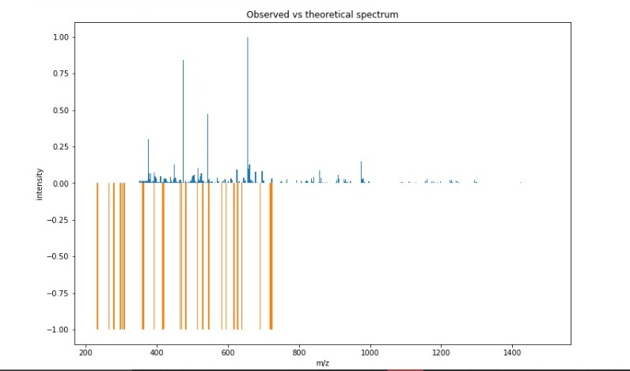
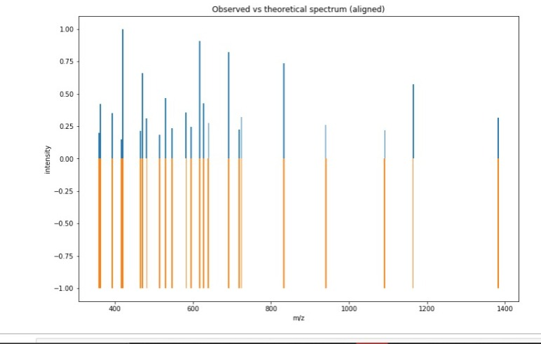
The First Raw
Number of matched peaks: 24

Slide 4
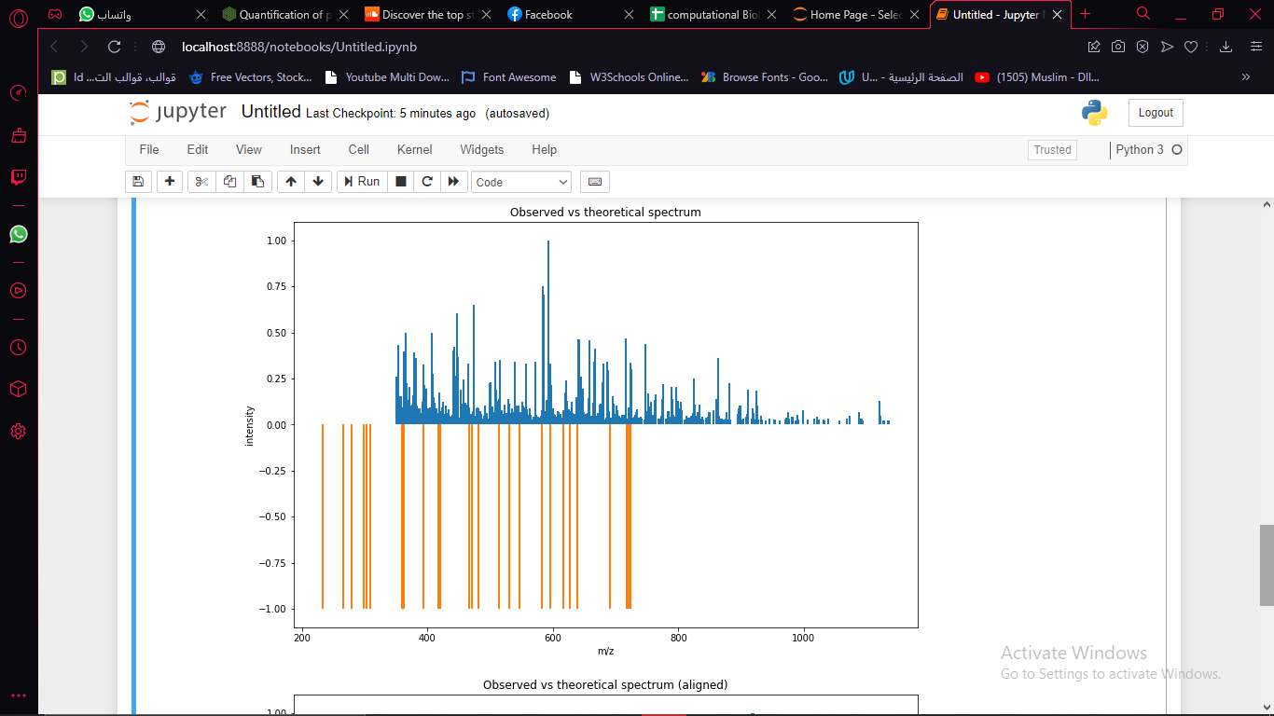
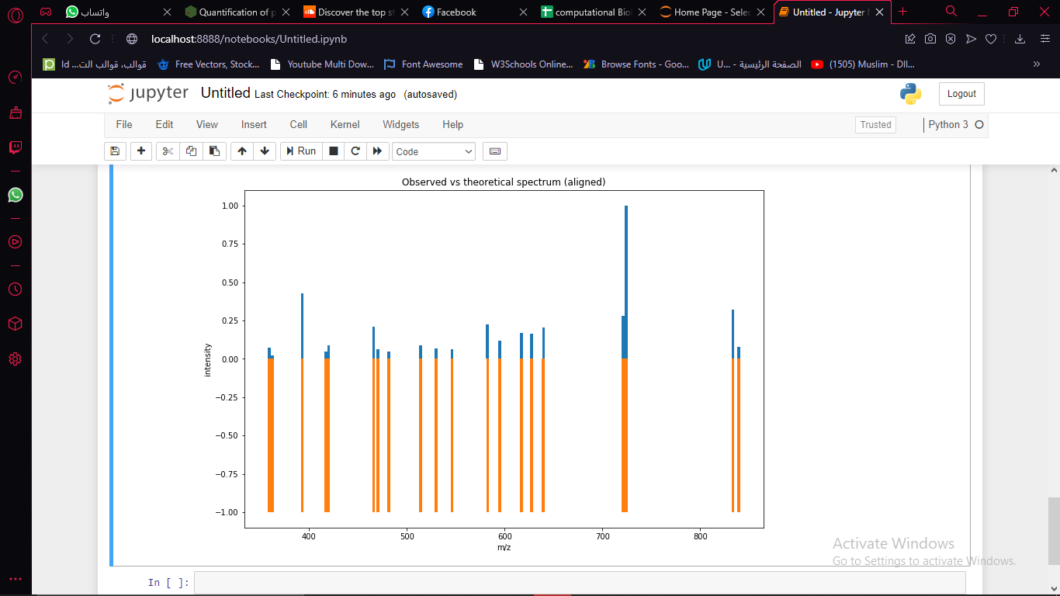
The Second Raw
Number of matched peaks: 20

Slide 5
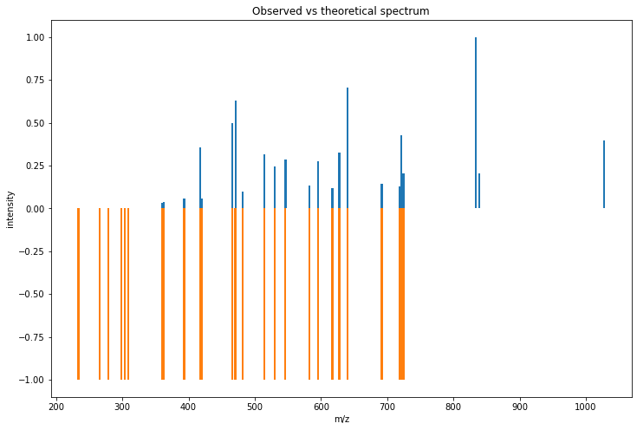
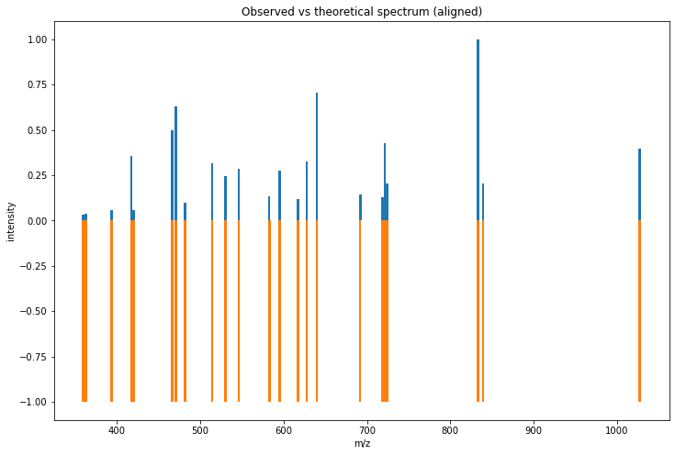
The Third Raw
Number of matched peaks: 23

Slide 6
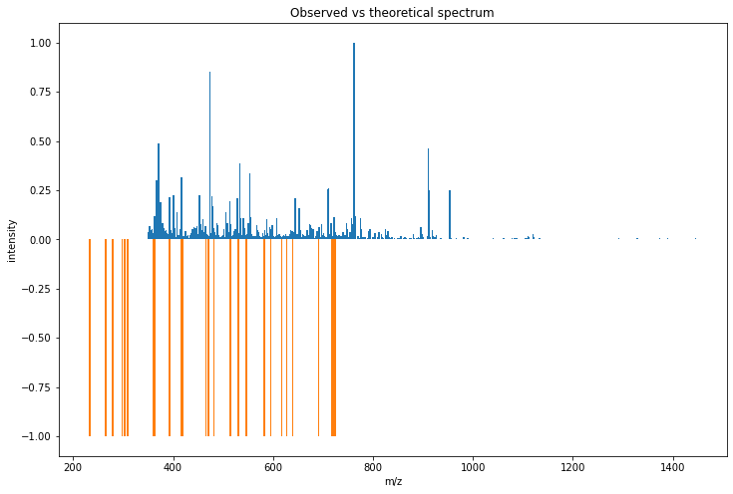
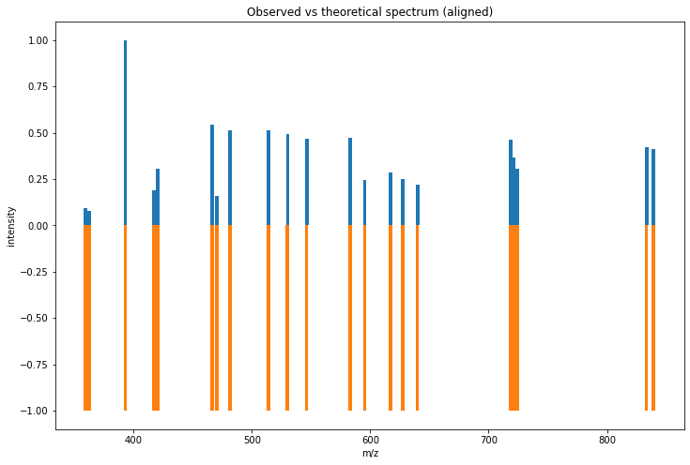
The Fourth Raw
Number of matched peaks: 21

Slide 7
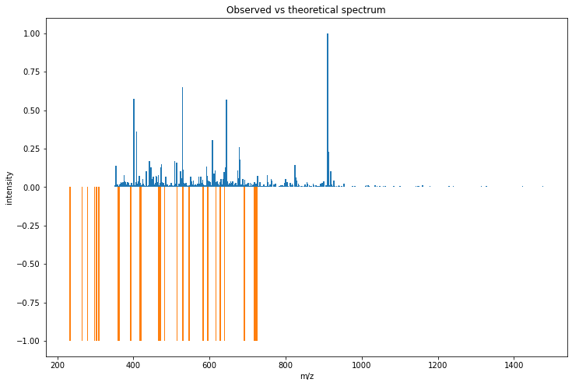
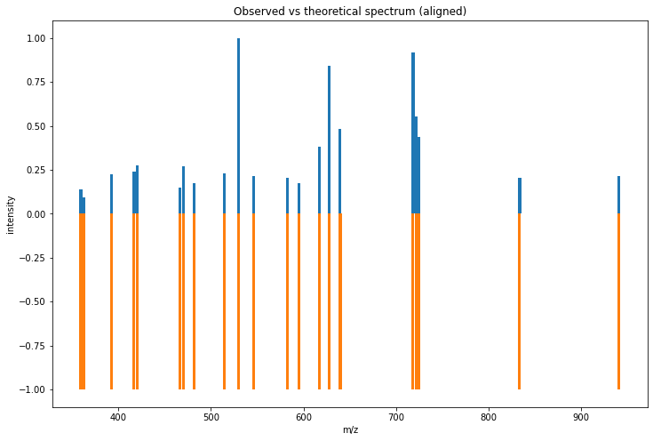
The Fifth Raw
Number of matched peaks: 21

Slide 8
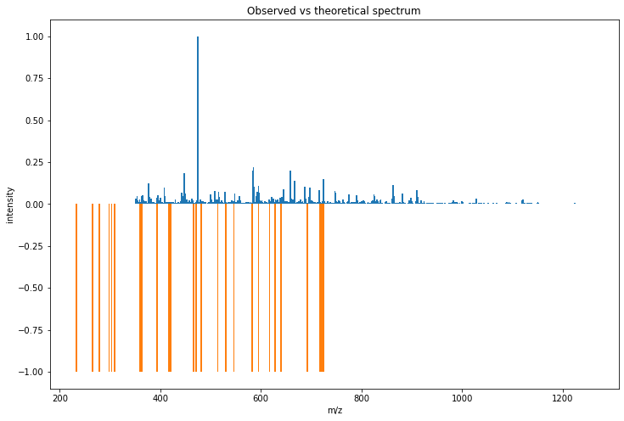
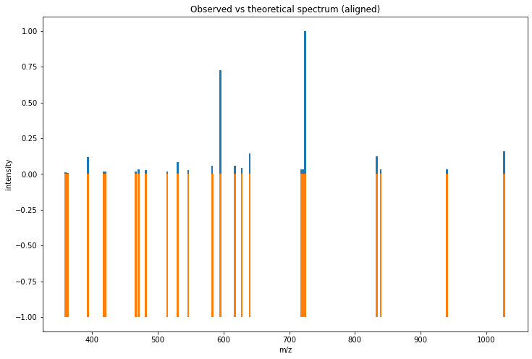
The Sixth Raw
Number of matched peaks: 23

Slide 9
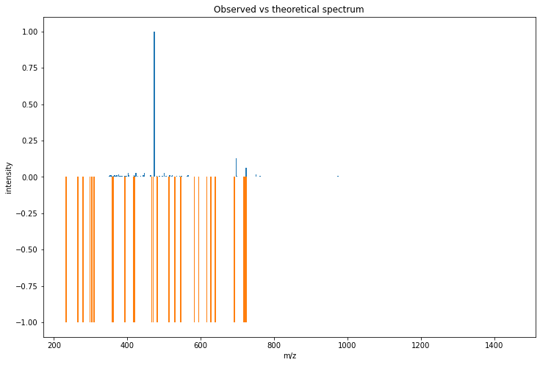
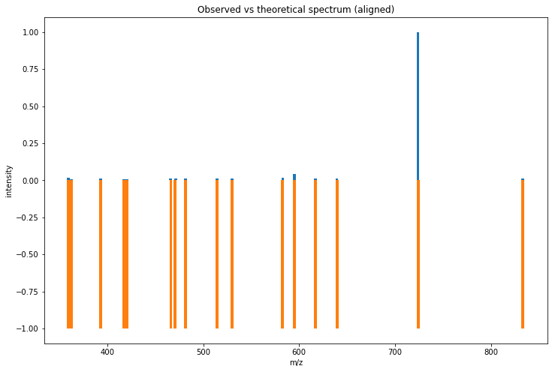
The Seven Raw
Number of matched peaks: 16

Slide 10
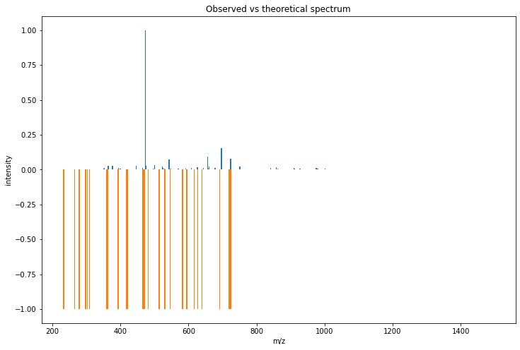
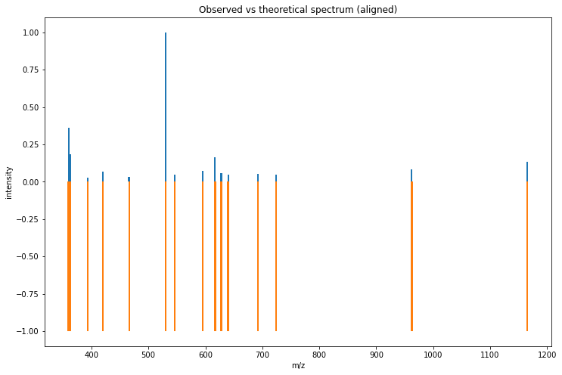
The Eight Raw
Number of matched peaks: 15

Slide 11
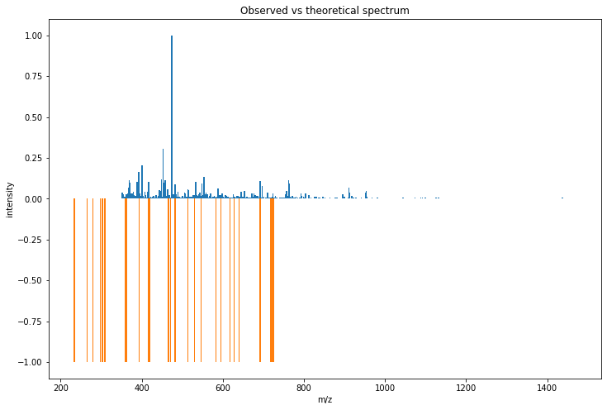
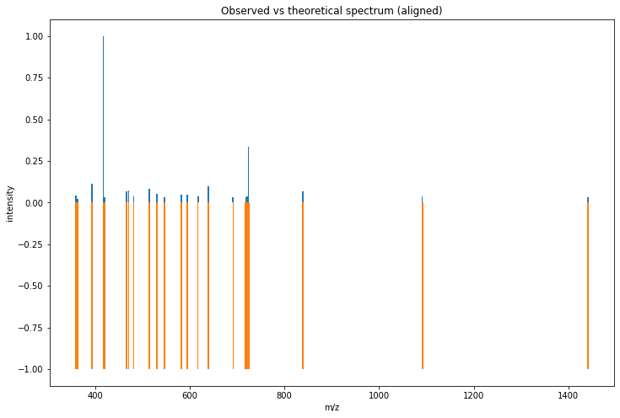
The Ninth Raw
Number of matched peaks: 22

Slide 12
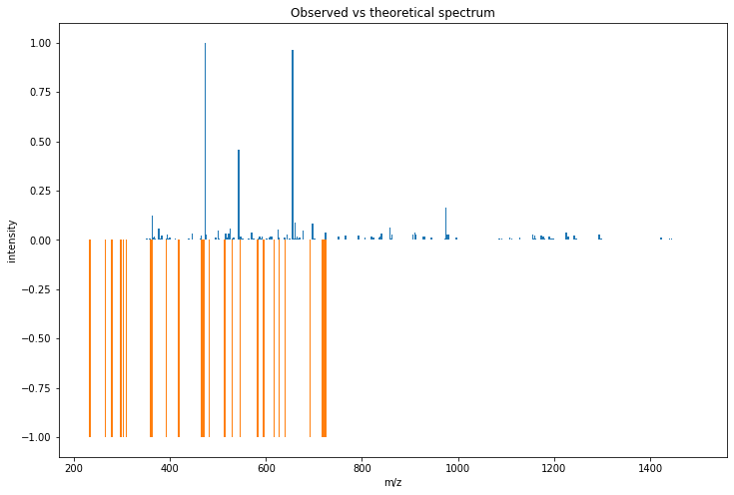
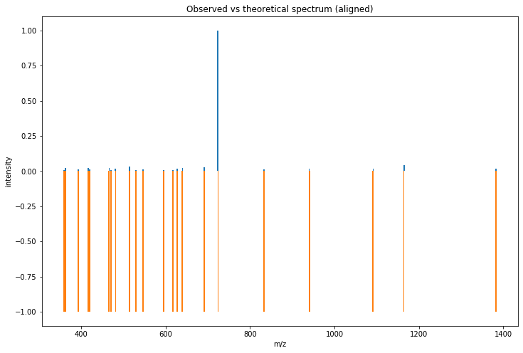
The Tenth Raw
Number of matched peaks: 22

Slide 13
THANKS!

