Slide 1
Data Structure
Single Linked List

Slide 2
Single Linked List
노드
data
저장하고 싶은 데이터
다음 노드를 가리키는 참조

Slide 3
Single Linked List
맨 앞을 가리킴
현재 위치 전
현재 탐색 위치
맨 뒤를 가리킴
head
before
current
tail
1
2
3
4
None
1. 4개의 참조와
2. 데이터의 개수를 담고 있는 데이터 개수

Slide 4
Single Linked List
Insert - 1
newNode
3
head
tail
1
2
None

Slide 5
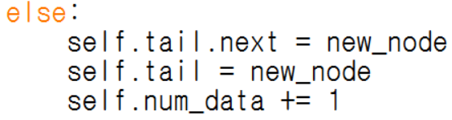
Single Linked List
Insert - 2
head
tail
new_node
1
2
3
None

Slide 6
Single Linked List
Insert - 3
head
tail
new_node
1
2
3
None

Slide 7
Single Linked List
search - 1
head
before
current
tail
1
2
3
4
None

Slide 8
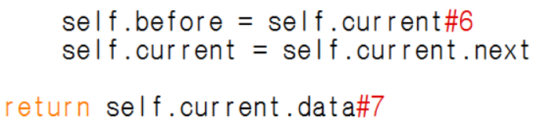
Single Linked List
search - 2
head
before
current
tail
1
2
3
4
None

Slide 9
Single Linked List
search - 3
head
before
current
tail
1
2
3
4
None

Slide 10
Single Linked List
remove - 1
current == head
current
head
before
tail
1
2
3
4
None

Slide 11
Single Linked List
remove - 1
current == head
current
head
before
tail
1
2
3
4
None

Slide 12
Single Linked List
remove - 2
current == tail
head
before
current
tail
1
2
3
4
None

Slide 13
Single Linked List
remove - 2
current == tail
head
before
tail
current
1
2
3
4
None

Slide 14
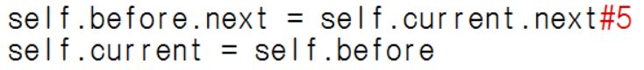
Single Linked List
remove - 3
before
current
1
2
3
4
None

Slide 15
Single Linked List
remove - 3
before
current
1
2
3
4
None

