Slide 1

LSL Part 3:
Using the APIs
David Medine 21/10/2021

Slide 2

Preamble
All materials presented are available for download on github:
https://github.com/Diademics-Pty-Ltd/BrainProducts_BCI_Event
You may contact me by email at david.medine@diademics.com

Slide 3
Correction!
LSL samples do never arrive out of order. It is the timestamps that can be out of sequence, and it is this that the flag post_monotonize will correct. The sample order not the timestamp order is the ground truth.

Slide 4
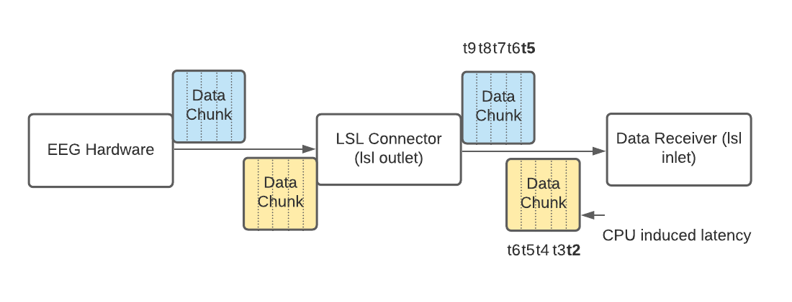
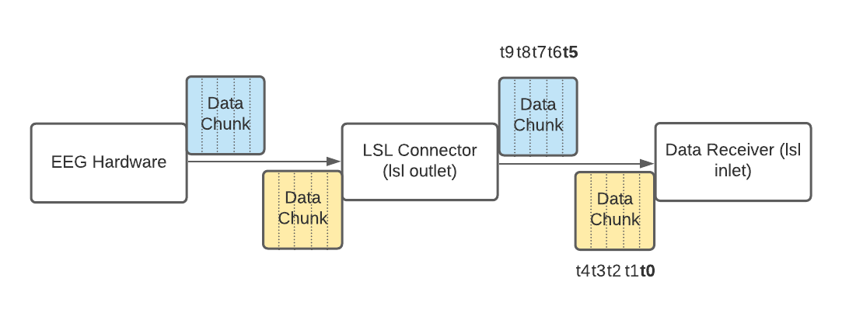
How can timestamps be out of order?

Slide 5
Outline

Slide 6
Outline
An overview of the LSL Example programs
A little bit of real-time programming theory
How to listen to markers in C#
server
client
LSL EEG analysis in Python
offline
online
The LiveAmp LSL server (a full-scale C++ example)

Slide 7
LSL Example Programs

Slide 8
Timeless Problems in Real-Time

Slide 9
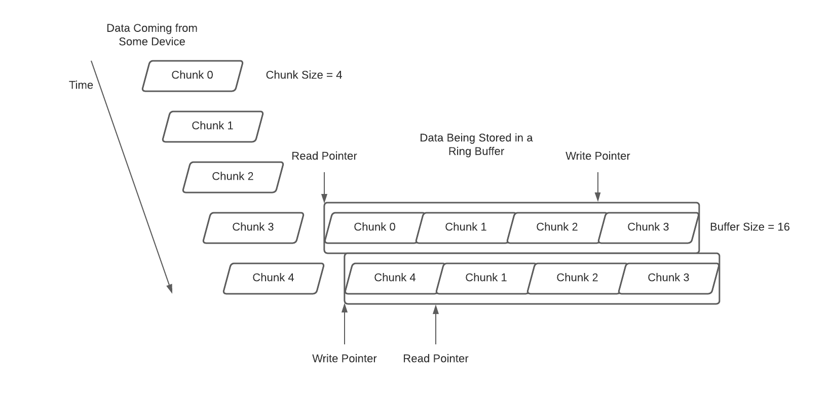
Ring Buffers

Slide 10
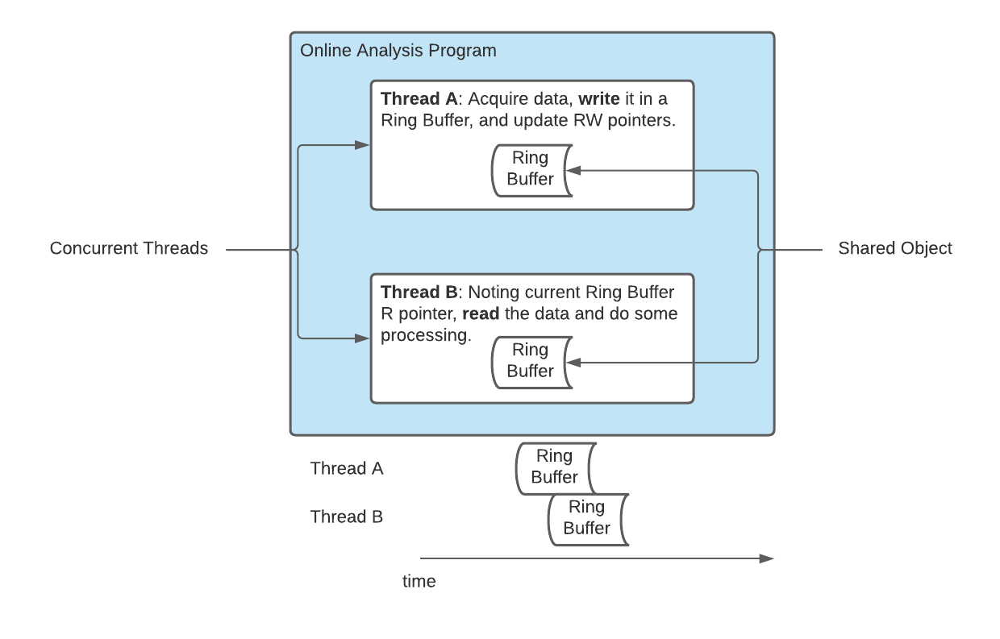
Concurrency
This is bad. If the thread that is writing to a shared object happens during the same time a different thread is reading from that shared object, the program is indeterminate. The problem is that some data in the ring buffer can be overwritten by the write thread before it has been read by the read thread.

Slide 11
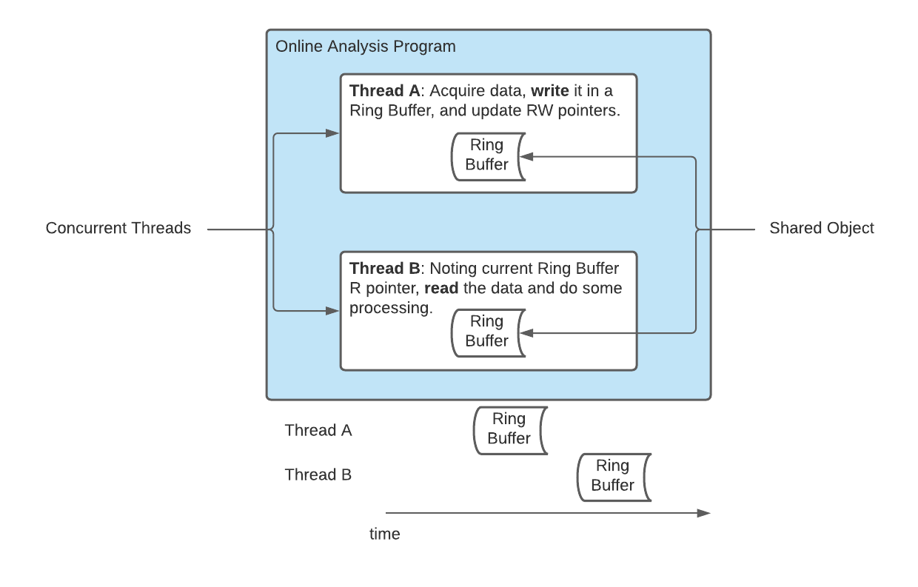
Concurrency
Thread locking must be used to ensure that concurrency issues do not arise. In practice, most programs that do not do this will simply crash.

Slide 12
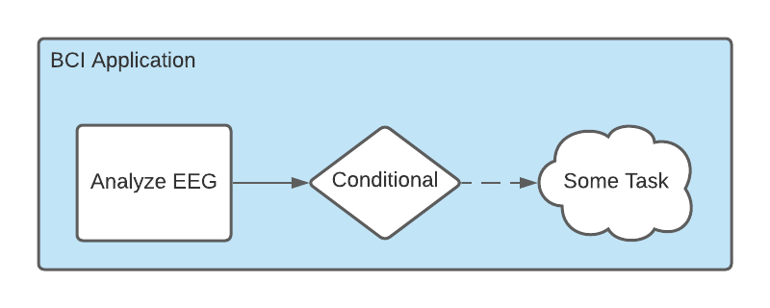
Callback Function
while(acquire_data == true)
{
condition = process_data();
if (condition == true)
launch(task);
}

Slide 13
LSL Markers in C#: Server and Client

Slide 14
LSL EEG Analysis in Python: Offline and Online

