Slide 1

LSL Part 2:
Synchronization
David Medine 20/10/2021

Slide 2

Preamble
All materials presented are available for download on github:
https://github.com/Diademics-Pty-Ltd/BrainProducts_BCI_Event

Slide 3
Approaches to Digital Data Synchronization

Slide 4
Approaches to Digital Data Sync
Just in time/as fast as possible
as soon as new data is available, grab it and process it
synchronization tends to be hardware driven
Grid-like Sync
Exact synchronization
each digital sample from one stream is aligned with a digital sample from another
Commensurate data
each digital sample from one stream is aligned with an integer multiple digital sample from another stream with a higher sampling rate
‘Continuous time’ rebase sync
digital samples are not aligned, but their time stamps refer to non-aligned points on a single, continuous time-base

Slide 5
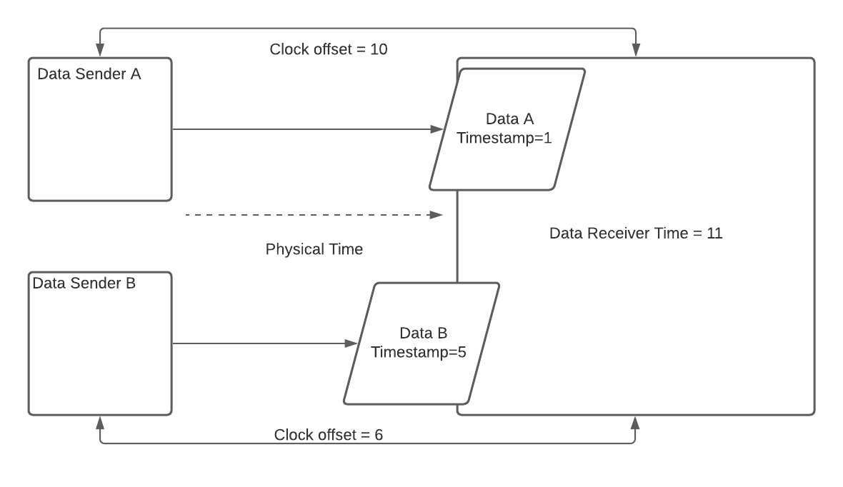
Approaches to Digital Data Sync
Just in time/as fast as possible
In this scenario, the Data Receiver simply processes first Data A, then Data B because that is the order the data are received. It throws away all a priori understanding of its time-base or the time-base of the Data Senders because all that matters is which Data is newest. Even though Data A and Data B should be exactly synchronous, Data B has a higher latency so the Data Receiver ‘believes’ it happened later in time.

Slide 6
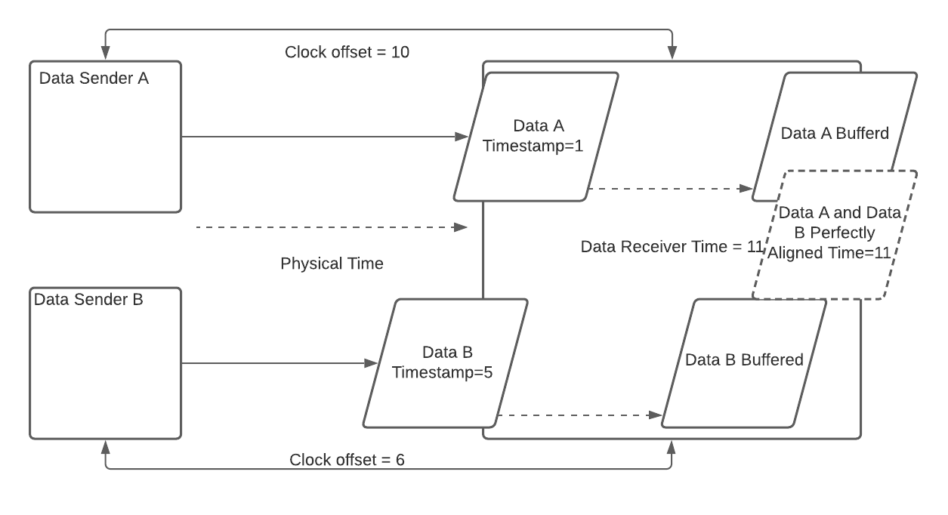
Approaches to Digital Data Sync
Exact Sync
In this scenario, the Data Receiver waits until Data B arrives with the same relative time as the earlier Data A. Then, because the Data Receiver knows the clock offset between itself and the two Data Senders, and because both Data Senders have the same sampling rate it can perfectly align the data from both Senders and assign their receive times to its own time-base.

Slide 7
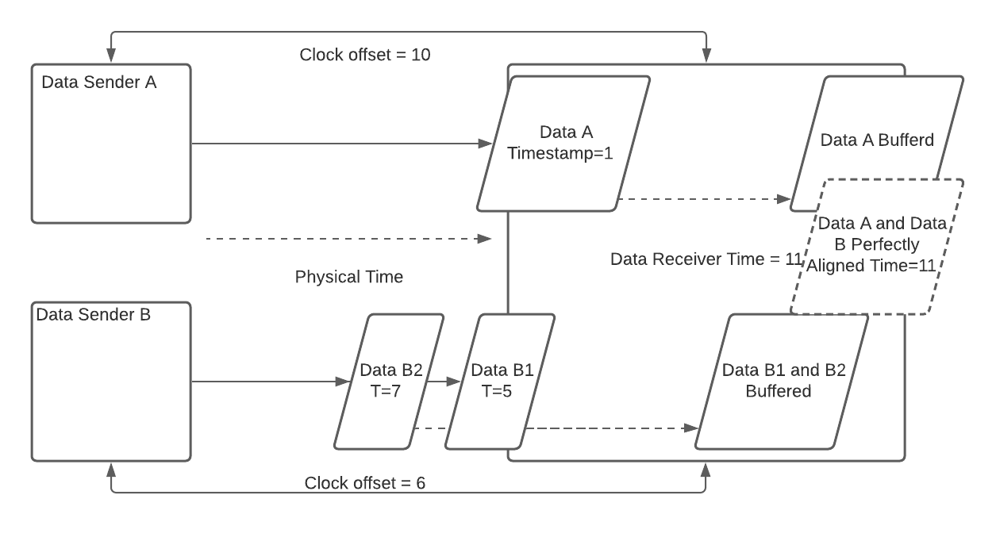
Approaches to Digital Data Sync
Commensurate Sync
In this scenario, the Data Receiver waits until Data B1 and B2 have arrived with the same relative time and sample count as the earlier Data A. Then, because the Data Receiver knows the clock offset between itself and the two Data Senders, and because both Data Senders have the integer multiple sampling rates it can perfectly align the data from both Senders and assign the receive time to its own time-base.

Slide 8
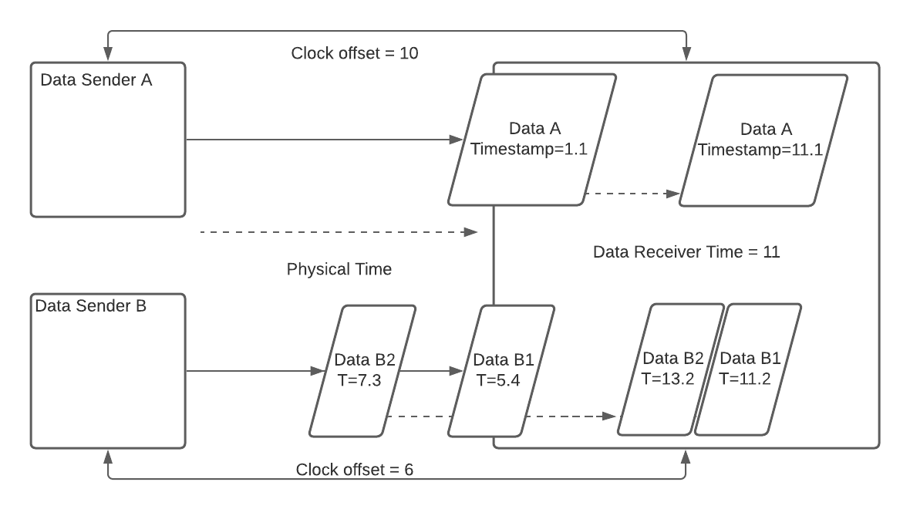
Approaches to Digital Data Sync
‘Continuous Time’ Rebase Sync
In this scenario, Data Sender A and Data Sender B can have any sampling rate. The Data Receiver cannot perfectly align the digital samples, but it can shift their timestamps so that any relative moment in time in one streams is the same moment in another stream. In this case, if we wish to know the value of Data A at timesamp 11.2 (relative to the first sample in Data B1) interpolation may be required. LSL uses this approach (but does not do any interpolation).

Slide 9
Approaches to Digital Data Sync
Just in time/as fast as possible
Pros:
simple
fast
Cons:
inexact
jitter is impossible to remove
if samples times are not monotonically increasing there are problems
requires a ‘master’/’main’ clock: how to choose?
This approach is a good choice if all you care about is NOW.

Slide 10
Approaches to Digital Data Sync
Grid-like Sync
Pros
very exact
Cons:
very constrained
in reality, this always requires hardware triggers
almost impossible to do in real-time
Snapping samples to a quantized grid can only be done reliably in an offline scenario and when the sampling rate of the hardware is very reliable.

Slide 11
Approaches to Digital Data Sync
‘Continuous Time’ Rebase Sync
Pros:
extremely flexible
exact sampling rate of devices/data suppliers is irrelevant
since it is sampling rate agnostic, any combination of devices is possible
Cons:
hard to understand
requires interpolation for exactness
things can go very wrong if care is not taken to make sure they don’t
This is LSL’s approach.

Slide 12
LSL (Offline) Synchronization Overview

Slide 13
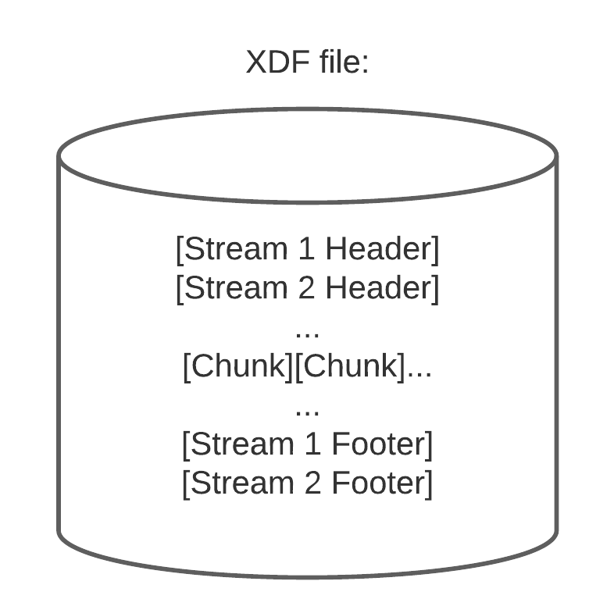
LSL Synchronization Overview
LabRecorder records not only data and their timestamps, it also measures and records clock offsets between CPUs and the local timestamps when those measurements are taken.
Using this information XDF loaders (load_xdf.m/pyxdf/XDF.jl) can correct for 2 things:
Clock offsets (slowly drifting differences between the CPU sending the data and the CPU recording the data)
Jitter (random noise added to the timestamps due to minutely varying processing times)

Slide 14
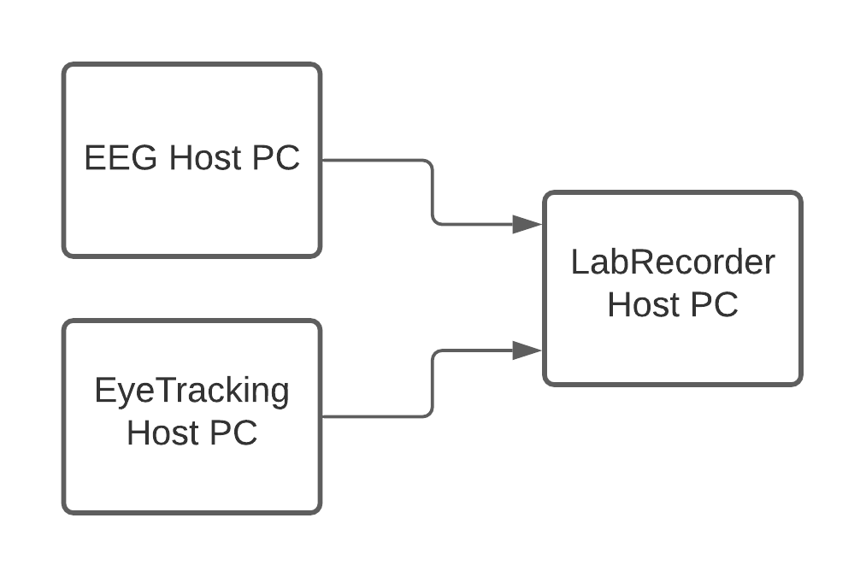
LSL Synchronization Overview
Correcting for clock offsets:
LabRecorder uses the LSL function time_correction() to measure clock differences between PCs for each stream
The default is to do this every 5s
This data is stored in the footer portion of an XDF file along with data write times
Using this data, the timestamps from each stream can be put on the same time-base as the recording PC

Slide 15
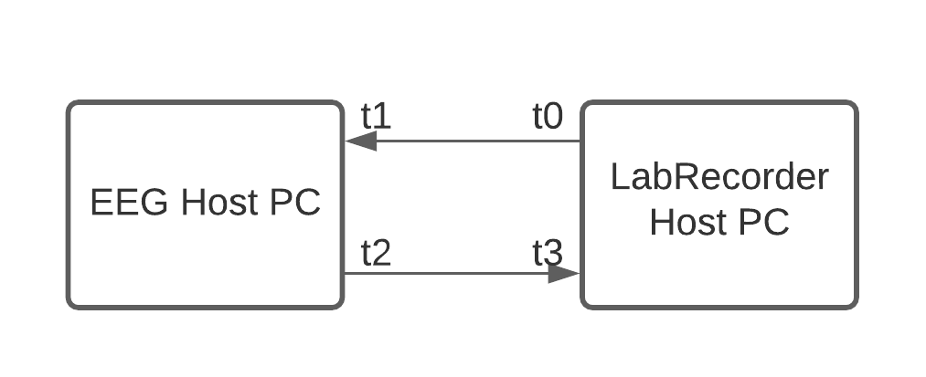
LSL Synchronization Overview
time_correction() uses the clock synchronization algorithm (part of the Network Time Protocol) to compute clock offsets:
t0 send time of packet from LabRecorder to stream host
t1 receive time of packet from LabRecorder host
t2 send time of packet from stream host to LabRecorder
t3 receive time of packet from stream host
RTT = (t3-t0) - (t2-t1)
OFS = ((t1-t0) + (t2-t3))/2 for lowest RTT

Slide 16
LSL Synchronization Overview
Using record times and clock offsets, XDF loaders have all the information they need to remap timestamps from device host PCs to a Recording PC’s timebase
load_xdf.m uses a robust fitting procedure, an ADMM (alternating direction method of multipliers) incorporating the Huber loss function (code/paper)
The result is a simple linear map (DC offset and slope) between the stream host timebase and the LabRecorder host timebase
This map is then applied to the timestamps from each stream to thus synchronizes the data

Slide 17
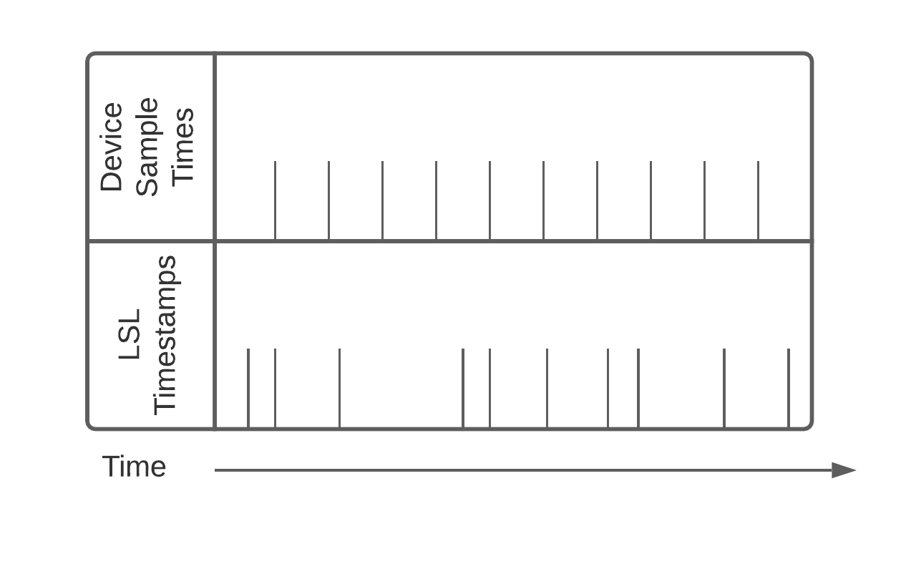
LSL Synchronization Overview
Jitter also needs to be corrected:
Linear regression to a line will map the jittery timestamps to a nice grid, but it will never be exactly the same as the advertised device sampling rate.
This can lead to confusion:
nominal_srate vs effective_srate

Slide 18
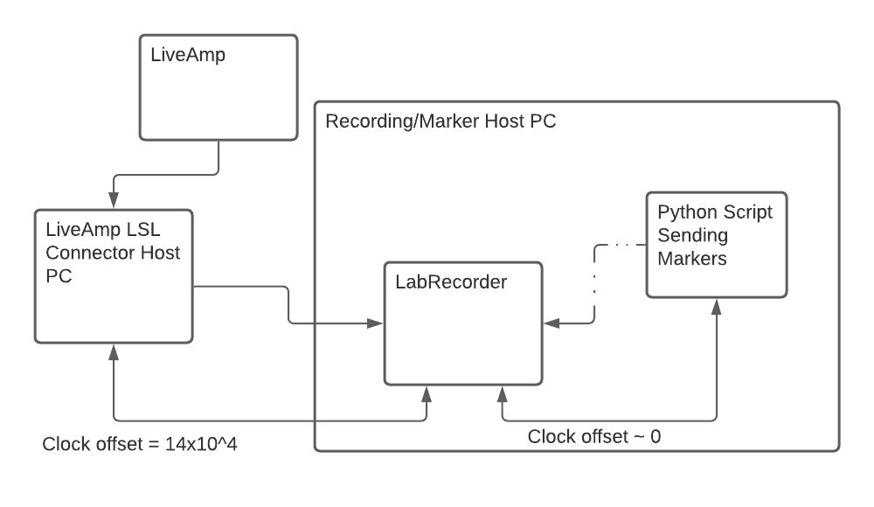
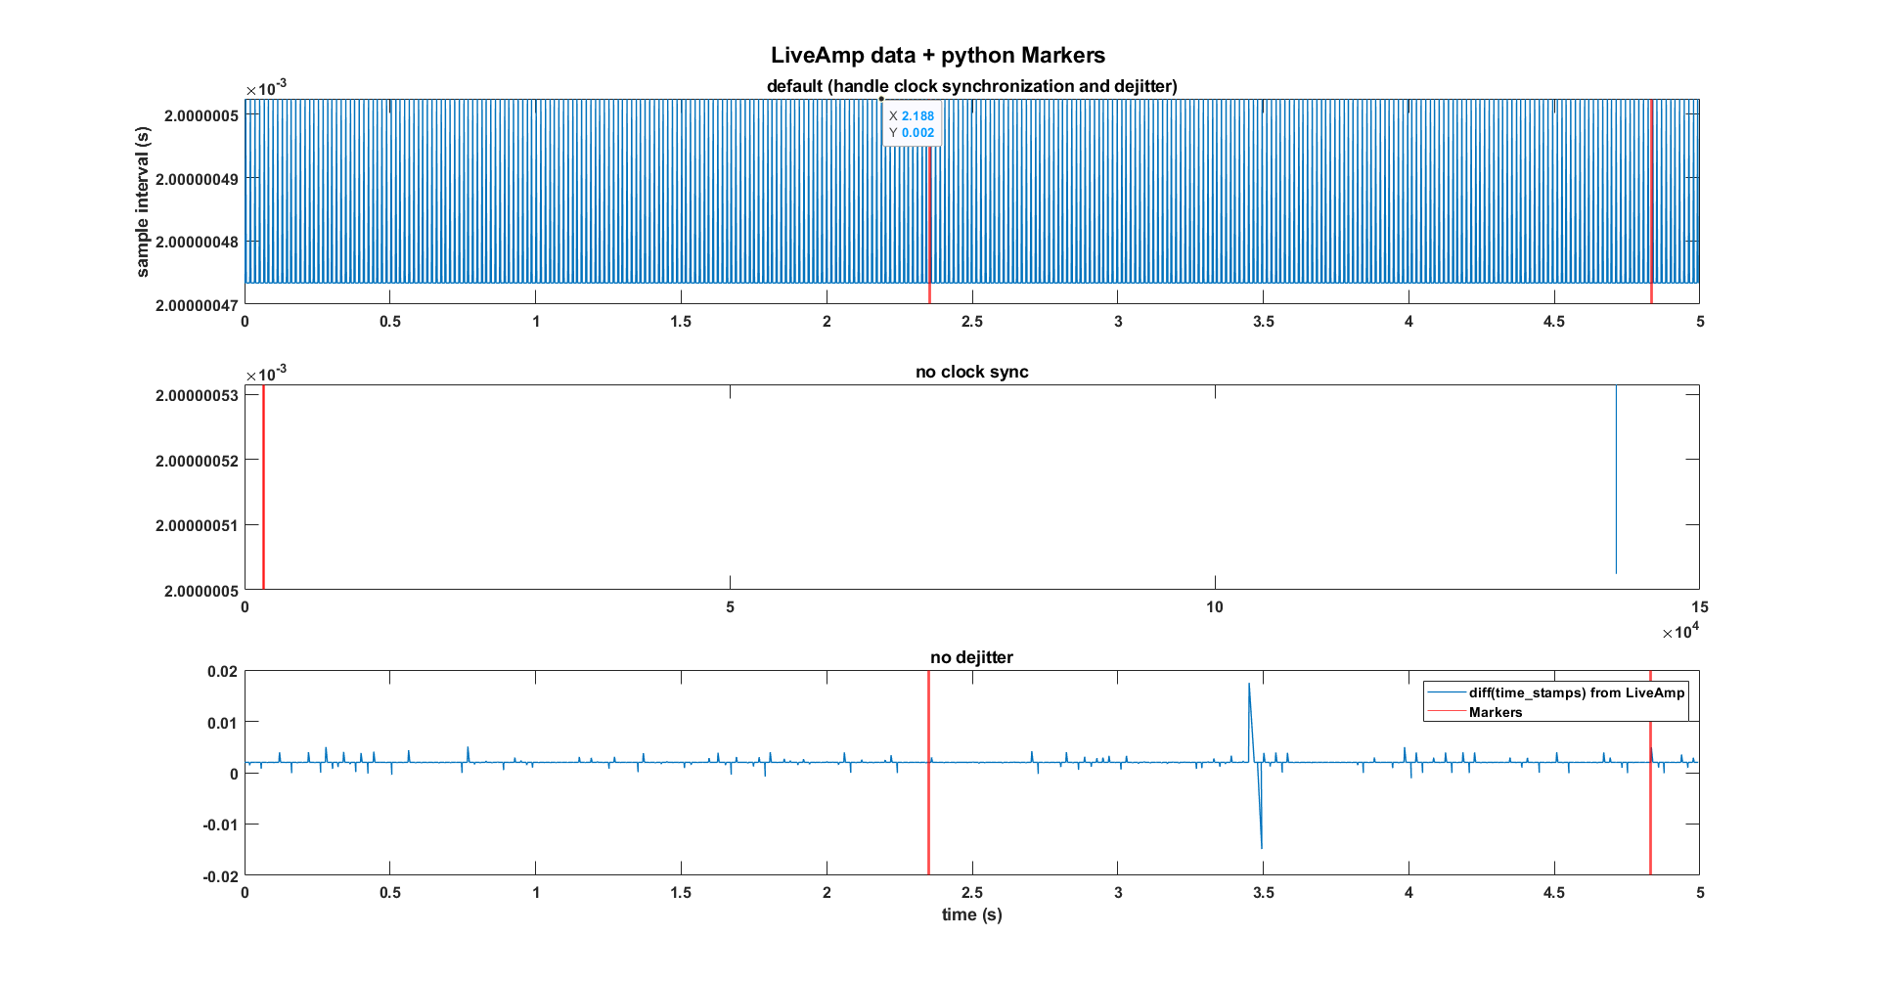
LSL Synchronization Overview

Slide 19
What Can Go Wrong?

Slide 20
What Can Go Wrong
A changing sampling rate (or data that drops some, but not many samples) will cause the dejittering algorithm to produce terrible results.
If there are problems with calls to time_correction(), the algorithm that corrects clock offsets will produce terrible results.
If everything is working properly, your data will not have these problems. Always pilot before doing a study---hearts have been broken by these two issues.

Slide 21
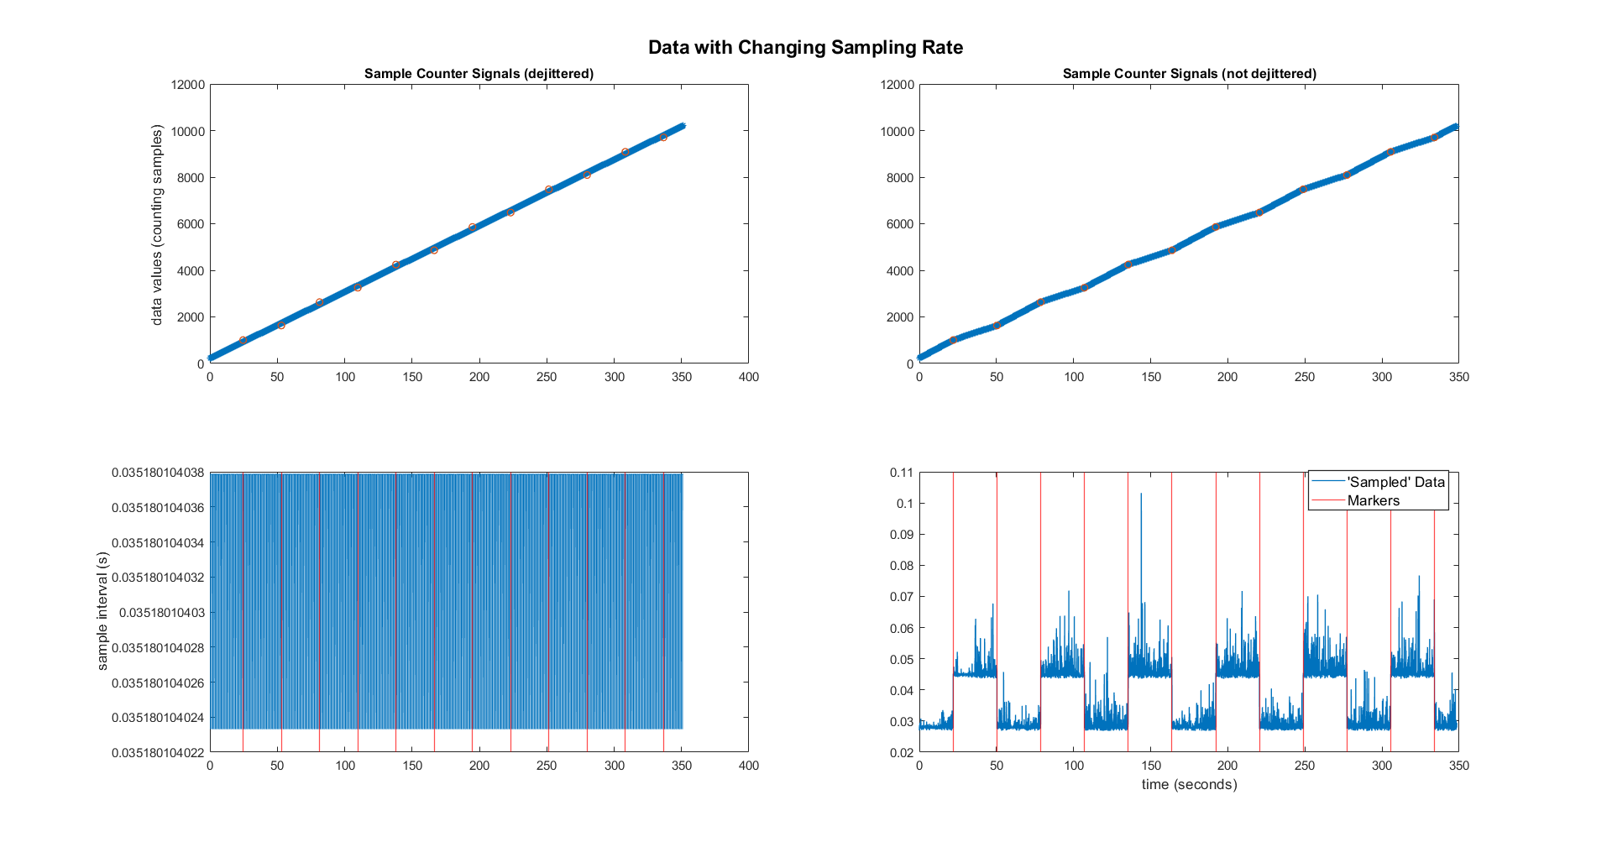

Slide 22
What Can Go Wrong
The clock offset problem can occur if either of the following is true:
The data is coming from a software that imposes its own timestamps.
Network insufficiency cause problems with calls to time_correction()---this can happen in faulty or low-bandwidth/highly taxed wireless networks---or even old/bad wired routers.

Slide 23
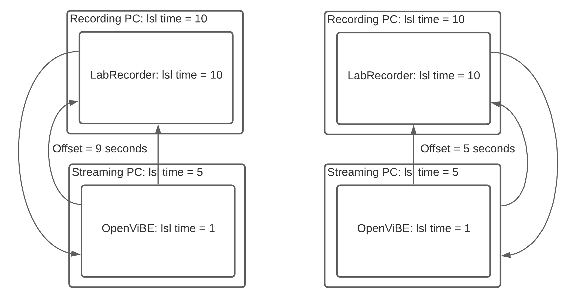
What Can Go Wrong
The ‘external timestamp’ problem can be fixed adding the following code to an LSL config file:
[tuning]
ForceDefaultTimestamps=1

Slide 24
What Can Go Wrong
LSL based experiments often require heavy network bandwidth, so it is best to transmit over a wired LAN.
But, if wireless is needed, the following tuning may help prevent data loss and time_correction() malfunction:
[tuning]
TimeProbeMaxRtt = 0.100
TimeProbeInterval = 0.010
TimeProbeCount = 10
TimeUpdateInterval = 0.25
MulticastMinRTT = .100
MulticastMaxRTT = 30
Courtesy of Matthew Grivich

Slide 25
LSL Sync For Online (e.g. BCI)

Slide 26
LSL Sync For Online
LSL’s offline sync tools are also available for real-time scenarios.
The algorithms do require some ‘warm up’ time in order to work properly.
They do not provide the same level of accuracy and stability as their offline counterparts (I don’t think any quantitative comparison has ever been made).

Slide 27
LSL Sync For Online
Synchronization is done on the inlet level.
From the C++ API (https://github.com/sccn/liblsl/blob/200c1c938a4ed3fa922cff8c0208f7d768b472e5/include/lsl_cpp.h#L92-L112):
enum processing_options_t {
post_none = 0,
post_clocksync = 1,
post_dejitter = 2,
post_monotonize = 4,
post_threadsafe = 8,
post_ALL = 1 | 2 | 4 | 8
};

Slide 28
LSL Sync For Online
When the inlet is created, a variable containing these options can optionally set them on an inlet object:
processing_options_t flags = post_clocksync | post_dejitter | post_monotonize;
inlet.set_postprocessing(flags);
To the Code!

Slide 29
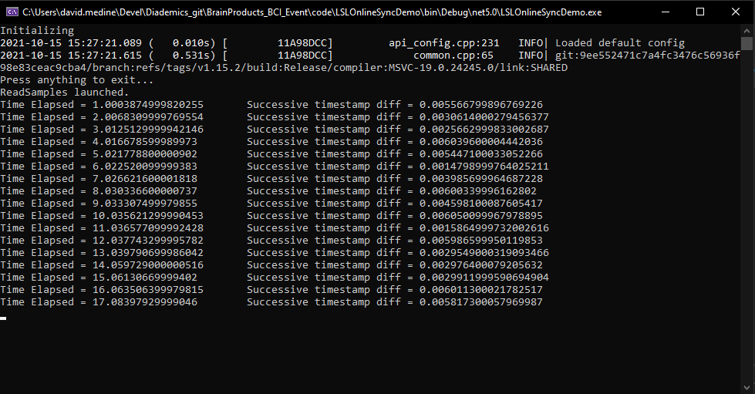
LSL Sync For Online
Results (if online demo doesn’t work due to network overload from GoToWebinar...)
Post-processing options off:

Slide 30
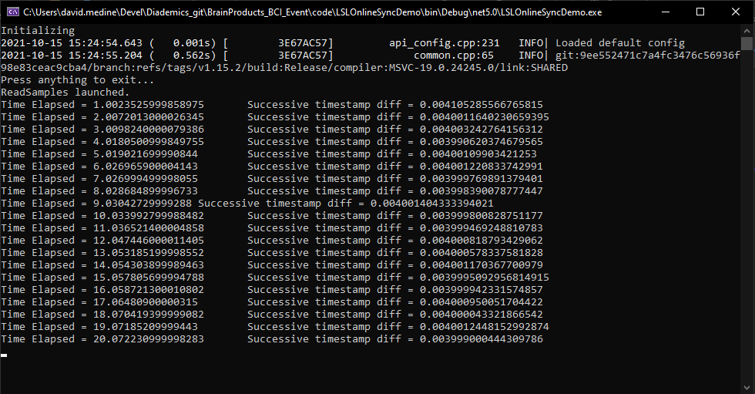
LSL Sync For Online
Results (if online demo doesn’t work due to network overload from GoToWebinar...)
Post-processing options on:

Slide 31
LSL Sync For Online
Some rules of thumb for using LSL sync in BCI applications:
Actually, ‘just in time’ sync approach is good enough in most RT situations, with a couple of caveats/exceptions:
When segmenting EEG data from markers originating from a different PC.
When exact timing between streams is an inherent goal: e.g. Suzanne Dikker’s Rhythms of Relating projects where hyperscanning EEG synchrony is in fact what is being computed.
It is often a good idea to set the post processing flag post_monotonize because it is possible that the order of incoming samples can be reversed: i.e. an earlier sample might be read after one that is in fact later in time.

