Slide 1

Troubleshooting LSL Problems
David Medine 15/06/2021
www.diademics.com

Slide 2

Troubleshooting Your Setup
For any questions (especially for beginners) regarding LSL, it is always good to consult the online documentation.
Check the connectivity section, especially regarding:
Firewalls
Network adapters
Security
LabRecorder and the Brain Vision LSL Viewer will tell you what streams are available on your network.
Join the Slack channel and ask the pros!

Slide 3
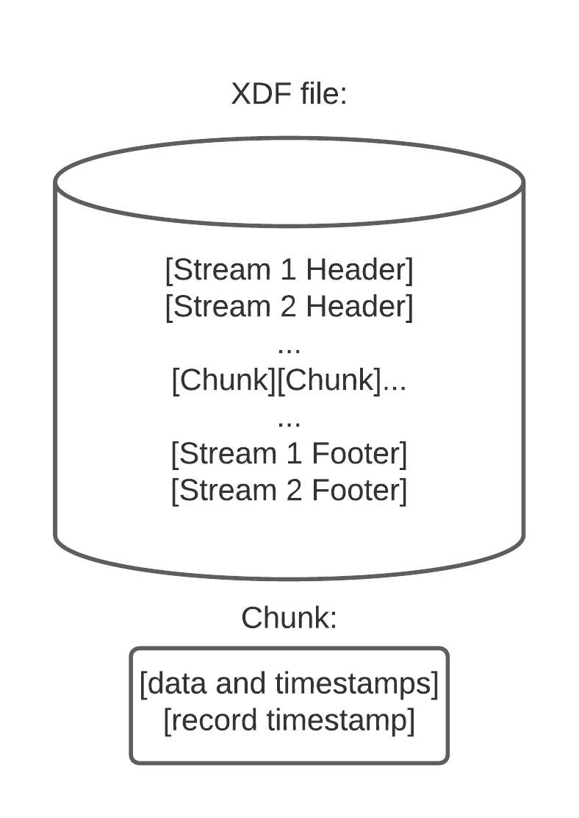
LSL Synchronization Overview
LabRecorder records not only data and their timestamps, it also measures and records clock offsets between CPUs and the local timestamps at record time
Using this information XDF loaders (load_xdf.m/pyxdf/XDF.jl) can correct for 2 things:
Clock offsets (slowly drifting differences between the CPU sending the data and the CPU recording the data)
Jitter (random noise added to the timestamps due to minutely varying processing times)

Slide 4
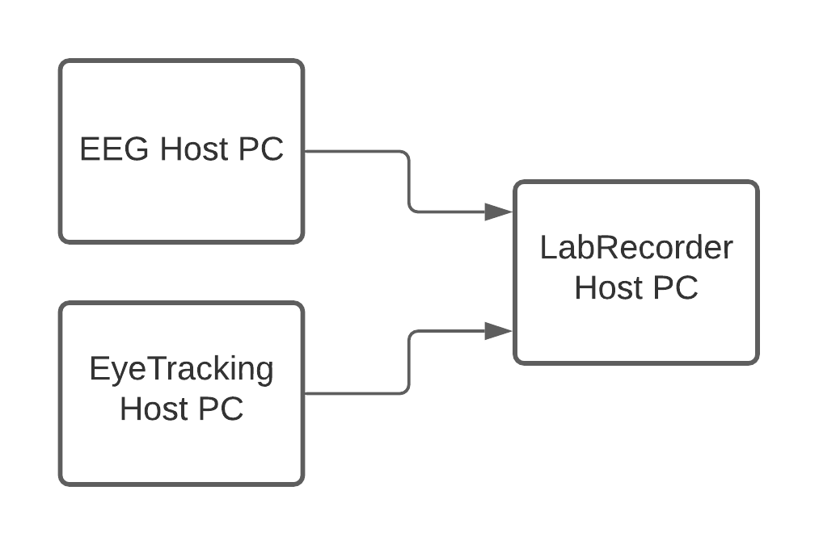
LSL Synchronization Overview
Correcting for clock offsets:
LabRecorder uses the LSL function time_correction() to measure clock differences between PCs
The default is to do this every 5s
time_correction() computes the clock offsets for each stream being recorded
This data is stored in the footer portion of an XDF file along with data write times
Using this data, the timestamps from each stream can be put on the same timebase as the recording PC

Slide 5
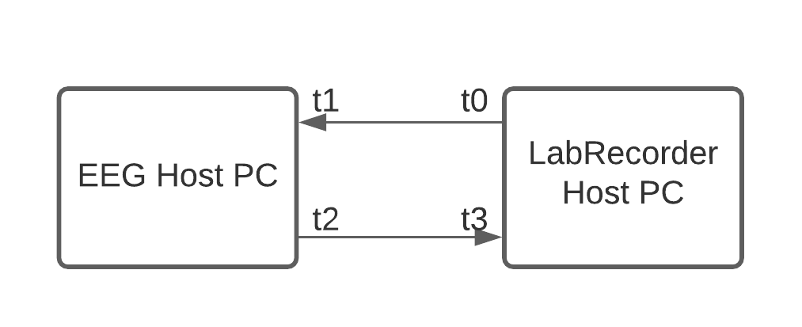
LSL Synchronization Overview
time_correction() uses the clock synchronization algorithm (part of the Network Time Protocol) to compute clock offsets:
t0 send time of packet from LabRecorder to stream host
t1 receive time of packet from LabRecorder host
t2 send time of packet from stream host to LabRecorder
t3 receive time of packet from stream host
RTT = (t3-t0) - (t2-t1)
OFS = ((t1-t0) + (t2-t3))/2 for lowest RTT

Slide 6
LSL Synchronization Overview
Using record times and clock offsets, XDF loaders have all the information they need to remap timestamps from device host PCs to a unified Recording PC timebase
load_xdf.m uses a robust fitting procedure, an ADMM (alternating direction method of multipliers) incorporating the Huber loss function (code/paper)
The result is a simple linear map (DC offset and slope) between the stream host timebase and the LabRecorder host timebase
This map is then applied to the timestamps from each stream to and thus synchronizes the data

Slide 7
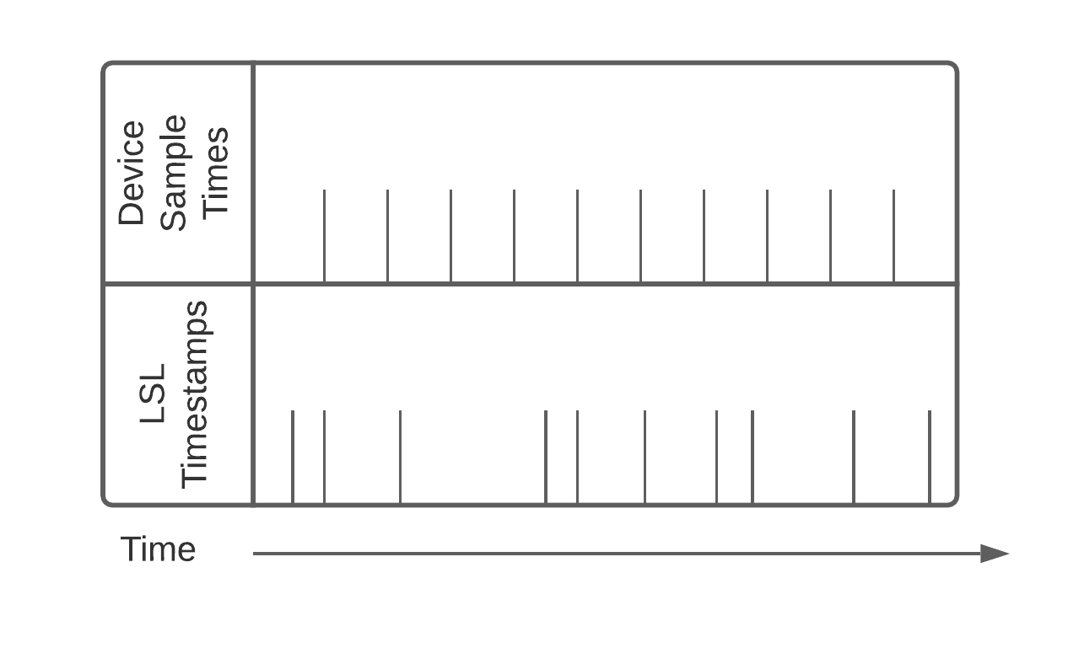
LSL Synchronization Overview
Jitter is also a problem:
Linear regression to a line will map the jittery timestamps to a nice grid, but it will never be exactly the same as the advertised device sampling rate.
This can lead to confusion:
nominal_srate vs effective_srate

Slide 8
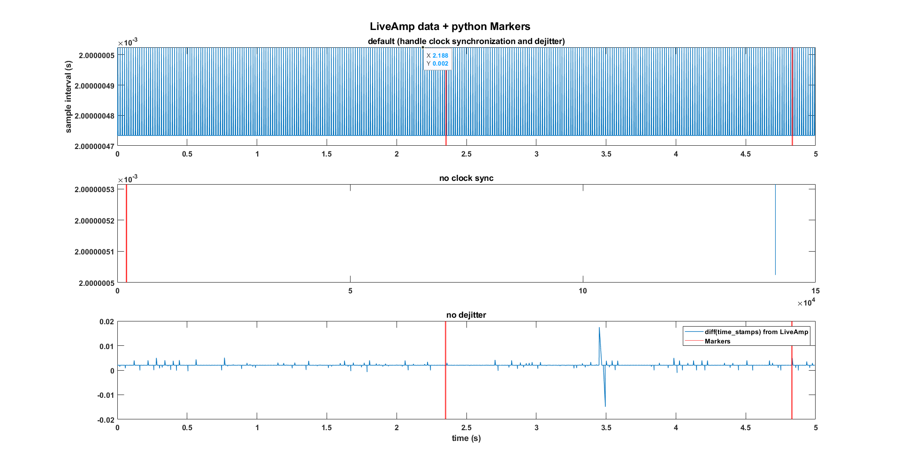
LSL Synchronization Overview

Slide 9
What Can Go Wrong
A changing sampling rate (or data that drops some, but not many samples) will cause the dejittering algorithm to produce terrible results.
If there is problems with calls to time_correction(), the algorithm that corrects clock offsets will produce terrible results.
If everything is working properly, your data will not have these problems. Always pilot before doing a study---hearts have been broken by these two issues.

Slide 10
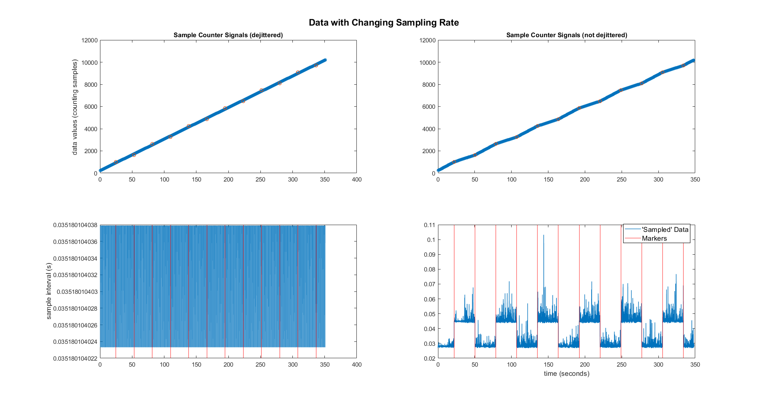

Slide 11
What Can Go Wrong
The clock offset problem can occur if either of the following is true:
The data is coming from a software that imposes its own timestamps.
Network insufficiency cause problems with calls to time_correction()---this can happen in faulty or low-bandwidth/highly taxed wireless networks.

Slide 12
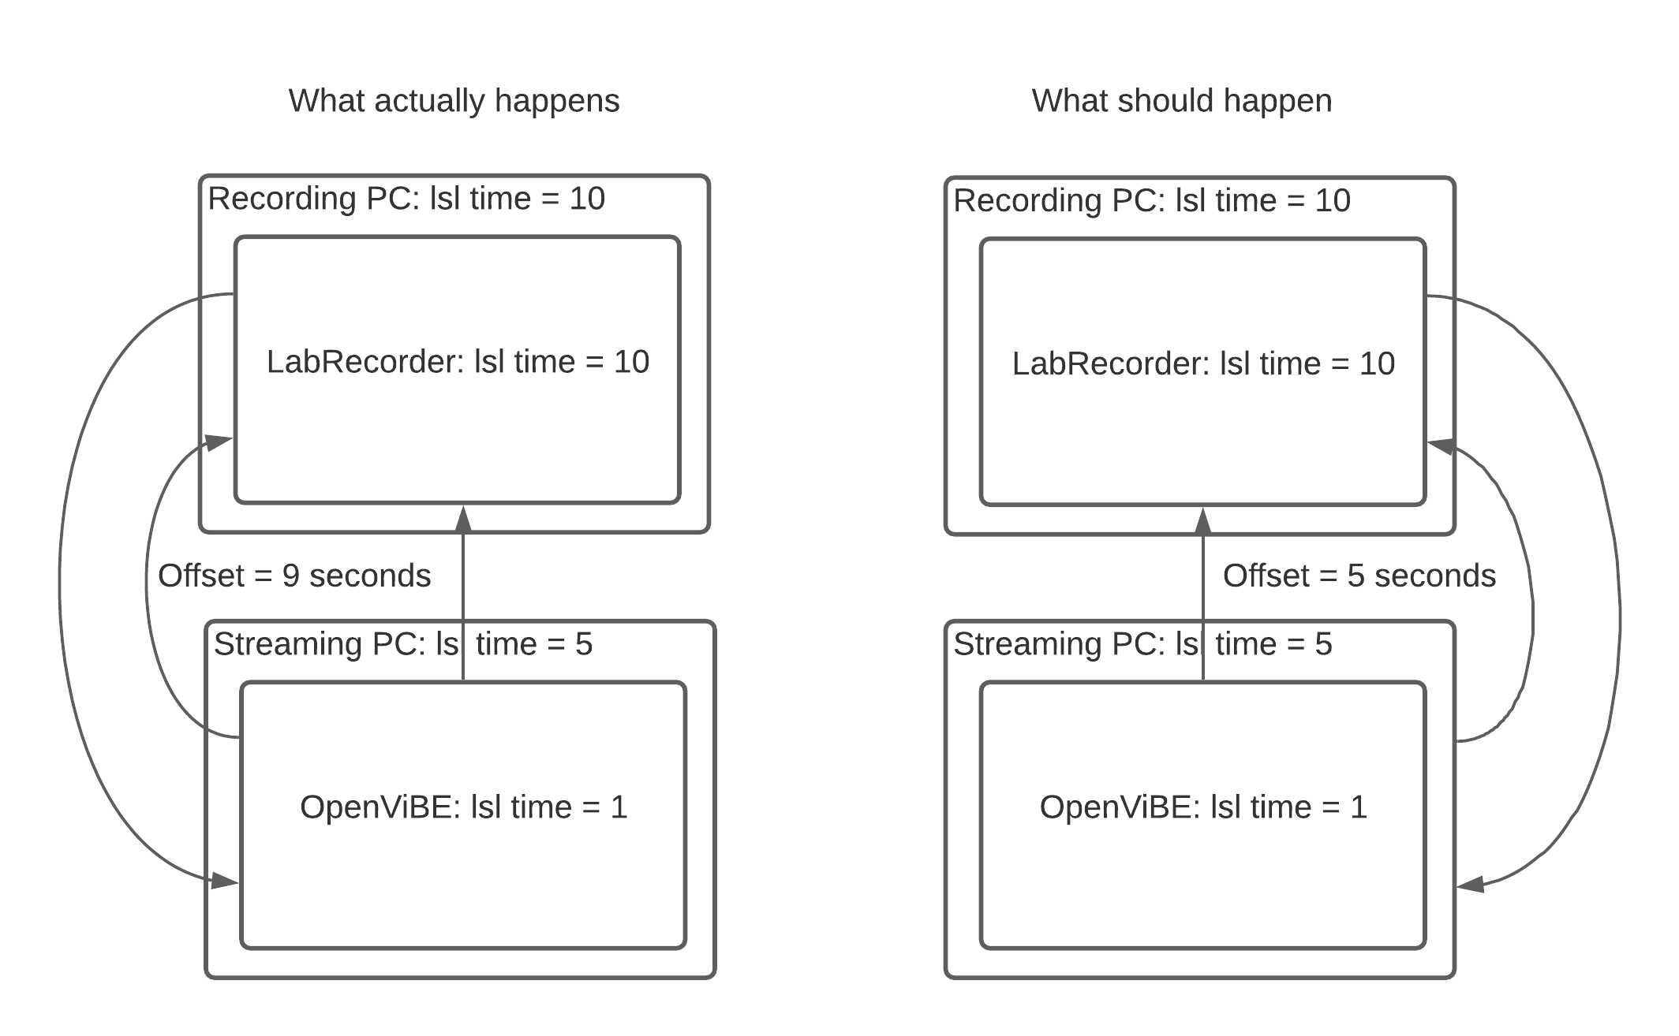
What Can Go Wrong
The ‘external timestamp’ problem can be fixed adding the following code to an LSL config file:
[tuning]
ForceDefaultTimestamps=1

Slide 13
What Can Go Wrong
LSL based experiments often require heavy network bandwidth, so it is best to transmit over a wired LAN.
But, if wireless is needed, the following tuning may help prevent data loss and time_correction() malfunction:
[tuning]
TimeProbeMaxRtt = 0.100
TimeProbeInterval = 0.010
TimeProbeCount = 10
TimeUpdateInterval = 0.25
MulticastMinRTT = .100
MulticastMaxRTT = 30
*Courtesy of Matthew Grivich

Slide 14
A Note on EEGLAB and XDF
EEGLAB does not ship with an XDF reader, but it is a downloadable extension (File->Manage EEGLAB extensions->Search for ‘xdfimport’)
XDFImport only loads EEG and Marker streams and will arbitrarily choose one EEG stream in the case of multiple EEG streams in one file.
XDFImport keeps the nominal sampling rate, but it uses the effective sampling rate to align Markers with EEG data.
File->History scripts is your friend! You can go in and tweak the loader if something is amiss.

Slide 15
Links
LSL on github: https://github.com/sccn/labstreaminglayer
XDF on github: https://github.com/sccn/xdf
All material from this presentation including code, data, and analysis scripts is available on github: https://github.com/Diademics-Pty-Ltd/EEGLABWorkshop2021
Clement is also uploading everyone’s slides---but I don’t know where?
My website: www.diademics.com

Slide 16
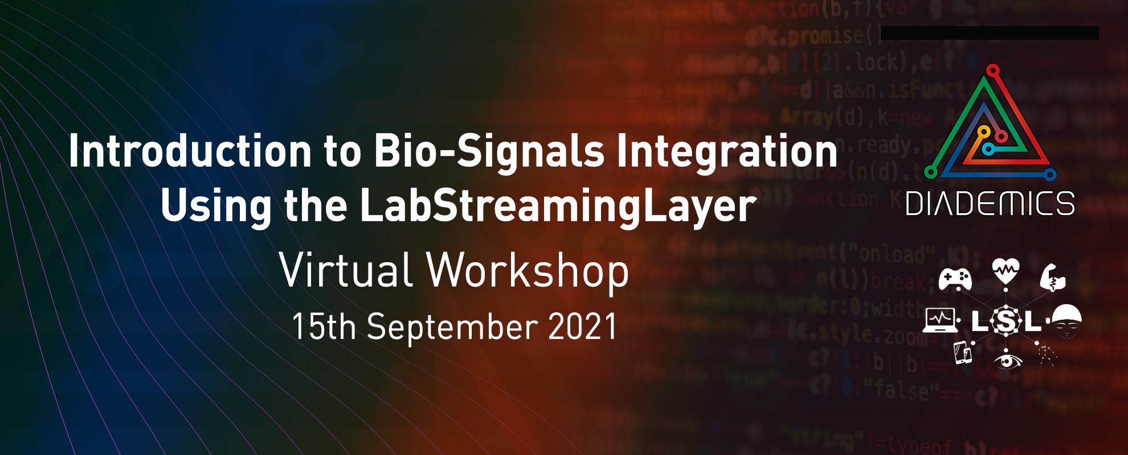
http://www.diademics.com/#events

Slide 17
The End
Thank you!
All material Copyright Diademics Pty Ltd, 2021

