Slide 1

Troubleshooting LSL Problems
David Medine 15/06/2021
www.diademics.com

Slide 2

Troubleshooting Your Setup
For any questions (especially for beginners) regarding LSL, it is always good to consult the online documentation.
Check the connectivity section, especially regarding:
Firewalls
Network adapters
Security
LabRecorder and the Brain Vision LSL Viewer will tell you what streams are available on your network.
Join the Slack channel and ask the pros!

Slide 3
Approaches to Digital Data Synchronization

Slide 4
Approaches to Digital Data Sync
Just in time/as fast as possible
as soon as new data is available, grab it and process it
synchronization tends to be hardware driven
Grid-like Sync
Exact synchronization
each digital sample from one stream is aligned with a digital sample from another
Commensurate data
each digital sample from one stream is aligned with an integer multiple digital sample from another stream with a higher sampling rate
‘Continuous time’ rebase sync
digital samples are not aligned, but their time stamps refer to non-aligned points on a single, continuous time-base

Slide 5
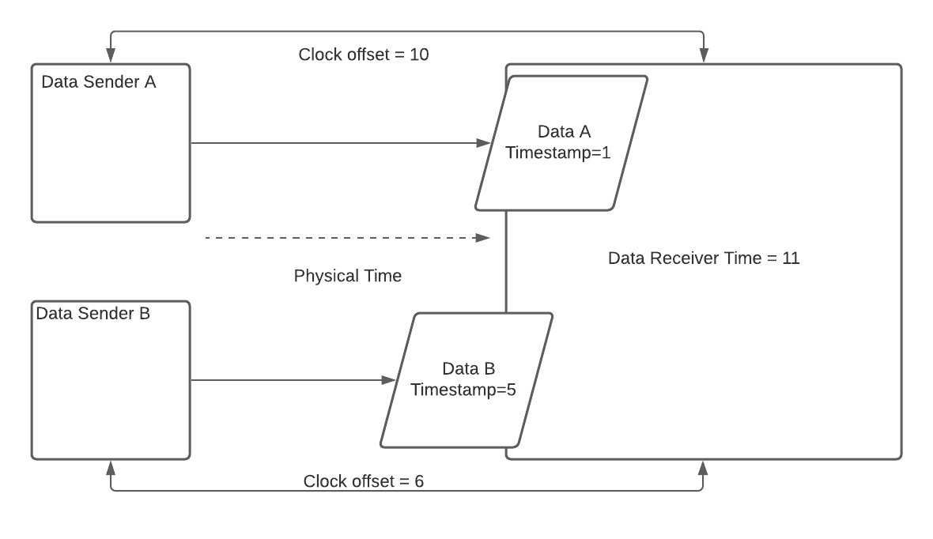
Approaches to Digital Data Sync
Just in time/as fast as possible
In this scenario, the Data Receiver simply processes first Data A, then Data B because that is the order the data are received. It throws away all a priori understanding of its time-base or the time-base of the Data Senders because all that matters is which Data is newest. Even though Data A and Data B should be exactly synchronous, Data B has a higher latency so the Data Receiver ‘believes’ it happened later in time.

Slide 6
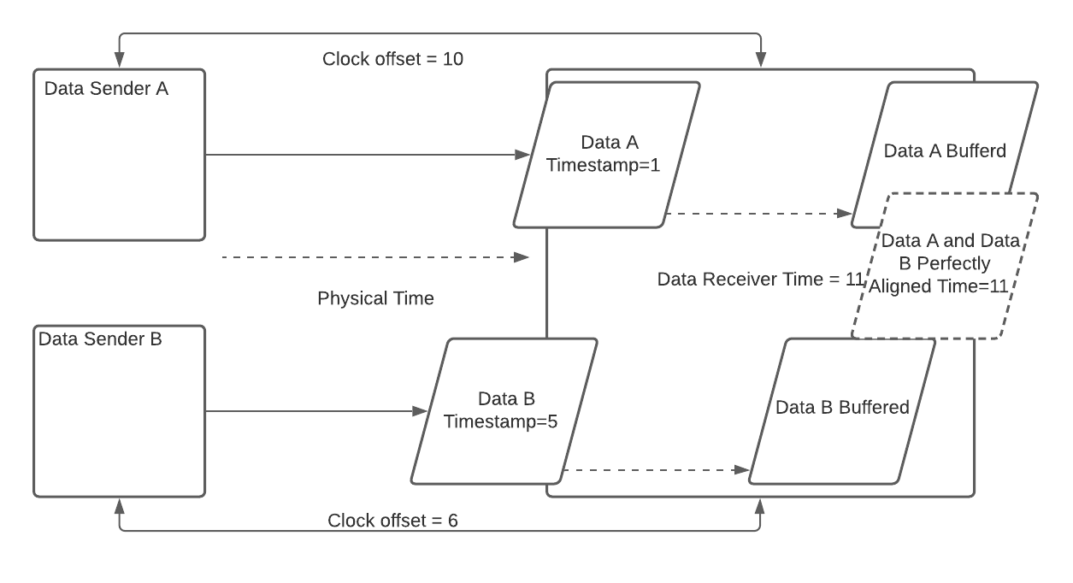
Approaches to Digital Data Sync
Exact Sync
In this scenario, the Data Receiver waits until Data B arrives with the same relative time as the earlier Data A. Then, because the Data Receiver knows the clock offset between itself and the two Data Senders, and because both Data Senders have the same sampling rate it can perfectly align the data from both Senders and assign their receive times to its own time-base.

Slide 7
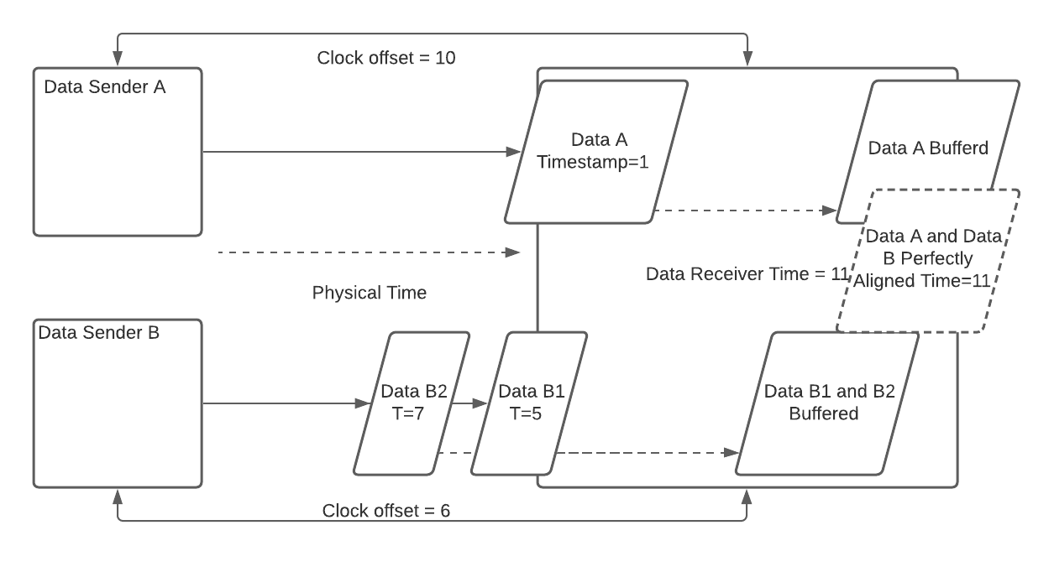
Approaches to Digital Data Sync
Commensurate Sync
In this scenario, the Data Receiver waits until Data B1 and B2 have arrived with the same relative time and sample count as the earlier Data A. Then, because the Data Receiver knows the clock offset between itself and the two Data Senders, and because both Data Senders have the integer multiple sampling rates it can perfectly align the data from both Senders and assign the receive time to its own time-base.

Slide 8
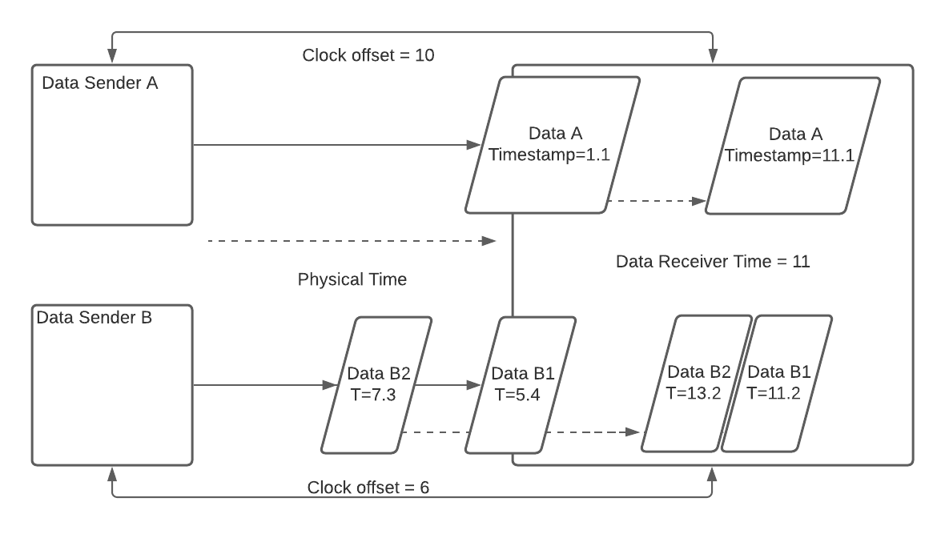
Approaches to Digital Data Sync
‘Continuous Time’ Rebase Sync
In this scenario, Data Sender A and Data Sender B can have any sampling rate. The Data Receiver cannot perfectly align the digital samples, but it can shift their timestamps so that any relative moment in time in one streams is the same moment in another stream. In this case, if we wish to know the value of Data A at timesamp 11.2 (relative to the first sample in Data B1) interpolation may be required. LSL uses this approach (but does not do any interpolation).

Slide 9
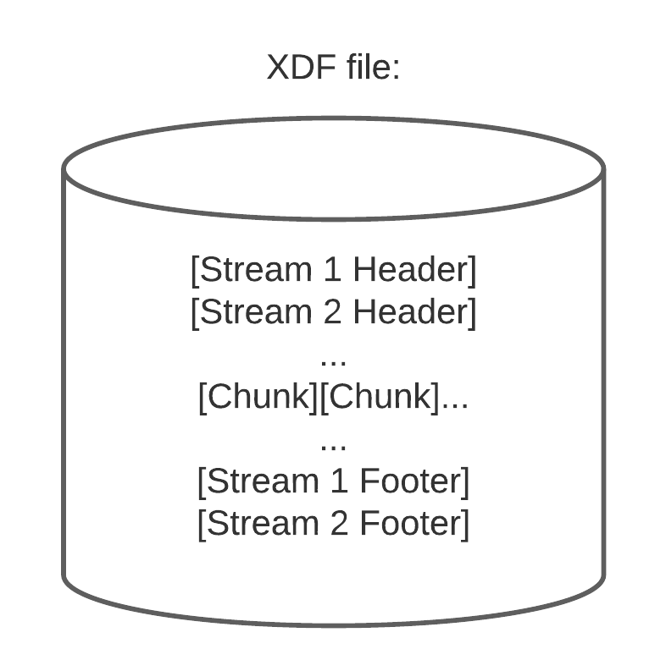
LSL Synchronization Overview
LabRecorder records not only data and their timestamps, it also measures and records clock offsets between CPUs and the local timestamps when those measurements are taken.
Using this information XDF loaders (load_xdf.m/pyxdf/XDF.jl) can correct for 2 things:
Clock offsets (slowly drifting differences between the CPU sending the data and the CPU recording the data)
Jitter (random noise added to the timestamps due to minutely varying processing times)

Slide 10
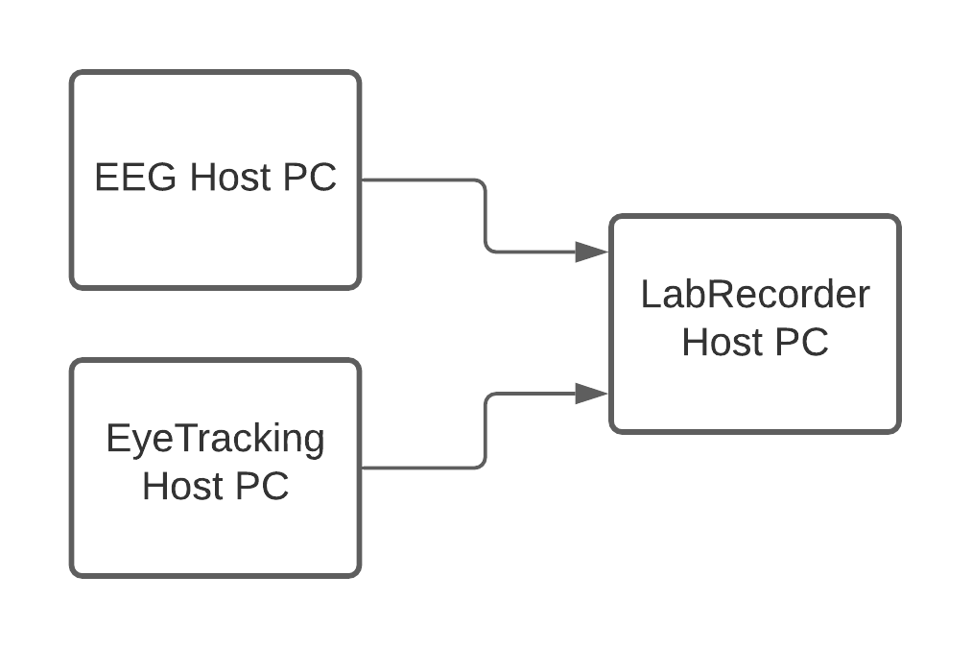
LSL Synchronization Overview
Correcting for clock offsets:
LabRecorder uses the LSL function time_correction() to measure clock differences between PCs for each stream
The default is to do this every 5s
This data is stored in the footer portion of an XDF file along with data write times
Using this data, the timestamps from each stream can be put on the same timebase as the recording PC

Slide 11
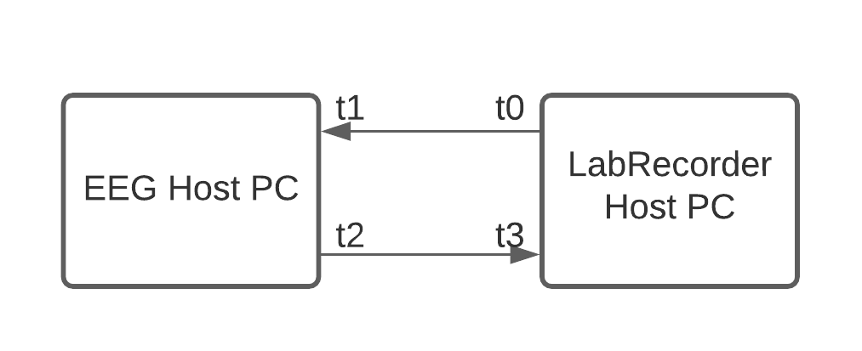
LSL Synchronization Overview
time_correction() uses the clock synchronization algorithm (part of the Network Time Protocol) to compute clock offsets:
t0 send time of packet from LabRecorder to stream host
t1 receive time of packet from LabRecorder host
t2 send time of packet from stream host to LabRecorder
t3 receive time of packet from stream host
RTT = (t3-t0) - (t2-t1)
OFS = ((t1-t0) + (t2-t3))/2 for lowest RTT

Slide 12
LSL Synchronization Overview
Using record times and clock offsets, XDF loaders have all the information they need to remap timestamps from device host PCs to a Recording PC’s timebase
load_xdf.m uses a robust fitting procedure, an ADMM (alternating direction method of multipliers) incorporating the Huber loss function (code/paper)
The result is a simple linear map (DC offset and slope) between the stream host timebase and the LabRecorder host timebase
This map is then applied to the timestamps from each stream to thus synchronizes the data

Slide 13
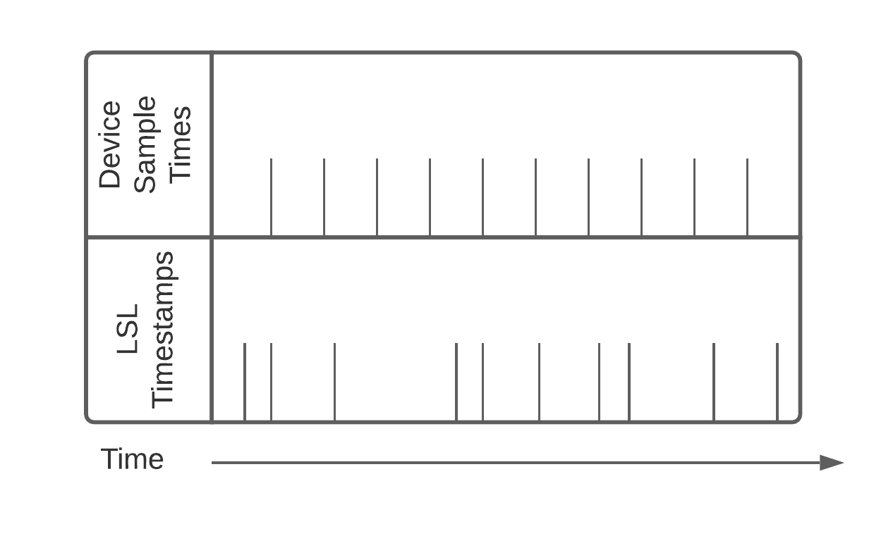
LSL Synchronization Overview
Jitter is also a problem:
Linear regression to a line will map the jittery timestamps to a nice grid, but it will never be exactly the same as the advertised device sampling rate.
This can lead to confusion:
nominal_srate vs effective_srate

Slide 14
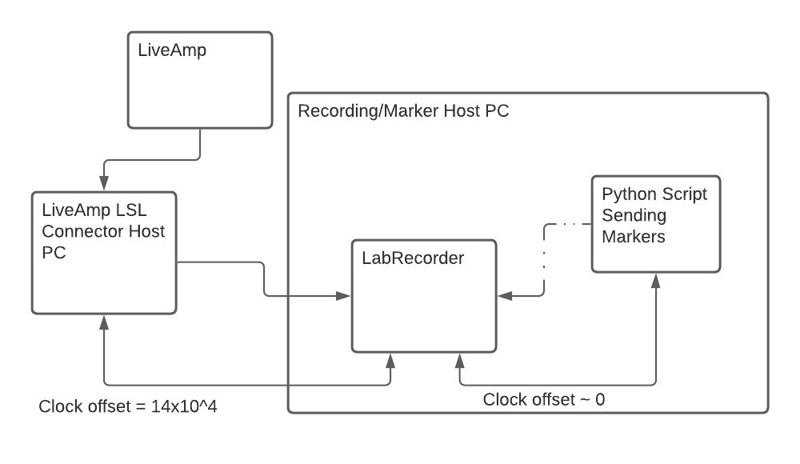
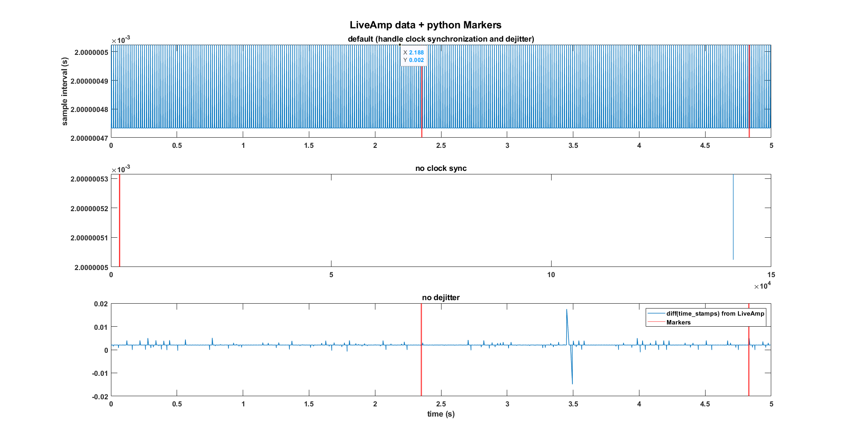
LSL Synchronization Overview

Slide 15
What Can Go Wrong
A changing sampling rate (or data that drops some, but not many samples) will cause the dejittering algorithm to produce terrible results.
If there is problems with calls to time_correction(), the algorithm that corrects clock offsets will produce terrible results.
If everything is working properly, your data will not have these problems. Always pilot before doing a study---hearts have been broken by these two issues.

Slide 16
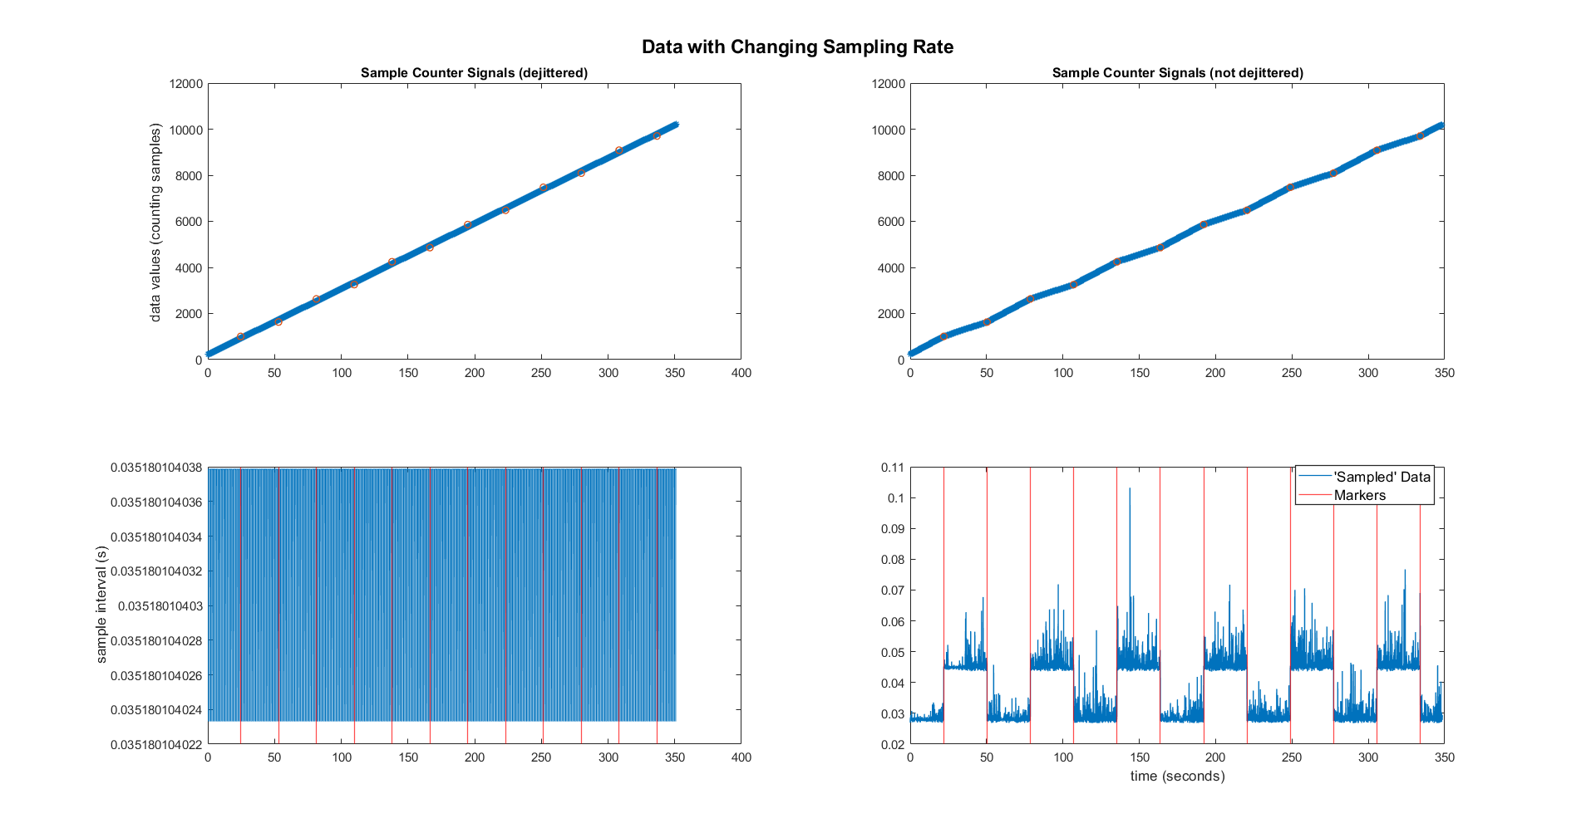

Slide 17
What Can Go Wrong
The clock offset problem can occur if either of the following is true:
The data is coming from a software that imposes its own timestamps.
Network insufficiency cause problems with calls to time_correction()---this can happen in faulty or low-bandwidth/highly taxed wireless networks.

Slide 18
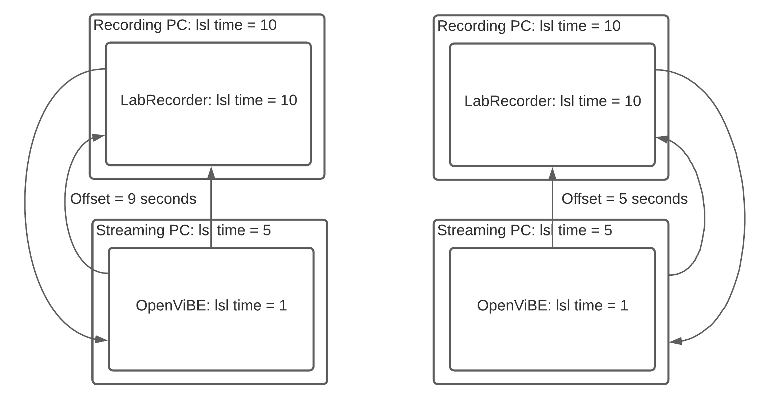
What Can Go Wrong
The ‘external timestamp’ problem can be fixed adding the following code to an LSL config file:
[tuning]
ForceDefaultTimestamps=1

Slide 19
What Can Go Wrong
LSL based experiments often require heavy network bandwidth, so it is best to transmit over a wired LAN.
But, if wireless is needed, the following tuning may help prevent data loss and time_correction() malfunction:
[tuning]
TimeProbeMaxRtt = 0.100
TimeProbeInterval = 0.010
TimeProbeCount = 10
TimeUpdateInterval = 0.25
MulticastMinRTT = .100
MulticastMaxRTT = 30
*Courtesy of Matthew Grivich

Slide 20
A Note on EEGLAB and XDF
EEGLAB does not ship with an XDF reader, but it is a downloadable extension (File->Manage EEGLAB extensions->Search for ‘xdfimport’)
XDFImport keeps the nominal sampling rate, but it uses the effective sampling rate to align Markers with EEG data.
File->History scripts is your friend! You can go in and tweak the loader if something is amiss.

Slide 21
Links
LSL on github: https://github.com/sccn/labstreaminglayer
XDF on github: https://github.com/sccn/xdf
All material from this presentation including code, data, and analysis scripts is available on github: https://github.com/Diademics-Pty-Ltd/EEGLABWorkshop2021
Clement is also uploading everyone’s slides---but I don’t know where?
My website: www.diademics.com

Slide 22
The End
Thank you!
All material Copyright Diademics Pty Ltd, 2021

