Slide 1

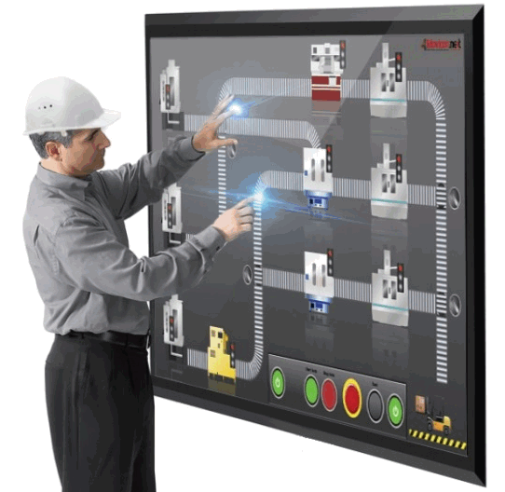

DIAGRAMICS
IoT Data Visualization
VISUAL AUTOMATION
near real time live data visualization
animated dashboards
monitor and analyze your IoT & business data
integrated with Azure IoT Suite & IoT Central
Interactive Visualization for Process Digital Twins
InfoCard ™
Intel Compute Card
Windows 10 IoT Core
Microsoft Azure
Ingram Micro
+
Diagramics Visual Automation
REAL TIME
REMOTE MONITORING
in a card
interactive diagrams
animated graphics
3D models
GPU signal processing
AUTOMATION ON EDGE
INTERACTIVE ANIMATED DIGITAL TWINS
ON ANY SCREEN
out-of-the box integrations:
Azure Connected Factory
Azure Remote Monitoring
Diagramics Software Corporation
Vancouver, BC, Canada
Alexander Abalakov
alexander@diagramics.com
778-829-8573
www.diagramics.com

Slide 2
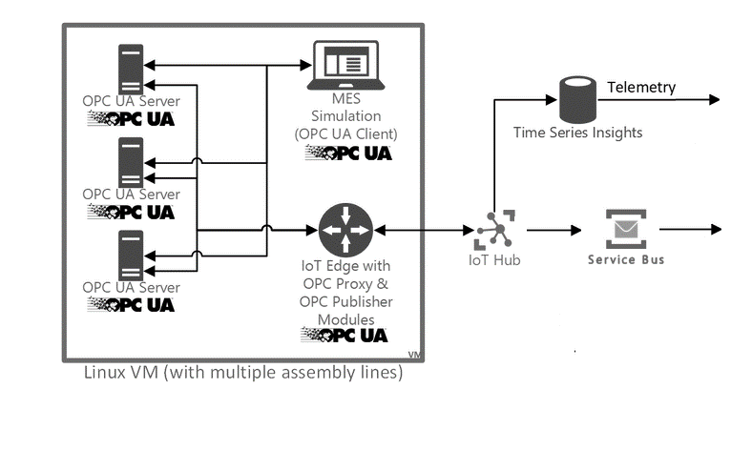
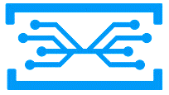
DIAGRAMICS
IoT Data Visualization
VISUAL AUTOMATION
near real time live data visualization
animated dashboards
monitor and analyze your IoT & business data
integrated with Azure IoT Suite & IoT Central
DIAGRAMICS
INFO-CHANNELS
InfoCard ™
Intel Compute Card
Windows 10 IoT Core
Microsoft Azure
Process Digital Twin
Diagramics Visual Automation
out-of-the box integrations:
Azure Connected Factory
Azure Remote Monitoring
Digital Twins
Interactive Visualization - "Interactive visualization technology enables the exploration of data via the manipulation of chart images, with the color, brightness, size, shape and motion of visual objects, that go beyond those of pie, bar and line charts.” [Gartner]
Digital Twins - "Digital twins drive the business impact
of the Internet of Things (IoT) by offering a powerful way
to monitor and control assets and processes. [Gartner]
REAL-TIME
INTERACTIVE
ANIMATED
DASHBOARDS
Diagramics Software Corporation
Vancouver, BC, Canada
Alexander Abalakov
alexander@diagramics.com
778-829-8573
www.diagramics.com

