Slide 1


DIAL D4D Data Security & Governance – Malawi Use Case

Slide 2
Overview
This document covers end to end data pipeline security and data governance specific to DIAL MALAWI Use case.
Huge volume of data from different sources are considered for analytics.
Few of them contains Personally Identifiable Information(PII) , which are very sensitive and handling those data in huge volume will be a challenge.
Identified data sources for this use case
CDR data from Airtel Malawi
Health and Population Data from Ministry of Health , Malawi.
Other reference data from Facebook, World pop etc.

Slide 3
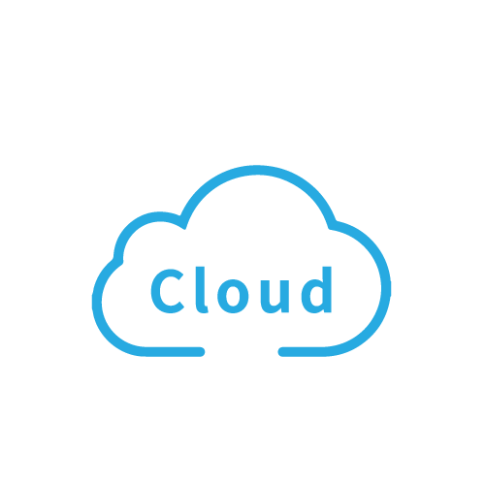





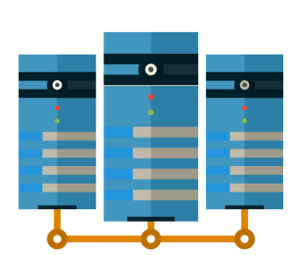







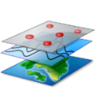
End to End Data Pipeline
Data from various sources will be transferred to a central repository in Malawi.
From the central repository data will be then copied to identified Cloud services like Azure , AWS, etc.,
Data processing and analytics will be performed on Cloud
Only the results will be published to the outside world.
High data security will be implemented across the data pipe line to ensure the data safety in rest and transit.
Health & Govt data
Data from Ministry of Health in Flat files
MNO data
Data from Operators
Anonymization
Anonymized Flat file data
Geospatial reference data
Geospatial Co-ordinate data in Flat file

Slide 4
DATA SOURCES

Slide 5




Understanding the Data Sources
CDR data from Airtel Malawi
Around 26 months of Call Detail Records will be used in this use case.
The data contains PIIs like Telephone number , Tower Location etc.
Health Data from Ministry of Health, Malawi
Disease burden across various part of the country
Health facilities information
Facebook & Worldpop.org
Open source data contains information around population density

Slide 6

Handling the PII data
The CDR data from Airtel contains , Call Originating Number , Call Terminating Number and Tower ID across each events.
The telephone numbers fall under PII category.
Before transferring the data into DIAL premise , the data has to be masked / anonymized at the source itself.
Airtel Premise
Data Transfer out from Airtel network
Anonymization
Raw Data
Anonymized Data

Slide 7
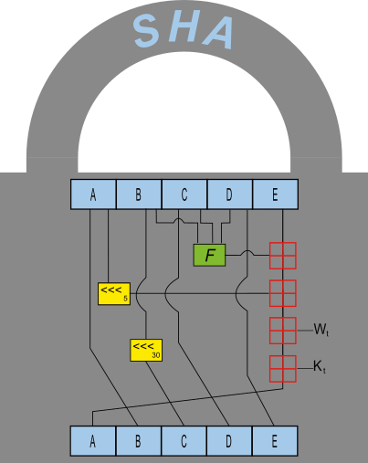
Handling the PII data – Data Anonymization
The telephone numbers should be masked / anonymized within in Airtel’s network.
Anonymization should follow highly secured algorithms - SHA256 is recommended.
Why SHA256 ?
A key aspect of cryptographic hash functions is their collision resistance (nobody should be able to find two different input values that result in the same hash output).
SHA 256 is a cryptographic hash function designed by the United States National Security Agency(NSA) .
Successor to SHA-1 and is one of the strongest hash functions available
This algorithm generates an almost-unique, fixed size 256-bit (32-byte) hash.
Hash is a one way function – it cannot be decrypted back. This makes it suitable for password validation, challenge hash authentication, anti-tamper, digital signatures.
High Collision Resistance.

Slide 8
Data in Transit

Slide 9


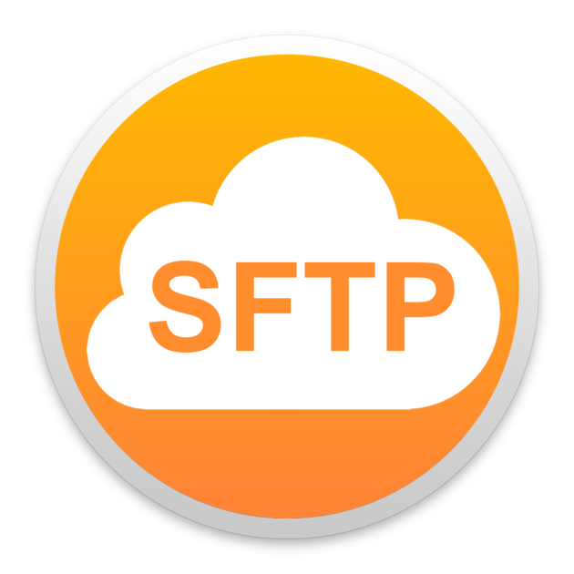
Data Transfer to Malawi Central Repository
Data from various sources will be transferred to a central repository in Malawi.
Below are the options to transfer the data to the central repo.
Transferring via a Portable storage device
Transferring over Secured FTP
Transferring via a Portable storage device:
Easiest way but has its own limitations.
Additional digital copy will be residing in the device.
Additional scanning at source and destination is required, if any one fails , there will be a rework.
Additional overhead in maintaining multiple Portable Storage devices.
After the data transfer proper disposal / shredding of device may required.
Portable Device

Slide 10






Data Transfer to Malawi Central Repository – Portable Storage Device
The portable device should be scanned before loading the data from Airtel Premise.
The device should be password protected.
Only the Anonymized data should be loaded in the device.
Data should be loaded by Airtel and Password should be set by Airtel.
With supervision of Airtel , Storage device with data should be transported to Malawi server location by DIAL stakeholders.
Airtel should unlock the device and DIAL should copy the data under supervision of Airtel stakeholders.
After data copy Airtel should format and take the device.
The entire process should be documented and duly signed between Airtel and DIAL.
DIAL Provides storage device to Airtel.
Portable Device
Airtel should load the data.
Airtel should enable password protection
Airtel should format and take the device
Data Transfer to DIAL server Under supervision of Airtel

Slide 11
Data Transfer to Malawi Central Repository - SFTP
SFTP transfers files with the Secure Shell (SSH) connection – SFTP is an encrypted network protocol that can enable a remote login to operate over a network that lacks security.
SFTP offers encryption of commands and data. It also prevents passwords and sensitive information from open transmission over the network.
Best practices :
256-bit AES encryption for data-at-rest :
The Advanced Encryption Standard is a symmetric block cipher chosen by the U.S. government to protect classified information and is implemented in software and hardware throughout the world to encrypt sensitive data.
SSL encryption for data-in-motion and file upload/download :
Secure Sockets Layer is the standard security technology for establishing encrypted private and integral link between web server and browser.
Integration with AV, DLP & SIEM :
Data loss prevention (DLP) is a strategy for making sure that end users do not send sensitive or critical information outside the corporate network. DLP infrastructure detects when sensitive content is added and lets you restrict access and sharing based on the results of the DLP scan.
Security information and event management (SIEM) software gives enterprise security professionals both insight into and a track record of the activities within their IT environment.

Slide 12
Data in Rest

Slide 13

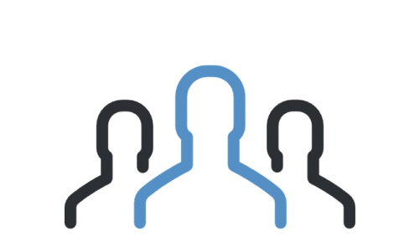
Data Security – Malawi Central Repository
All the source data will be co-located in the central repository in Malawi.
Though the CDR data i.e. all PII data / fields are anonymized , we need to ensure 100 % data security at rest.
Below are few best practices at server side:
Authentication
Implement strong password policies , which demands strong passwords and regular change of passwords.
It's recommended to use public key authentication to replace the password authentication mechanism if possible
Implement two-factor authentication when possible
Users & groups
Delete users and groups that are no longer in use
Enforce role separation: If your server and IT infrastructure are managed by a group of people, role separation will help restrict the amount of power held by a member of the team

Slide 14



Data Security – Malawi Central Repository
File system, Files and directories
Set the right permissions: The right permissions have to be set for all folders, files and partitions on your file system.
It is better to use 'sudo' when unprivileged users need access to an administrative function.
Assign the right ownership: Identify and assign the right ownership to the users and groups allowed to read, modify or even execute commands and scripts.
Monitor your file system's integrity : For the protection of critical systems, monitoring file integrity is important
Scan your server for viruses, rootkits, backdoors and local exploits

Slide 15

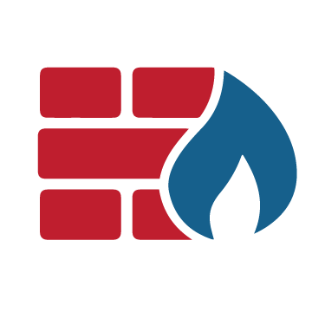
Data Security – Malawi Central Repository
Operating System and Software
Remove services and software packages that are not required for your server
Keep your software and operating system up-to-date:
Apply vendor’s Security Patches as soon as they are available.
Install software from trusted sources and providers.
Firewall, IDS and IPS
Secure your infrastructure using a firewall: You can choose between software or hardware firewalls to protect your servers.
To keep the servers and the infrastructure secure, the firewall has to be up and running at all times.
Use an Intrusion Detection System (IDS) when needed

Slide 16

Data Security – Malawi Central Repository
Regular Audits & Vulnerability scans
Audit your servers and check the logs regularly: Auditing your server regularly is an important component of your IT infrastructure Management Lifecycle.
This will help you to ensure that the minimum security requirements are always met and your users and administrator are compliant with your security policies.
It will also enable you to identify any security issues that have to be fixed.
Scan your server for vulnerabilities: To identify vulnerabilities in your software and packages installed on your server(s), regular vulnerability scans are important. Hackers are always scanning the internet to discover vulnerable servers and websites.

Slide 17
Data Security - Cloud

Slide 18
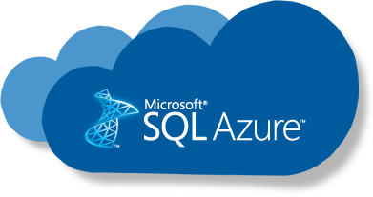
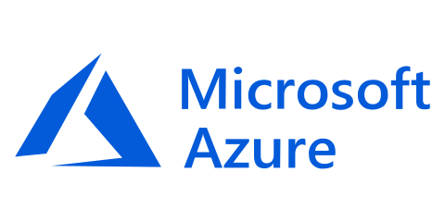
Data Security – Azure - Database security best practices
Enable database authentication
It allows SQL Azure to support environments with mixed operating systems, where all users are not authenticated by a Windows domain.
Allows SQL Azure to support older applications and applications provided by third parties that require SQL Server Authentication.
Allows users to connect from unknown or untrusted domains. For instance, an application where established customers connect with assigned SQL Server logins to receive the status of their orders.
Allows SQL Azure to support Web-based applications where users create their own identities.
Allows software developers to distribute their applications by using a complex permission hierarchy based on known, preset SQL Server logins.
Use firewall rules to restrict database access
Microsoft Azure SQL Database provides a relational database service for Azure and other Internet-based applications.
To provide access security, SQL Database controls access with firewall rules limiting connectivity by IP address, authentication mechanisms requiring users to prove their identity, and authorization mechanisms limiting users to specific actions and data. Firewalls prevent all access to your database server until you specify which computers have permission.
The firewall grants access to databases based on the originating IP address of each request.

Slide 19
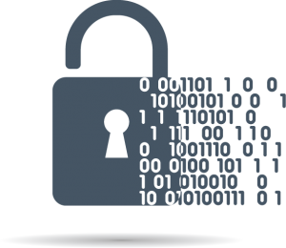
Data Security – Azure - Database security best practices
Protect your data using encryption
Azure SQL Database transparent data encryption (TDE) helps protect against the threat of malicious activity by performing real-time encryption and decryption of the database, associated backups, and transaction log files at rest without requiring changes to the application.
TDE encrypts the storage of an entire database by using a symmetric key called the database encryption key.
Since an authorized user such as a security administrator or a database administrator can access the data even if the database is encrypted with TDE, you should also follow the recommendations below:
Enable SQL authentication at the database level.
Use Azure AD authentication using RBAC roles.
Users and applications should use separate accounts to authenticate. This way you can limit the permissions granted to users and applications and reduce the risks of malicious activity.
Implement database-level security by using fixed database roles (such as db_datareader or db_datawriter), or you can create custom roles for your application to grant explicit permissions to selected database objects.

Slide 20
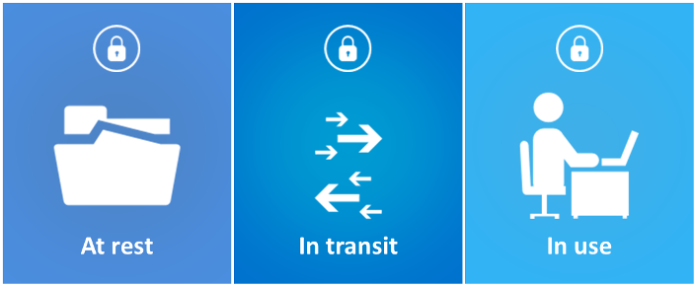
Data Security – Azure - Database security best practices
For data moving between your on-premises infrastructure and Azure, you should consider appropriate safeguards such as HTTPS or VPN.
For organizations that need to secure access from multiple workstations located on-premises to Azure, use Azure site-to-site VPN.
For organizations that need to secure access from individual workstations located on-premises or off-premises to Azure, consider using Point-to-Site VPN.
Protect data in transit
Since data will be moving back and forth from many locations, the general recommendation is that you always use SSL/TLS protocols to exchange data across different locations. In some circumstances, you may want to isolate the entire communication channel between your on-premises and cloud infrastructure by using a virtual private network (VPN).

Slide 21
Data Security – Azure - Data Security and Encryption Best Practices
Enforce multi-factor authentication
The first step in data access and control in Microsoft Azure is to authenticate the user. Azure Multi-Factor Authentication (MFA) is a method of verifying user’s identity by using another method than just a username and password.
This authentication method helps safeguard access to data and applications while meeting user demand for a simple sign-in process.
Encrypt Azure virtual machines
Use role based access control (RBAC)
Restrict access based on the need to know and least privilege security principles.
Azure Role-Based Access Control (RBAC) can be used to assign permissions to users, groups, and applications at a certain scope.
Azure Disk Encryption enables IT administrators to encrypt Windows and Linux IaaS Virtual Machine (VM) disks.
Azure Disk Encryption leverages the industry standard BitLocker feature of Windows and the DM-Crypt feature of Linux to provide volume encryption for the OS and the data disks.
Use hardware security models
Azure disk encryption uses Azure Key Vault to help you control and manage disk encryption keys and secrets in your key vault subscription, while ensuring that all data in the virtual machine disks are encrypted at rest in your Azure storage.
You should use Azure Key Vault to audit keys and policy usage.

Slide 22



Data Security – Cloud (AWS)
Data Upload from Malawi Data center to AWS, can be done by creating a VPC
What is VPC?
Amazon Virtual Private Cloud (Amazon VPC) lets you provision a logically isolated section of the AWS Cloud where AWS resources in a virtual network can be launched in any defined network.
Complete control over the virtual networking environment, including selection of IP address range, creation of subnets, and configuration of route tables and network gateways.
Can use both IPv4 and IPv6 in your VPC for secure and easy access to resources and applications.

Slide 23
Data Security – Cloud (AWS)
Access:
AWS provides an advanced set of access, encryption, and logging features to do this effectively (such as AWS CloudTrail). AWS do not access or use the content for any purpose without consent.
Storage:
Ability to choose the AWS Region(s) in which the content is stored. AWS do not move or replicate your content outside of the chosen AWS Region(s) without consent.
Security:
AWS offers strong encryption for the content in transit and at rest, and provides the option to manage our own encryption keys.
Security Assurance:
AWS developed a security assurance program that uses best practices for global privacy and data protection which helps to operate securely within AWS, and to make the best use of AWS security control environment. These security protections and control processes are independently validated by multiple third-party independent assessments.
Shared Responsibility Environment:
AWS is responsible for securing the underlying infrastructure that supports the cloud and the services provided; while customers and APN partners, acting either as data controllers or data processors, are responsible for any personal data they put in the cloud.

Slide 24
Data Security – Cloud
Below are the additional key policies , (independent of any cloud service provider) ,that can be leveraged in the solution , on need basis.
Classification-based Policy
A data asset such as a table or column can be marked with the metadata tag related to compliance or business taxonomy (such as "PCI"). This tag is then used to assign permission to a user group.
Location-based Policy
Administrators can customize entitlements based on geography. A user trying to access the same data from different locations would be subject to unique geographical context thereby triggering access based on different set of privacy rules.
Data Expiry-based Policy
Apache Atlas can assign expiration dates to a data tag. Apache Ranger would inherit the expiration date and automatically deny users access to the tagged data after the expiration date. This policy is relevant for business use cases where data can become toxic after an expiry date.
Prohibition-based Policy
Administrators can now apply a metadata tag to both data sets to prevent them from being combined, helping avoid privacy violations.

Slide 25
Data Security – Presentation Layer – Power BI

Slide 26
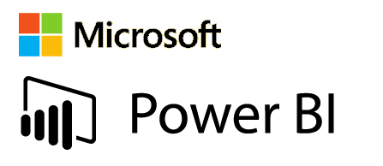
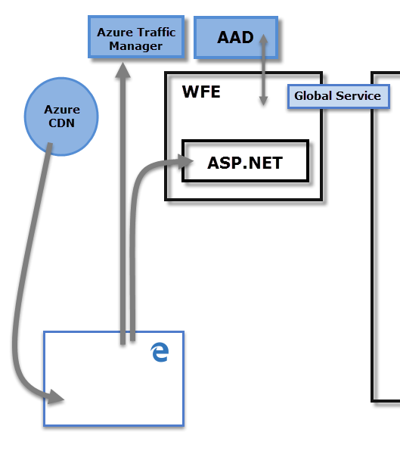
Data Security – Azure – Power BI
Each Power BI deployment consists of two clusters – a Web Front End (WFE) cluster, and a Back End cluster.
The WFE cluster manages the initial connection and authentication process for Power BI, using AAD to authenticate clients and provide tokens for subsequent client connections to the Power BI service.
Power BI also uses the Azure Traffic Manager (ATM) to direct user traffic to the nearest datacenter, determined by the DNS record of the client attempting to connect, for the authentication process and to download static content and files.
Power BI uses the Azure Content Delivery Network (CDN) to efficiently distribute the necessary static content and files to users based on geographical locale.

Slide 27
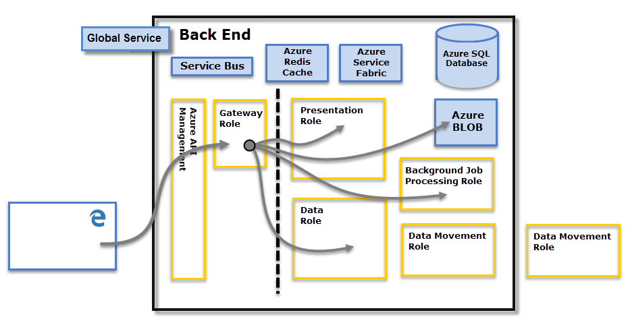
Data Security – Azure – Power BI
The Back End cluster is how authenticated clients interact with the Power BI service.
The Back End cluster manages visualizations, user dashboards, datasets, reports, data storage, data connections, data refresh, and other aspects of interacting with the Power BI service.
The Gateway Role acts as a gateway between user requests and the Power BI service.
Users do not interact directly with any roles other than the Gateway Role. Azure API Management will eventually handle the Gateway Role.

Slide 28
Data Security – Azure – Power BI
Data Storage Security
Power BI uses two primary repositories for storing and managing data:
Azure BLOB for data storage,
Azure SQL Database for Metadata.
When an authenticated user connects to the Power BI Service, the connection and any request by the client is accepted and managed by the Gateway Role
For example, when a client attempts to view a dashboard, the Gateway Role accepts that request then separately sends a request to the Presentation Role to retrieve the data needed by the browser to render the dashboard.
User Authentication
Power BI uses Azure Active Directory to authenticate users who login to the Power BI service, and in turn, uses the Power BI login credentials whenever a user attempt to resources that require authentication.
For organizations that used work emails for Power BI login (such as david@contoso.com), the effective username to UPN mapping is straightforward. For organizations that did not use work emails for Power BI login (such as xyz@abc.com), mapping between AAD and on-premises credentials will require directory synchronization to work properly.

Slide 29
THANK YOU

