Slide 1


DIAL D4D High Level Data Architecture – Malawi Use Case
Author : Infosys
Version : 1.0
Date 15 -09 -2018

Slide 2
Overview
This document covers end to end data pipeline and its Data Architecture specific to DIAL MALAWI Use case.
Azure Data lake has been considered as data platform.
This document will cover
Data Sources
High Level Data Flow
High Level Data Architecture
Data processing within the cloud
Key solution considerations

Slide 3
DATA SOURCES

Slide 4




Data Sources
CDR data from Airtel Malawi
Around 26 months of Call Detail Records will be used in this use case.
The data contains PIIs like Telephone number , Tower Location etc.
Health Data from Ministry of Health, Malawi
Disease burden across various part of the country
Health facilities information
Facebook & Worldpop.org
Open source data contains information around population density

Slide 5






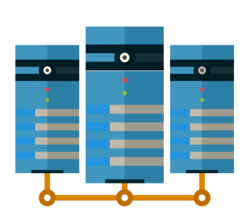







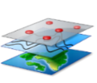
High Level Data Flow
Data from various sources will be transferred to a central repository in Malawi.
From the central repository data will be then copied to identified Cloud services Azure.
Data processing and analytics will be performed on Azure Cloud
Only the results will be published to the outside world.
Health & Govt data
In Scope
Data from Ministry of Health in Flat files
MNO data
Data from Operators
Anonymization
Anonymized Flat file data
Geospatial reference data
Geospatial Co-ordinate data in Flat file

Slide 6
High Level Data Architecture

Slide 7
To – Be Platform
Reporting
Recording what has happened
Data sources
{
MNO
Business Data Warehouse
Geospatial Data
Insight
Explaining why something happened
Health Data
Foresight
Ingest
Transform
Understanding the what & why before it happens
Analyze
Anonymized data sources are getting ingested in to Data Lake
Data Processing and Data Analytics on Azure Cloud
Data Processing within Data Lake
Data Analytics on Data Lake
Data Security | Data Governance | Metadata Management | Alert Mechanisms

Slide 8










High Level Data Architecture
Sources
Ingestion
Processing / Storage
Consumption
Presentation
HD Insight
Spark SQL / Hive QL
HD Insight
HIVE
Azure Data Factory
Spark SQL
Malawi Windows Server
Server Contains flat file sources
All the source data are anonymized
26 Months MNO CDR data
Health Data
FB, World pop Reference Data
Raw Zone
Processed zone
Aggregations/
Reporting
Govt , NGO Economic Users
Azure Blob
Azure Data lake
SQL Data Warehouse
Storage Area
Monitoring & Alerts (Azure OMS ) | Security(Azure AD, Transparent data Encryption, MD5)|Configuration Management

Slide 9
Data Processing within Data Lake
The Anonymized Source data from Malawi Server will be securely transferred to Azure Blob storage by creating an VNET & Azure Data Factory.
Azure Blob Storage will have Secured Storage encryption at rest and SSL/TLS based security in Transit.
Data will be moved to Azure data lake where the data processing will happen.
Hive tables will be created and the raw data cleansing ,filtering the valid records, Partitioning the data etc will happen in this layer.
Based on the aggregation rules , the data will be aggregated using Spark / Scala and the aggregated data will be moved to SQL Data warehouse.
Data can be accessed from Data Lake and SQL DW for Analytics and reporting.
HDInsight
Hive
Spark SQL
MNO Data
Azure Blob
Raw Data
Processed Data
Aggregation/ Reporting
Azure Data Lake
SQL Data Warehouse
Health Data
Azure Data Factory
Azure Data Factory
Reference data
Data at Rest - Secure Storage Encryption
Data at Rest - Role Based Security
Data at Rest - Transparent Data Encryption
In Transit - SSL/TLS;
IP White List
In Transit - Client-Side Encryption, Https
In Transit - SSL/TLS;
IP White List

Slide 10
Data Processing within Data Lake
Raw Data feeds
CDR data
Administrative shapefiles (TA and GVHs)
Facebook High Resolution Settlement Layer
Population projection [2008-2030]
CH District data summary [2017]
Catchment population
Malawi Burden of Disease Data
Geography_Master
Airtel MW_Database
District / Site Lookup Files (covers Tower locations (e.g. LAT/LONG, district, regions, etc.))
In Blob Storage
Administrative shapefiles (TA and GVHs)
Facebook High Resolution Settlement Layer
Processed Data in Data Lake
CDR data
Population projection [2008-2030]
CH District data summary [2017]
Catchment population
Malawi Burden of Disease Data
Geography_Master
Airtel MW_Database
Processed Data in SQL Data Warehouse
Aggregated CDR data on Month level & Day Level

Slide 11
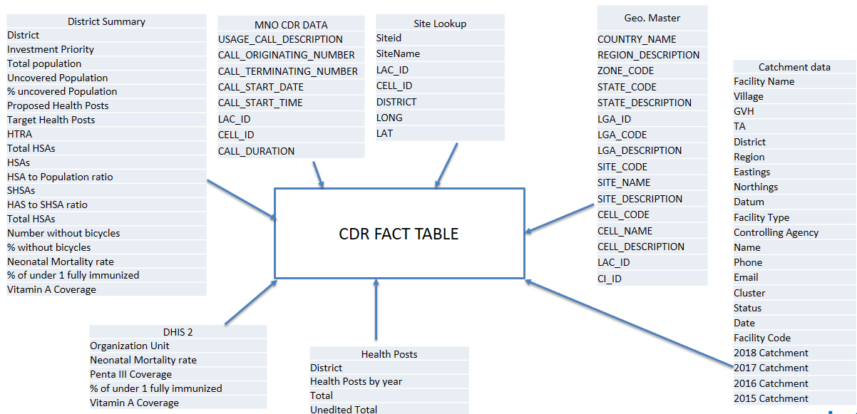
Data Processing within Data Lake
Processed Data in Data Lake
CDR data
The data will be cleansed and the unwanted records like A2P numbers will be identified and filtered in this process.
Spark / Scala will be used
The Processed Data will be loaded in Hive Tables
The reference table along with CDR will create a master Fact table which will be used for Aggregation
De-Normalized data in Hive Table

Slide 12

Key solution consideration
Cloud Challenges | Factored ? | Solution
Scalability |  | The solution is scalable across Storage, Compute and solution stack Storage components are Azure Blob, Azure Data Lake and Azure SQL DB , Azure SQL DW – All these can be configured either static or elastic storage and they are highly scalable as needed. Compute resources are HDInsight Spark Cluster with Spark Engine – Compute power can be increased by adding nodes to the cluster on demand Solution stack is aligned with Azure PaaS native and Azure PaaS Roadmap
Data Management and Movement |  | Azure native components and Informatica BDE/BDM is used for data movement and data management capabilities Azure PaaS Components such as Data Factory (Batch) is used for data ingestion to cloud. Initial bulk load during Data Migration is done using Express Route and we can also explore the other option such as using Export/Import services ( MSFT provides facilities to ship the HDDs to the data centre with appropriate security processes)
Security and Compliance |  | The following solution components are included to protect data in motion, data at rest, user access and PII For data in motion, Azure Data Migration Gateway which will be installed on premises will be used to encrypt data For data at rest, the access level security is set up at storage component level – for example access level restrictions at a entity/attribute level will be set up in Azure SQL DB User Authentication and Authorization is done using Azure Active Directory (AD) For PII data, the critical fields will be anonymized at source level
Support and Operation |  | Azure Altering and Azure OMS (Operations Management Suite) will be used to monitor, alert and analyze the availability and performance of different resources including physical and virtual machines
Resilience |  | Resilience is measured by the availability of the application to conduct BAU (Business As Usual) at any time and at any circumstances Resilience in connectivity is achieved through Express Route / VPN to connect Azure Data Centre from on premise Data Centre. Azure offers 99.5% availability because Express Route connections uses parallel peer to peer connections and don’t go over public internet. Azure Data Lake, Blob and Azure SQL DB and Azure comes with inbuilt backup feature that are configurable at component level

Slide 13
THANK YOU

