Slide 1


DIAL Data Storage Options Malawi use case
June 2018

Slide 2
Synopsis
Envisioning the To- Be Platform
Data Sources and Pre-Processing
Data Storage & Processing Options
Option 1 -Hadoop On Premise Solution
Data Architecture
Overview
Governance
Option 2 -Hadoop On Cloud Solution
Data Architecture
Overview
Governance

Slide 3
Envisioning the To – Be Platform
{
MNO
Reporting
Recording what has happened
Health Data
Business Data Warehouse
1
Geospatial Data
Insight
Explaining why something happened
IoT
Foresight
Understanding the what & why before it happens
Population Data from Social media
Ingest
Transform
Analyze
Ad-hoc data
1
Data sources Identified so far

Slide 4
Data Sources
Data Sources and Pre-Processing
Anonymization
Data Transfer
For the current use case below are the identified data sources.
MNO data:
From Airtel Malawi
SMS & Voice CDR
Health data:
From Ministry of Health, Malawi.
Disease burden
Mortality rate
Population growth rate
Other reference Data:
Facebook Population density Data.
The pre-requisite is to load the MNO data in the database only after anonymization and the algorithm / script should be executed at source level i.e., at MNO premise.
Anonymization Strategy:
We are use SHA256 algorithm for anonymization
SHA 256 is a cryptographic hash function designed by the United States National Security Agency(NSA)
Hash is a one way function – it cannot be decrypted back.
A python Script with SHA256 algorithm will anonymize the data as per the ask of data providers.
Currently Infosys has established secured file transfer protocol InfyDrive , which will allow the MNO data providers to transfer the data to Infosys network.
The data will be Stored intermediately in Local secured network.
Similar MoH data will be stored intermediately in DIAL Drop box

Slide 5
Data Storage & Processing Options
To perform Data Analytics , the data storage & processing mechanism plays crucial role.
For storage and processing ,below Key points are the major driving factors in aligning the technology stack for this solution.
Open Source technologies.
Easy Access of data.
Scalable solution.
Robust and Secured Architecture.
Cost optimal
Below options are captured:
Option 1: Hadoop On Premise Solution
Option 2: Hadoop On Cloud Solution

Slide 6
Option 1
Hadoop On Premise Solution

Slide 7



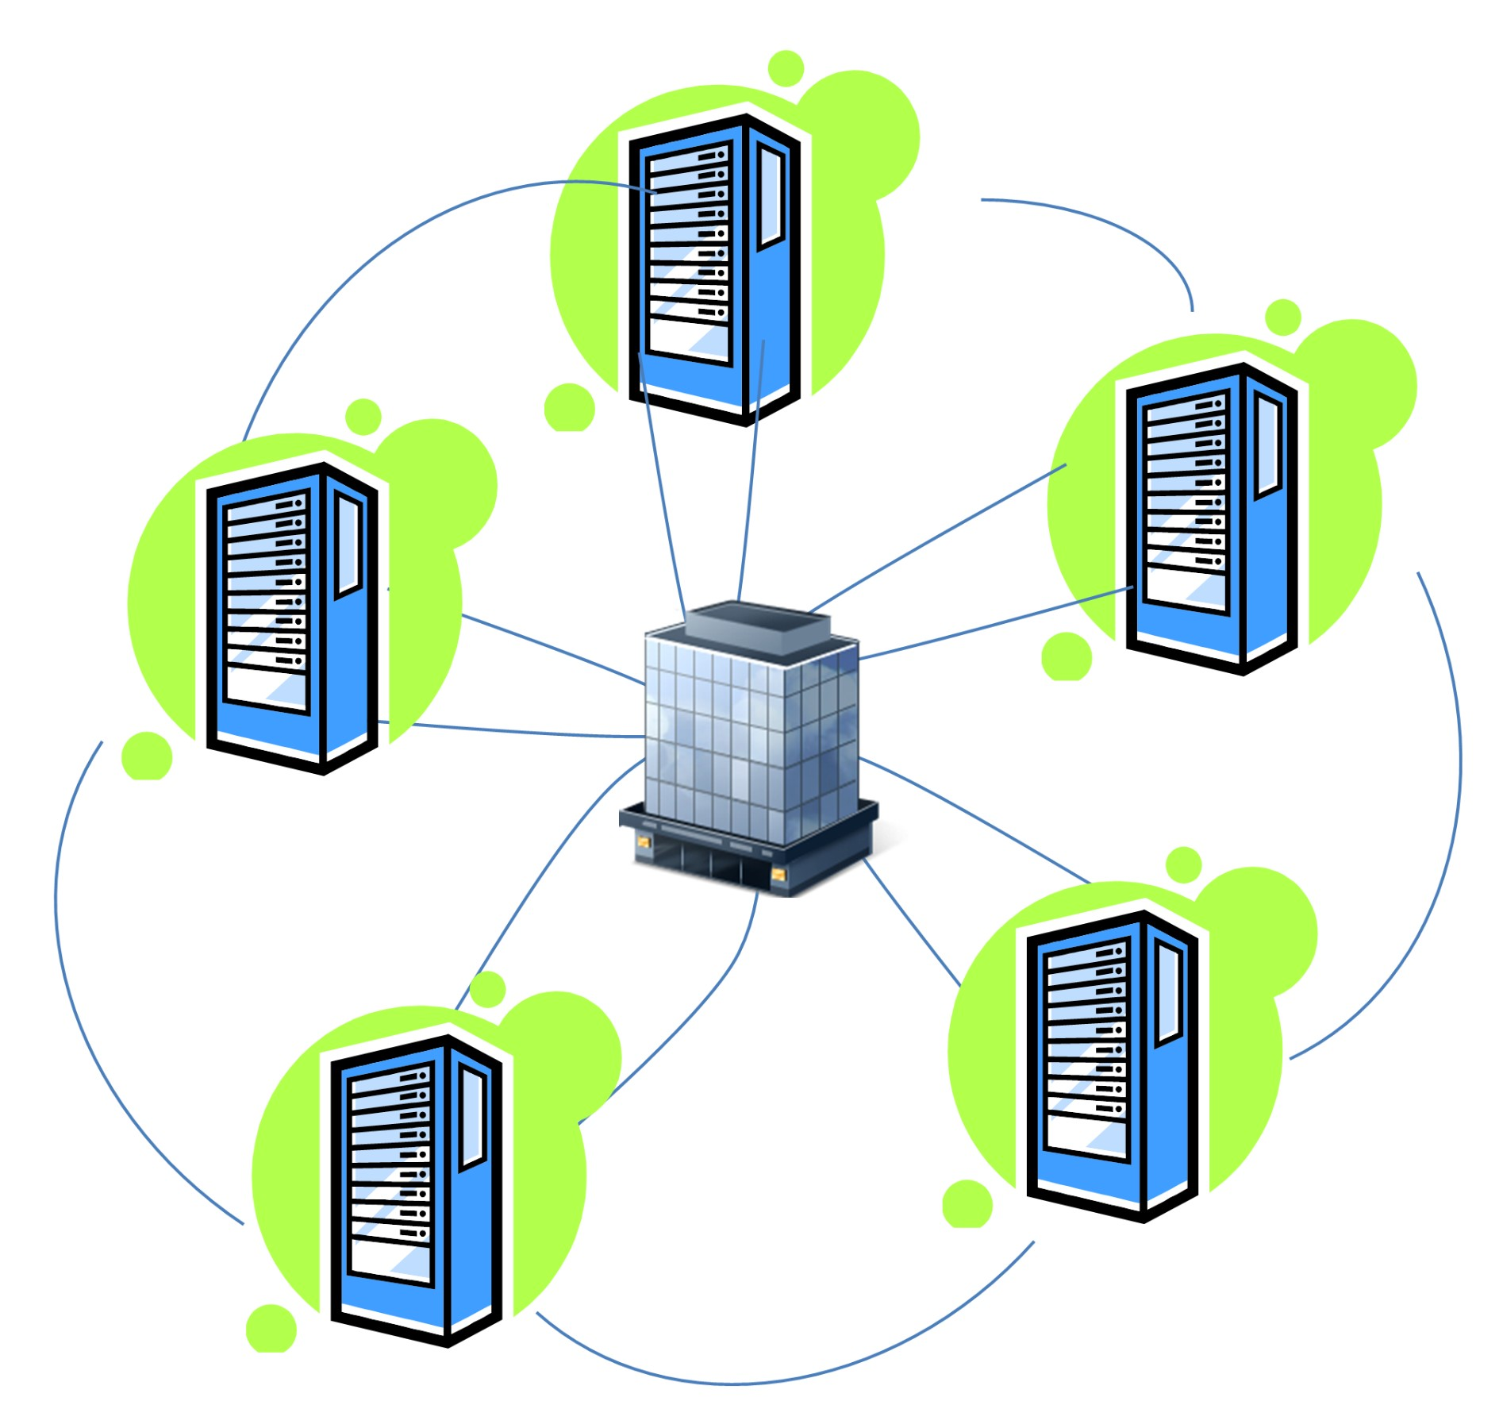









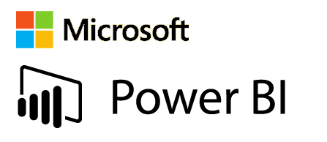



Hadoop On Premise Solution
MNO data processing
Data Storage , Processing & Analytics within Malawi
Data center
On Premise Big Data platform
Analytics Platform
Anonymization
Data from Operators
Anonymized Flat file data
MoH data
Secured File Transfer
Data Analytics using
R / Python
Data from Ministry of Health in Flat files
Aggregation
Data Presentation
View Results
Geospatial reference data
Data Ingestion
Transformation
Geospatial Co-ordinate data in Flat file

Slide 8
Hadoop On Premise Solution
Data providers will have control over the access and security.
Data storage & Processing will happen within country.
Only the analytical results will be published.
Watch outs:
Co-location of MNO data , Geo spatial along with Health data.
Green field implementation of Big data platform in Malawi may consume time.
On going sever maintenance and support operations in Malawi will be required.
Future data addition may demand lot of Impact assessment and Admin expertise.

Slide 9
Hadoop On Premise Solution - Data Governance
Below are the key policies that can be leveraged in the solution , on need basis.
Classification-based Policy
A data asset such as a table or column can be marked with the metadata tag related to compliance or business taxonomy (such as "PCI"). This tag is then used to assign permission to a user group.
Location-based Policy
Administrators can customize entitlements based on geography. A user trying to access the same data from different locations would be subject to unique geographical context thereby triggering access based on different set of privacy rules.
Data Expiry-based Policy
Apache Atlas can assign expiration dates to a data tag. Apache Ranger would inherit the expiration date and automatically deny users access to the tagged data after the expiration date. This policy is relevant for business use cases where data can become toxic after an expiry date.
Prohibition-based Policy
Administrators can now apply a metadata tag to both data sets to prevent them from being combined, helping avoid privacy violations.

Slide 10
Hadoop On Premise Solution - Infrastructure Recommendations
Key Assumptions on Data Size and Growth:
Size of Source Data - 2.5 TB
No Growth expected
Average no of applications per day- 15 to 25
Average no of concurrent applications per day 10 to 15
There will be 3 master nodes. 1 each will run dedicated HDFS and YARN master nodes (Name node and Resource manager). The 3rd master node will co-locate both Name node and Resource Manager instances
With a RF of 3, each slave node will host around 7 TB of data. If the storage requirement grows, more slave nodes can be added dynamically.
Infra recommendation
 | Master Nodes (3 Nos) | Slave Nodes (3 Nos)
CPU | 24 Cores (With hyperthreading) | 24 Cores (With hyperthreading)
RAM | 64 GB | 128 GB
Disk | 500 GB | 5 X 2 TB Hard Disks in JBOD

Slide 11
Option 2
Hadoop On Cloud Solution (AWS)

Slide 12









Hadoop On Cloud Solution - AWS
MNO data processing
Data Storage , Processing & Analytics on Cloud
Anonymization
EMR Hadoop Clusters
Data from Operators
Anonymized Flat file data
Data Visualization
MoH data
Secured File Transfer
Data from Ministry of Health in Flat files
View Results
AWS S3 Buckets
Geospatial reference data
Secured Data Transfer Via Virtual Private cloud
AWS - EC2
Amazon - Redshift
Geospatial Co-ordinate data in Flat file
Data Storage
Data Processing
Data Analytics

Slide 13
Hadoop On Cloud Solution - Overview
The MNO data will be anonymized and kept as flat files.
Geospatial reference data will also formatted and stored in a flat file.
The various data from MoH will be merged as a flat file
The data from the centralized location will be moved to AWS via Virtual Private Cloud.(VPC)
The Raw data will be stored in s3 Buckets.
EMR Clusters will access s3 buckets and creates Hive Tables for the data in S3 Buckets.
EC2 will run the scripts for the identified business rules on EMR and processed data from EMR will be pushed to s3 buckets.
Redshift will access the processed / aggregated data from s3 buckets and will create data warehouse.
The aggregated data from Redshift will be accessed by the analytical tools like QuickSight within the cloud.
The results will be published for Govt / NGO Economic Users

Slide 14
Option 3
Data Copy on Premise and Data processing On Cloud Solution (AWS)

Slide 15
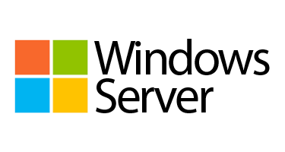






On Premise + On Cloud Solution - AWS
Health & Govt data
Data Processing & Analytics on Cloud
Secured Data storage in Malawi
Data Visualization
EMR Hadoop Clusters
Data from Ministry of Health in Flat files
MNO data processing
Data from Operators
Anonymization
Anonymized Flat file data
Govt , NGO Economic Users can view the results
Geospatial reference data
AWS S3 Buckets
AWS - EC2
Secured Data Transfer Via Virtual Private cloud
Amazon - Redshift
Geospatial Co-ordinate data in Flat file
Data Storage
Data Processing
Data Analytics

Slide 16
On Premise + On Cloud Solution - AWS
This option is very similar to Option 2 ( On cloud processing & analytics).
The key difference is, in this approach , a copy of the data will remain within the country.
The below source data will be moved securely to a centralized data center within Malawi.
MNO data
Health data from MoH
Geospatial reference data from UNESCO, Facebook
From the centralized location , using secured VPC , applying necessary authentication process, the data will be copied to AWS S3 buckets.
EMR Clusters will access s3 buckets and creates Hive Tables for the data in S3 Buckets.
EC2 will run the scripts for the identified business rules on EMR and processed data from EMR will be pushed to s3 buckets.
Redshift will access the processed / aggregated data from s3 buckets and will create data warehouse.
The aggregated data from Redshift will be accessed by the analytical tools like QuickSight within the cloud.
The results will be published for Govt / NGO Economic Users

Slide 17
Hadoop On Cloud Solution - Governance
Access:
AWS provides an advanced set of access, encryption, and logging features to do this effectively (such as AWS CloudTrail). AWS do not access or use the content for any purpose without consent.
Storage:
Ability to choose the AWS Region(s) in which the content is stored. AWS do not move or replicate your content outside of the chosen AWS Region(s) without consent.
Security:
AWS offers strong encryption for the content in transit and at rest, and provides the option to manage our own encryption keys.
Security Assurance:
AWS developed a security assurance program that uses best practices for global privacy and data protection which helps to operate securely within AWS, and to make the best use of AWS security control environment. These security protections and control processes are independently validated by multiple third-party independent assessments.
Shared Responsibility Environment:
AWS is responsible for securing the underlying infrastructure that supports the cloud and the services provided; while customers and APN partners, acting either as data controllers or data processors, are responsible for any personal data they put in the cloud.

Slide 18
On Premise vs Cloud
 | On-Premise | Cloud
Capital expenditure (CAPEX costs) | The larger the enterprise, the greater the CAPEX costs. High installation costs because hardware needs to be installed. | Low CAPEX costs. No hardware costs. Low installation costs because little/no hardware needs installing. Total cost of ownership savings are low when compared to On-premise
Data Security | Flexibility to add more security. Updating / upgrading the security features' may consume time and additional effort. | Cloud security at *AWS is the highest priority. Customers pay only for the services they use, meaning that you can have the security you need, but without the upfront expenses, and at a lower cost than in an on-premises environment.
Infrastructure set up and admin skills | Required for infra set up and maintenance. | Not required , vendor takes the complete responsibility
Licensing | Licensing is more granular and complex. | Providers typically charge a per-user licensing fee.
Maintenance and updates | Updating features may need to be repeated a number of times, depending on the architecture of the on-prem solution. Upgrades or feature enhancements can take months or even years. | Software updates are maintained by the cloud provider, so subscribers will always be up to date.
Disaster recovery (DR) | Disaster recovery can be enabled with additional cost and effort. | Most providers do offer reliable redundancy.

Slide 19
On Premise vs Cloud – Cost Comparisons
Total Cost of Ownership:
TCO will be determined by using the below sub categories.
Hardware / Infrastructure Cost
Severs ,Peripherals, Network Storage
Communication Cost
LAN, WAN, Remote Access
Software Costs
License / Subscription Fees
Management Costs
Hardware & Software Upgrade, Hardware & software admin, legal
Support Costs
Support Staff
High availability Cost
Disaster Recovery Cost
Monitoring Cost

Slide 20
On Premise vs Cloud – Cost Comparisons
Total Cost of Ownership – On Premise:
For on premise solution the capital expenditure (Capex) cost ,like procurement of hardware will be huge when compared to Cloud.
In our use case it will be ~90K USD (This cost doesn’t include Installation, Admin ,Maintenance and Support efforts)
For a standard set up of Hadoop cluster after procuring the necessary hardware will consume efforts and cost associated for the efforts and it is assumed approximately ~2k USD
Post implementation support will also consume effort and cost associated to the efforts, which will be on-going till the end of the project. This effort is assumed to be ~3.5k USD.
Below is a sample effort calculation for the set up of Hadoop cluster:
Total Cost of Ownership – On Cloud:
The subscription cost for our data size will be approximately ~6k USD / Month
This is more of Pay As You Go approach.
Maintenance , High availability and support will be taken care by vendor with no additional cost.
Minimum / No set up efforts required
We will also have a flexibility to stop the services , if it exceeds budget.
For Option additional 1.5k USD assumed to be spent on setting up the data storage server within the country.
Incremental cost will be assumed around 300 USD , if there is any new data addition or new rule implementation.
Tasks | Efforts in man days
Design a Cluster Architecture | 5
Prepare Environment - Hardware, OS, Hosts | 4
Establish Network Connection with the identified H/W | 4
Logical partitioning on cluster | 4
Install Hortonworks HDP Hadoop Ecosystem Tools | 6
Run Sample Applications workloads | 5
Monitor Non-Prod clusters performance | 2
Total | 30

Slide 21
Option 1 vs Option 2 vs Option 3
Below high level cost comparison across all three options.
Option1 – On Premise(Malawi) :
One time Hardware Cost : ~90K $
Assumed Setup Cost : ~2k $
Monthly Maintenance Cost: ~3.5K $
Option 2 – On AWS Cloud :
Monthly Subscription Cost : ~6K $
Assumed Incremental Monthly Cost: ~300$
Option 3 – On Premise Data (Malawi) & AWS cloud:
One time Hardware Cost : ~1.5K $
Monthly Subscription Cost : ~6K $
Assumed Incremental Monthly Cost: ~300$
AWS cost estimates
Please note –
This cost is only for hardware, services and Maintenance. It does not include the licensing cost of any third party software.

Slide 22
Few AWS case studies
DC Health Benefit Exchange Authority:
DC Health Link is the District of Columbia’s health insurance marketplace created to support the federal health laws known as the Affordable Care Act.
DC Health Link moved mission critical IT into the AWS cloud, adopted an agile delivery model, and re-architected the website using open source technology.
https://aws.amazon.com/stateandlocal/
Cleveland Clinic:
The Cleveland Clinic runs its Healthy Brains Initiative on AWS, lowering operating costs so it can focus on bringing value to patients.
https://aws.amazon.com/solutions/case-studies/cleveland-clinic/
Simfy Africa:
Simfy Africa has been providing music-streaming services in South Africa since 2012.
Simfy Africa identified the best Amazon Elastic Compute Cloud(Amazon EC2) instances for its workloads and the most effective way to distribute resources using Elastic Load Balancing.
https://aws.amazon.com/solutions/case-studies/simfy-africa/
Bristol-Myers Squibb:
BMS is a global biopharmaceutical company committed to discovering, developing and delivering innovative medicines that help patients prevail over serious diseases. BMS used AWS to build a secure, self-provisioning portal for hosting research so scientists can run clinical trial simulations on-demand while BMS is able to establish rules that keep compute costs low.
https://aws.amazon.com/solutions/case-studies/bristol-myers-squibb/

Slide 23
Option 3 setup and configuration

Slide 24
Option 3 – High level activities
Sno | Activity | Subtasks | To be executed from
1 | Account creation and MFA setup | Creation of AWS account. Configuring MFA set up and account level securities. | DIAL , USA
2 | IAM role creation | Creation of Admin role Creation of Developer roles Enabling the necessary security features. Granting access to developers. | Creation of Admin role can be carried out from DIAL office , USA. Other activities can be performed from “Infosys DCs , India” on mutual agreement.
3 | Instance configuration and subscription. | Based on the baselined architecture (Data model , Analytical model) and data size , below activities will be performed. Identifying instances to be used. Subscription and confirmation Configuration of S3 Buckets & VPC | With grant access , Developers / Admins from Development Centers in India can execute this activity. “Infosys DCs, India”
4 | MNO & MoH data copied to central data repository | Anonymized MNO data to be copied to the central data repository in Malawi MoH & UNICEF Geospatial data to copied to central repository | To be executed in Malawi
5 | Data copy to S3 buckets | Data Upload | The data will be copied from Central Data Repository, Malawi, to AWS , with help of Infosys Team.
6 | Data Engineering and Data Analytics | Performing data engineering using the subscribed services and instances. Preforming data analytics Installation of any required third party soft wares. | “Infosys DCs, India”

Slide 25
Thank You

