Slide 1
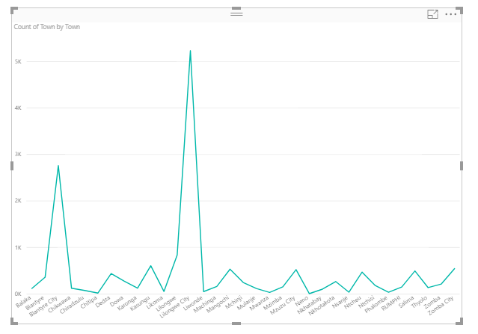
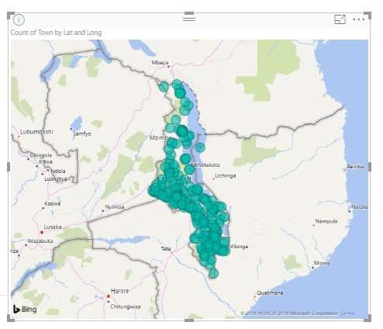
# of calls made from town/district
For the given sample MNO data, it is found that -
Maximum # of calls are made from Lilongwe City town/district
2nd highest # of calls are made from Blantyre town/district
Lowest # of calls were made from Chitipa town/district

