Slide 1

Experiences with $k$-means clustering on Spark
Status Report, Fall 2010
Ankur Dave
Notes:
I wanted to give you a status update on what I’ve been working on this semester.
My goal was to implement and benchmark k-means clustering on Spark, and I’m going to give you a summary of the experiences that came out of that.

Slide 2

Outline
$k$-means algorithm
Spark implementation
Benchmarks on EC2
Experiences
Future
Notes:
Briefly describe the k-means algorithm, how I adapted it to run on Spark
Benchmark results
Describe some interesting experiences from the process
And finally start the plan for my involvement with Spark next semester

Slide 3
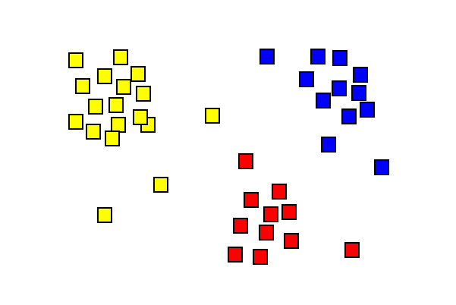
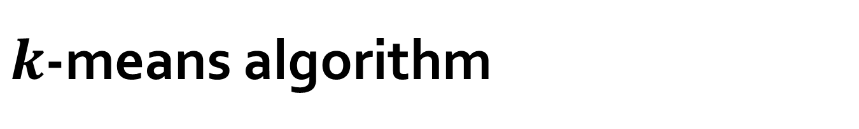
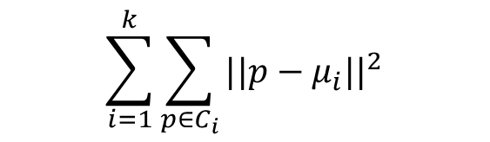

$k$-means algorithm
Minimizes the within-cluster sum of squares:
Iterative clustering
Input: $n$, $k$
Output: $k$ centroids
$$\sum_{i=1}^{k}{\sum_{p∈C_{i}}{{||p−μ_{i}||}^{2}}}$$
}
}
}
Distance from point to centroid
For each cluster
For each point in the cluster
Notes:
I’m sure you’re familiar with k-means, but here’s a brief refresher.
Given n points and desired number of clusters k, finds k centroids for a locally optimal clustering
Locally minimizes this function

Slide 4
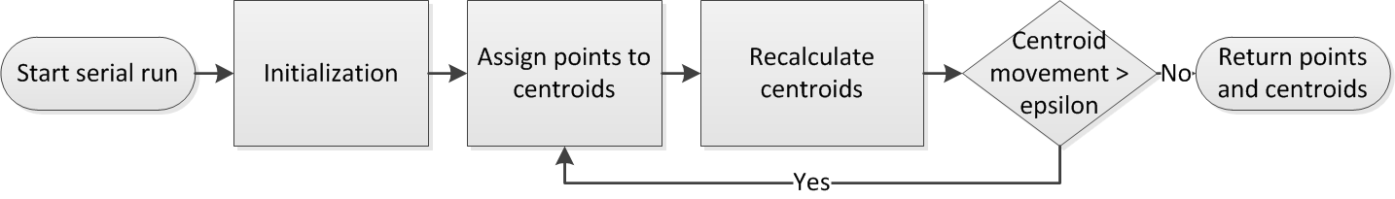
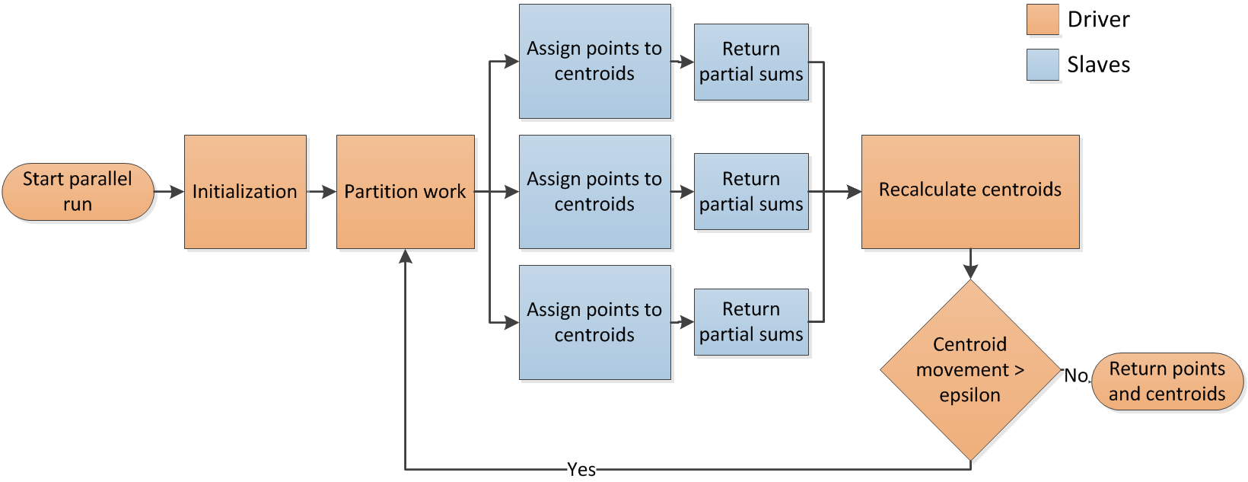


$k$-means algorithm
Conventional (Serial) $k$-means
Distributed $k$-means
Notes:
Initializes k centroids randomly, then improves those centroids iteratively
Assigns points to closest centroids, then recalculates each centroid as average of points in its cluster, then checks a stopping condition.
To make it distributed we do a Spark map to assign points to centroids
Then have to add a step: partial sums
This is to avoid having to send all points to the driver to average.
Instead slaves do as much summing as they can and only send the partial sums for each cluster
Then driver has much less work

Slide 5
$k$-means algorithm
Iterative
CPU-bound, not network I/O-bound
(unless dealing with high-dimensional points or a data-intensive stopping condition)
Notes:
Here are some important characteristics of k-means
It’s iterative, so it’s well suited for Spark
It’s CPU-bound, there’s not much movement of data. Only the centroids move around, the points stay on their respective nodes
Unless we have high-dimensional points, because then we’re sending large centroids
Or we have a different stopping condition.
Instead of checking centroid movement, another common one is to check point movement: whether points have been reassigned. If none, then stop
But to do that, the driver needs access to every point’s assignment. That requires lots of network I/O

Slide 6
Spark implementation
def kmeans(points, centroids, epsilon, sc) = {
// Assign points to centroids
clusters = points.groupBy(closestCentroid)
= points.map(centroid -> (point, 1))
.reduceByKeyToDriver(partialSum)
// Recalculate centroids
newCentroids = centroids.map(old => clusters.get(old).average)
// Calculate centroid movement
// for stopping condition
movement = (centroids zip newCentroids).map(a distance b)
// Iterate if movement exceeds threshold
if (movement.exists(_ > epsilon))
kmeans(points, newCentroids, epsilon, sc)
else
return newCentroids
}
Notes:
Here’s what the core code for k-means looks like.
This is edited to fit on the slide, but it’s broadly similar to the real thing
The red and green show the difference between local code and spark code
There’s not much difference thanks to Spark

Slide 7
Benchmarks on EC2

Slide 8
Benchmarks on EC2

Slide 9
Benchmarks on EC2

Slide 10
Benchmarks on EC2

Slide 11
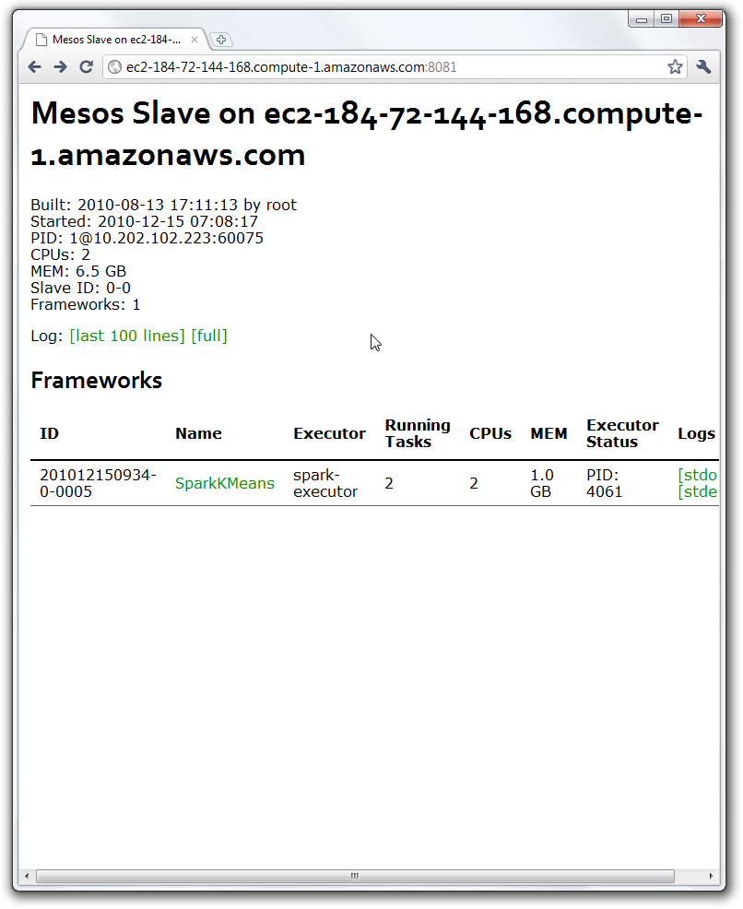
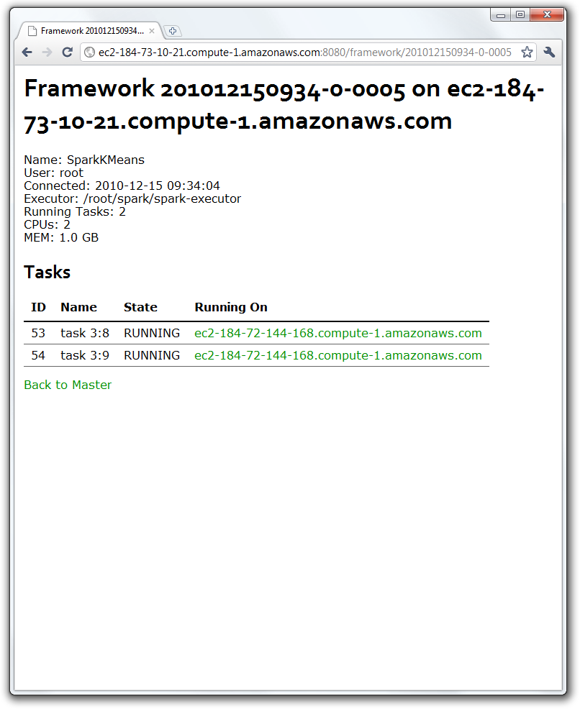
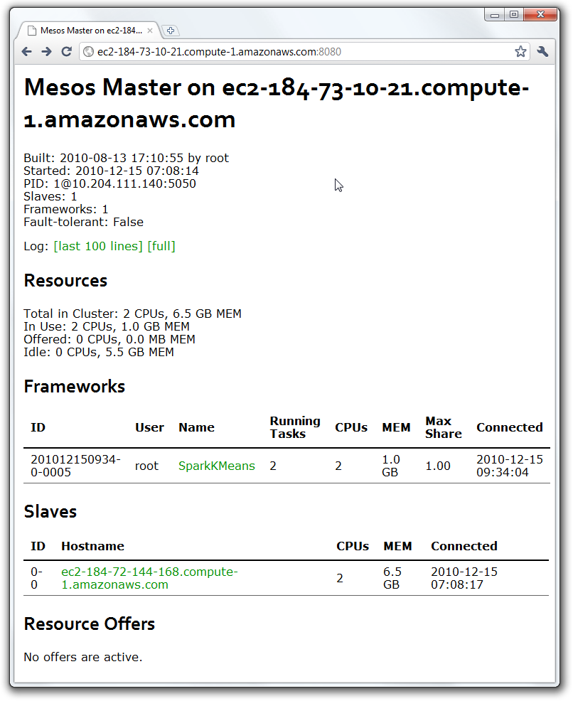
Experiences
Debugging a distributed system can be frustrating
Tasks get lost with no explanation up-front
Finding the reason requires fast reactions!
Wishlist: Present framework logs persistently on the Mesos dashboard

Slide 12
Experiences
Repeatability is best with scripted runs on EC2
R cluster gives highly variable performance compared to EC2
On the other hand, instance scarcity can be a problem – scripts need to detect and retry

Slide 13
Experiences
Need more documentation on deploying an application with Spark
Currently building JARs with a custom Makefile
Discovering what works takes trial and error
I’d be happy to write up the correct way for the Spark wiki

Slide 14
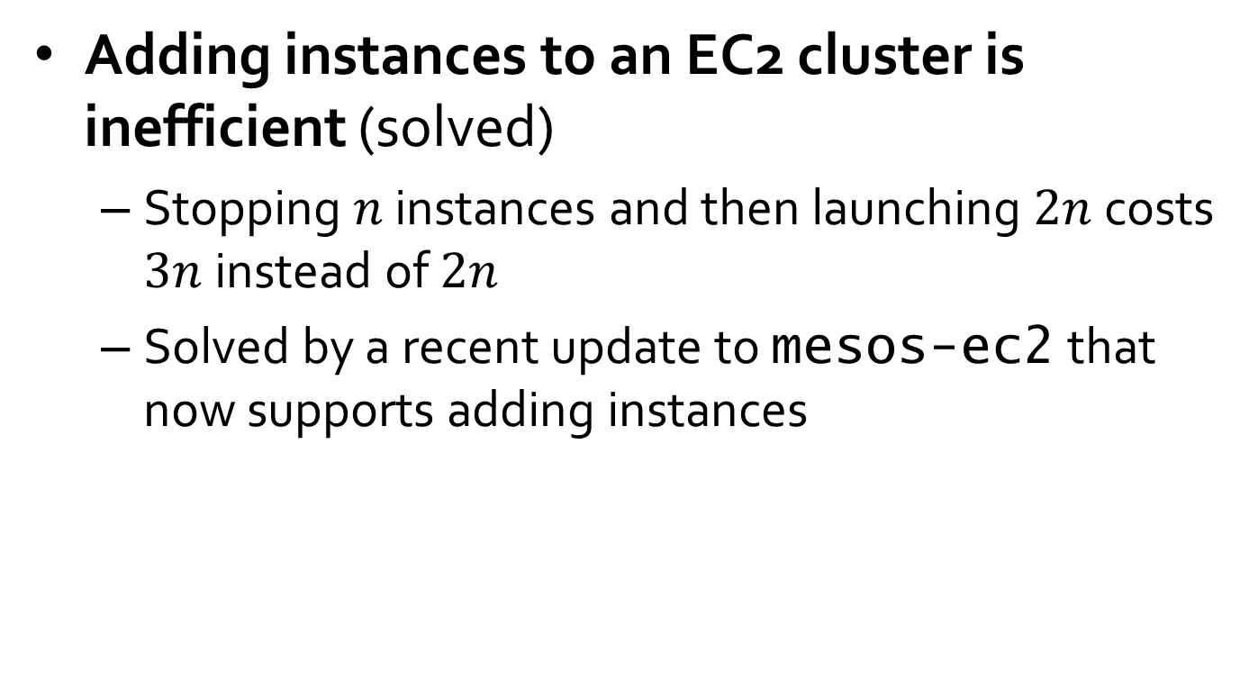
Experiences
Adding instances to an EC2 cluster is inefficient (solved)
Stopping $n$ instances and then launching $2n$ costs $3n$ instead of $2n$
Solved by a recent update to mesos-ec2 that now supports adding instances

Slide 15
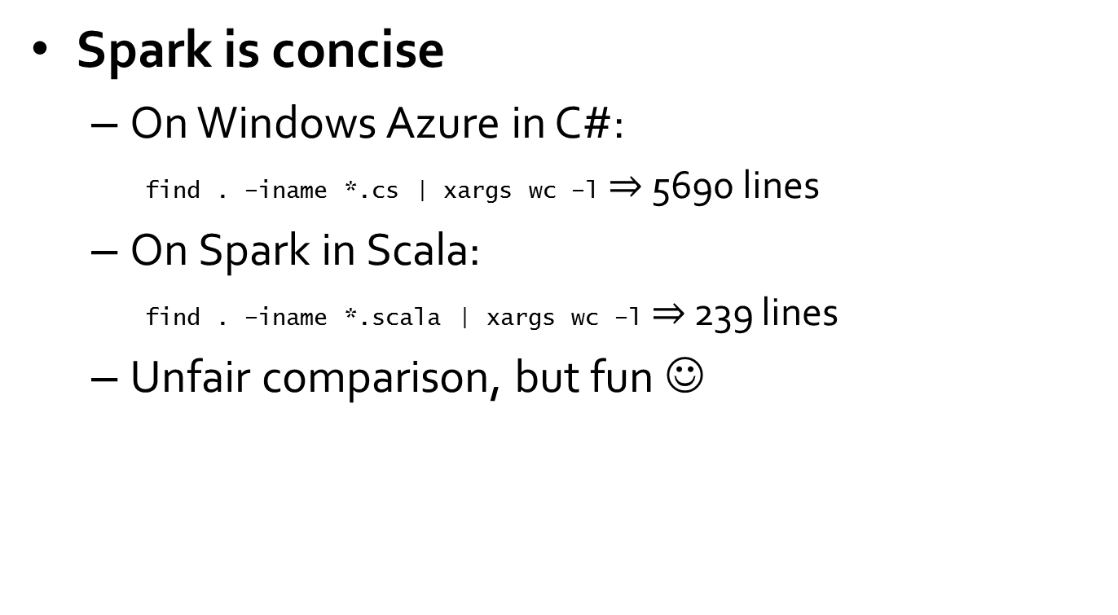
Experiences
Spark is concise
On Windows Azure in C#:
find . –iname *.cs | xargs wc –l $⇒$ 5690 lines
On Spark in Scala:
find . –iname *.scala | xargs wc –l $⇒$ 239 lines
Unfair comparison, but fun ☺
Notes:
Not really a fair comparison because of different levels of abstraction and differences in the algorithm implemented – just for fun ☺

Slide 16
Future
Improve the Spark core
Build more applications on Spark
frameworks like Pregel
other machine learning algorithms
Improve the Spark interfaces
data visualization
R integration

