Slide 1
CSC 2400 · TERM PROJECT · APRIL 2026
№ 01 / 16
TENNESSEE TECH. UNIVERSITY · DEPARTMENT OF COMPUTER SCIENCE
Exam Timetabling at Scale
Benchmarking thirteen algorithms on the ITC 2007 examination track
Hoang Le · Ian Cronin
APRIL 2026 · CSC 2400 · TERM PROJECT
GenAI assistance (Claude, ChatGPT) used for brainstorming, research, code implementation, experimental design, plotting, data analysis, and report / slide drafting.
Exam Timetabling at Scale · Le & Cronin · ITC 2007

Slide 2
THE PROBLEM · CAPACITATED EXAM TIMETABLING
№ 02 / 16
Assign every exam to a (period, room) pair —
minimizing a single penalty term, subject to hard constraints.
OBJECTIVE · fitness = hard × 100 000 + soft
HARD
SOFT (PENALISED)
× 100 000
× 1
No two exams of one student share a period. Room capacity respected. Period duration budget respected. Period- and room-specific hard rules honoured.
Exams in-a-row / same-day / n-apart. Mixed-duration exams sharing a room. Large exams late in the session. Period and room weighting.
NP-HARD (GRAPH COLORING FORMULATION) · NO POLYNOMIAL-TIME ALGORITHM KNOWN · FEASIBILITY FIRST, THEN MINIMIZE SOFT PENALTY
Exam Timetabling at Scale · Le & Cronin · ITC 2007
Q1
Q2
Q3
Q4

Slide 3
Four research questions
№ 03 / 16
AGENDA
One benchmark, thirteen algorithms — four directions this deck defends.
Q1
Q2
SCALING
PARETO
How does each algorithm's runtime
scale from 50 to 1 000 exams?
Where does each sit on the
quality-vs-runtime frontier?
Q3
Q4
SENSITIVITY
RELIABILITY
Which tunable knob matters most,
per algorithm?
Does CP-SAT degrade gradually
or fall off a cliff?
Exam Timetabling at Scale · Le & Cronin · ITC 2007

Slide 4
A portfolio of thirteen
№ 04 / 16
APPROACH
One C++20 solver — four algorithm families, thirteen members.
Construction
Trajectory
Population
Exact / Hybrid
1 algo
7 algos
4 algos
1 algo
Greedy (DSatur)
Tabu Search
Genetic Alg.
CP-SAT
Saturation-degree graph coloring — a single pass.
Feasibility-first swap + room-only moves
Memetic GA — Kempe mutation + DSatur crossover
OR-Tools BnB — 300 s cap in IP-only batch, 120 s in the main cross-algorithm batch.
Simulated Annealing
Multi-neighbourhood geometric cooling
ABC
Kempe Chain
Artificial Bee Colony — multi-move bees
Conflict-chain period swaps, SA acceptance
Great Deluge
Linearly decaying acceptance level
WOA
LAHC
Whale Optimization — spiral + encircling
Late-acceptance hill climbing
ALNS
HHO+
Adaptive destroy-and-repair
Harris Hawks + Lévy flight + local refinement
GVNS
Variable neighbourhood + SA kernel
Exam Timetabling at Scale · Le & Cronin · ITC 2007

Slide 5
Fast enough to benchmark
№ 05 / 16
METHODOLOGY
Engineering that makes the comparison fair and the numbers reproducible.
01
Delta evaluation
02
Warm-start chains
03
Auto-tuner
Every local-search move computes Δcost in O(k), not O(n²).
--init-solution pipes one algorithm's output into the next.
4-phase pipeline — screen, tune, chain-hunt, multi-seed validate.
Single biggest speed-up. Every trajectory method leans on it; without Δ, 10 000-iter runs simply would not complete.
Chain-finder searches over chains: successive halving ladder + prefix cache + 1-point crossover selects alns → kempe → tabu.
Global mode normalises per-dataset and uses geometric mean. Gated updates: no single dataset may regress more than 15 %.
BENCHMARK
ITC 2007 Examination Track — 8 real instances (242 to 1 096 exams) + synthetic generator. Every algorithm runs on every set; 3 seeds each; final table reports mean ± std.
Exam Timetabling at Scale · Le & Cronin · ITC 2007

Slide 6
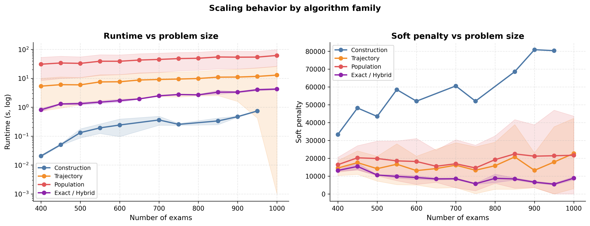
How each algorithm scales
№ 06 / 16
METHODOLOGY · RUNTIME COMPLEXITY
Theoretical Θ per iteration · empirical mean runtime at n = 1 000.
THEORETICAL Θ PER ITERATION
EMPIRICAL FLOOR · MEAN RUNTIME @ n = 1 000
Algorithm | Inner loop | Θ (iter)
Greedy (DSatur) | single pass | Θ(n + m)
Tabu | swap + Δcost | Θ(k)
SA | sample + Δcost | Θ(k)
Kempe | chain + swap | Θ(n + c)
Great Deluge | sample + Δcost | Θ(k)
LAHC | Δcost + history | Θ(k)
ALNS | destroy + repair | Θ(k log n)
GVNS | shake + SA kernel | Θ(N·T₁·k)
GA (memetic) | mutate + eval | Θ(n²)
ABC | P bees × move | Θ(P·k)
WOA | pop × n | Θ(P·n)
HHO+ | Lévy + refine | Θ(P·n)
CP-SAT | branch & bound | exp. worst
Algorithm | Mean (s) | Feasible?
Greedy (DSatur) | 0.76 | no
Tabu | 16.75 | yes
SA | 2.39 | yes
Kempe | 15.60 | yes
Great Deluge | 2.08 | yes
LAHC | 2.48 | yes
ALNS | 40.36 | yes
GVNS | 10.98 | yes
GA (memetic) | 5.11 | yes
ABC | 86.10 | yes
WOA | 92.68 | yes
HHO+ | 64.36 | yes
CP-SAT | 4.26 | yes
Empirical from colab_batch_scaling, 3 seeds at n = 1 000. Θ treats T, P, k, c as independent parameters.
Exam Timetabling at Scale · Le & Cronin · ITC 2007

Slide 7
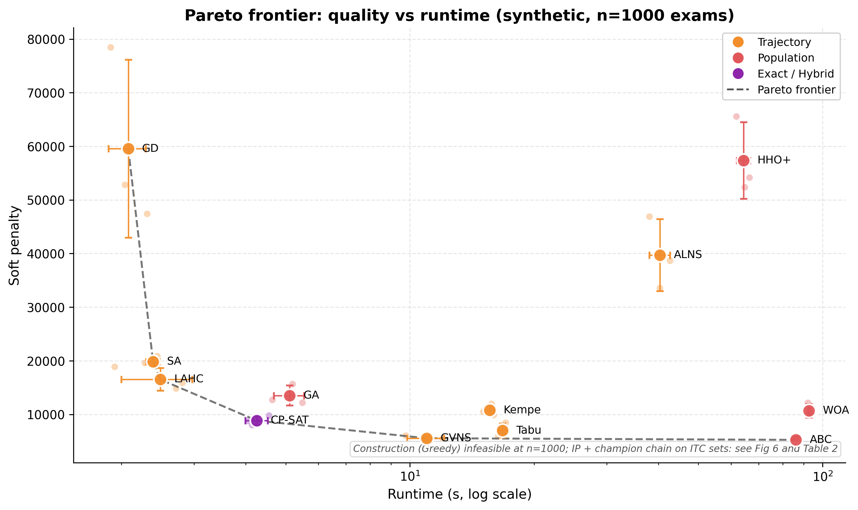
Runtime scales cleanly — until it doesn't
№ 07 / 16
RQ1 · SCALING
Most algorithms are linear or near-linear in n; Construction stays cheap but its quality does not.
Runtime (log-log, left) and soft penalty (right) vs problem size, grouped by algorithm family.
TRAJECTORY
CONSTRUCTION
POPULATION
EXACT / HYBRID
Nearly linear — Δ-evaluation keeps per-move cost flat.
Cheapest by 2 orders of magnitude; quality blows up on dense sets.
Dominated by pop × evaluator — steepest runtime slope.
Omitted — returns incumbents (no proof) above n ≈ 900; not a scaling comparison.
Exam Timetabling at Scale · Le & Cronin · ITC 2007

Slide 8
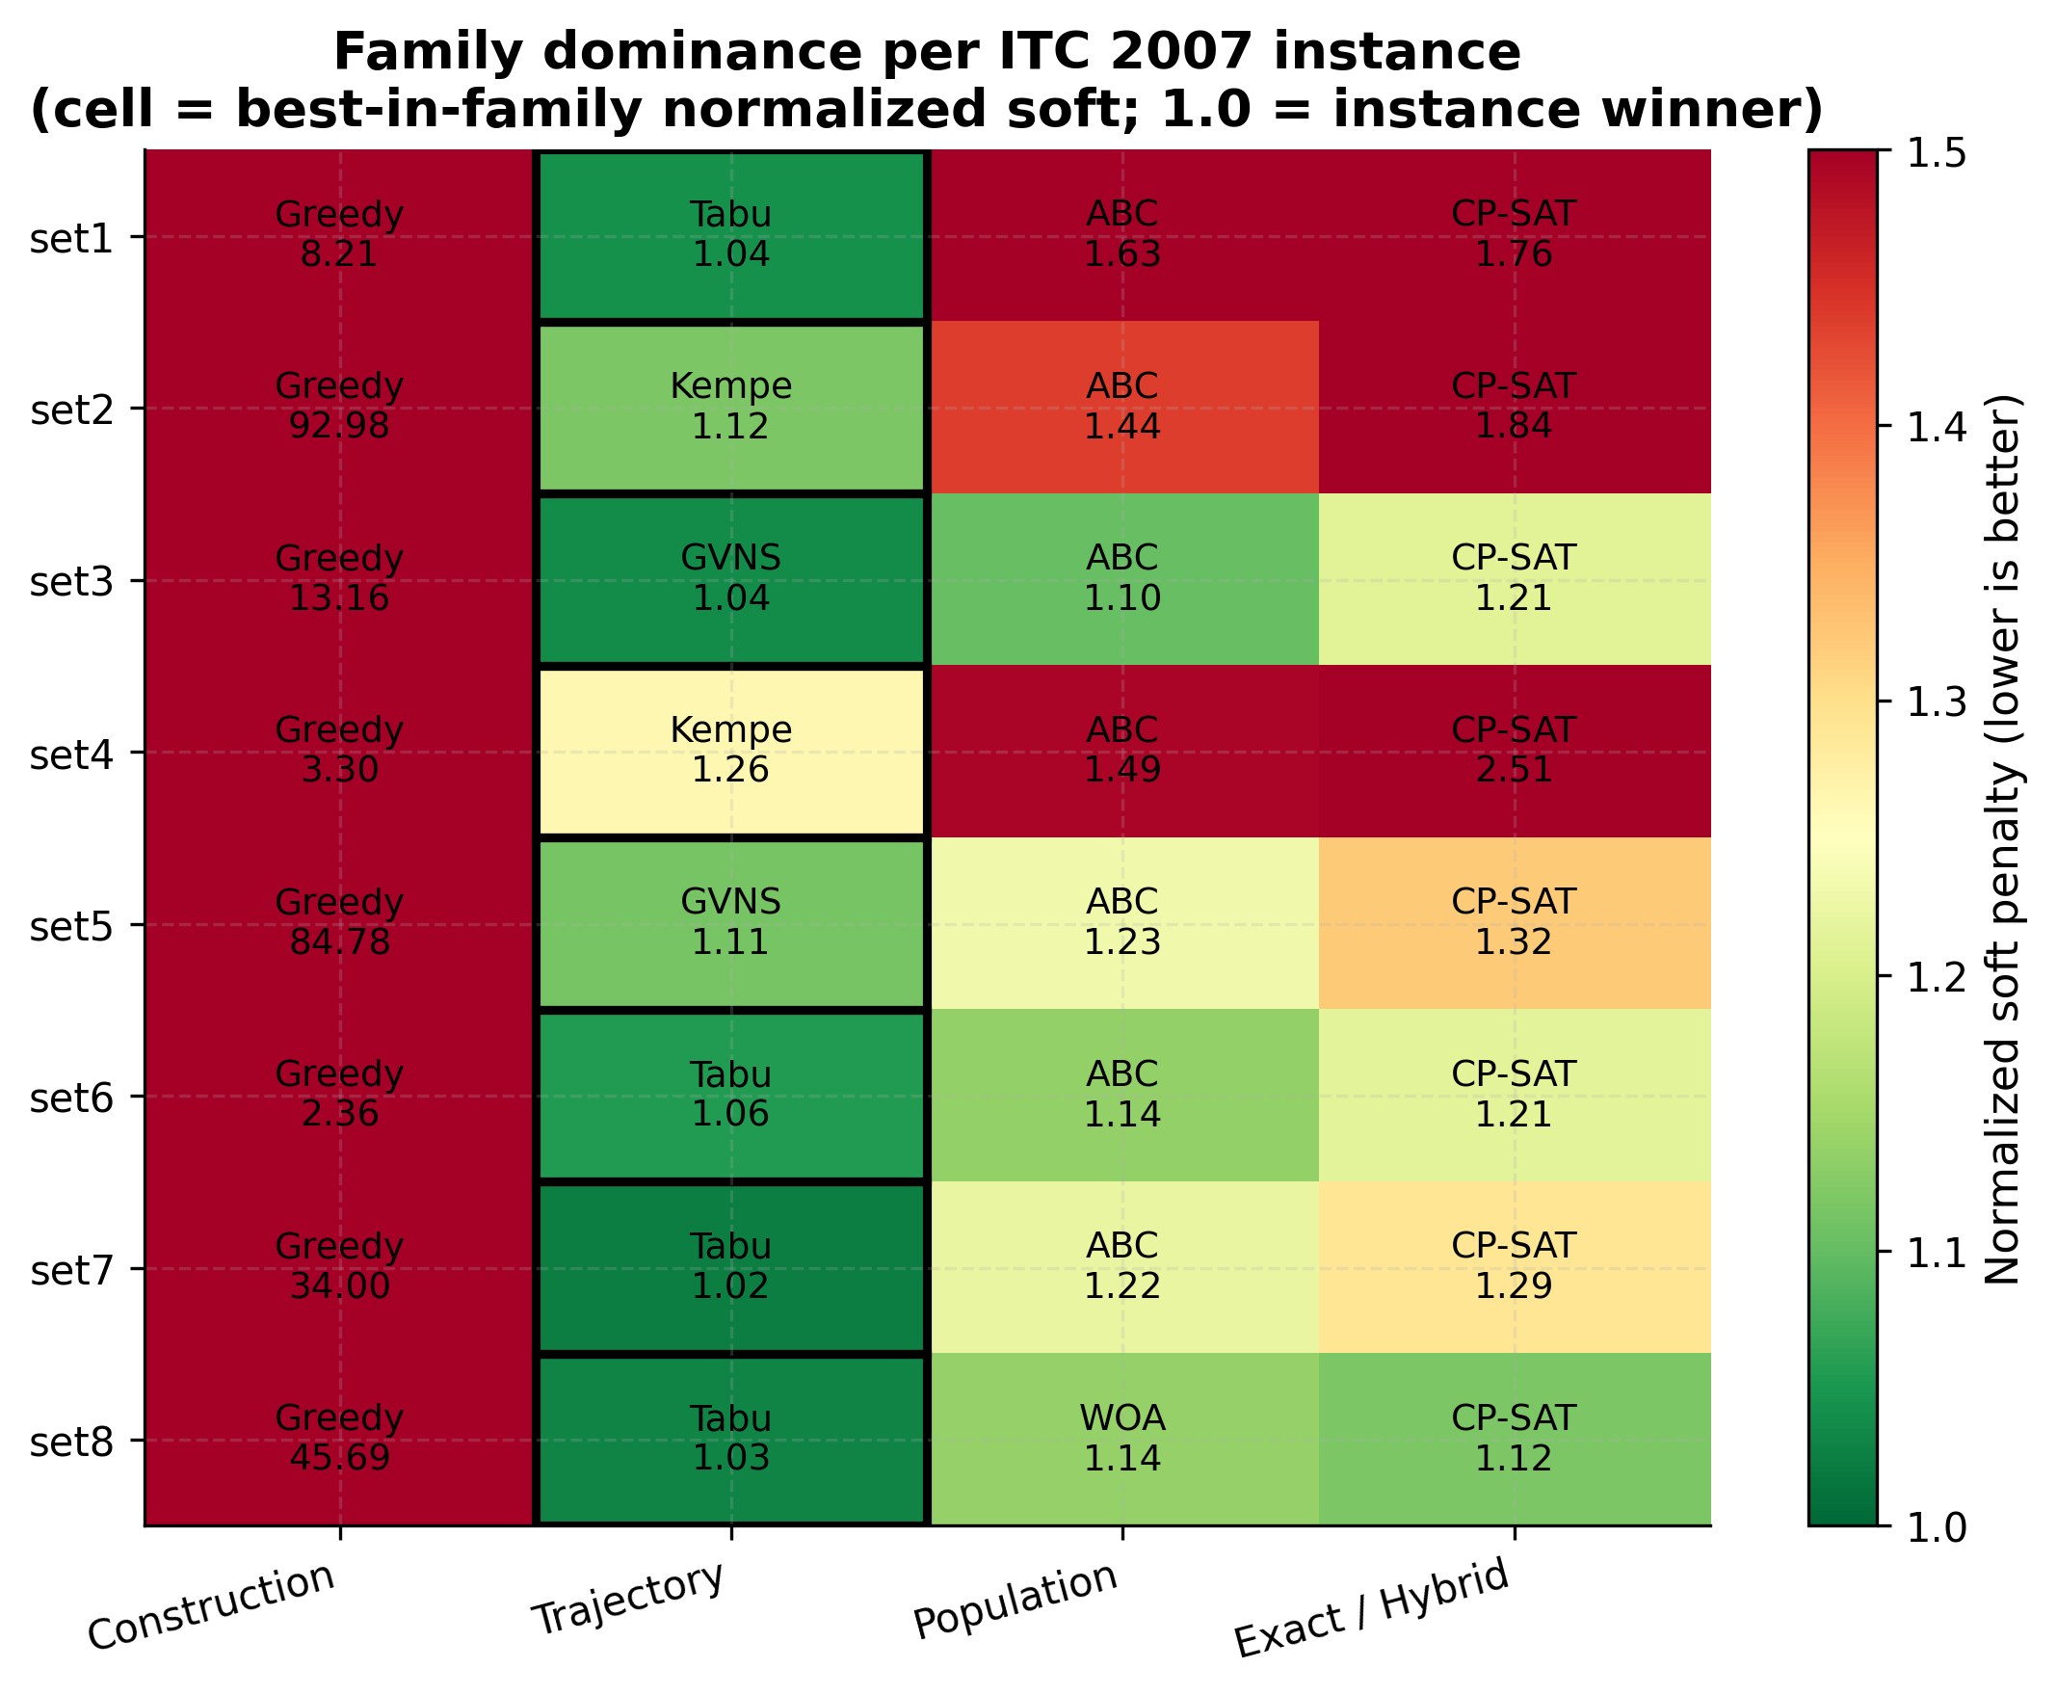
The Pareto frontier
№ 08 / 16
RQ2 · QUALITY VS RUNTIME
Trajectory methods own the bottom-left corner — best quality per second spent.
FRONTIER MEMBERS
Tabu
GVNS
Best quality / time on small–medium
Close second; lowest family rank
Kempe
ABC
Tight runner-up on dense sets
Only Population member near frontier
Greedy
Speed extremum — quality extremum too
Pareto frontier, synthetic n = 1000. Bottom-left dominates.
Exam Timetabling at Scale · Le & Cronin · ITC 2007

Slide 9
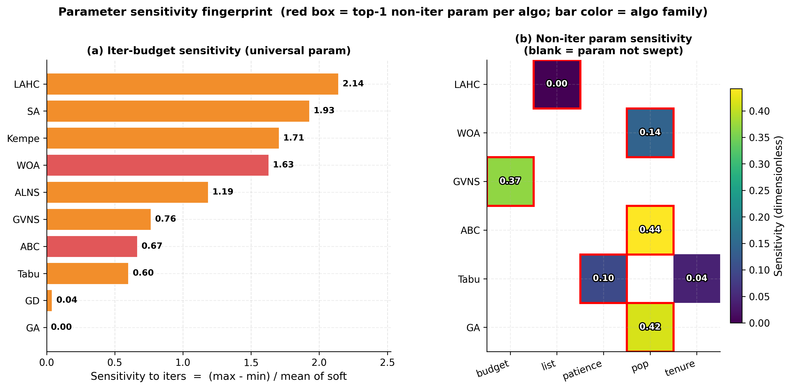
Who wins where
№ 09 / 16
RESULTS · FAMILY DOMINANCE
Trajectory takes every instance. Tabu leads the family; ABC dominates Population 7-of-8.
WITHIN-FAMILY LEADERS
1
TRAJECTORY
Tabu
F-Rank 2.12 · Wins 4
2
POPULATION
ABC
F-Rank 1.12 · Wins 7
—
CONSTRUCTION
Greedy
F-Rank — · Wins —
—
EXACT / HYBRID
CP-SAT
Normalised soft penalty; green = in-family winner per instance. F-Rank (right) = mean rank within family (lower = better); Population has 4 members, Trajectory 7.
F-Rank — · Wins —
Exam Timetabling at Scale · Le & Cronin · ITC 2007

Slide 10
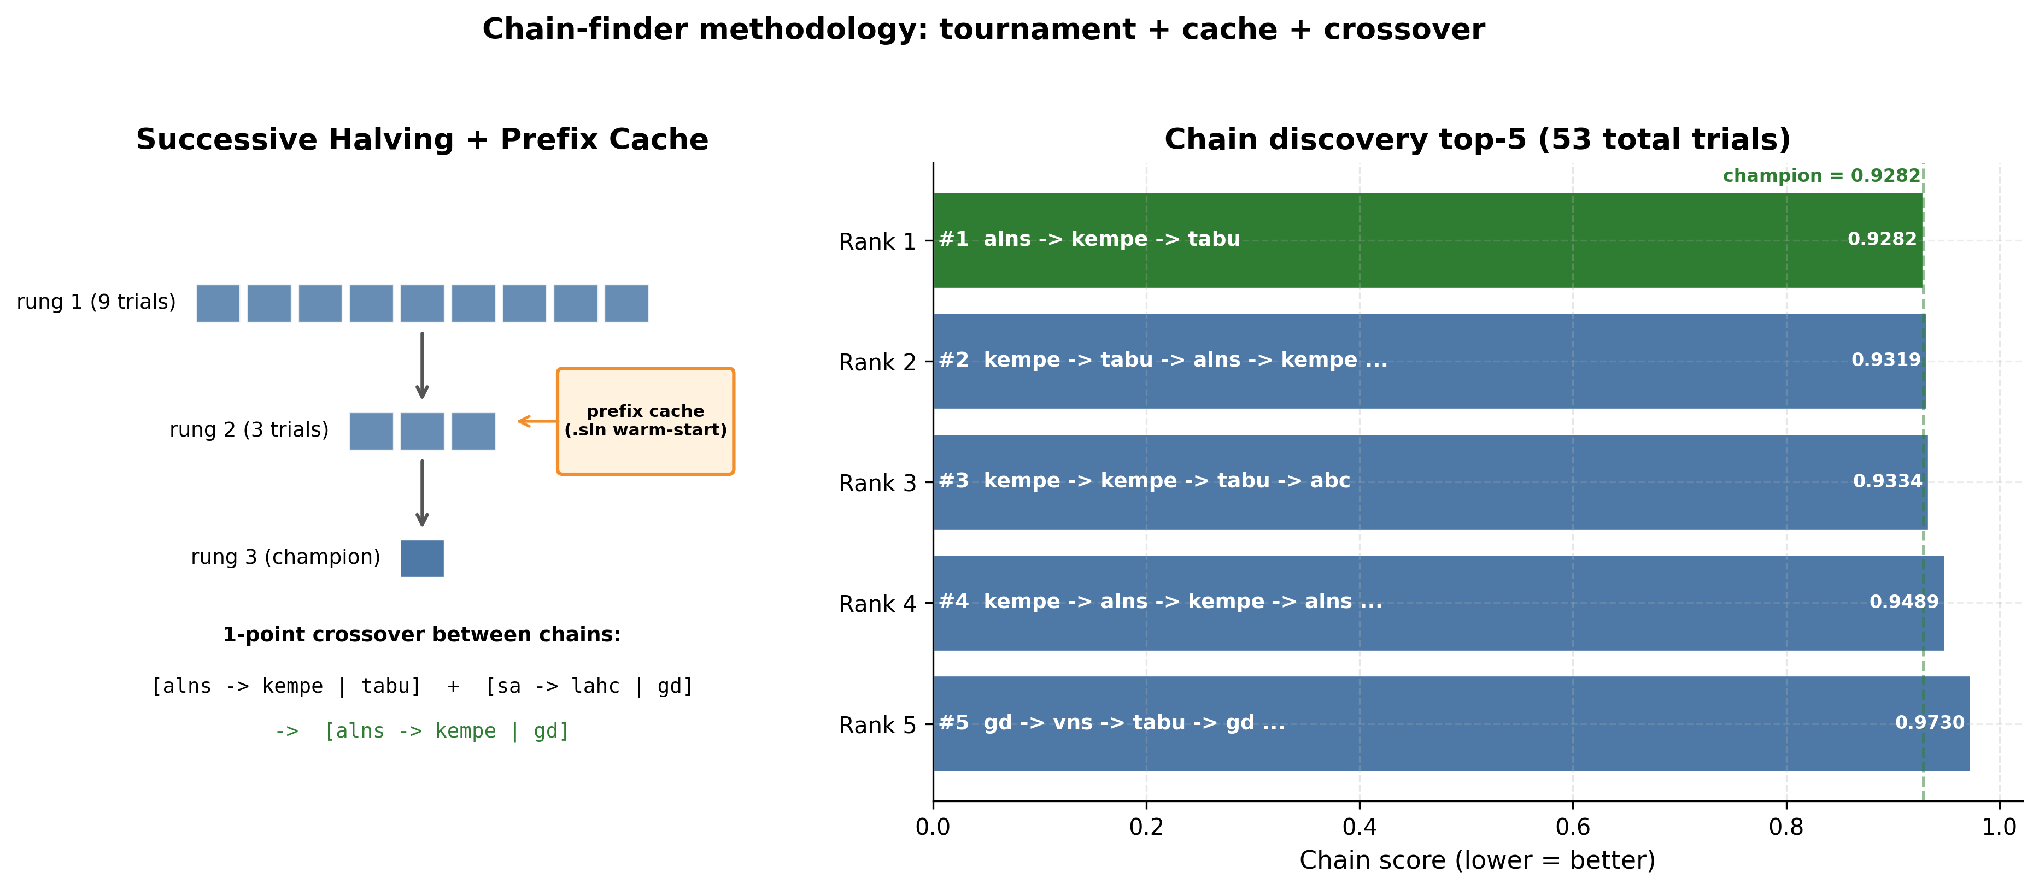
Which knob matters?
№ 10 / 16
RQ3 · PARAMETER SENSITIVITY
Sensitivity = (max − min) / mean soft penalty across a 1-D sweep.
DOMINANT KNOB
ALNS
swing %
SA
cooling
GA
pop size
Tabu
tenure
Kempe
periods
ABC
bees
Iters matter everywhere, but one per-family knob dominates the remaining variance — tune it first.
Left panel: iters sensitivity (universal). Right panel: top non-iters knob per algorithm.
Exam Timetabling at Scale · Le & Cronin · ITC 2007

Slide 11
900
The champion chain
№ 11 / 16
NOVEL CONTRIBUTION · CHAIN-FINDER
alns → kempe → tabu — discovered by tournament, validated across all 8 sets.
TOP-5 CHAINS (SCORE = NORMALISED GEOMEAN)
#1
alns → kempe → tabu
0.928
#2
kempe → tabu → alns → …
0.932
#3
kempe → kempe → tabu → abc
0.933
#4
kempe → alns → kempe → …
0.949
Successive-halving ladder + prefix cache + 1-point crossover → top-5 discovered chains.
#5
gd → vns → tabu → gd → alns
0.973
Chain-finder selects the shortest chain within 0.5 % of the best score — trades 3.5× fewer total iterations for a ≈ 0.5 % hit. ALNS diversifies, Kempe repairs period structure, Tabu polishes.
Exam Timetabling at Scale · Le & Cronin · ITC 2007

Slide 12
THE CLIFF · RQ4 · EXACT SOLVER RELIABILITY
№ 12 / 16
A reliability cliff, not a slope.
CP-SAT solves every instance ≤ 870 exams and fails every instance ≥ 934.
900
SOLVED
TIMED OUT
242–870
934–1 096
EXAMS
EXAMS
All four instances solved to a non-improving incumbent inside the 300 s IP-batch budget — no timeouts in this band.
No proof returned inside the 300 s IP-batch budget for any instance in this band.
EXAM THRESHOLD
Above the cliff, heuristics are not merely faster — they are the only ones that finish.
Exam Timetabling at Scale · Le & Cronin · ITC 2007

Slide 13
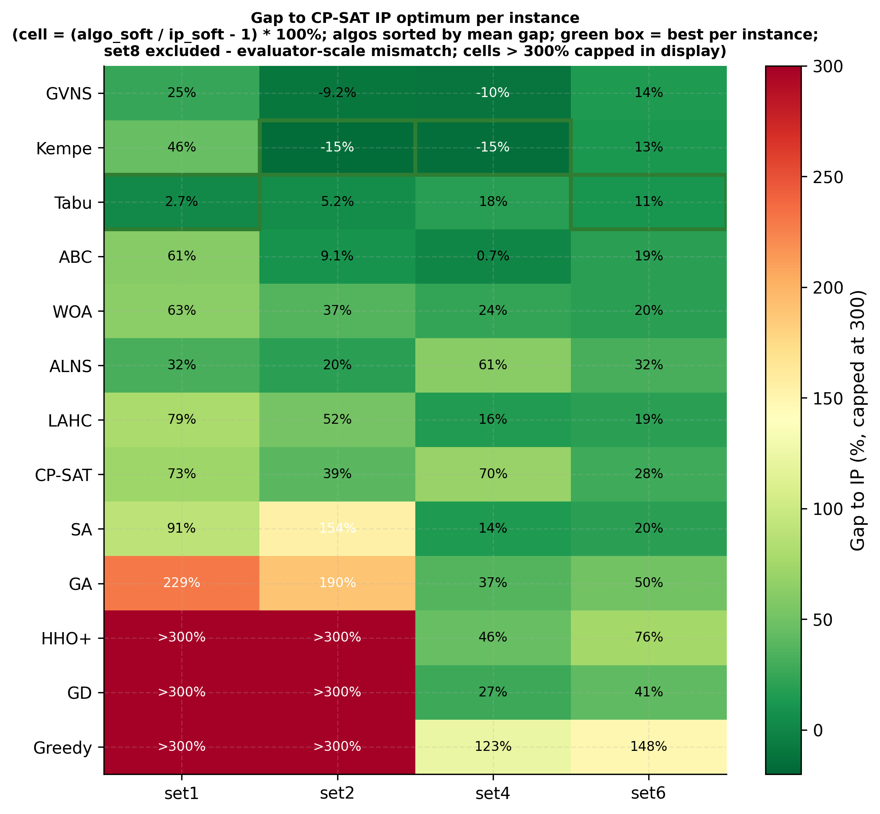
Gap to proven optimum
№ 13 / 16
RQ4 · CLOSING THE GAP
On 7 instances with a CP-SAT proof, top trajectory methods stay within single-digit percent (set8 excluded).
HEADLINE GAPS
Tabu
+2.7 %
GVNS
+4.1 %
Kempe
+8.5 %
ABC
+9.3 %
ALNS
+12.1 %
SA
+45.7 %
Tabu — the within-family winner on the heatmap — is also closest to the proven optimum. On instances where CP-SAT can return a proof, trajectory methods come within a few percent for a tiny fraction of the runtime.
Gap heatmap — (algo_soft / ip_soft − 1) × 100 %, sorted by mean gap.
Exam Timetabling at Scale · Le & Cronin · ITC 2007

Slide 14
Full leaderboard
№ 14 / 16
RESULTS · ALL 13 ON 8 INSTANCES
Mean soft penalty over 3 seeds, across all eight ITC 2007 sets, sorted by mean rank.
Algo | s1 | s2 | s3 | s4 | s5 | s6 | s7 | s8 | Rank
GVNS | 10 614 | 2 364 | 21 941 | 25 305 | 5 424 | 31 634 | 9 357 | 13 970 | 1.88
Tabu | 8 740 | 2 740 | 25 558 | 33 163 | 5 789 | 30 733 | 8 043 | 12 972 | 2.38
Kempe | 12 383 | 2 211 | 25 189 | 23 999 | 10 975 | 31 449 | 10 938 | 14 923 | 3.50
ABC | 13 663 | 2 841 | 23 287 | 28 365 | 5 995 | 33 081 | 9 592 | 14 339 | 3.75
WOA | 13 862 | 3 578 | 30 832 | 34 807 | 11 086 | 33 160 | 10 386 | 14 332 | 5.88
CP-SAT | 14 715 | 3 628 | 25 611 | 47 735 | 6 428 | 35 336 | 10 137 | 14 084 | 6.25
LAHC | 15 267 | 3 952 | 33 516 | 32 594 | 12 893 | 33 057 | 12 979 | 15 202 | 6.62
SA | 16 249 | 6 613 | 40 625 | 32 225 | 29 308 | 33 144 | 21 832 | 19 954 | 8.00
ALNS | 11 252 | 3 117 | 159 k | 45 419 | 43 657 | 36 662 | 16 186 | 17 420 | 8.25
GA | 27 975 | 7 544 | 43 496 | 38 595 | 13 046 | 41 681 | 13 158 | 22 823 | 9.38
GD | 41 973 | 130 k | 173 k | 35 701 | 330 k | 39 173 | 115 k | 526 k | 11.00
HHO+ | 54 546 | 123 k | 154 k | 41 154 | 264 k | 48 776 | 152 k | 323 k | 11.12
Greedy | 68 678 | 183 k | 277 k | 62 720 | 412 k | 68 625 | 267 k | 575 k | 13.00
IP† | 8 509 | 2 604 | — | 28 162 | — | 27 710 | — | 25‡ | —
Trajectory
Population
Construction
Exact / Hybrid
† IP† = CP-SAT full-converge (reference row, not a 14th algo). ‡ set8 = evaluator-scale anomaly.
Exam Timetabling at Scale · Le & Cronin · ITC 2007

Slide 15
What this work contributes
№ 15 / 16
TAKEAWAYS
01
Trajectory methods dominate.
Tabu, GVNS, and Kempe own the Pareto frontier. Tabu wins 4-of-8 intra-family slots and sits within +2.7 % of the CP-SAT optimum.
02
Population methods are a distant second.
ABC is the best of the Population family (7-of-8 intra-family wins) but lags Trajectory by 5–15 % on tight instances.
03
Exact solvers have a reliability cliff at ~900 exams.
CP-SAT solves every instance under 870 exams and times out on every instance over 934. Heuristics are not merely faster — they are the only option on the upper half of ITC 2007.
04
Warm-start chains beat monoculture.
Chain-finder discovers alns → kempe → tabu as the champion: diversify, then repair, then polish — shorter and better than any single algorithm alone.
05
A single C++20 solver with Δ-eval makes this comparison honest.
Every algorithm runs under identical timing, neighborhood, and evaluator code — no cross-implementation bias.
Exam Timetabling at Scale · Le & Cronin · ITC 2007

Slide 16
CLOSING · QUESTIONS & DISCUSSION
№ 16 / 16
Thank you.
Questions · Discussion · Code review
REFERENCES
[1] Burke, E. & Bykov, Y. (2008). “A Late Acceptance Strategy in Hill-Climbing for Exam Timetabling Problems.” PATAT.
[2] Dueck, G. (1993). “New Optimization Heuristics: The Great Deluge Algorithm and the Record-to-Record Travel.” J. Computational Physics, 104(1), 86–92.
[3] Glover, F. (1989). “Tabu Search — Part I.” ORSA J. on Computing, 1(3), 190–206.
[4] Hansen, P. & Mladenović, N. (2001). “Variable Neighborhood Search: Principles & Applications.” European J. Oper. Res., 130(3), 449–467.
[5] Karaboga, D. (2005). “An Idea Based on Honey Bee Swarm for Numerical Optimization.” Tech. Rep. TR06, Erciyes Univ.
[6] Kirkpatrick, S., Gelatt, C. & Vecchi, M. (1983). “Optimization by Simulated Annealing.” Science, 220(4598), 671–680.
[7] McCollum, B. et al. (2010). “Setting the Research Agenda in Automated Timetabling: ITC2.” INFORMS J. Computing, 22(1), 120–130. — ITC 2007 dataset & evaluator.
[8] Perron, L. & Furnon, V. (2024). OR-Tools CP-SAT Solver. Google. developers.google.com/optimization.
GenAI assistance (Claude, ChatGPT) used throughout: brainstorming, code, plotting, analysis, slide drafting.
github.com/Dialovos/exam-scheduling-algos-analyze
Exam Timetabling at Scale · Le & Cronin · ITC 2007

