Slide 1
AUTONOMOUS AGENTS PLH412 PROJECT
DIAMANTIS RAFAIL PAPADAM - 2017030044
FRIDAY, 4th APRIL, 2022

Slide 2
Goals of this project:
Create the template of a 3D tic tac toe in code.
1
Create an agent that uses the Monte Carlo Tree Search (MCTS) algorithm.
2
Create an agent that uses the Minimax algorithm.
3
Compare the two agents when they're both given less than a minute to make a decision.
4

Slide 3
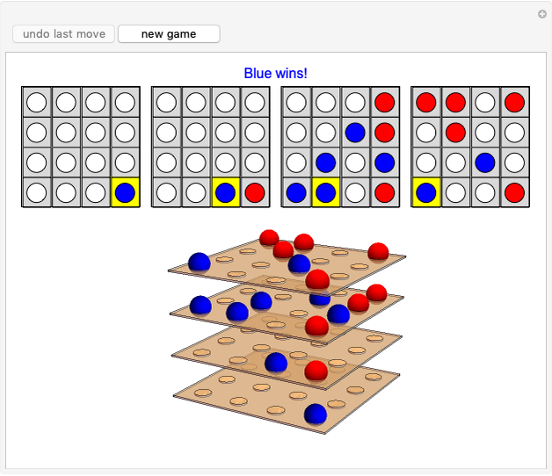
Visualization of a 4x4x4 tic tac toe.

Slide 4
Rules and Properties of the game.
Each of the two players has his own pieces. They take turns placing them in available cells on the 64-cell board of the game.
The first player to achieve 4 of his pieces in a row, in any direction, wins the game.
On the 4x4x4 board, there are 76 winning lines. 10 (in each individual layer) x 4 = 40 and 36 when imagining all the winning combinations in the third dimension (winning lines that contain a signle piece in each of the layers).

Slide 5
Here is a good source that goes through the rules, as well as some tips about the game.
https://www.youtube.com/watch?v=aHLiYvmgkwY&ab_channel=TheAtariGeek

Slide 6
Monte Carlo Tree Search (MCTS)
Selection: Start from root R and select successive child nodes until a leaf node L is reached. The root is the current game state and a leaf is any node that has a potential child from which no simulation (playout) has yet been initiated. For the purpose of selection between different child nodes the UCB1 metric was used.
Expansion: Unless L ends the game decisively (win/loss/draw) for either player, create one (or more) child nodes and randomly choose node C from one of them. Child nodes are any valid moves from the game position defined by L.
Simulation: Complete one random playout from node C by choosing uniform random moves until the game is decided.
Backpropagation: Use the result of the playout to update information in the nodes on the path from C to R.
The 4 steps above are the heart of the MCTS algorithm and they run multiple times until we are out of resources (time/computer memory/processing power etc). Finally, the "best" child of the root node is selected as the move to be played. In our porgram, the "best" child is defined as the child node that minimzes the win ratio (wins/simulations), since that ratio corresponds to the opponent.

Slide 7
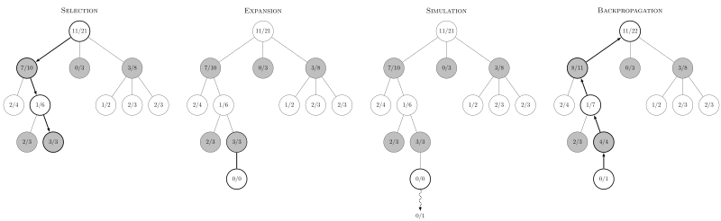
Visualization of the 4 steps taking place on the MCTS tree.

Slide 8
MINIMAX
The minimax algorithm recursively expands the game tree until a specified depth. Every time a node reaches that depth, the future position that it represents is evaluated and the score is back-propagated while making sure that the minimizing player chooses the move with the lowest evaluation while the maximizing player chooses the move with the highest evaluation.
An optimization of the minimax algorithm, known as "a-b pruning", cuts off whole sub-trees of the game tree if it is known that the opponent can force a worse position in the current sub-tree than previously calculated ones. This optimization can reduce the time complexity from O(b^{d}) down to O(b^{d/2}) if the moves can somehow be explored from best to worst. Of course this is not fully feasible since if we already knew the best move what would the point of minimax be!? Something that is implementable though, is the sorting of moves with a heuristic function (from seemingly best to worst) before any node is explored deeper.

Slide 9
MINIMAX
Another optimization, that allows us to search deeper into the tree while exploring less possibilities as the depth increases, is known as "forward pruning". Since we have implemented a sorting of moves with a heuristic function, we are going to completely ignore seemingly bad moves as we're getting deeper into the tree. The strategy of considering only 1 move at very high depths is known as "singular extensions" since each node only explores a single possibility (ideally, the one that maximizes the heuristic function). A very significant note here is that it is very dangerous to prune the game tree in low depths (for our 3D tic tac toe we don't start pruning until depth 4 is reached), because straightforward wins/losses may never be explored by the algorithm.
Finally, a property worth noting about minimax is that it assumes best play by the opponent. Therefore, in case the algorithm goes up against a rookie, it will play more "defensively" than needed and therefore take more time to beat the opponent than really necessary.

Slide 10
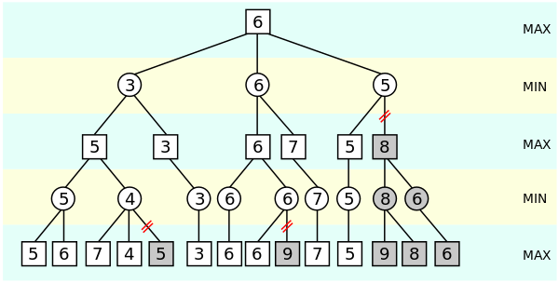
Visualization of a minimax tree with "a-b pruning" implemented.

Slide 11
General comparison between the 2 algorithms.
MINIMAX
MCTS
PROS
The best option when the state space is small.
Optimal if it can explore the entirety of the state space.
Works great with small branching factors.
CONS
Needs an evaluation (heuristic) function.
If there is a time limit in the game, minimax may not be able to return a result. This can be solved with iterative deepening but it reduces the effectiveness of the algorithm, especially when little time is available.
PROS
Doesn't need a heuristic function.
Can be stopped at any given time.
Effective with large branching factors because of its assymetric tree expansion.
CONS
Needs to run many iterations (in its most basic form) to return a good move.
Needs infinite iterations to mathematically converge to an optimal move.
Uses significantly more memory than minimax.

Slide 12
Which algorithm is best in this project?
When both algorithms are given a minute to run, Minimax is significantly more effective in this project. This could be due to the fact that more time was invested in optimizing minimax, using a-b pruning, forward pruning as well as move sorting with a heuristic before the prune takes place. On the other hand, MCTS was implemented in its most basic form and it uses uniform random moves to simulate a playout instead of more sophisticated approaches like a heuristic function or a well-trained neural network that returns an evaluation of any given position.

Slide 13
Sources:
http://demonstrations.wolfram.com/3DTicTacToe/
https://en.wikipedia.org/wiki/3D_tic-tac-toe
https://en.wikipedia.org/wiki/Monte_Carlo_tree_search
https://en.wikipedia.org/wiki/Alpha%E2%80%93beta_pruning

