Slide 1

Is E-Commerce Sales effected by the weather?
DE2 Term Project by Dajka Daniel, Eszter Diamant and Ozan Kaya
Notes:
Our initial idea was to scrutinize the E-Commerce traffic change during the global pandemic. Allegedly the covid pandemic has accelerated the E-Commerce globally forcing people to order online in times of lockdowns and restrictions. Typically, e-commerce datasets are proprietary, therefore we could not find appropriate data to conduct this specific research.

Slide 2


INTODUCTION
We are looking at a E-Commerce Transactions from a UK Retailer and would like to find out, if weather is influencing daily sales.
Ozan – describes the E-commerce Dataset
Dani – presents the Weather API
Eszter – shows the KNIME WORKFLOW and analysis
Notes:
We have settled with an older dataset on E-Commerce Sales from 2010. The choosen E-Commerce Data contains 540 thousand sales records from a UK Retailer between 2010 and 2011. We were curious to find out, if the weather has any effect on the E-Commerce sales. It was suspected, that on rainy and cold days, people tend to spend more time with online shopping whereas in warm and sunny days, people are less inclined to spend ordering online.
First, Ozan is presenting the E-Commerce Sales Dataset in more detail
Dani is discussing the process of receiving the weather data
Eszter presents the KNIME Workflow and details the data pipeline from loading the data until the analytics section. After the data cleaning has been completed, the analytics is briefly shown and conclusion is discussed.

Slide 3
DATASET – E-Commerce Sales in UK

Slide 4


Weather API
https://www.ncdc.noaa.gov/cdo-web/api/v2/data?startdate=2010-12-01&enddate=2011-12-09&locationid=FIPS:UK&datacategoryid=TAVG&datacategoryid=PRCP&units=metric&datasetid=GHCND&stationid=GHCND:UKM00003772
Notes:
To get the Weather Data we have requested an API from NOAA. Since we had the Daily E-Commerce Data from the UK, we were interested in the temperature and rainfall in the UK between 1st of December 2010 and 9th of December 2011.
All in all, there are 144 weather station in the UK. Since London is the most densely populated area and we expect to receive most sales from London, we have chosen one weather station, the London Heathrow Station that is labelled with the stationID: UKM00003772. NOAA provides very detailed weather categories, for us, the most relevant were average daily temperature and precipitation.
After defining the needed parameters with the help of postman, we could create the needed URL link:

Slide 5


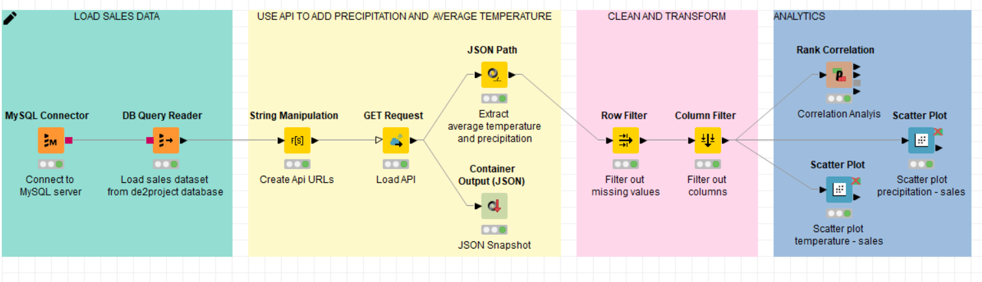

Slide 6

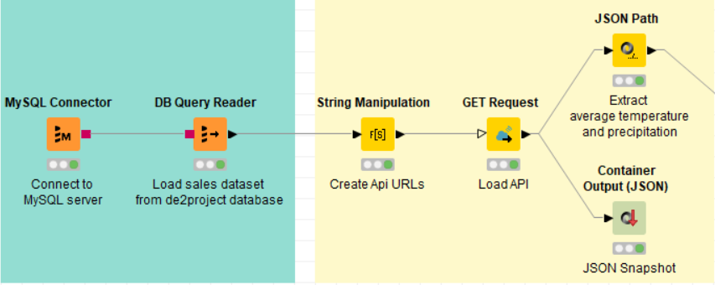
LOAD DATA
Load average daily temperature and precipitation data from API
Connet to database

Slide 7

DATA CLEANING
Drop missing values
Exclude unrelated columns
What left:
→ InvoiceDate
→ TotalSales
→ Temperature
→ Precipitation

Slide 8
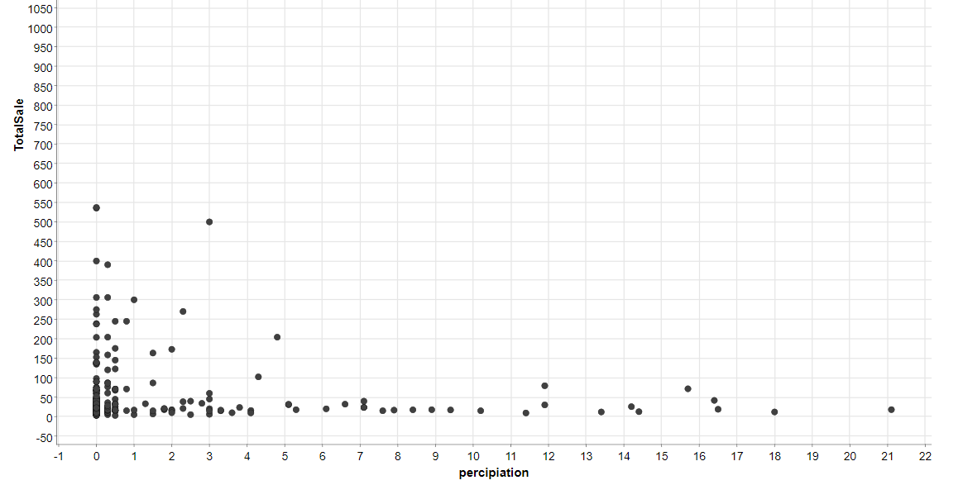
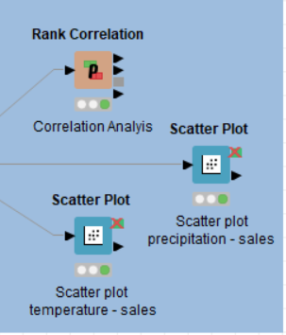


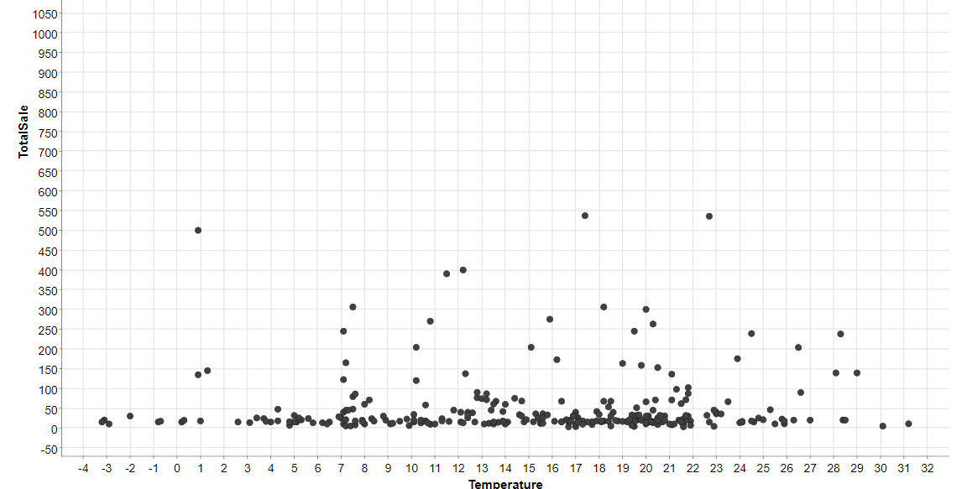
ANALYTICS

