Slide 1
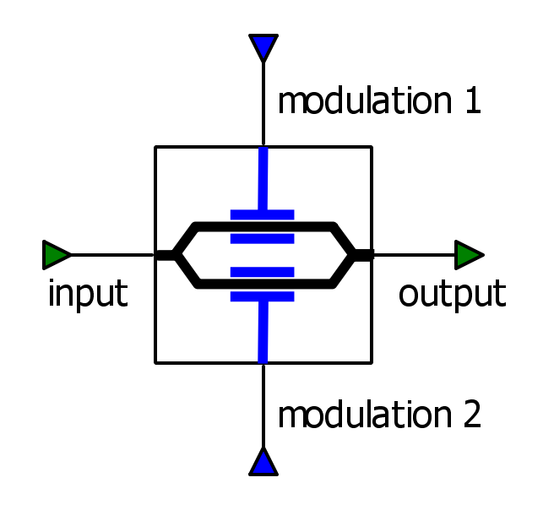

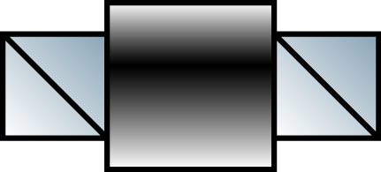
TIA
DSP
DAC
Fiber
Loop
Polarization
Controller
LASER
Isolator
Transmitted
Signal
TIA
DSP
DAC

