Slide 1
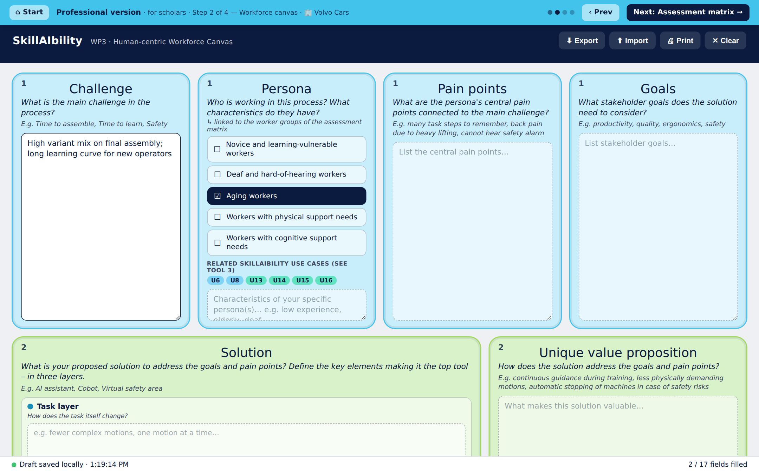
Chalmers contribution to WP3
T3.2 Skill-gap mapping & personas · T3.3 Assessment methodologies — from human-centric criteria to an interactive workshop toolkit
MAIN OUTCOME
5
118
24
10
Interactive Workshop Toolkit
publications
workshop participants
survey respondents
operator interviews
IFAC · APMS · SPS ×2 · PLM
2 AIM co-creation events
managers & experts
SSAB · System 3R · Natl. Gummi
Turns the WP3 models into a browser-based, data-collecting workshop – no login, no install.
1
Workforce canvas
Research results feeding D3.2
open brainstorming
Worker-demand taxonomy – core (physical / cognitive / sensing) and contextual demands (leadership, training, social inclusion) · SPS 2026
Human–AI collaboration principles – trust, autonomy, usability for shared tasks · APMS 2026
Five vulnerable-group personas + multimodal-redundancy design principle · PLM 2026
Operator evidence – 10 interviews → 6 human-centric factors, 5 implementation principles (involvement, transparency, social learning, learning by doing, continuous governance)
Actionable requirement lists – Task characteristics TA1–9, Technology requirements TE1–16, Organisational conditions OR1–10, mapped per worker group × learning pathway
Assessment building blocks – user journeys, goals & metrics, micro → macro KPIs, human value–technology fit
2
Assessment matrix
checklists → linked solution
3
Use case matching
gaps vs. real use cases
Interconnected: shared worker groups, learning pathways and TA / TE / OR lists; canvas and solution canvas mirrored live
Guided flows: Industrial (2 steps, 40–60 min) and Professional (4 steps, 65–90 min), instructions and timing at every step
Automated data collection: one Submit → Google Sheet, analysis-ready tabs, Excel workbook emailed to the team
Validated: canvas piloted with 50 AIM participants – praised for collaboration, guided brainstorming, clear steps
diamondcao1996.github.io/SkillAIbility-WP3
Next: Prysmian pilot validation (M26) → assessment tools and methodology in D3.2 (M30) → feeds the T3.4 maturity model and WP4 Learning Factory training

