Slide 1

WP3 Workshop procedure
Interactive workshop toolkit
Grouping · guided steps · results
diamondcao1996.github.io/SkillAIbility-WP3
September 2026

Slide 2
Three interconnected tools
Everything runs in the browser – no login, no install. One device per group; the tools share their data on that device.
1
Workforce canvas
2
Assessment matrix
3
Use case matching
Open-ended discussion and brainstorming around your own case: personas, challenge, pain points, goals, a first solution, KPIs, action plan.
Organise the ideas into actionable requirement checklists per worker group × learning pathway, then design a solution linked to those checklists.
Match your institute's SkillAIbility use cases against the requirement lists and mark what is missing.
Interconnected: the same five worker groups everywhere · the requirement code lists (TA / TE / OR) live in the matrix and appear in the solution canvas and the use case toolkit · the workforce canvas and the solution canvas mirror each other live · company and participants are entered once on the start page.

Slide 3
Before you start: form the groups
The grouping rule decides who shares a computer.
Same use case → one group, one computer
Different use cases → own computer each
→
1 PC
PC
PC
PC
Everyone working on the same use case sits together and fills in the tools together.
One person types; the group discusses and agrees.
The group's name is the Company / organisation entered on the start page – it identifies the submission.
Keep the same device and browser for the whole session: the tools share their data on that device.
People working on different use cases fill in the tools individually – even if they are from the same institute.
Each person uses their own computer and their own start-page entry.
Each becomes a separate submission in the results.
Tip: name the entry after the use case (e.g. “MADE – U10 Visual guidance”) so results are easy to tell apart.

Slide 4
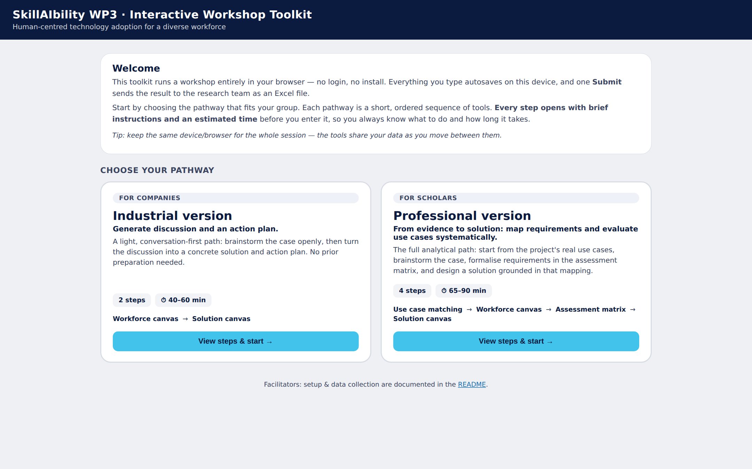
Start page and the two versions
Every step then opens with brief instructions and an estimated time before you enter it.
Industrial Version
Academic Version
companies · 2 steps · 40–60 min
scholars · 4 steps · 65–90 min
Workforce canvas
Solution canvas
1. Use case matching
2. Workforce canvas
3. Assessment matrix
4. Solution canvas
Generate discussion and an action plan. Conversation-first, no preparation needed.
From evidence to solution: map requirements and evaluate use cases systematically. The rest of this deck follows these four steps.
Company / organisation, participants and date are entered once here and carried through all tools.

Slide 5
The four learning pathways
Every solution aims at one or more of these. They are the columns of the assessment matrix and the pathways of the use case mapping.
Augmentation
Inclusion
Symbiosis
Empowerment
enhance what workers can do
make the job accessible
human and AI work as one system
workers grow and decide
Technology extends what a worker can do. It strengthens human capabilities – physical, cognitive or sensory – so the worker performs the task better, faster or more safely, while the human stays in charge of the task.
Technology removes barriers so that workers who would otherwise be excluded – novice or learning-vulnerable, ageing, deaf and hard-of-hearing, or with physical or cognitive support needs – can perform the task and take part in work on equal terms.
Human and technology work as one system. Tasks are shared and adapted dynamically, each side compensating for the other's limits, with continuous two-way communication, transparency and trust.
Technology helps the worker to grow and to decide. It builds skills, autonomy and confidence, and gives workers a say in how the technology and the work around it are shaped.

Slide 6
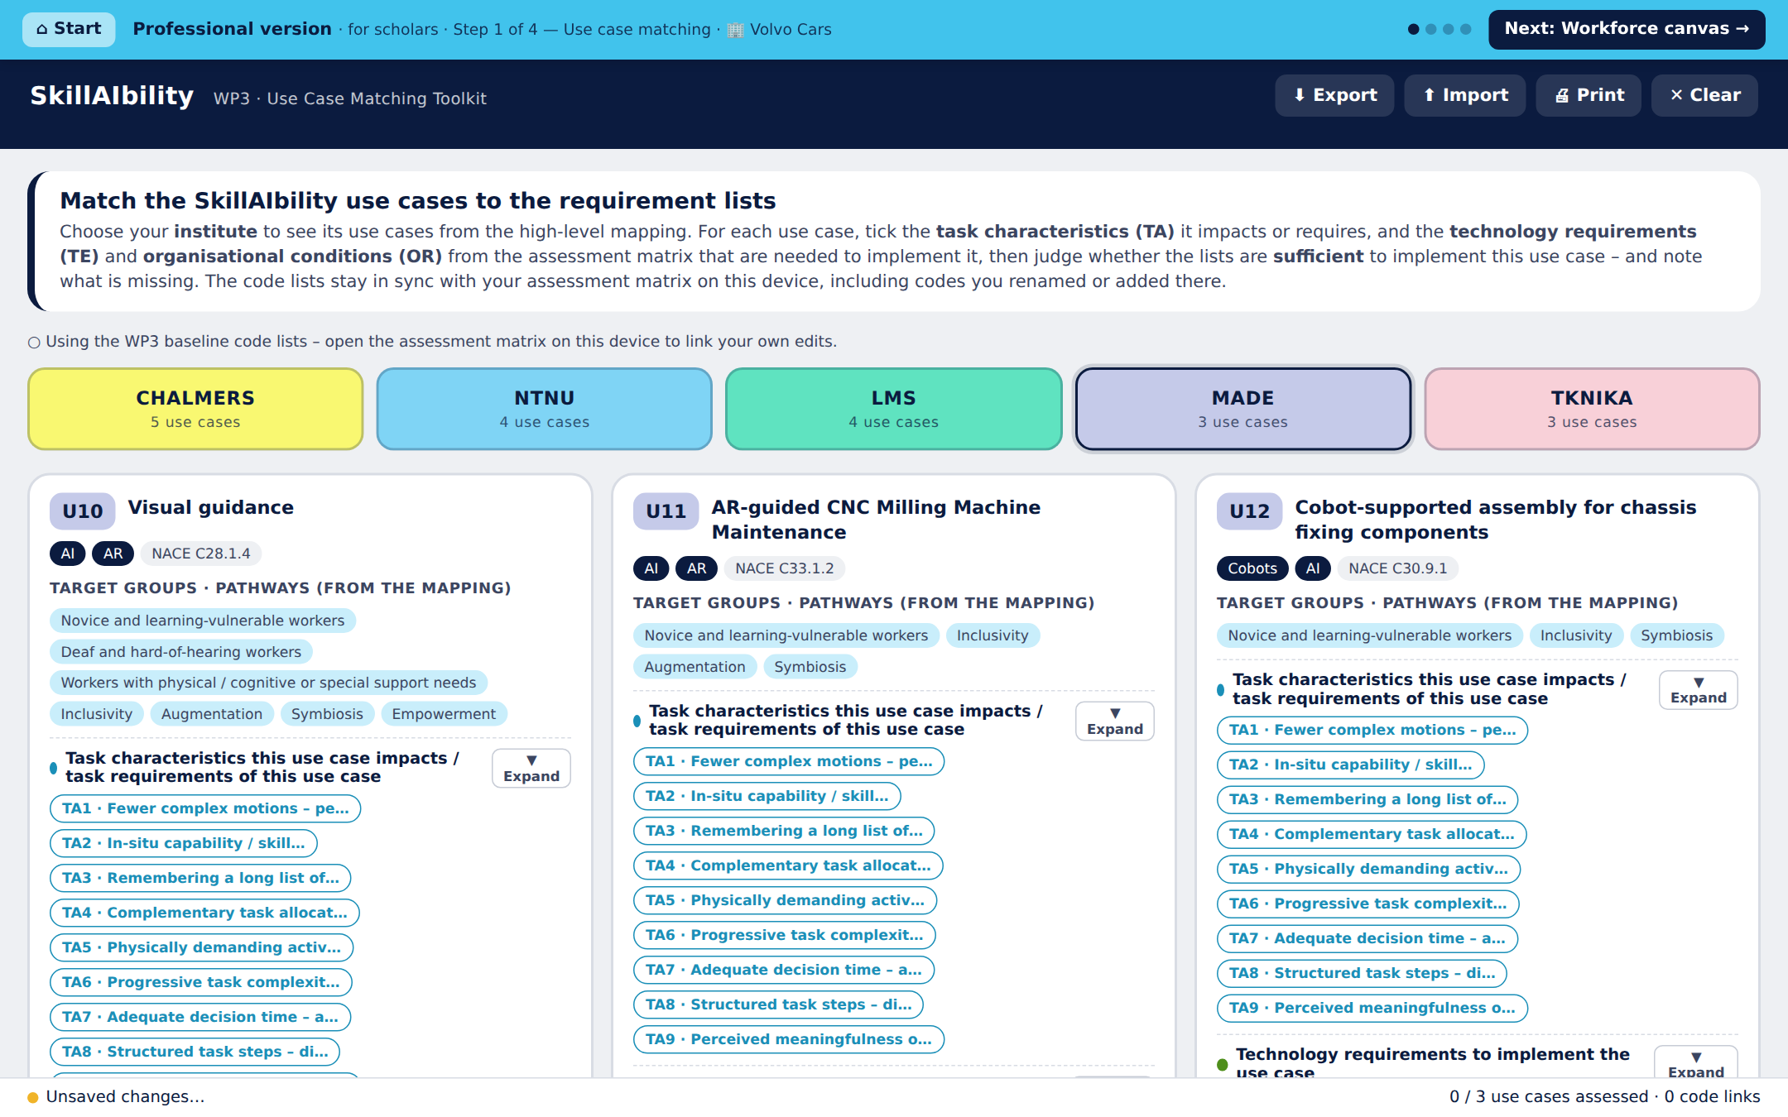
Step 1 · Use case matching
⏱ 10–15 min
Ground the workshop in the project's real SkillAIbility use cases.
1
Choose your institute (CHALMERS, NTNU, LMS, MADE, TKNIKA) – you see only its use cases.
For each use case, tick the Task characteristics (TA) it impacts, and the Technology requirements (TE) and Organisational conditions (OR) needed to implement it.
Use ▼ Expand on any list to read the full text of every item.
Judge whether the lists are sufficient to implement the use case: yes / partly / no.
Note what is missing – these gaps feed the discussion in the next steps.
No Submit here: you submit once, at the last step.
Everything autosaves on this device. The guided bar at the top shows your step and leads to the next one.

Slide 7
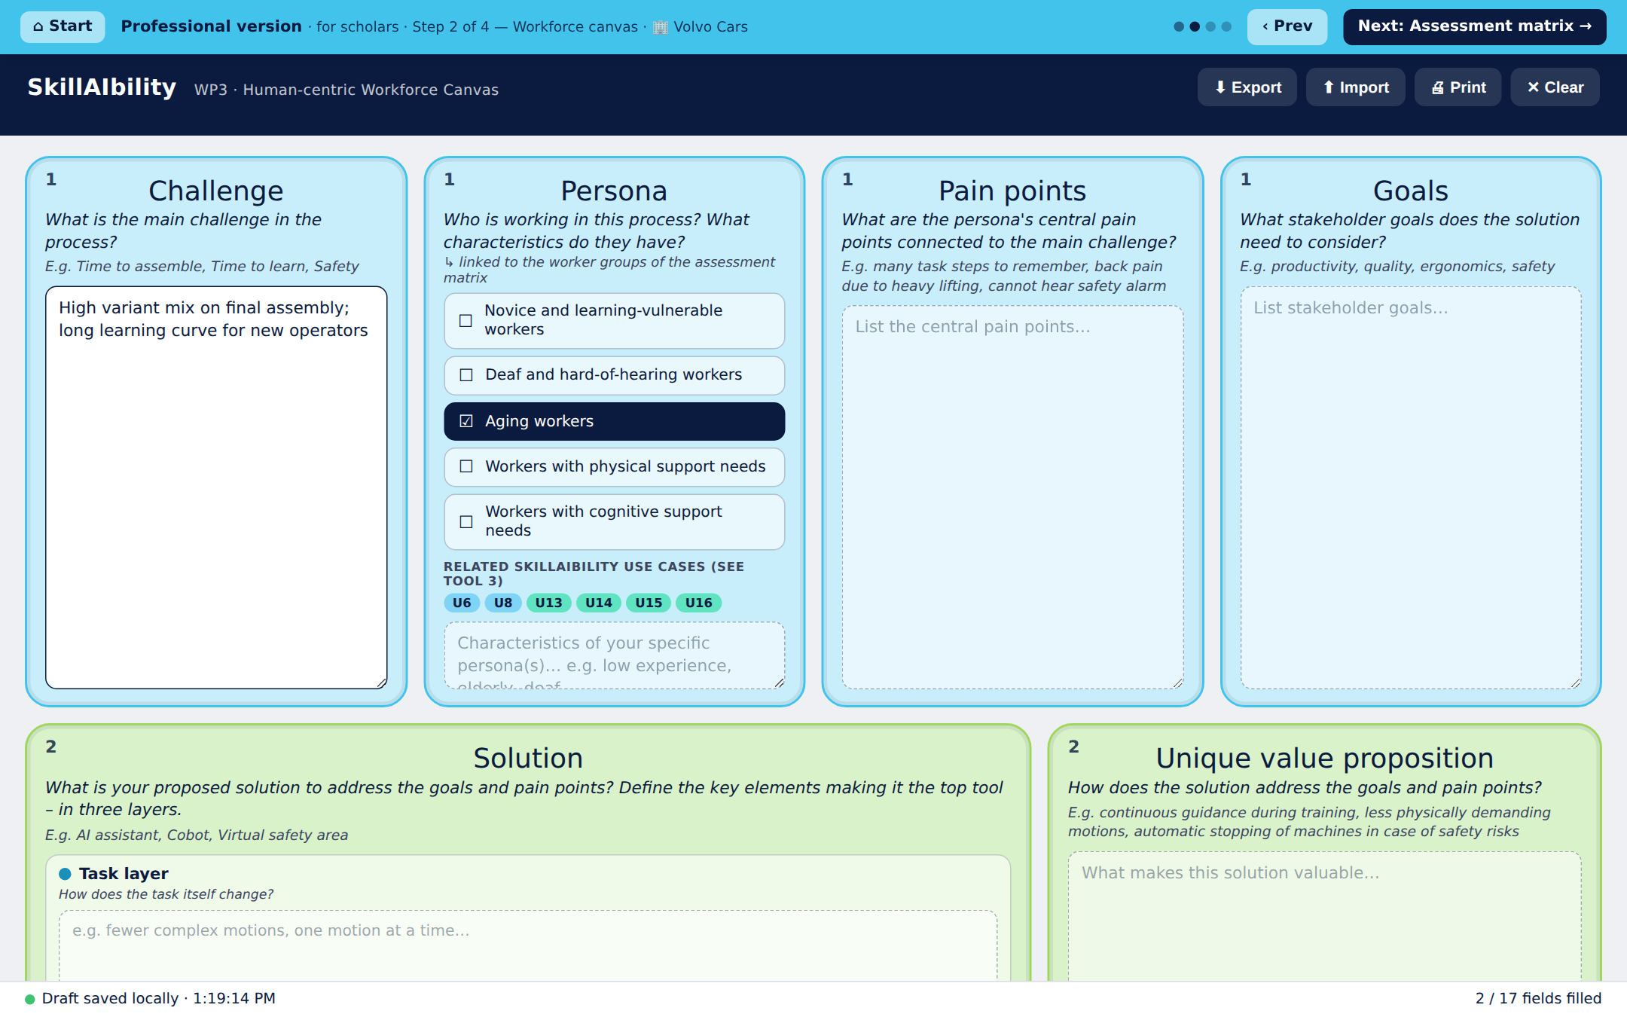
Step 2 · Workforce canvas
⏱ 25–30 min
Brainstorm the human-centred case that frames the requirements.
2
Pick the worker groups (personas) your use case is for, and describe your specific persona.
Work through the boxes: Challenge → Pain points → Goals → an initial Solution (task / technology / organisation) → Unique value → Risks → KPIs → Skills → Action plan.
In the KPIs box, use 📊 Score success metrics to rate how you will measure success.
Keep it open and exploratory – the requirements are formalised in the next step.
Everything you write here is mirrored into the solution canvas of step 4, so you never type it twice.
Everything autosaves on this device. The guided bar at the top shows your step and leads to the next one.

Slide 8
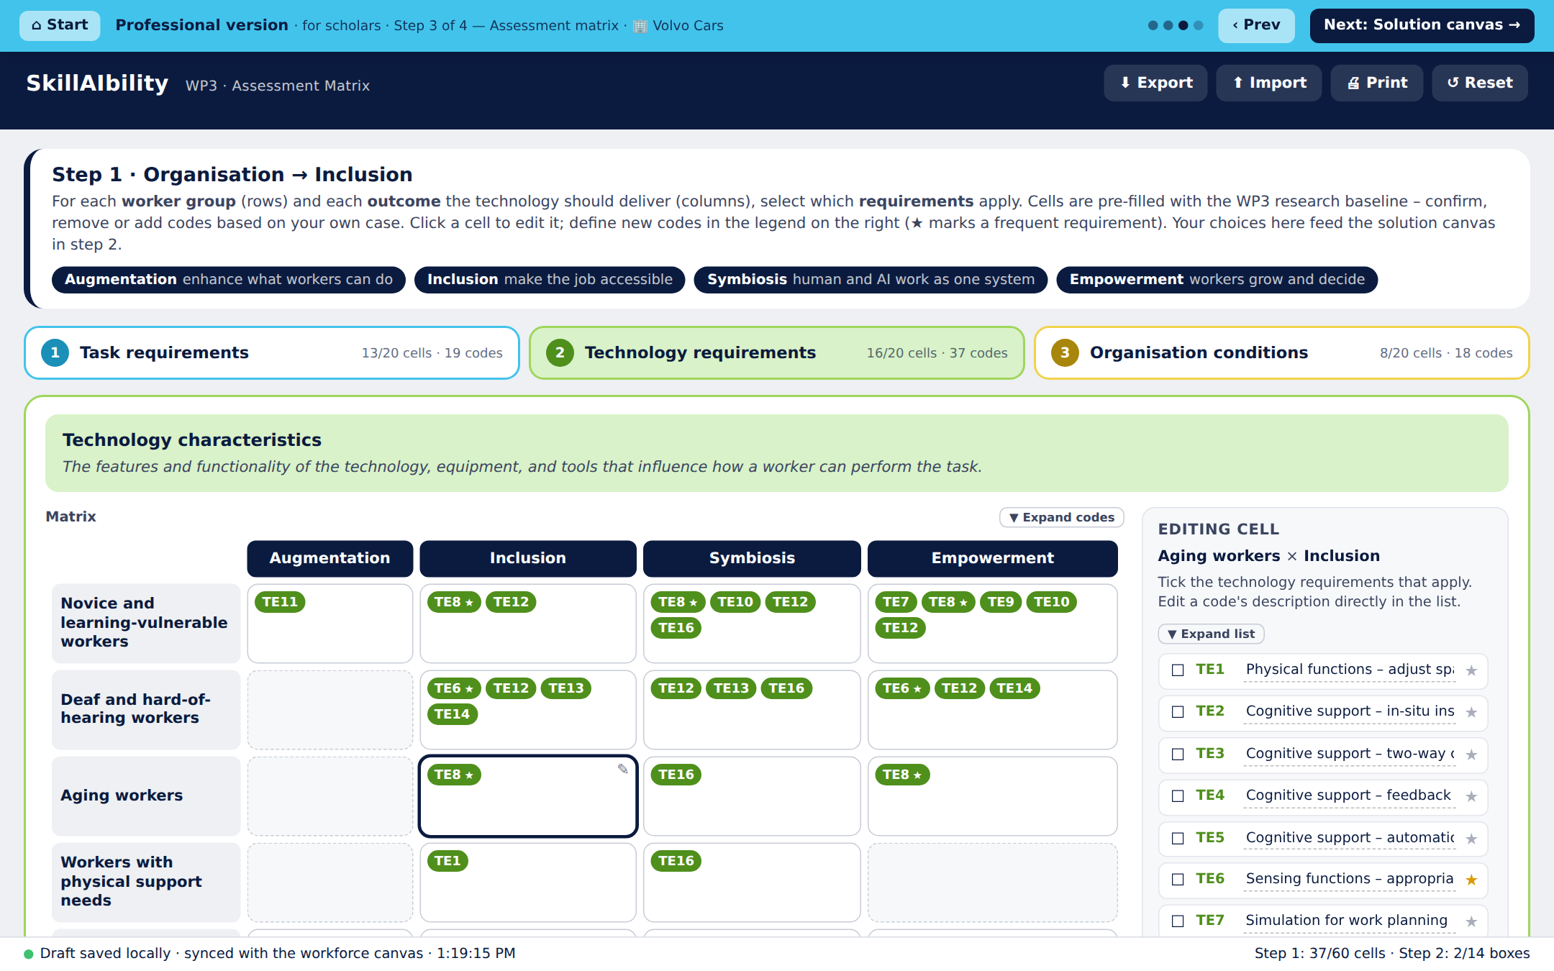
Step 3 · Assessment matrix
⏱ 25–35 min
Formalise requirements per worker group × learning pathway – the analytical core.
3
Three dimensions, each a grid of worker groups × learning pathways: Task characteristics (TA), Technology requirements (TE), Organisational conditions (OR).
Cells are pre-filled with the WP3 research baseline – confirm, remove or add.
Click a cell, then tick / untick codes in the legend on the right; add a note for the cell.
Rename codes, add new ones (+ New code) or mark frequent ones with ★.
▼ Expand codes shows full text inside the cells; ▼ Expand list shows the full legend.
The lists you build here flow into the solution canvas and back to the use case toolkit.
Everything autosaves on this device. The guided bar at the top shows your step and leads to the next one.

Slide 9
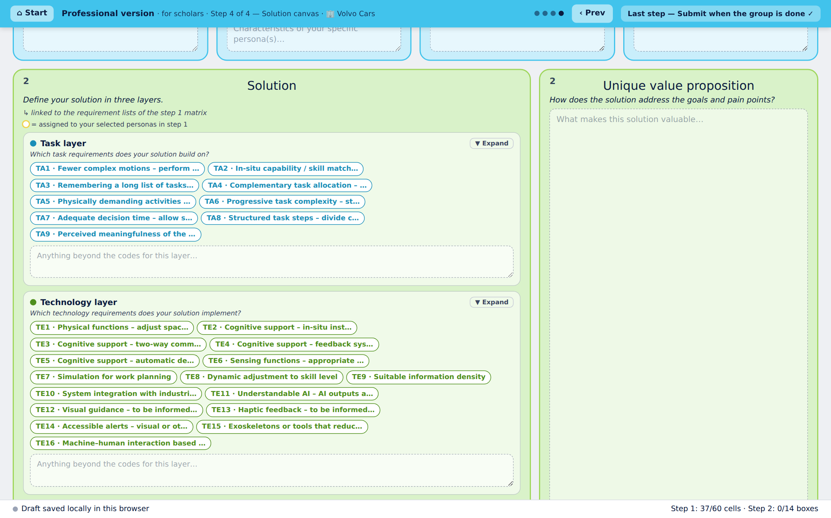
Step 4 · Solution canvas
⏱ 5–10 min
Design the solution, linked to the requirements you mapped.
4
Your texts from step 2 are already here – this canvas mirrors the workforce canvas.
Click the three solution layers – Task characteristics (TA), Technology requirements (TE), Organisational conditions (OR) – and select the codes your solution builds on.
Codes assigned to your personas in step 3 are ringed in yellow as suggestions; add free text for anything beyond the codes.
Then reflect on the free-text boxes – challenge, pain points, goals, UVP, risks, KPIs, skills, action plan: does the solution still answer them? Refine where needed.
When the group agrees: Submit all steps.
Everything autosaves on this device. The guided bar at the top shows your step and leads to the next one.

Slide 10
Submitting: once, at the last step
No Submit button on earlier steps – nothing can be sent by mistake.
1
2
3
4
Group finishes the last step
One click sends everything
Rows land in the Google Sheet
One email to the research team
→
→
→
The Submit all steps button appears only on the last step of the flow.
All steps of the flow – use case matching, workforce canvas, matrix, solution canvas – are sent together, in a second or two.
One tab per tool, analysis-ready (wide and long formats).
About 1–2 minutes later: a summary of the submission plus the complete workbook as an Excel attachment.
Good to know Groups can re-submit; every submission is stored separately. · Export gives a JSON backup any time (Ctrl/Cmd + S). · Print makes an A3 PDF of a canvas. · If a page looks outdated, hard-refresh (Cmd/Ctrl + Shift + R). · Company is required: it identifies the group.

Slide 11
Suggested agenda (Academic)
About 95 minutes including introduction and wrap-up. Adjust to your slot.
0–10 min
Introduction
Purpose, the four learning pathways, grouping rule, start page: enter Company / participants / date, choose the version.
10–25 min
Step 1 · Use case matching
Institute's use cases vs. TA / TE / OR lists; sufficiency and gaps.
25–55 min
Step 2 · Workforce canvas
Personas, challenge → action plan; score success metrics.
55–85 min
Step 3 · Assessment matrix
Worker groups × pathways for TA, TE, OR; refine the code lists.
85–95 min
Step 4 · Solution canvas
Select the codes in the three layers, reflect on the texts, Submit all steps.
95+ min
Wrap-up
Each group presents its solution in two minutes; facilitators have the Excel results in their inbox.

Slide 12
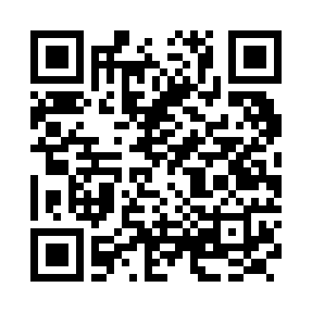
Ready to start
Open the start page on the group's computer and choose a version.
Start page
diamondcao1996.github.io/SkillAIbility-WP3/
Workforce canvas
…/SkillAIbility-WP3/canvas.html
Assessment matrix
…/SkillAIbility-WP3/inclusion.html
Use case matching
…/SkillAIbility-WP3/usecases.html
Scan for the start page
Repository & facilitator guide
github.com/DiamondCao1996/SkillAIbility-WP3
Facilitators: setup and data collection are documented in the README.

