Slide 1


A personal
physiological world model
个人生理世界模型
A complex adaptive system
复杂适应系统与交互演示
Concept hardware / 硬件概念图
Research prototype / 研究原型
01
Notes:
MOND as a complex adaptive system is an architectural framing of the person, changing context and feedback over time. The implemented engine is a transparent personal decay autoregression. It is not a validated full nonlinear simulator or an autonomous treatment policy.
将人与情境、观测和反馈看作复杂适应系统。当前可运行部分是透明的个人衰减自回归原型，行动响应学习仍属后续研究。
Style source: MOND_Poster_Style_Updated.pptx, slides 1,3,9,17. Preserve ivory/sage palette, PingFang SC, source theme and MOND logo.
Implementation: prediction-lab/engine.js, user-results.js. Engine mond-lab-1.1.0, 5 November 2026.

Slide 2
The full factor landscape
覆盖完整因素体系
Physiological observations
Personal profile
Behaviors and settings
生理观测
个人画像
行为与场景
HRV, resting heart rate
Sleep, physical activity
Age, height
Education level
Diet, daily habits, sport
Work, reading, meditation
HRV、静息心率
睡眠、身体活动
年龄、身高
教育背景
饮食、日常习惯、运动
工作、阅读、冥想
Temporal context
Health research
Additional context
时间背景
健康研究拓展
补充个人背景
Time of day, season
Heart failure, mental health
Life expectancy
Menstrual cycle
时段、季节
心力衰竭、心理健康
预期寿命
月经周期
02
Notes:
Scope transcribed from HRV Evidence and World Model Development Report, 31 October 2026, Scope of the model and Factor evidence and models 1–6. Original18: HRV,RHR,sleep,physical activity,age,height,education,heart failure,mental health,life expectancy,diet,daily habits,sport/exercise,work,reading,meditation,time of day,season. Menstrual cycle is an additional optional context factor from later research. Health endpoints remain separate research extensions. Inclusion in architecture does not imply every variable is implemented in the lab. Model status is specified on slide7. Profile/behavior/context requires explicit logs, no inferred habits from HRV.

Slide 3
One world model, a continuous feedback loop
观测、状态、预测与行动形成持续反馈
New records / 新记录
Observe
State
Predict
Act
观测
状态
预测
行动
Quality + context
Level + deviation
Trajectory + range
Feasible choices
质量与情境
长期水平与短期偏移
变化轨迹与不确定性
适合当下的自主选择
Action and outcome feedback / 行动与结果反馈（规划）
Target architecture: personal dynamics, delayed effects and uncertainty across timescales.
目标架构：刻画多时间尺度的个人动态、延迟影响与不确定性。
03
Notes:
Target architecture from original report: observation, hierarchical probabilistic personal state, context/event-conditioned transitions, action-response and decision/explanation. Continuous event timeline includes arrival times, quality, device, missingness. Shared population parameters with personal adaptation are planned. The working lab currently runs explicit personal reference/decay AR forecasting, not full latent-state inference. Dashed return: durable execution/outcome logging and learning action effects are planned. Both loops are a target architecture. Present action selection is an in-memory intention only.
实线路径可在实验页手动运行。虚线表示尚待建设的执行与结果回流、个体行动效应学习。用户选择建议目前只表达临时意向。
Sources: engine.js calc(), advice(), fit(); user-results.js optional suggestion buttons.

Slide 4
Support across everyday life
面向完整日常生活的支持
Daily habits
Sport and activity
日常习惯
运动与活动
Sleep, reading, meditation
Load, easy movement, recovery
睡眠、阅读、冥想
负荷、轻松活动、恢复
Work
Diet
工作
饮食
Breaks and task rhythm
Meal context and timing
短休息与任务节奏
结合饮食背景与进食时间
Choose one feasible step. Track behavior, energy and fatigue alongside physiology.
选择一个可执行的小步骤，结合生理变化记录行为、精力与疲劳。
04
Notes:
Original report recommendation areas: diet,daily habits,sport,work. Reading and meditation are optional habit-level actions with their own evidence and preferences. Examples are candidate choices, not fitted causal effects. Diet requires diet/meal context; work requires user-confirmed context; avoid inferring exposures from HRV. First release rule suggestions and user-facing optional choices are implemented; durable execution/outcome capture and action-response learning require further work. Outcomes should include energy,fatigue,sleep,behavior,performance,adherence and prompt burden, with HRV one outcome among others. Exact plan first-stage general adult wellness, not disease diagnosis or life expectancy prediction.

Slide 5
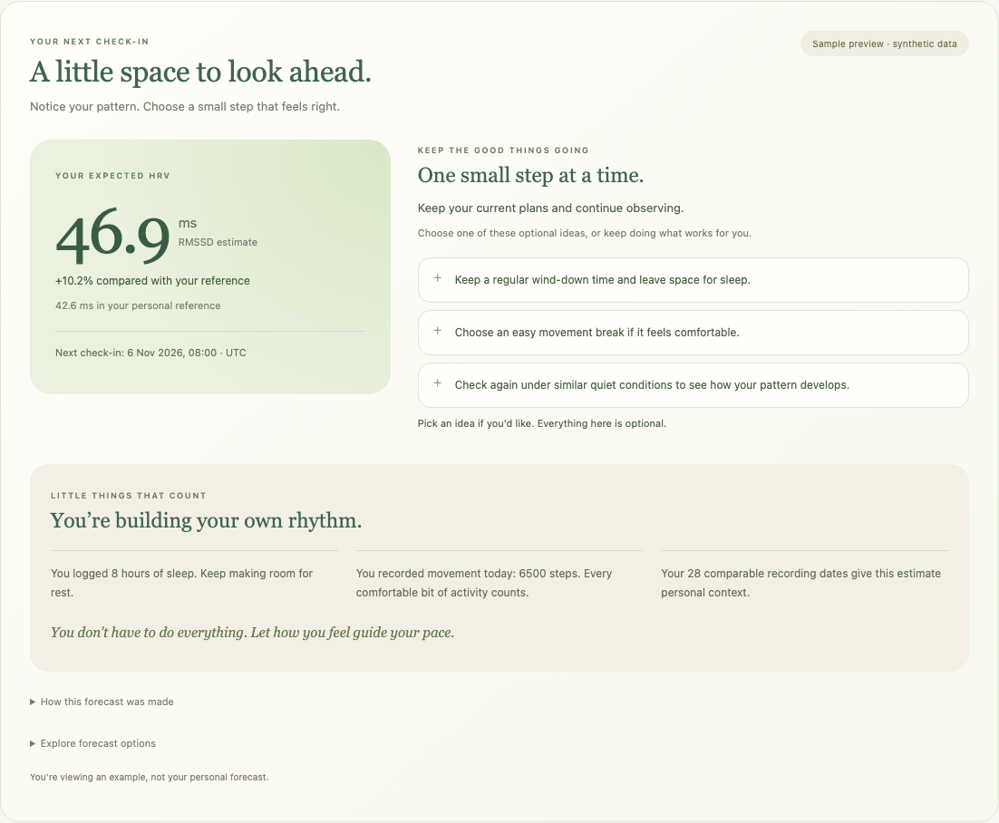
Expected HRV, with a useful next step
把预期 HRV 与可选择的建议放在一起
46.9 ms
+10.2% vs personal reference
较个人参考值高 10.2%
Acknowledge logged habits
肯定已记录的习惯
Offer one manageable step
提供一个易尝试的小步骤
Synthetic example / 合成演示数据
05
Notes:
Actual screenshot of default synthetic user sample, 5 November 2026. Personal reference~42.6ms, latest50ms, tau48h, forecast24h, beta0. Output46.9ms,+10.2%. This rise vs reference comes from persistence of recent deviation, not a predicted benefit of sleep or activity. A higher value is not always better health.
主页 Personal Context 下方。可选择小步骤，查看已记录的积极习惯，展开解释。勾选仅是临时意向，不代表完成或预测更新。
Source: docs/demo/images/user-forecast.png and user-results.js.

Slide 6

Explore the model, then view the result
探索模型，并在用户端查看结果
01
Load sample
载入合成示例
02
Run forecast + backtest
运行预测与回测
03
Edit and compare
修改参数并比较
04
Save and view in app
保存后在用户端查看
Synthetic records demonstrate the workflow. They do not establish predictive validity.
合成数据用于演示流程，不能证明模型预测有效。
06
Notes:
UI sequence: 载入合成示例, 运行预测与回测, inspect 预测与观察 and 用未来数据检验. Save A, change parameter, run B. Lab sample differs from positive user sample. Screenshots are synthetic and do not show validated predictive effectiveness.
参数均可编辑，但正值、合法时间等数学和格式校验保留。拟合门槛默认 max(30,10×参数数) 有效日期，岭回归固定 tau。
Source: prediction-lab.html, lab.js, docs/demo/images/lab-overview.png.

Slide 7
Build the whole model through evidence
以证据逐步建设完整世界模型
01
02
03
Working prototype
Personal world model
Adaptive support
当前可运行原型
完整个人世界模型
个性化适应支持
Forecast, compare, explain
State, context, interactions
Test actions, learn responses
预测、比较、解释
状态、情境、因素互动
检验行动、学习响应
Clinical and survival extensions have separate validation pathways.
临床与生存研究拓展采用独立验证路径。
07
Notes:
Full research scope is broader than the current lab implementation. Today engine implements HRV/reference/continuous-time decay plus optional sleep/activity/RHR/cycle inputs and rule suggestions; manual fitting/backtesting. Planned hierarchical state-space personal model integrates profiles,timing,events,lagged interactions,uncertainty. Future action-response learning uses microrandomized/N-of-1 experiments and prospective policy evaluation. Heart failure,psychiatric diagnosis,survival/life expectancy remain separate protocols, independent outcomes and linked clinical/event data. No statement that all18 factors are currently trained. Source original report architecture,stages0–6 and validation, plus implementation engine.js.

Slide 8
Papers across the full model
覆盖完整模型的论文参考
HRV / 测量
Rigor and reproducibility guidelines (2026)
Sleep / 睡眠
Sleep deprivation and HRV (2025)
Exercise / 运动
Exercise training and HRV (2024)
Work / 工作
Job stress and autonomic activity (2018)
Diet / 饮食
Mediterranean diet and autonomic function (2010)
Actions / 行动
HeartSteps micro-randomized trial (2019)
Cycle / 周期
Individual cycle-related HRV dynamics (2026)
Systems / 系统
Holland: Complex Adaptive Systems (1992)
Click titles for sources. All 39 original references and factor mapping are in the guide.
点击标题打开来源；原始 39 篇参考文献及因素映射见配套指南。
08
Notes:
Selected representative sources from the original39-paper bibliography plus the added cycle study. Original source IDs:32 HRV,21 sleep,36 exercise,26 work,16 diet,31 action trials. Additional Holland1992 and Schaffarczyk2026. Full39 linked original bibliography and source-by-factor mapping in accompanying Markdown guide. References are architectural/methodological evidence, not pretrained MOND weights or proof of model validity.

