Slide 1
MOND / MODEL DEMONSTRATION
Personal HRV prediction
Model, user experience
and hands-on walkthrough
A configurable research prototype for personal forecasts
with transparent assumptions and retrospective tests
5 November 2026 • Engine 1.1.0
1
Notes:
Demonstration deck for current MOND code. Open hosted app at https://mond-hrv-prediction-lab.muxueqianxun.chatgpt.site/app.html#user-prediction and lab at the site root. This prototype is experimental. Companion guide: docs/demo/MOND_Model_and_Interaction_Guide.md. Screenshots show synthetic data.

Slide 2

MOND / MODEL DEMONSTRATION
The app and the prediction lab
The app
Expected HRV
Personal comparison
Optional next steps
The lab
Editable inputs, assumptions
and evaluation tools
5 November 2026 • Engine 1.1.0
2
Notes:
The user app presents results and optional ideas. The lab lets researchers edit assumptions, import records, fit coefficients, compare configurations and evaluate historical predictions. Source: index.html, prediction-lab.html and prediction-lab/lab.js. The Site is private. Local app and lab must share an origin for saved browser data.

Slide 3

MOND / MODEL DEMONSTRATION
A forecast users can understand
46.9 ms expected RMSSD
About +10.2% versus
a 42.6 ms reference
The sample is clearly labeled.
Higher HRV does not always
mean better health.
5 November 2026 • Engine 1.1.0
3
Notes:
This screen is a synthetic example, not an actual participant outcome. The sample uses 50 ms as the latest measurement, a personal log reference of about 42.6 ms and tau=48h. The zero-coefficient 24h forecast is about 46.9 ms, +10.2% versus reference. Sleep/activity are context, not the cause of the projected rise. The card is immediately after Personal Context.

Slide 4
MOND / MODEL DEMONSTRATION
The personal forecast formula
Forecast lnRMSSD = personal reference
+ exp(−elapsed hours / τ) × latest deviation
+ background coefficients × centered context
Personal reference: daily-weighted history
Latest deviation: recent reading relative to that reference
Context: sleep, activity, resting pulse and optional cycle phase
5 November 2026 • Engine 1.1.0
4
Notes:
Source: prediction-lab/engine.js calc(). Delta is the time from the latest eligible measurement to the target. Background values and centering are available at the prediction origin. Exponentiating the log forecast gives a median-form RMSSD estimate, not a calibrated arithmetic mean. It is not a complete hierarchical state-space model.

Slide 5
MOND / MODEL DEMONSTRATION
Comparable personal history
28 days
7 / 14 dates
Rolling reference window
Initial / more mature comparison
Same device and recording conditions
Local clock time within ±2 hours
Each date has equal reference weight
Current-day readings stay out of the reference
5 November 2026 • Engine 1.1.0
5
Notes:
Defaults from engine.js: 28-day window, 7 initial dates, 14 mature dates, ±2 local-clock hours, 120-second records. Exclude the current local date. Match user, PPG/ECG modality, device, algorithm, duration, posture, breathing and quality. Average within dates on log scale then average dates equally. These are adjustable engineering gates, not validated scientific thresholds.

Slide 6
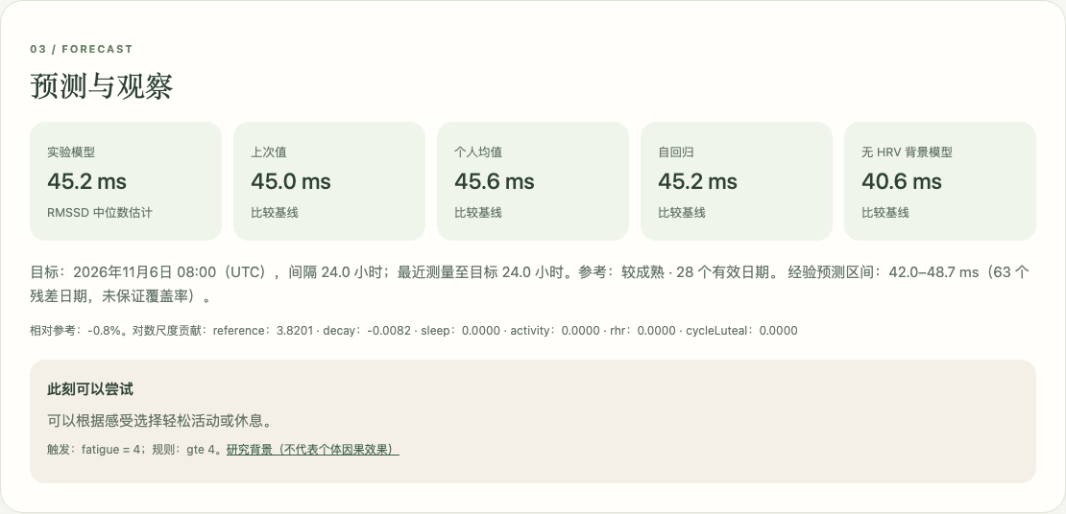
MOND / MODEL DEMONSTRATION
A repeatable lab demonstration
1 Load sample records
2 Run prediction
3 Review supporting data
4 Inspect backtest results
Synthetic demonstration data. These results do not establish predictive performance.
6
Notes:
Live sequence: Load synthetic sample, Run prediction/backtest, inspect results. Source: prediction-lab/lab.js. Synthetic data demonstrates function only. Read errors/exclusions before interpreting the numbers. Open the formula and settings explanation if asked.

Slide 7
MOND / MODEL DEMONSTRATION
Parameter comparison and fitting
Scenario A and B
Historical fitting
Same records
A saved configuration
One changed assumption
A visible difference in output
Ridge regression
Fixed time constant
Enough valid training dates
Past-only training at each origin
Changing a coefficient tests the model’s sensitivity. It does not estimate an action’s causal effect.
5 November 2026 • Engine 1.1.0
7
Notes:
Save A using identical records. Change sleep coefficient to 0.05 as a deliberately arbitrary assumption, then Run B. It does not encode a published sleep effect. Fit coefficients uses ridge regression with fixed tau; daily total weights equal. Default gate max(30,10 x parameter count). With fitted mode, backtests refit at each past origin. Manual values and inspected backtests remain exploratory.

Slide 8
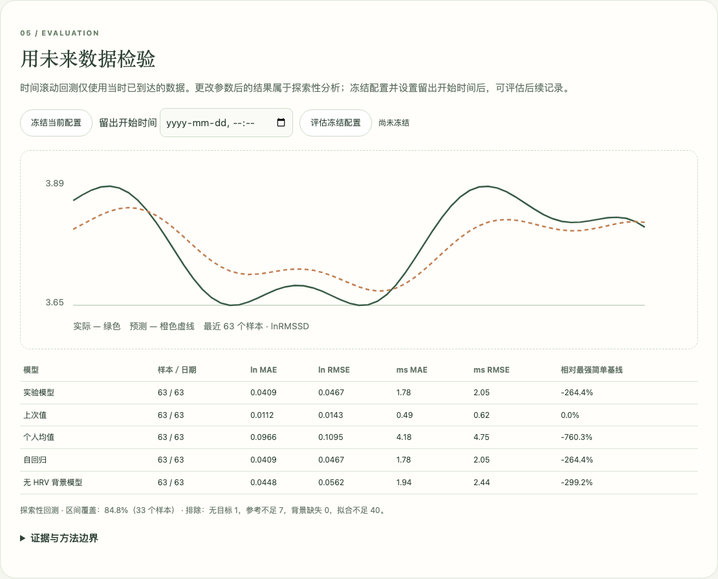
MOND / MODEL DEMONSTRATION
Backtesting with future outcomes
Past information only
Common evaluation samples
Missing targets remain missing
Error and interval coverage
Synthetic demonstration data. These results do not establish predictive performance.
8
Notes:
Source: engine.js backtest(), matchTargets(), fit(). Sort by information arrival. Match closest eligible target within ±2h by default and never score the same target twice. Use common valid samples across models. Interval residuals must already be available at origin and have >=30 dates by default. Coverage is empirical, not guaranteed. The sample graph is synthetic.

Slide 9
MOND / MODEL DEMONSTRATION
Cycle evidence supports personal testing
2019 meta-analysis
Average cardiac vagal activity decreased
from follicular to luteal phase
2024 wearable amplitude model
Quantified within-cycle variation
in resting pulse and RMSSD
2026 cyclic mixed model
Strong individual variation with
a flat population lnRMSSD pattern
5 November 2026 • Engine 1.1.0
9
Notes:
Sources: https://pmc.ncbi.nlm.nih.gov/articles/PMC6912442/ ; https://pmc.ncbi.nlm.nih.gov/articles/PMC11666598/ ; https://pubmed.ncbi.nlm.nih.gov/42012497/ . The 2019 meta-analysis pooled CVA metrics, not one calibrated personal RMSSD response. The 2026 ovulation-aligned cyclic GAMM study found individual deviations despite a flat population trajectory. No pretrained weights from these studies are used.

Slide 10
MOND / MODEL DEMONSTRATION
Optional cycle inputs
Recorded phase and provenance
Known follicular = 0 Known luteal = 1 Unknown = blank
Natural-cycle status, phase source and cycle identifier
Individual contribution
Disabled and zero coefficient by default
Personal fitting requires both phases and multiple logged cycles
A no-cycle comparison checks incremental predictive value
5 November 2026 • Engine 1.1.0
10
Notes:
Fields: cycleLuteal 0 known follicular /1 known luteal/blank unknown; cycleStatus=natural; cycleMethod self_report/calendar/LH/hormone; cycleId explicit. Calendar is an estimate. Use origin-known phase as lagged covariate, never target labels. Fitting gates both phases >=5 dates and >=2 recorded IDs by default plus general gates. Do not extrapolate to contraception, pregnancy or menopause. No-cycle ablation uses same scored samples.

Slide 11
MOND / MODEL DEMONSTRATION
Suggestions and encouragement
What the user sees
What the interaction does
One main suggestion
Several optional small steps
Acknowledgment of logged habits
Encouragement at their own pace
Select or deselect an intention
Show a temporary check mark
Keep the forecast unchanged
Leave completion logging for later
5 November 2026 • Engine 1.1.0
11
Notes:
Source: engine.js advice() and user-results.js. The numerical forecast and recommendation rules are separate. Default rules use declared context, and the app additionally offers general optional ideas. Acknowledgments refer to logged sleep/activity/history and do not establish causation. Selecting an idea is in-memory only. It does not record adherence, update the forecast or train the model.

Slide 12
MOND / MODEL DEMONSTRATION
Saved results and cross-device use
Lab
App
Run the experiment
Save to this browser
Explore forecast options
Use my saved prediction
A saved result is a dated snapshot.
Export and import the JSON package to move between devices.
5 November 2026 • Engine 1.1.0
12
Notes:
Lab: run then explicitly Save to this browser. User app: Explore forecast options then Use my saved prediction. Same origin is required. Hosted app and lab share origin. localhost differs from hosted, and each browser/device has separate local storage. Export full JSON package, import/run/save on other device. Saved result retains original forecast time/version, so check stale targets. Packages may contain cycle logs.

Slide 13
MOND / MODEL DEMONSTRATION
Eight-minute demonstration
01 Read the user forecast and select an optional idea
02 Load the lab sample and run the model
03 Compare A and B, then show fitting and backtesting
04 Explain cycle provenance and missing information
05 Save, reopen in the app and export the experiment
The next research milestone is useful prospective prediction
and calibrated uncertainty on real comparable measurements.
5 November 2026 • Engine 1.1.0
13
Notes:
Suggested timing from the Markdown guide: 0–1 user sample; 1–2 optional intention/explanation; 2–3.5 load/run lab; 3.5–5 A/B coefficient; 5–6 fitting/backtest; 6–7 cycle context; 7–8 save/show/export. Current limits: no raw PPG validation, no clinical or causal conclusions, no automatic native-stream forecasting, no durable action completion feedback, no automatic cloud sync.

Slide 14
MOND / MODEL DEMONSTRATION
Reference and implementation map
Model and evaluation
prediction-lab/engine.js
Data filtering, fitting, forecasts, backtests
Interfaces
prediction-lab/lab.js and user-results.js
Research controls and user-side results
Reading and demo instructions
MOND_Model_and_Interaction_Guide.md
Linked papers, settings and presenter run sheet
5 November 2026 • Engine 1.1.0
14
Notes:
Full linked references and interface instructions are in MOND_Model_and_Interaction_Guide.md. Sources: engine.js, lab.js, user-results.js and README.md, branch feature/hrv-prediction-test. Related repositories supply methods or adjacent tasks, not pretrained MOND HRV weights: FLIRT https://github.com/im-ethz/flirt ; FitRec https://github.com/nijianmo/fit-rec ; HeartSteps https://github.com/StatisticalReinforcementLearningLab/HeartstepsV1Code . Cycle references are in slide 9 notes and guide.

