Slide 1
BMP Toolbox
Version One

Slide 2
How to link a Slicer Module

Slide 3
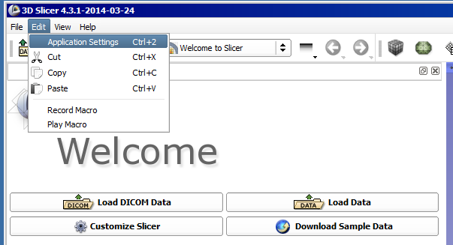
Click edit
Select “Application Settings”

Slide 4
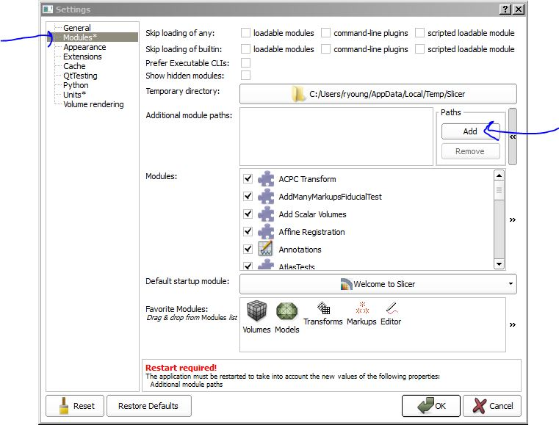
On the left choose Modules
Click add

Slide 5
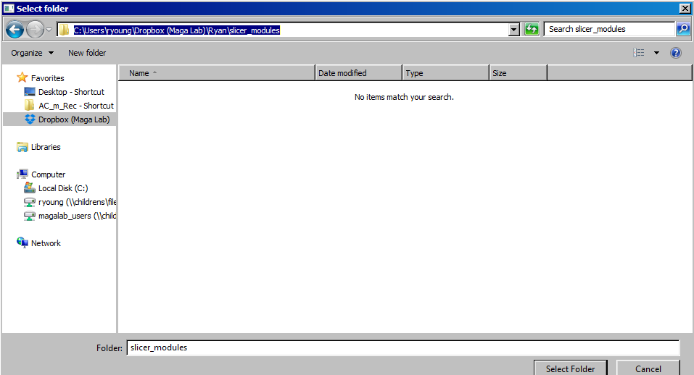
Select the following folder; \Dropbox (Maga Lab)\Ryan\slicer_modules
Click “Select Folder”

Slide 6
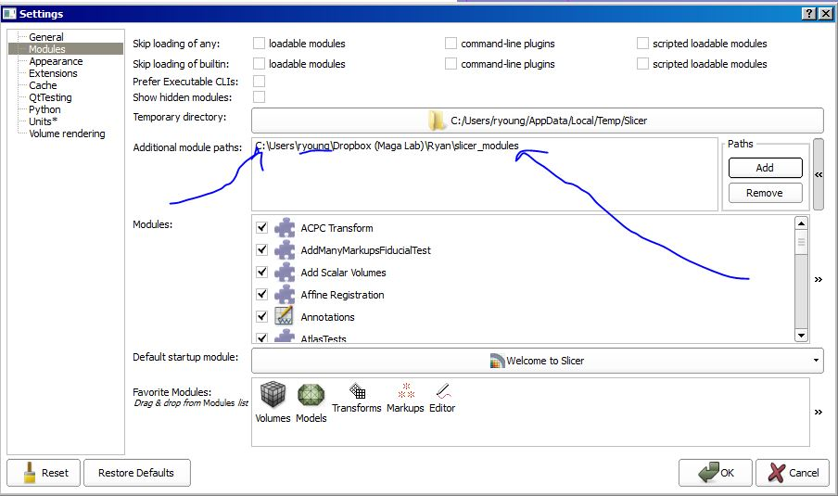
Double check path is correct. Your username will be different.
Hit “ok” on the bottom right and restart Slicer

Slide 7
Using the BMP Toolbox

Slide 8
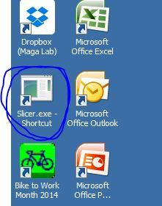
Open Slicer nightly
Open the slicer nightly. It will be much faster to load data.
You should have a shortcut on your desktop.

Slide 9
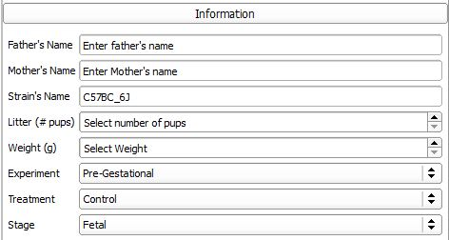
Step 1
Fill in the sample information
NO SPACES
This relates to the sample(mouse), not the scene

Slide 10
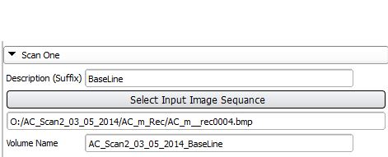
Step 2
Under the Scan 1 Button
Add one word description of scene, “day5” or “baseline”. Do this before choosing an Image Stack.
Click “Select Input Image Sequence” button and choose a bpm stack
Check that the Scene name is ok. If not change it. NO SPACES!

Slide 11
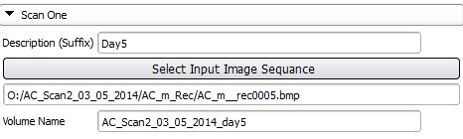
Step 3 (if importing two samples)
Under the Scan 2 Button
Add one word description of scene, “day5” or “Stained”
Click “Select Input Image Sequence” button and choose a bpm stack
Check that the Scene name is ok. If not change it. NO SPACES!

Slide 12

Step 4
Check that the sample name is ok.
Change it if needed.

Slide 13
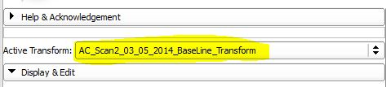
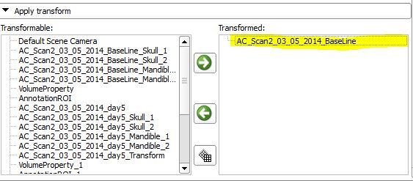
Linear Transform
When applying a transform, select the sample name from the Active Transform list.
Apply transform to correct volume

Slide 14
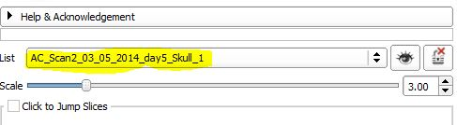
Landmarks
Enter the Markups Module
Choose the right name from the list menu. For example, the figure below is for the first set of skull landmarks

Slide 15
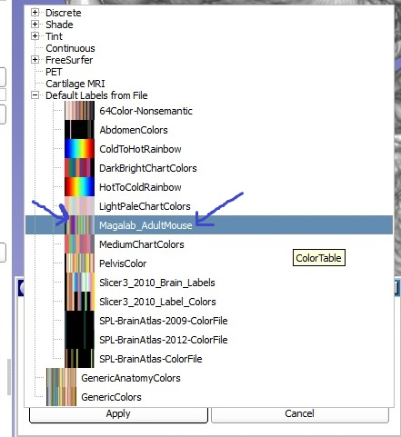
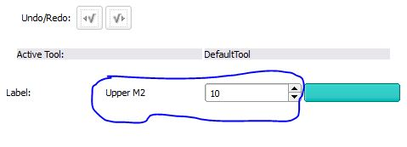
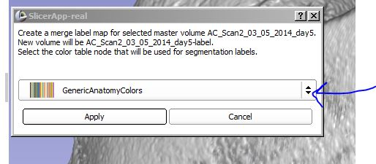
Segmentations
Choose the Editor Module.
Pick the Maga_AdultMouse color table. It is under “”Default Labels from File”
Choose the color that corresponds to your segmentation

Slide 16
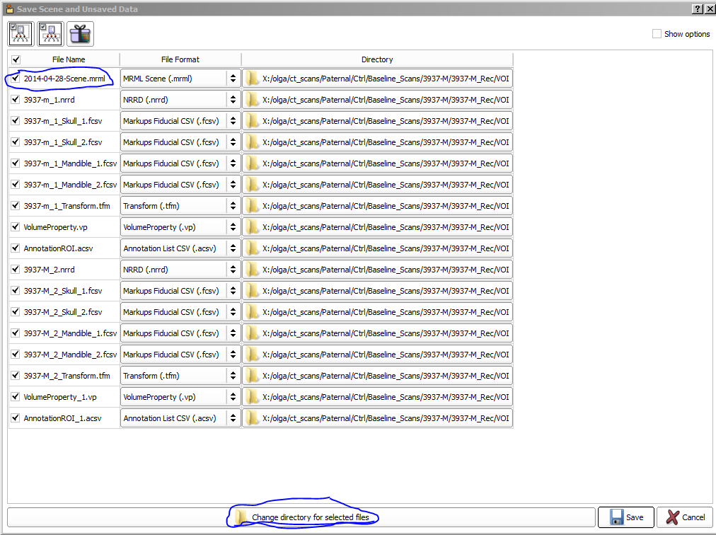
Saving the Scene
You must manually save the scene.
Double click on the name of the mrml file and change it to the sample name
Make sure all the boxes are checked
Select “Change directory for select files” at the bottom of the screen and choose the output directory.
Double check that all the files are getting saved to the same folder
Click “Save”

Slide 17
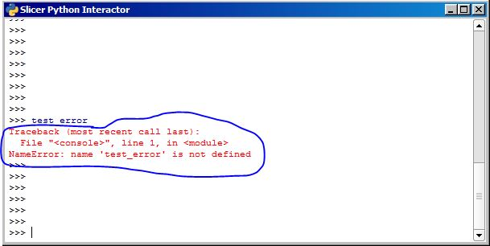

Errors
If something does not work, copy and paste the error message found in the python interactor and email it to me. Also write a sentence or two about what you where trying to do when it failed.

Slide 18
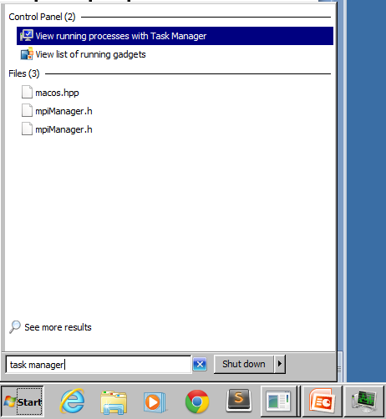
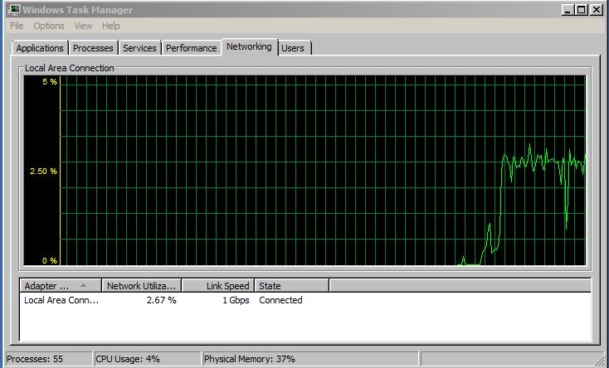
To see if Slicer is working
Open the Task Manager. To do this; Click Start, type ‘task manager’, select ‘view running processes with task manager’
In the task manager, go to the network window. If the network is in use, the program is running. It should take a max of 5 minutes.

