Slide 1
Linking a Slicer Module

Slide 2
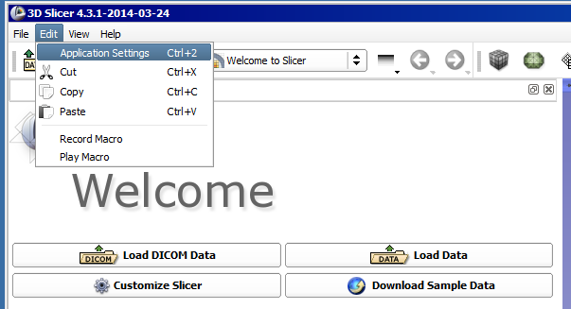
Click edit
Select “Application Settings”

Slide 3
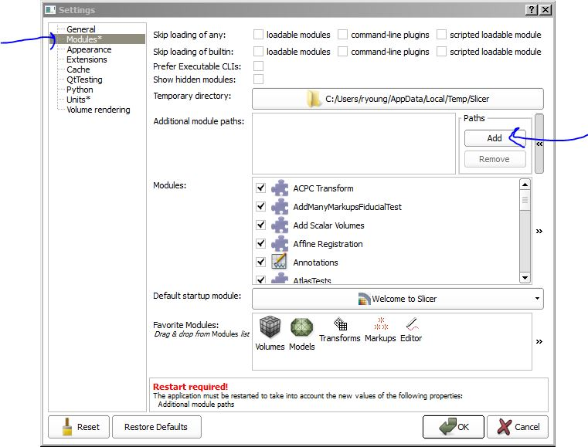
On the left choose Modules
Click add

Slide 4
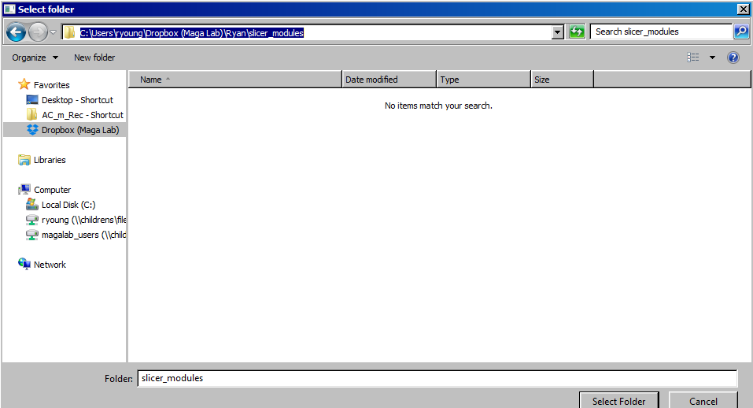
Select the following folder; \Dropbox (Maga Lab)\Ryan\slicer_modules
Click “Select Folder”

Slide 5
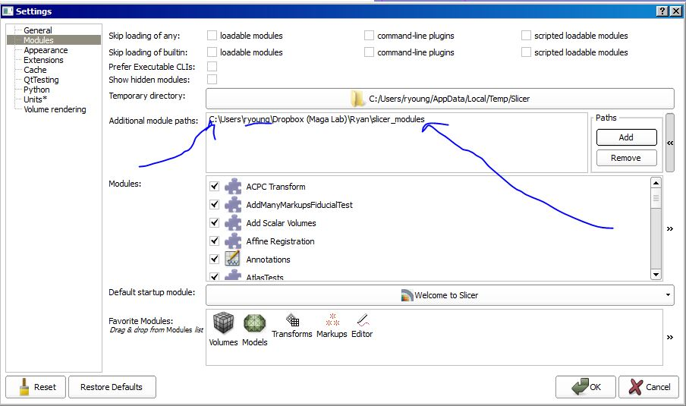
Double check path is correct. Your username will be different.
Hit “ok” on the bottom right and restart Slicer

