Slide 1
Hardware Triggered Scanning: Introduction
Philip Taylor, Emma Arandjelovic
Observatory Sciences Limited

Slide 2
Course Aims
Get to know the functionality provided by the hardware triggered scanning stack
Understand the architecture, and acquire basic knowledge of all the components
Get hands-on experience of setting up scans
Learn how to debug common problems!

Slide 3

Course Content
Introduction and demo
Overview of the hardware
Low level control and data acq. concepts
Scan configuration
Experiment control and data processing
Practical exercises

Slide 4
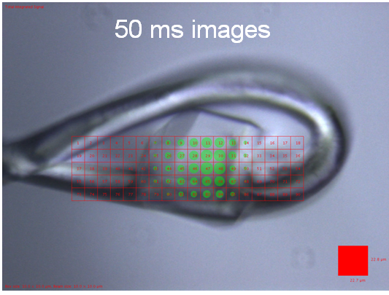
Grid Scanning Overview
Move sample in X and Y to scan it through the beam
Rewind at the end of each row or reverse direction (‘alternate/snake’ scan)
Data acquisition can be done using:
Software step scan
Hardware step scan
Continuous scan
Continuous scans are much faster! But also complex…

Slide 5
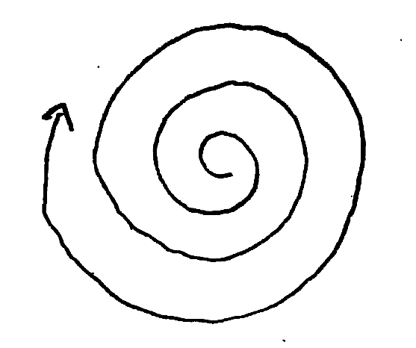
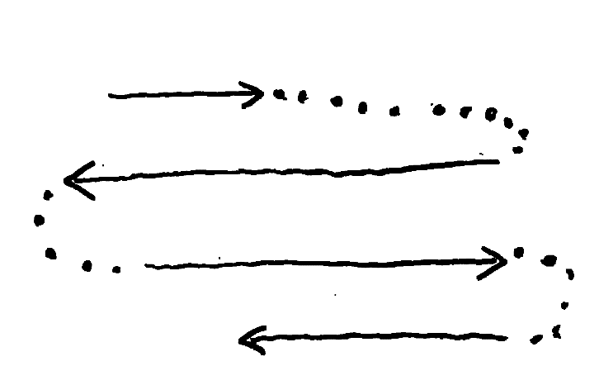
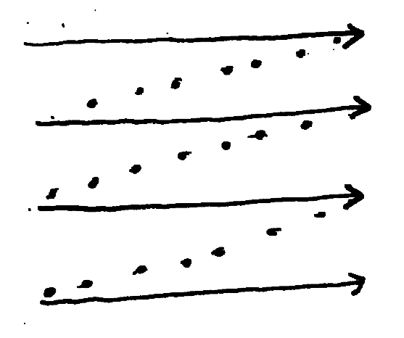
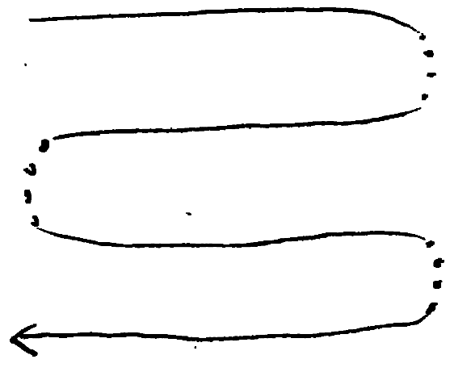
Framework Motivation
Growing need for fast, continuous scanning
Complex trajectories – not just grids!
Need for on-the-fly visualization of data
Desire for a generic solution

Slide 6
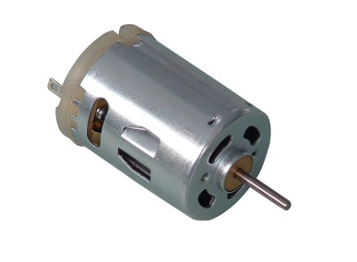
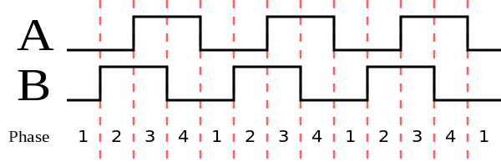
Hardware Components
Motion trajectory
control
T
Encoder signal
Motor drive

Slide 7
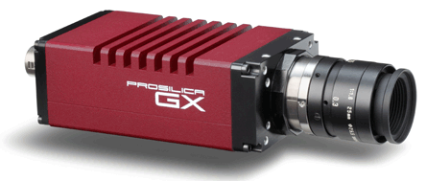

Hardware Components
Motion trajectory
control
Data capture
T
Encoder signal
Motor drive
Detector
images

Slide 8

Hardware Components
Motion trajectory
control
Flexible triggering, and fast position capture
Data capture
Raw trigger signals
Transformed trigger pulses
T
Encoder signal
PandABox
Motor drive
Detector
images

Slide 9
Hardware Components
Motion trajectory
control
Flexible triggering, and fast position capture
Data capture
Raw trigger signals
Transformed trigger pulses
T
Encoder signal
PandABox
Motor drive
Averaged position data
Detector
images

Slide 10




Software Components
Data Analysis WorkbeNch
- Analysis and visualization
Generic Data Acquisition
- Experiment setup and supervision
Malcolm
- Scan configuration
Experimental Physics & Industrial Control System
- Low level control of hardware

Slide 11
System Architecture Control Flow
GDA
GUI / scripts
pvAccess
Malcolm
Custom setup only
Channel access
TCP socket
EPICS
PandA
PMAC
driver
AreaDetector
driver
Delta Tau
Detector

Slide 12
System Architecture Data Flow
Position
data
PandA
EPICS
HDF
Frames
HDF
Detector
Metadata
GDA
NeXus File
Data Processing

Slide 13
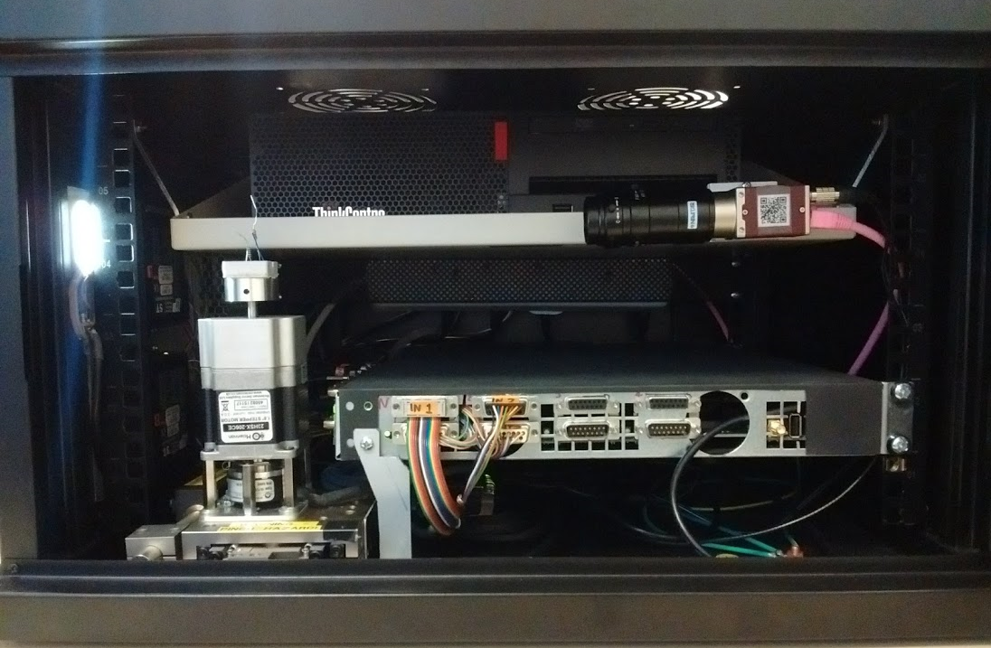
Test Rig

Slide 14
Test Rig
Beamline in a box!
Light illuminated ‘sample’
Two stepper motors (θ and X)
DT Turbo Clipper controller
Allied Vision Mako camera
PandA electronics
PC with full software stack for testing and training

Slide 15
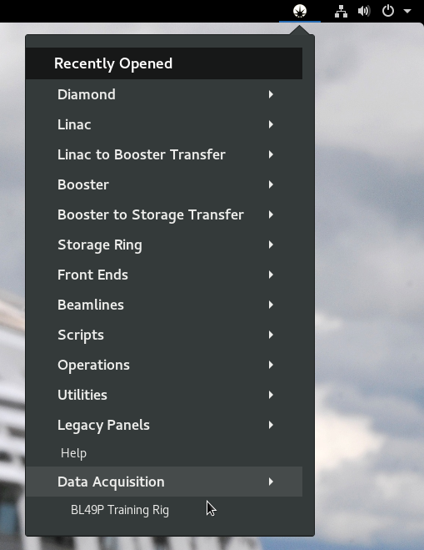
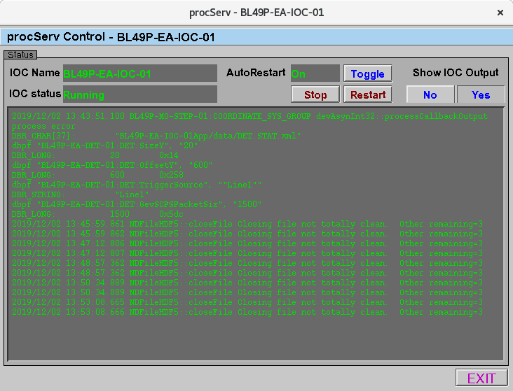
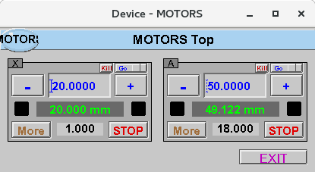
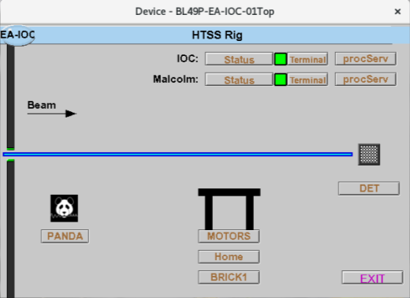
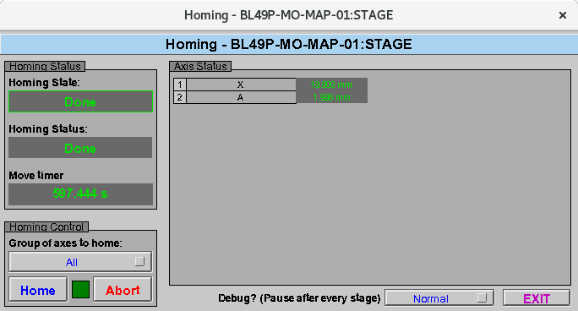
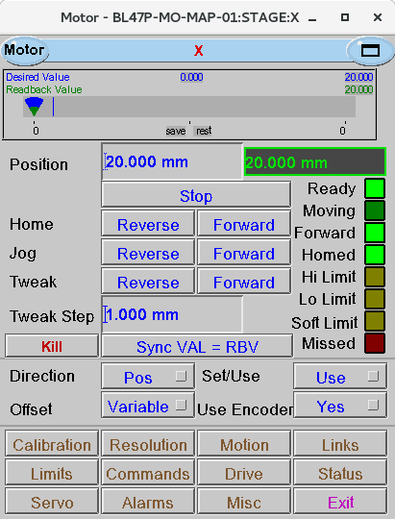
Test Rig

Slide 16
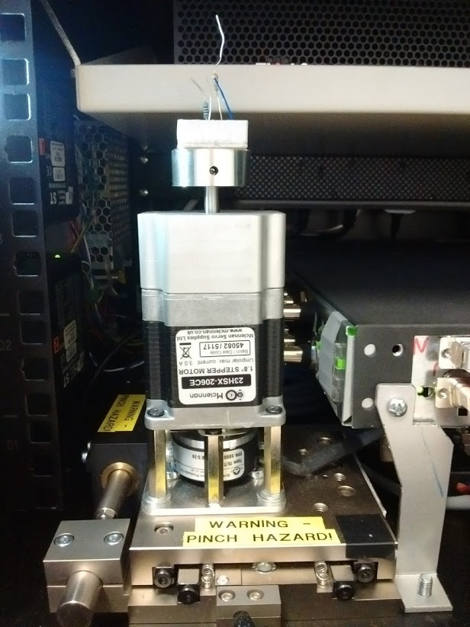
Demo Application
Grid scan in θ and X
‘Snake’ style
x-axis: rotation (θ)
1 | 2 | 3 | 4
8 | 7 | 6 | 5
9 | 10 | 11 | 12
16 | 15 | 14 | 13
y-axis: linear translation (X)

Slide 17
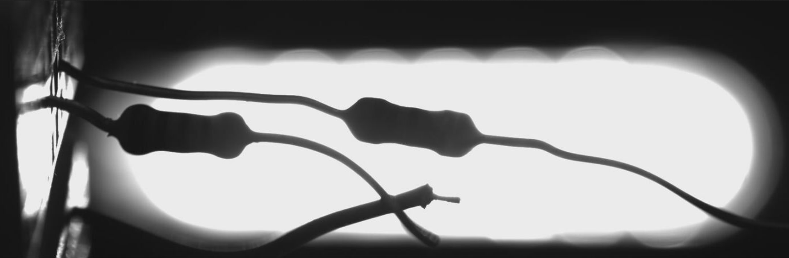
Camera View
Camera configured to capture a thin slice – each image is 1936 x 20 array
Images used to reconstruct the sample

Slide 18

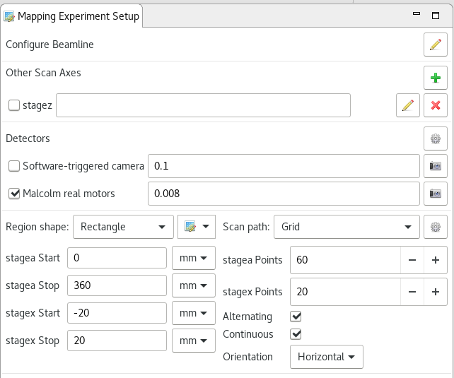
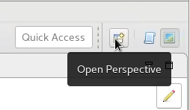
Stage 1: Setup scan
Open GDA mapping perspective
exposure time
rotation axis
translation axis
Open DET panel from the Test Rig panel and select MJPG tab

Slide 19
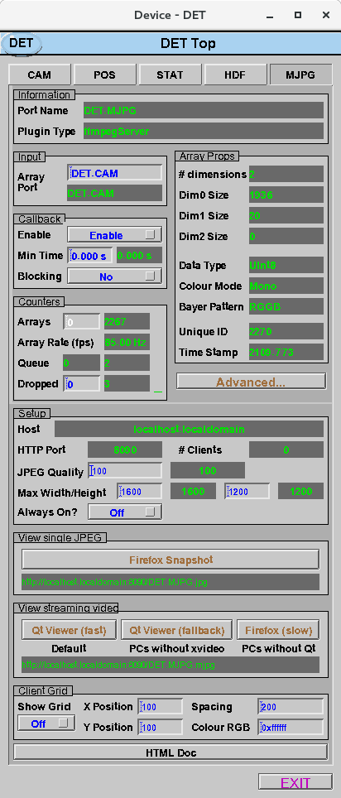
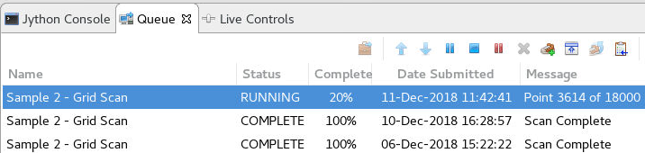
Stage 2: Start scan
Hit ‘Queue scan’
Motors move to initial positions
Scan starts
Images are acquired
Watch the data acq. in GDA

Slide 20
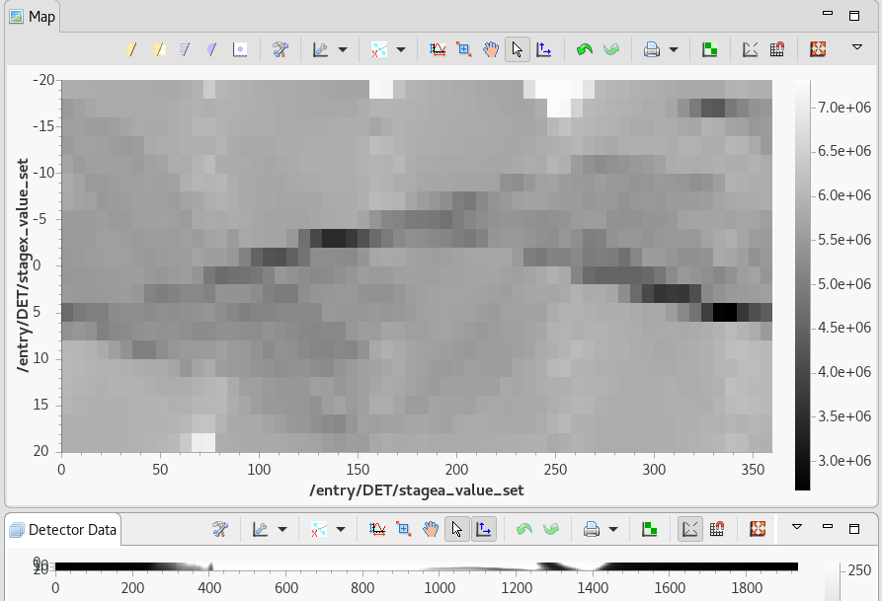
Stage 3: Check the data

Slide 21
To improve the image:
Higher resolution (AKA more images)
Increase stagea points ➔ 180
Increase stagex points ➔ 40
Process the image
If you see “jaggy edges” on the sinogram, try turning off alternating

Slide 22
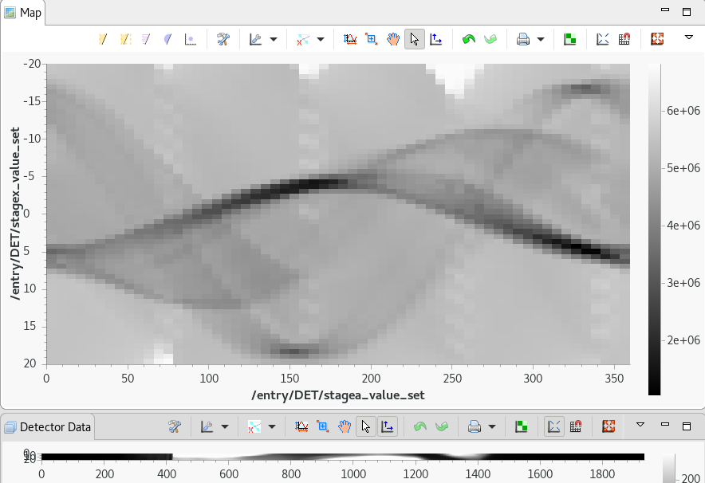
Stage 4: Check the data
Screenshot of improved data

Slide 23
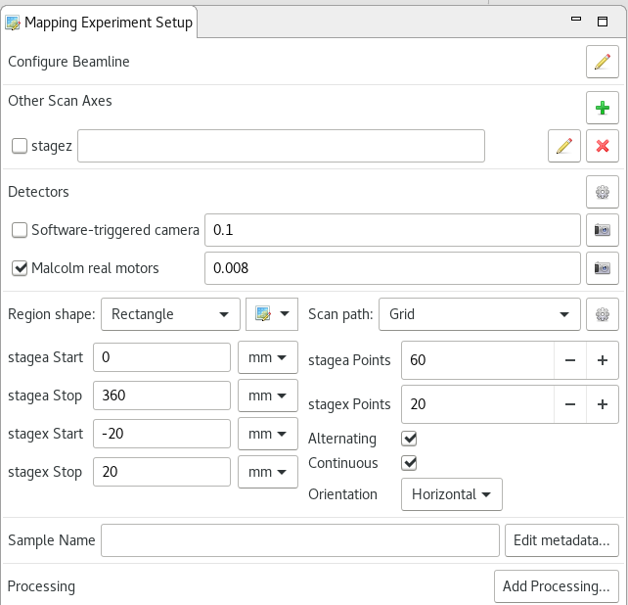
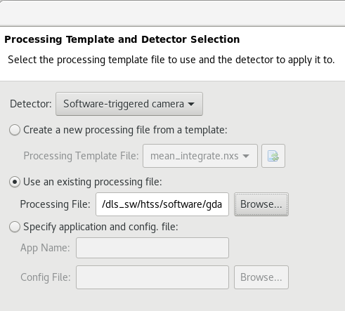
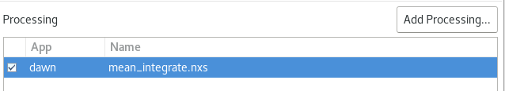
Stage 5: Add processing
/dls_sw/htss/software/gda_var/processingTemplates/mean_integrate.nxs

Slide 24
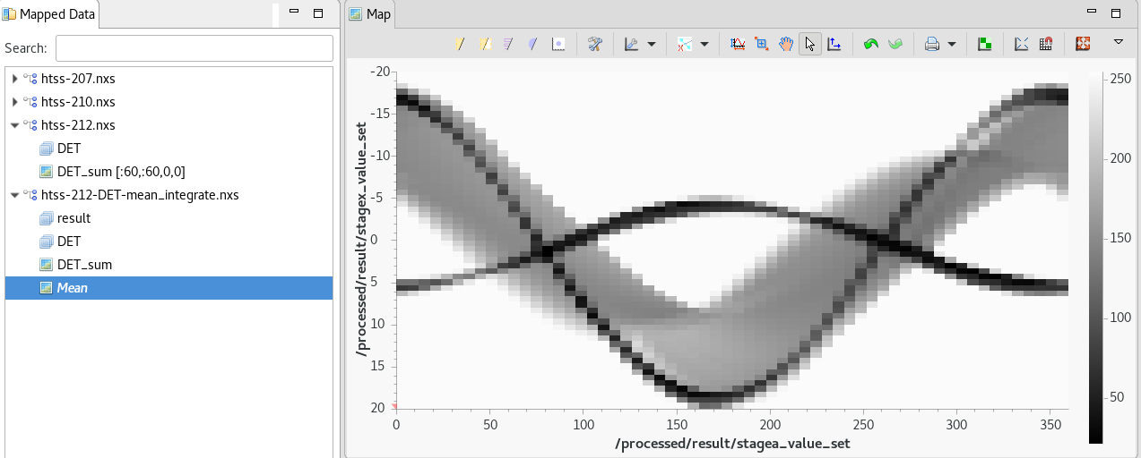
Stage 6: Check the data

Slide 25
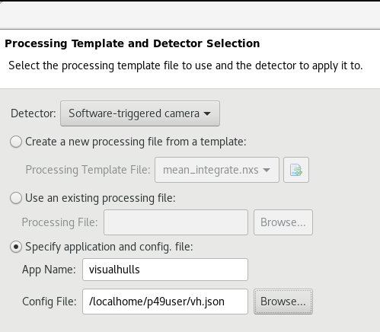
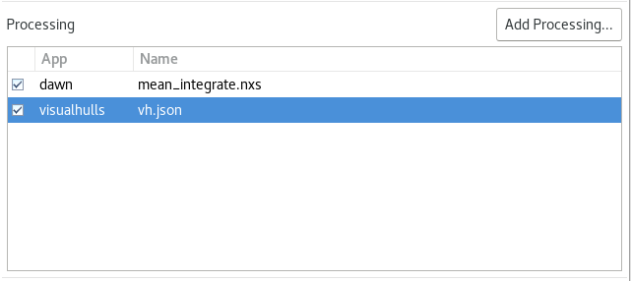
Stage 7: visualhulls
App Name must be exactly “visualhulls”
Config File: $HOME/vh.json

Slide 26
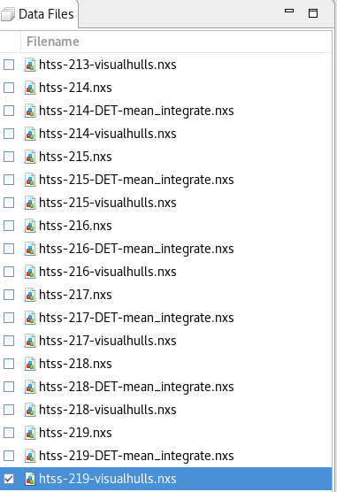
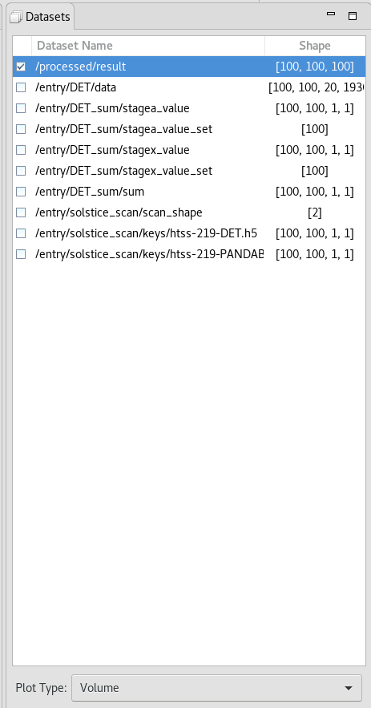
Stage 7: visualhulls
Right click on the visualhulls .nxs in Mapped Data
Transfer > DataVis
Check the visualhulls.nxs file just created in Data Files
Select /processed/result and Plot Type “Volume” in Datasets

Slide 27
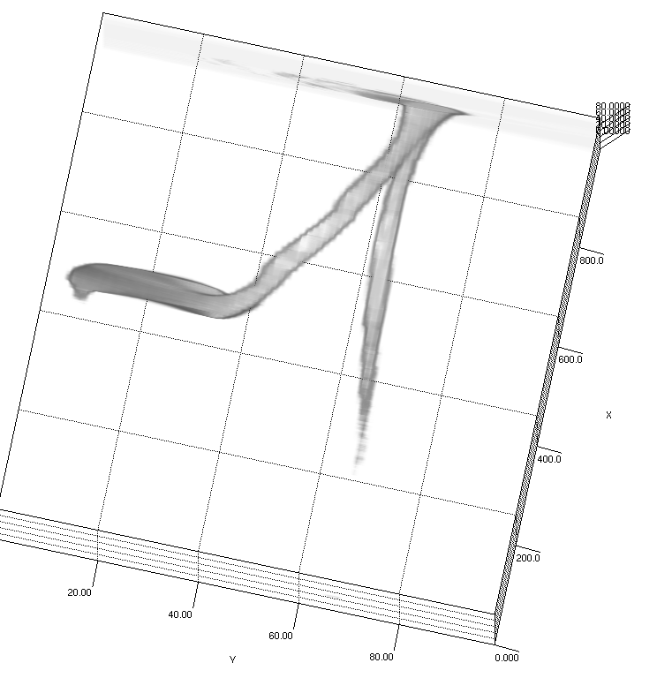
Stage 8: Check the data

Slide 28
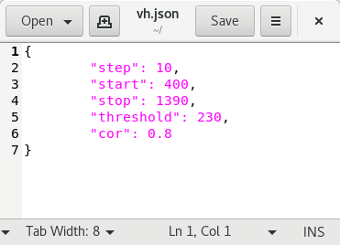
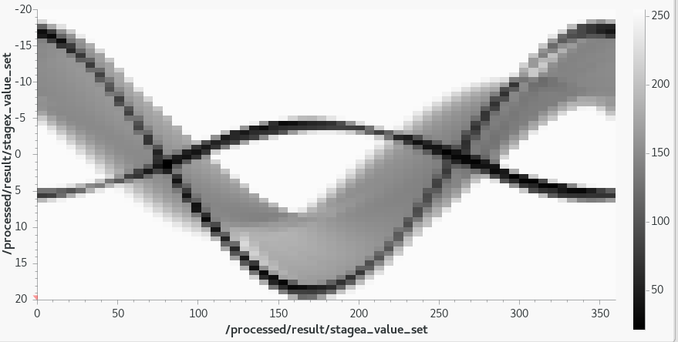

Stage 9: Improve visualhulls
height/2 = cor
start
stop

