Slide 1
Hardware Triggered Scanning: Hardware
Philip Taylor, Emma Arandjelovic
Observatory Sciences Limited

Slide 2

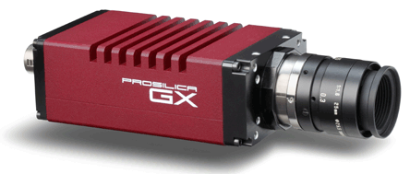
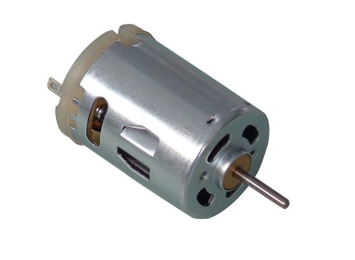
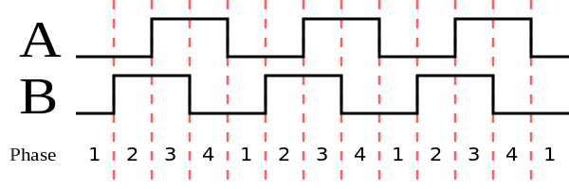
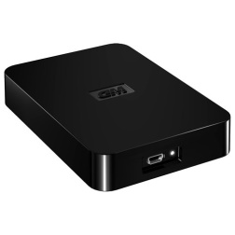
Overview
Motion trajectory
control
Flexible triggering, and fast position capture
Data capture
Raw trigger signals
Transformed trigger pulses
T
Encoder signal
PandABox
Motor drive
Averaged position data
Detector
images

Slide 3
Typical Triggering Setup
Trigger at start of each frame
1
2
3
4
Detector exposing
Detector readout

Slide 4
Triggering Setup: Warning
Trigger received when detector still reading out…
1
2
Detector exposing
Detector readout

Slide 5
Triggering Setup: Warning
Trigger received when detector still reading out…
… leads to missing frames!!
1
2
Detector exposing
Detector readout

Slide 6
Trigger Signals
The PMAC has 3 GPIO output signals, generated during a scan
They are fed into the PandA box, which in turn triggers detector acquisition
There are a wide range of detectors in use at Diamond which may require different trigger signals – the PandA can be configured to output an appropriate signal
The GPIO signals are:
Live: The start of a frame
Dead: The start of a period when no frames are acquired
Centre: The middle of the current frame (not normally used)

Slide 7
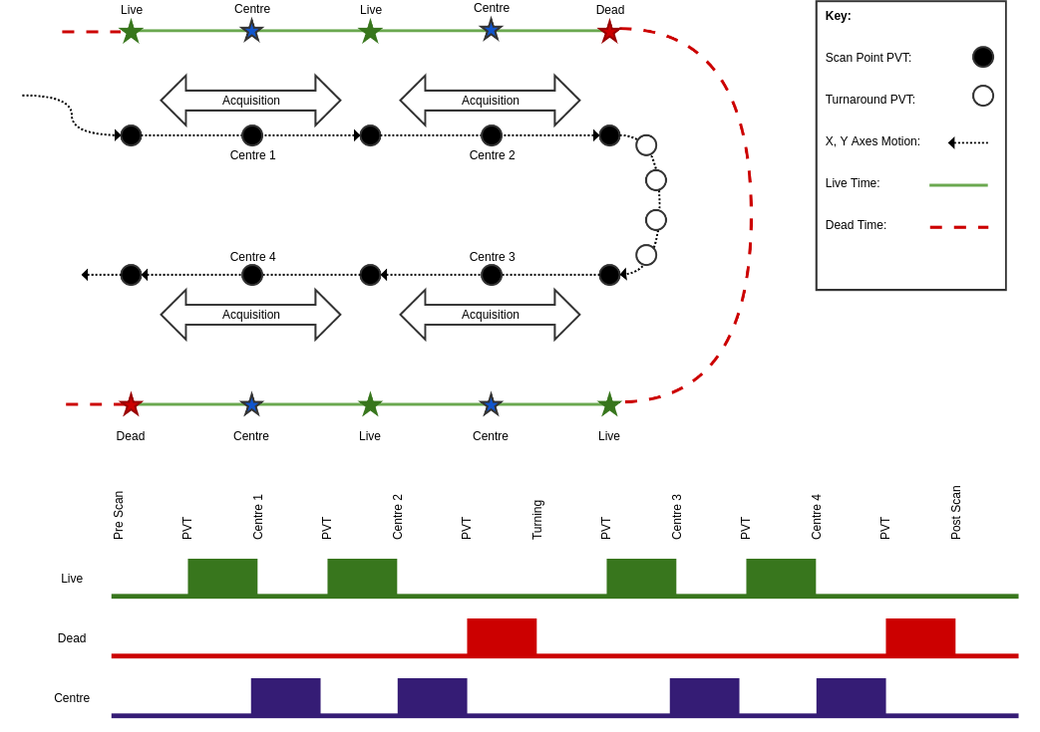
Snake Scan

Slide 8
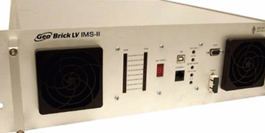
Motion Control Hardware
Motion control performed by Delta Tau PMAC
Note: Must be CLIPPER or Geobrick LV IMS II
(old style Geobricks don’t have enough memory)
Co-ordinate system needed to run motion program

Slide 9
Trajectory Control Overview
Precise control of the trajectory is needed
For each step, the user specifies the end position, the velocity at the end point and the time period for that step
This is called PVT mode:
Position
Velocity
Time

Slide 10
Trajectory Control Sequence
Malcolm generates trajectory positions and delta times using the Python module scanpointgenerator
EPICS writes them to the PMAC via the pmac driver
The PMAC calculates velocities and performs the scan using PVT mode
PMAC User Subroutines, which output GPIO signals, are called as each scan point is reached. 8 routines are available, corresponding to all combinations of the 3 signals: Live + Dead + Centre

Slide 11
PandABox Overview
Position and Acquisition Box
Flexible, modular platform
Supports a variety of scanning applications
Based on a PicoZed module which integrates:
ARM processor running embedded Linux
FPGA firmware providing configurable function blocks

Slide 12
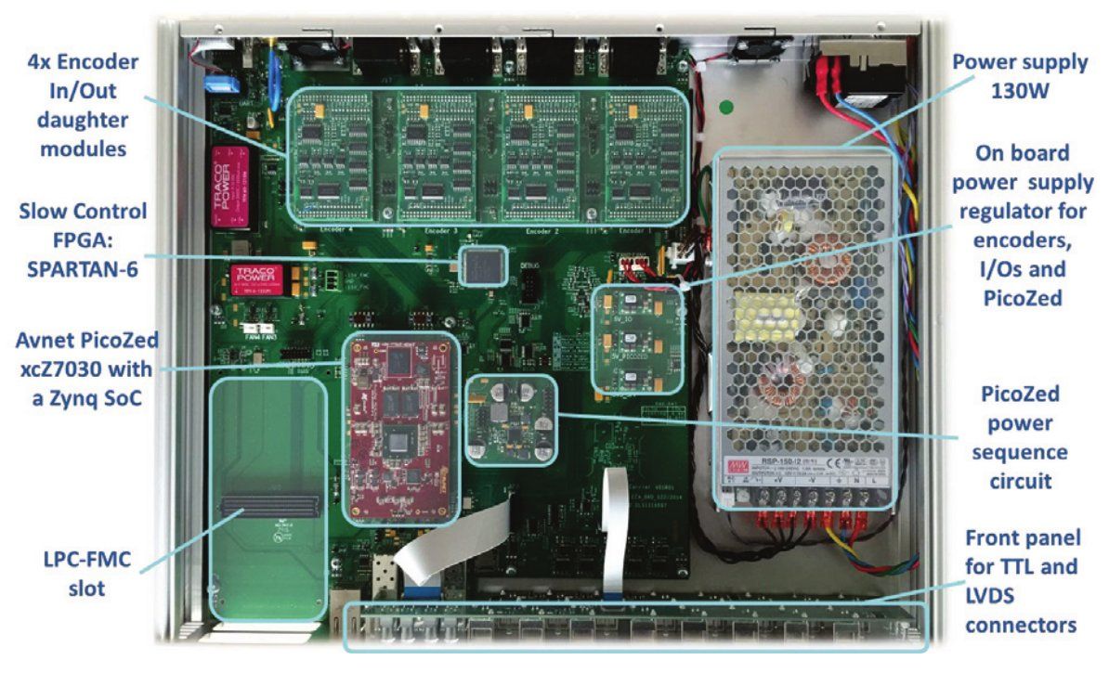
PandA Hardware

Slide 13
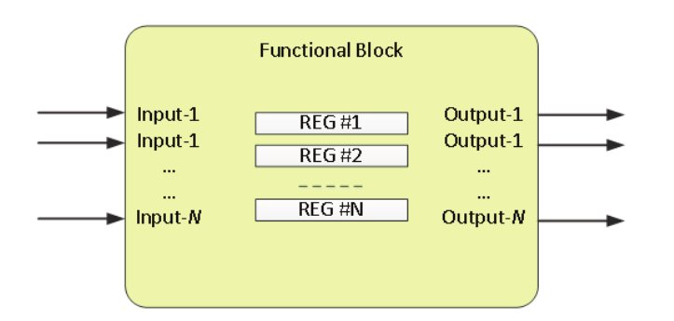
Functional Blocks
Each one performs a specific function, e.g. position capture
Configured via a number of registers
Wired up and configured at runtime via a TCP server
Configurations saved to disk

Slide 14
Available Function Blocks
Function Block | Description
INENC, OUTENC | Input and output encoder signals
TTLIN, TTLOUT | TTL Input and output signals
COUNTER | Up/down pulse counter
CALC | Sums up to 4 position inputs
LUT | Performs logical function on 5 inputs
PCAP | Position capture – options for min, max, sum
PULSE | One-shot pulse delay and stretch
SRGATE | Set Reset Gate – set configurable high or low output
…. | ….
For the full list and more information, see:
https://pandablocks-fpga.readthedocs.io/en/latest/blocks.html

Slide 15
Configuring PandA
PandA runs an embedded web server
Point a browser directly to this for low level configuration such as updating packages
For normal use, use Malcolm web gui:
Test rig: http://localhost:8008/gui
Beamlines: http://ixx-control:8008/gui

Slide 16
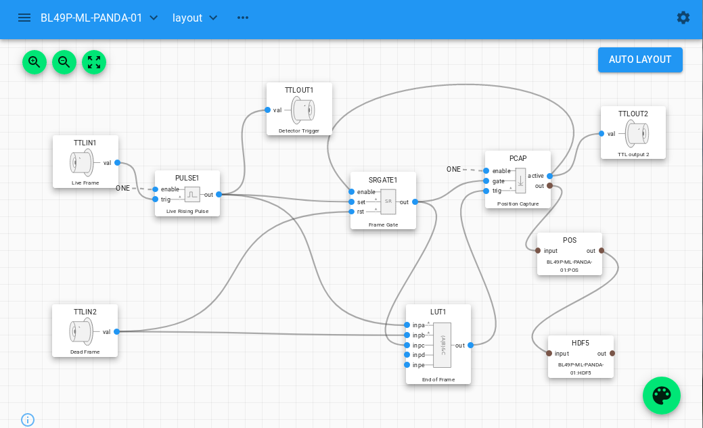
PandA Configuration GUI

