Slide 1
Hardware Triggered Scanning: EPICS Layer
Philip Taylor, Emma Arandjelovic
Observatory Sciences Limited

Slide 2




Software Stack: Reminder
Data Analysis WorkbeNch
- Analysis and visualization
Generic Data Acquisition
- Experiment setup and supervision
Malcolm
- Scan configuration
Experimental Physics & Industrial Control System
- Low level control of hardware

Slide 3
EPICS Responsibilities
Motion control interface
Detector setup
File saving
On training rigs, a single IOC BLxx-EA-IOC-01 takes care of everything
Beamlines may use multiple IOCs

Slide 4
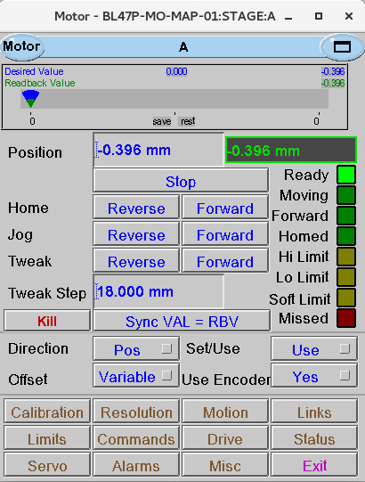
Motion Control
EPICS pmac module takes care of:
Co-ordinate system configuration
Sending trajectory profiles to the controller
Motion parameters defined in a motor record for each axis:
MRES: motor resolution
VMAX: maximum velocity
ACCL: acceleration time

Slide 5
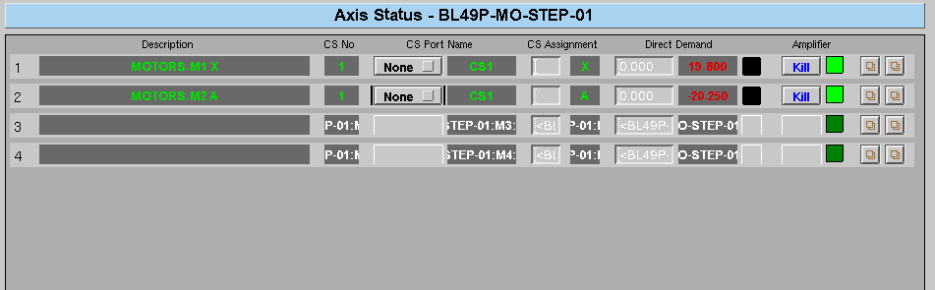
Coordinate system

Slide 6
AreaDetector
EPICS framework for controlling detectors
Provides a standard, general-purpose interface
Supports a wide variety of detectors
Real time data analysis and processing
Configurable plugin architecture
Data passed through plugin chain in an NDArray
N-dimensions (up to 10) with attached metadata (NDAttributes) associated with the frame
http://cars9.uchicago.edu/software/epics/areaDetector.html

Slide 7
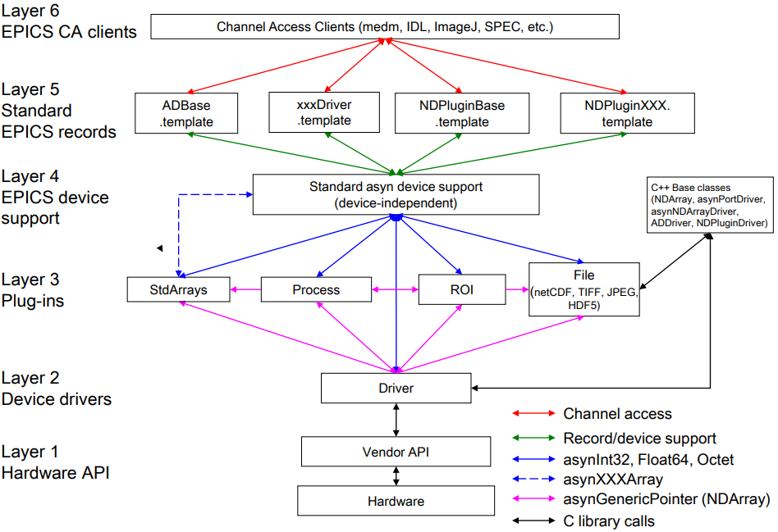
AD Architecture
Source: Mark Rivers, Using AreaDetector

Slide 8
AD Plugins
Plugins receive a copy of each NDArray via a callback
They can in turn be sources of NDArray callbacks
Plugins can also attach NDAttributes to the data
Chain can be ‘rewired’ on the fly and plugins enabled/disabled

Slide 9
Plugin Chain Example
Detector Driver
Processing Plugin
Statistics Plugin
ROI Plugin
Background removed
Total intensity attached for saving as a dataset
Small region of interest streamed for live viewing
HDF5 Plugin
HDF5 Plugin
MJPG Plugin

Slide 10
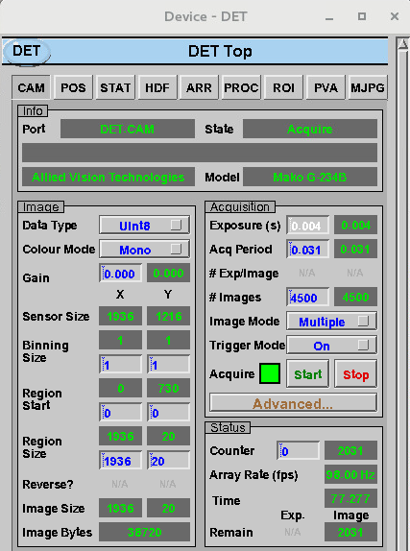
Detector Setup
Each detector has an AreaDetector driver
At scan start, this sets up parameters such as:
Exposure time

Slide 11
Detector Setup
Each detector has an AreaDetector driver
At scan start, this sets up parameters such as:
Number of images

Slide 12
Detector Setup
Each detector has an AreaDetector driver
At scan start, this sets up parameters such as:
Trigger mode

Slide 13
Detector Setup
Each detector has an AreaDetector driver
At scan start, this sets up parameters such as:
Frame size

Slide 14
Data Files
Data is saved in the hierarchical HDF format
Designed for:
Flexible, efficient I/O
high volume and complex data
/entry
Groups -
Datasets -
NDAttributes
detector
sum
Metadata is stored in the form of user-defined, named attributes attached to groups and datasets

Slide 15
SWMR Mode
Single Writer Multiple Reader
Process data as it’s written to file
Requires POSIX compliant file system (N.B. NFS is NOT POSIX compliant)
New data elements…
Writer
Reader
… are added to a dataset in the file…
…that can be read by a reader…
HDF5 File

Slide 16
HDF5 Considerations
Flush rate determines how often data is flushed to disk (controlled by Malcolm)
HDF Datasets are chunked: divided into equally sized blocks
Each chunk stored contiguously in the file
Avoids need to read in the whole file
Allows datasets to be extendible
Enables compression
Chunk size is configured in the HDF5 plugin
See HDF5 Advanced Topics Tutorial

Slide 17
Read/Write Performance
Performance GREATLY (up to 1000 times!!) affected by:
Chunking settings
Compression
Flush rate
Settings must be optimised for the experiment
Consider BOTH read and write performance
This is a complex issue!
Never set a chunk size of 1!

Slide 18
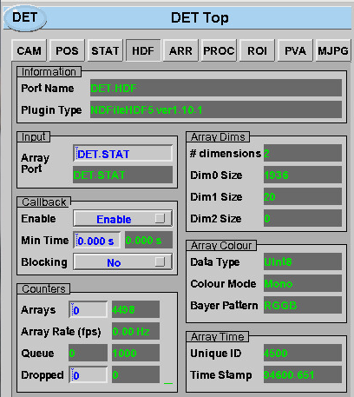
File Saving
NDFileHDF5 plugin saves the files to disk
Two files are generated:
<name>-DET.h5 – detector data
<name>-PANDABOX.h5 – position data
These are saved in a folder for each scan

Slide 19
File Saving
NDFileHDF5 plugin saves the files to disk
Two files are generated:
<name>-DET.h5 – detector data
<name>-PANDABOX.h5 – position data
These are saved in a folder for each scan
Callbacks must be enabled

Slide 20
File Saving
Images are buffered into a queue
If queue gets full -> frames are dropped!

Slide 21
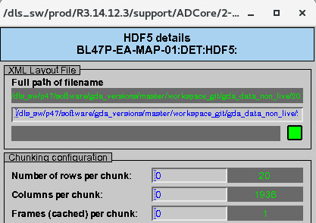
File Saving Configuration
Chunking parameters configured manually
Defaults to the frame size if left at 0
HDF file structure defined in XML
Configured by Malcolm
Stored in the same directory as the scan data
Deleted when the scan ends

Slide 22
File Structure
The STATS plugin computes the total sum and attaches it as an NDAttribute
This is used to create the sum dataset
XML definition:
<dataset name="sum“ ndattribute="STATS_TOTAL“ source="ndattribute” />

Slide 23
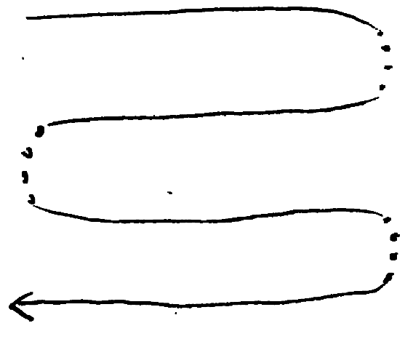
Frame Ordering
Remember: In a snake scan, alternate rows are captured backwards!
1 | 2 | 3
6 | 5 | 4
7 | 8 | 9
12 | 11 | 10

Slide 24
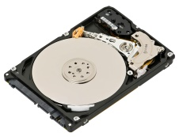
Solution
XML Position data
1
2
3
4
5
…
1 | (0,0)
2 | (0,1)
3 | (0,2)
4 | (1,2)
5 | (1,1)
…
1 | 2 | 3
6 | 5 | 4
7 | 8 | 9
12 | 11 | 10
Detector Driver
NDPos Plugin
HDF5 Plugin
Raw data
Raw data + positions
Correctly ordered data
The NDPosPlugin intercepts the image frame and attaches the corresponding position as an attribute
The file saving plugin reads the position attributes and ensures the frames are stored in the correct order

Slide 25
Unique Keys
When a dataset is extended, a ‘fill’ value is used
Q: How do we distinguish between fill and real data?
A: A special Unique Keys dataset is created:
Same size as the scan dataset, with fill value 0
A non-zero value is written when the corresponding scan data has been flushed to disk
DAWN monitors this data set in order to know when to start processing a scan point

Slide 26

h5watch
Command line tool for watching data added to a dataset
--dim option monitors for dimension size changes
h5watch --dim p45-164-DET.h5/entry/NDAttributes/NDArrayUniqueId
.h5 filename
HDF5 path to dataset
Opened "p45-164-DET.h5" with sec2 driver.
Monitoring dataset /entry/NDAttributes/NDArrayUniqueId...
dimension 0: 46->48 (increases)
dimension 1: 180->180 (unchanged)
dimension 2: 1->1 (unchanged)
dimension 3: 1->1 (unchanged)

Slide 27
IOC Utilities
To reboot an IOC:
console <IOC name> (remote IOCs)
ioc-connect <IOC name> (test rig)
Ctrl-X
To check what module versions are used:
configure-ioc show <IOC name>
Check the configure/RELEASE file

Slide 28
IOC RELEASE File
# Common prefixes
SUPPORT = /dls_sw/prod/R3.14.12.3/support
WORK = /dls_sw/work/R3.14.12.3/support
# Module definitions
ADCORE = $(SUPPORT)/ADCore/2-6dls5
ADPANDABLOCKS = $(SUPPORT)/ADPandABlocks/2-0
ADSUPPORT = $(SUPPORT)/ADSupport/1-2
ARAVISGIGE = $(SUPPORT)/aravisGigE/2-1dls9
ASYN = $(SUPPORT)/asyn/4-31
BL46P_BUILDER = $(WORK)/BL46P-BUILDER
BUSY = $(SUPPORT)/busy/1-6-1dls1
CALC = $(SUPPORT)/calc/3-1
FFMPEGSERVER = $(SUPPORT)/ffmpegServer/3-1dls1-5
MOTOR = $(SUPPORT)/motor/6-9dls14
NORMATIVETYPESCPP = $(SUPPORT)/normativeTypesCPP/5-0-2
PMAC = $(SUPPORT)/pmac/2-1
PROCSERVCONTROL = $(SUPPORT)/procServControl/1-17-1
PVACCESSCPP = $(SUPPORT)/pvAccessCPP/4-1-3
PVDATABASECPP = $(SUPPORT)/pvDatabaseCPP/4-1-1
PVDATACPP = $(SUPPORT)/pvDataCPP/5-0-4
# EPICS Base appears last
EPICS_BASE = /dls_sw/epics/R3.14.12.3/base
AreaDetector modules

