Slide 1
Hardware Triggered Scanning: Malcolm
Philip Taylor, Emma Arandjelovic
Observatory Sciences Limited

Slide 2




Software Stack: Reminder
Data Analysis WorkbeNch
- Analysis and visualization
Generic Data Acquisition
- Experiment setup and supervision
Malcolm
- Scan configuration
Experimental Physics & Industrial Control System
- Low level control of hardware

Slide 3

What is Malcolm?
Generic and extensible framework for scanning
Middle layer between GDA and control system
Implemented in
Creates a s/w map of the h/w layer
https://pymalcolm.readthedocs.io
Web GUI called MalcolmJS
https://malcolmjs.readthedocs.io

Slide 4
Malcolm Process
Each Malcolm instance is a Python process managed by procServ
On beamlines this runs on ixx-control
[p47user@localhost ]$ ioc-list
BL47P-EA-IOC-01: pid = 2628, telnet port = 7002
BL47P-ML-MALC-01: pid = 2663, telnet port = 7003
To reboot:
ioc-connect BL4xP-ML-MALC-01
Ctrl-X

Slide 5
Malcolm Concepts
A block is a user-centred view
Examples:
Motion controller
PandA
Detector
‘Hello World’ program
Blocks contain:
Methods (actions)
Attributes (data)
A process hosts multiple blocks
Parent blocks contain child blocks connected together in a design
Process
Block
method1()
attribute1
Block
method1()
attribute1

Slide 6
Malcolm Concepts
Each block has a unqiue name called an MRI (Malcolm Resource Identifier) e.g. BL47P-ML-SCAN-01
A device block is a higher level block for synchronizing a number of child blocks
Motion Controller Block
X stage block
Y stage block
Co-ordinate system block

Slide 7
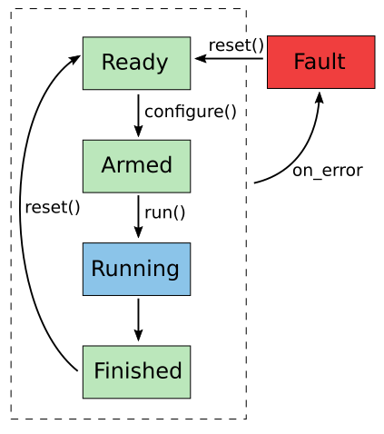
Malcolm Concepts
A runnable device block adds state machine functionality with two main methods:
configure(params)
– setup all child blocks
run()
– start all children and supervise their progress
Simplified runnable device block state machine

Slide 8
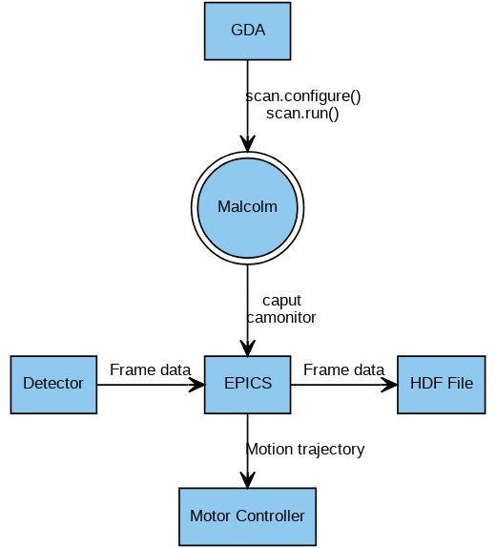
Control Flow
Two step process:
Configure the scan
Run the scan

Slide 9
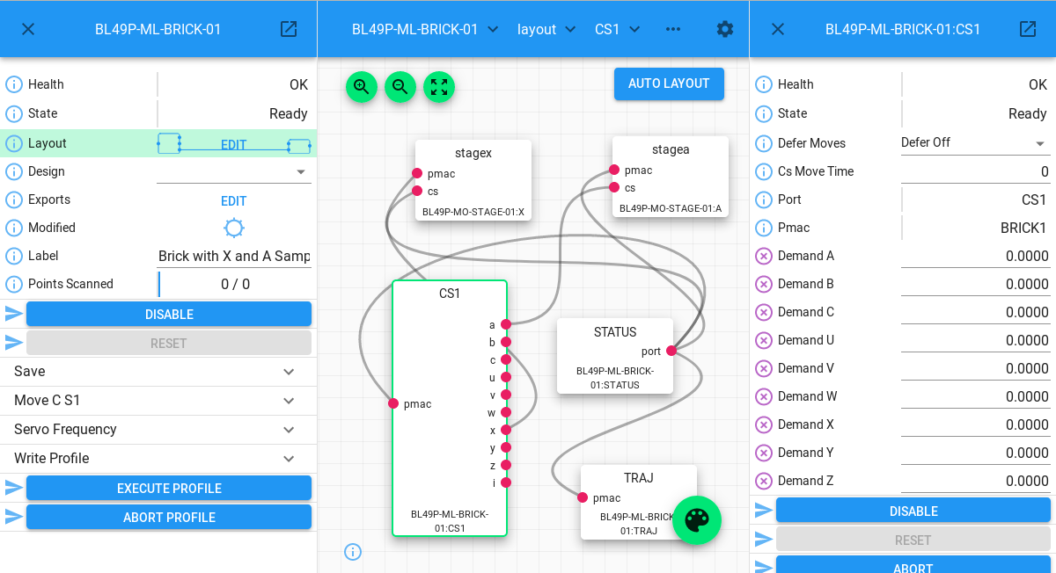
Web GUI: Overview
Left: parent block (in focus)
Central panel: design layout / attribute view
Right: inspector

Slide 10
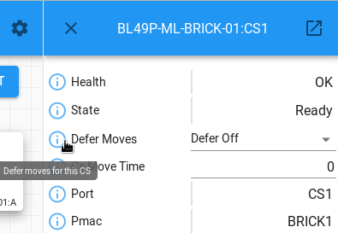
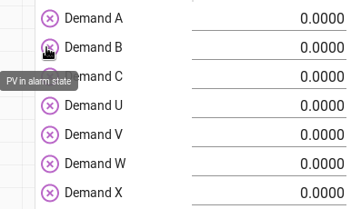
Web GUI: Block View
Attributes displayed depend on the type of block
Tool-tip text provide descriptions
Any problems connecting to the h/w are displayed in the tool-tip

Slide 11
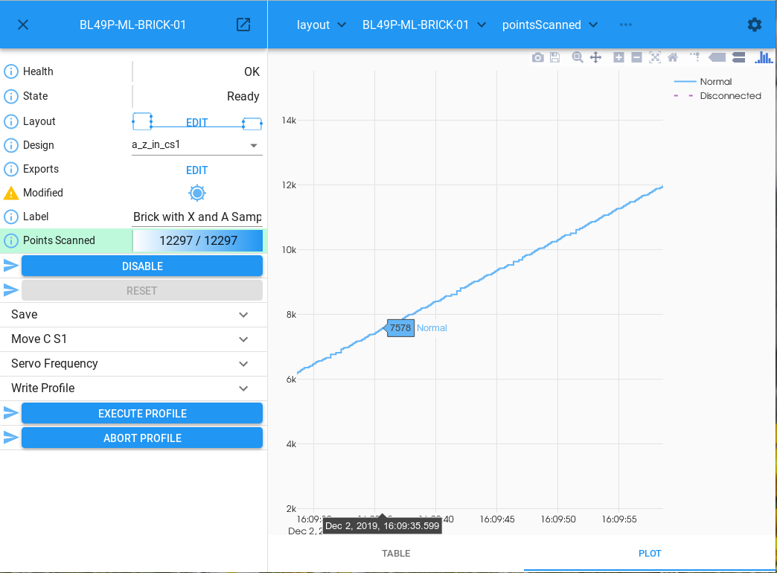
Web GUI: Attribute View
Displays table or plot of historical data values

Slide 12
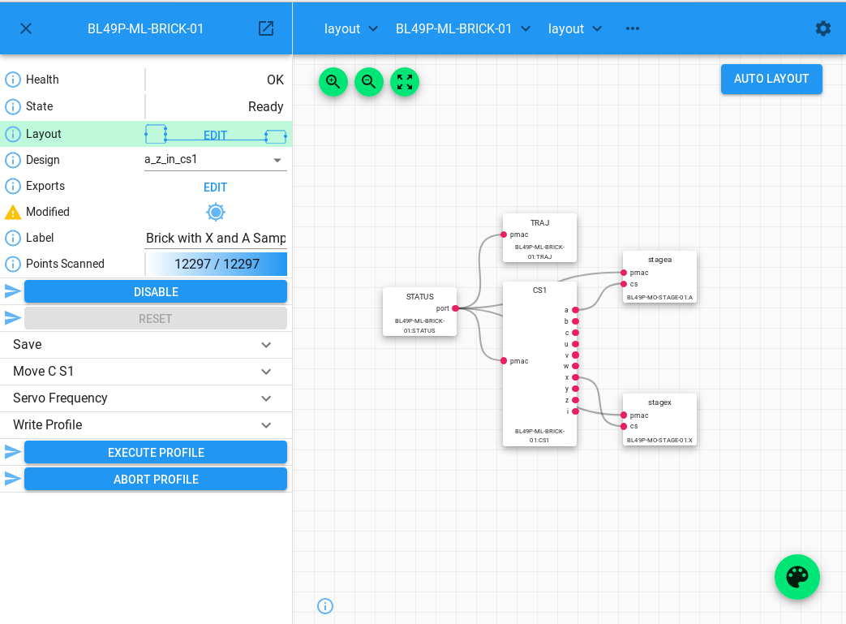
Web GUI: Layout View
Graphical view of selected root block, with automatic layout feature

Slide 13
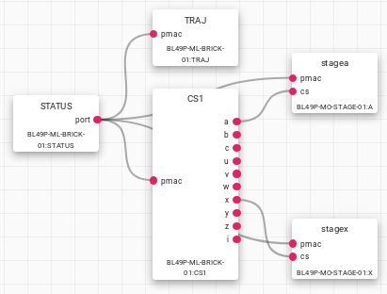
Web GUI: Layout View
‘Wire-up’ components visually

Slide 14
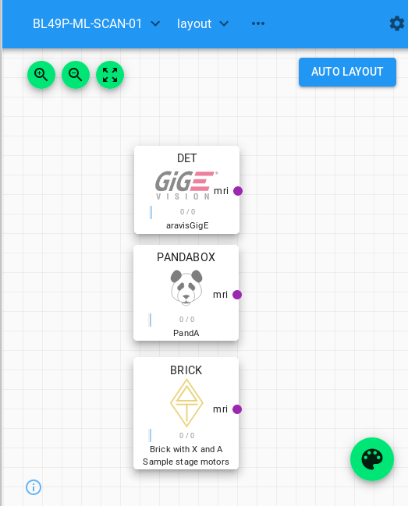
Web GUI: Layout View
Auto Layout – first step for complex layouts
Palette – drag and drop new items

Slide 15
Web GUI: Navigation
Breadcrumb trail in central panel
Starting with the selected root block, you can drill down into the design

Slide 16
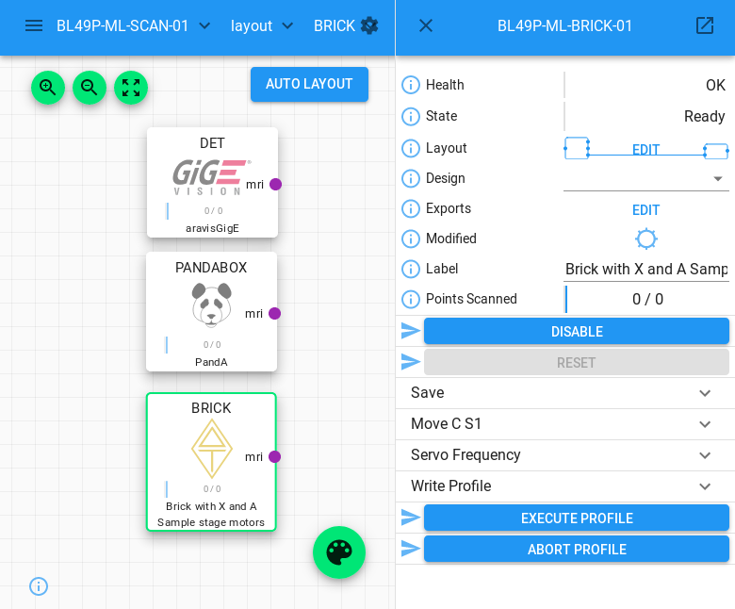
Web GUI: Navigation
Then choose Layout in the right hand inspector
Example: select BRICK in the layout view

Slide 17
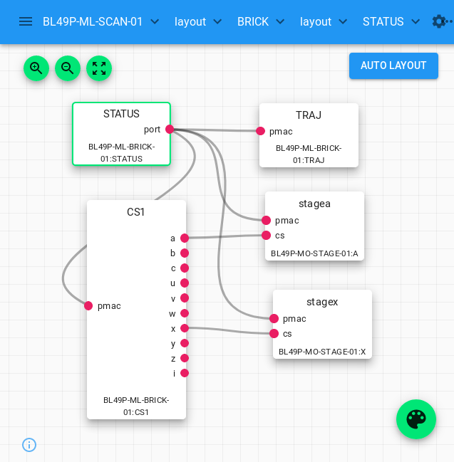
Web GUI: Navigation
Now focused on the BRICK block:
Controller
Trajectory
Co-ordinate system
Axes
Status

Slide 18
Web GUI: Navigation
Now focused on the BRICK block:
Controller
Trajectory
Co-ordinate system
Axes
Status
Select STATUS

Slide 19
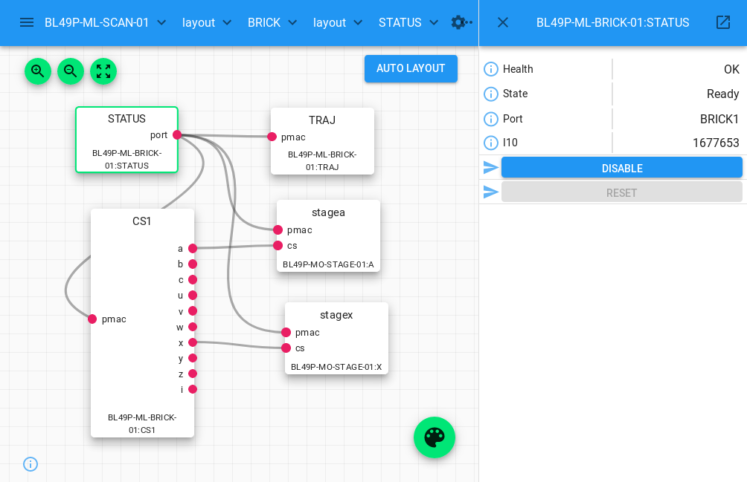
Web GUI: Navigation

Slide 20

Exercise: Web GUI
Navigate to the PANDA block
Try to toggle on/off the light controlled by TTLOUT2
For more info on the web GUI: https://malcolmjs.readthedocs.io

Slide 21
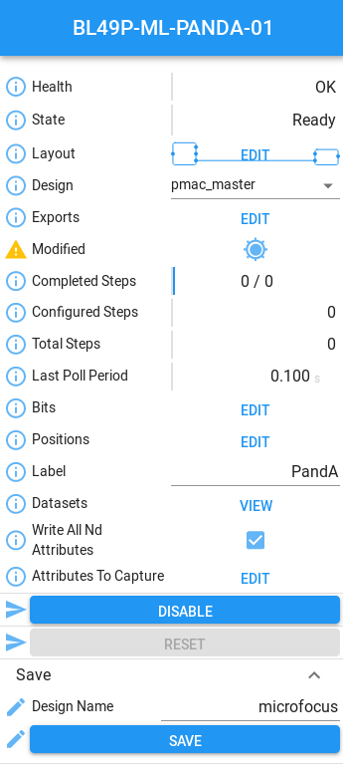
Designs
Different scan requirements can be implemented using multiple designs
Example: a new experiment requires a different PandA configuration
Step 1: Open the PANDA block in the layout view
Step 2: Modify the design as required
Step 3: Choose a name and save

Slide 22
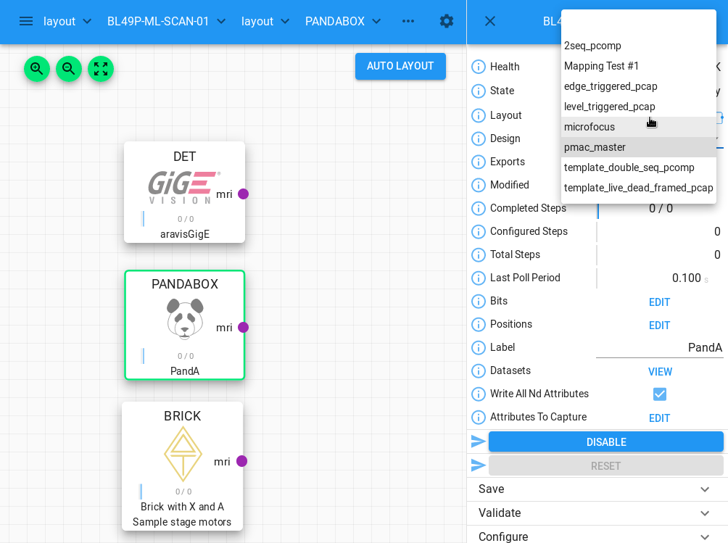
Designs
Step 4: Open the SCAN block layout
Step 5: Select the PANDABOX and choose the new design

Slide 23
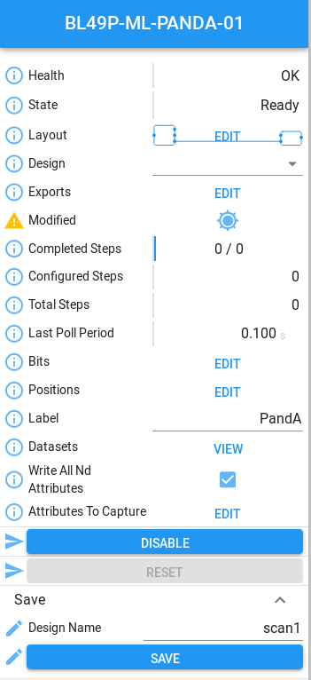
Designs
Step 6: Using the left hand panel, save this SCAN configuration as a new design

Slide 24
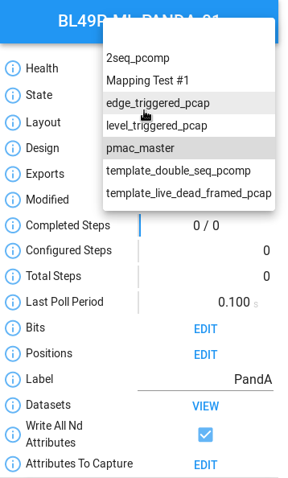
Designs
To load a design in the Web GUI:
Navigate to the root block
Select the design from the drop down list in the left hand panel

Slide 25
Malcolm Configuration
Blocks are reusable components that require configuration
Examples:
PV prefix (for EPICS devices), IP address (for PandA)
Initial design
Runtime config directories
Configuration specified in YAML
(‘YAML Ain’t Markup Language’!)

Slide 26
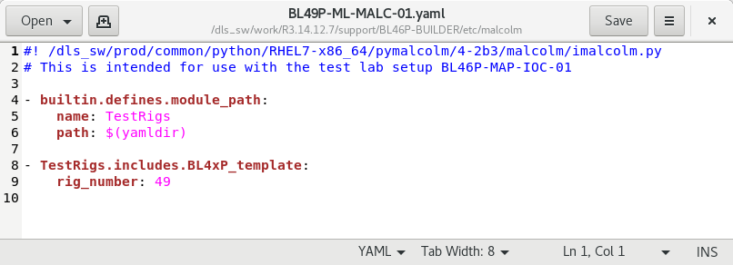
YAML Files

Slide 27
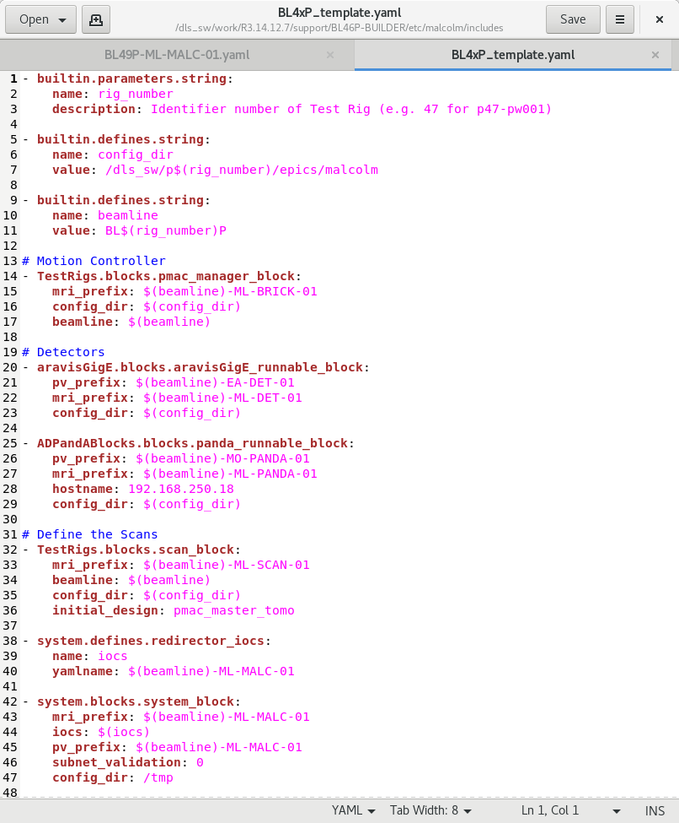
YAML Files

Slide 28
YAML Files

Slide 29
Exercise: pvAccess
Malcolm<->GDA interface uses pvAccess (EPICS V4)
Each block is represented as a V4 process variable (pv) with a number of fields
Use pvget to dump the entire SCAN block structure
pvget BL4xP-ML-SCAN-01 -r “”
(If pvget not in PATH, run module load pvatools)

Slide 30
pvAccess continued
-r ‘request’ option specifies which fields to return
pvget BL4xP-ML-SCAN-01 –r health.value
What information comes back for the layout field?
Other useful SCAN block fields include:
totalSteps
completedSteps
state

Slide 31
Exercise: Scan States
Start a scan in GDA and monitor the SCAN block in the Malcolm web GUI. What states does it go through?
The -m (‘monitor’) option to pvget monitors the PV for changes. Use this together with the –r option to monitor the completedSteps field from the command line as the scan progresses.

Slide 32
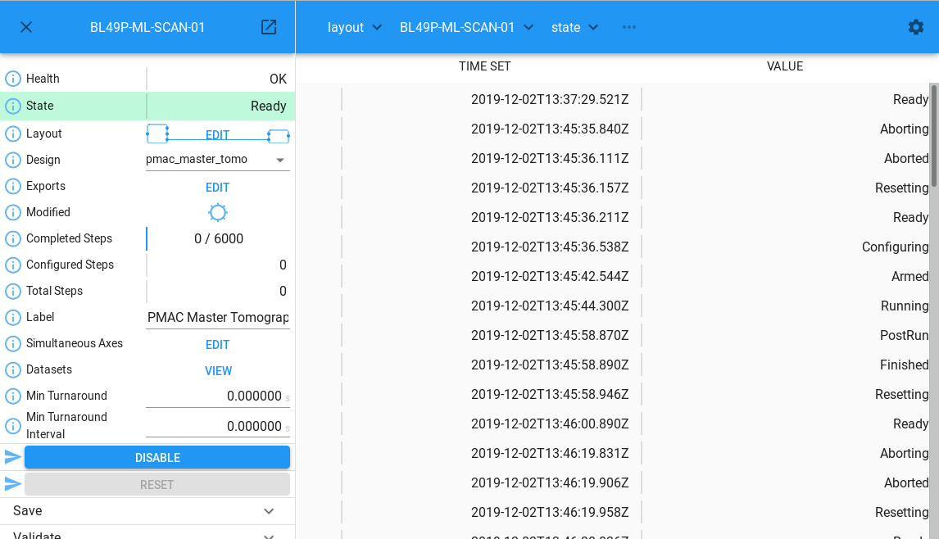
Scan States Screenshot

Slide 33
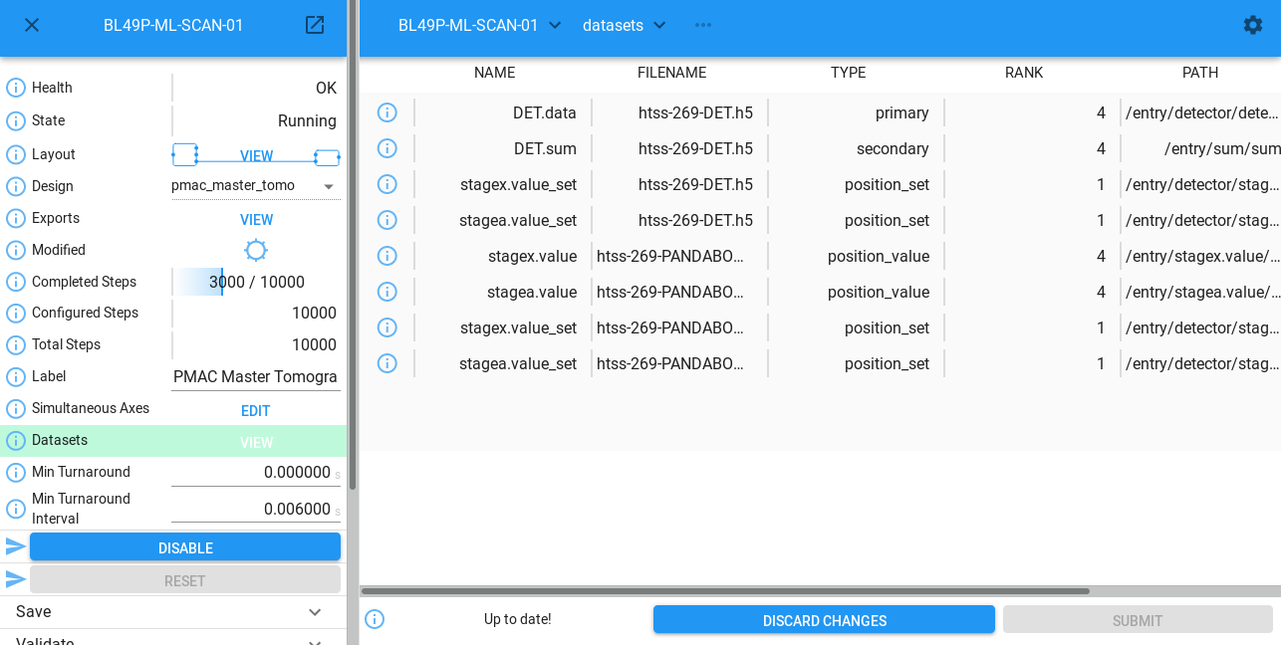
Dataset table

