Slide 1
Hardware Triggered Scanning: GDA and DAWN
Philip Taylor, Emma Arandjelovic
Observatory Sciences Limited

Slide 2




Software Stack: Reminder
Data Analysis WorkbeNch
- Analysis and visualization
Generic Data Acquisition
- Experiment setup and supervision
Malcolm
- Scan configuration
Experimental Physics & Industrial Control System
- Low level control of hardware

Slide 3
Overview
Main beamline user interface
Presents a science based view of experiments
Client-server design
Command Server provides a Jython interpreter
Client provides live data visualization
GDA client
workstation
GDA client
workstation
Data Vis.
Data Vis.
Java RMI
GDA server
ixx-control
Command Server
Channel Access
EPICS control system

Slide 4
Overview
Main beamline user interface
Presents a science based view of experiments
Client-server design
Command Server provides a Jython interpreter
Client provides live data visualization
GDA<->Malcolm interface developed to integrate scanning framework
GDA client
workstation
GDA client
workstation
Data Vis.
Data Vis.
Java RMI
GDA server
ixx-control
Command Server
Channel Access
pvAccess
Malcolm
Channel Access
EPICS control system

Slide 5
Overview
Data Analysis WorkbeNch
Sister project to GDA (Eclipse based)
Provides visualization components to GDA client
Includes generic data processing tools
Data processing pipelines can be customized
Supports multiple file formats, including NeXus
See https://dawnsci.org/

Slide 6
Data Flow
GDA Client
Data written to a POSIX file system
Enables SWMR mode
DAWN visualization
EPICS AreaDetector
GDA Server
DAWN webserver
Raw HDF5 data
NeXus metadata
DAWN Processing
Processed NeXus files
POSIX compliant file system

Slide 7
Data Flow
GDA Client
Data written to a POSIX file system
Enables SWMR mode
AreaDetector writes raw HDF data
DAWN visualization
EPICS AreaDetector
GDA Server
DAWN webserver
Raw HDF5 data
NeXus metadata
DAWN Processing
Processed NeXus files
POSIX compliant file system

Slide 8
Data Flow
GDA Client
Data written to a POSIX file system
Enables SWMR mode
AreaDetector writes raw HDF data
GDA writes metadata to another HDF file
DAWN visualization
EPICS AreaDetector
GDA Server
DAWN webserver
Raw HDF5 data
NeXus metadata
DAWN Processing
Processed NeXus files
POSIX compliant file system

Slide 9
Data Flow
GDA Client
Data written to a POSIX file system
Enables SWMR mode
AreaDetector writes raw HDF data
GDA writes metadata to another HDF file
The two HDF files are linked
DAWN visualization
EPICS AreaDetector
GDA Server
DAWN webserver
Raw HDF5 data
NeXus metadata
DAWN Processing
Processed NeXus files
POSIX compliant file system

Slide 10
Data Flow
GDA Client
Data written to a POSIX file system
Enables SWMR mode
AreaDetector writes raw HDF data
GDA writes metadata to another HDF file
The two HDF files are linked
DAWN processing reads both files
DAWN visualization
EPICS AreaDetector
GDA Server
DAWN webserver
Raw HDF5 data
NeXus metadata
DAWN Processing
Processed NeXus files
POSIX compliant file system

Slide 11
Data Flow
GDA Client
Data written to a POSIX file system
Enables SWMR mode
AreaDetector writes raw HDF data
GDA writes metadata to another HDF file
The two HDF files are linked
DAWN processing reads both file
DAWN webserver makes the raw and processed files available to the GDA client outside the POSIX file system
DAWN visualization
EPICS AreaDetector
GDA Server
DAWN webserver
Raw HDF5 data
NeXus
metadata
DAWN Processing
Processed NeXus files
POSIX compliant file system

Slide 12

Interface to Malcolm
Malcolm<->GDA interface uses pvAccess (EPICS V4)
This supports structured data
Each Malcolm ‘device’ in GDA maps onto a block:
$(gda_config)/servers/main/live/malcolm_real.xml
This defines the MRI (Malcolm Resource Identifier) for the top level scan block

Slide 13
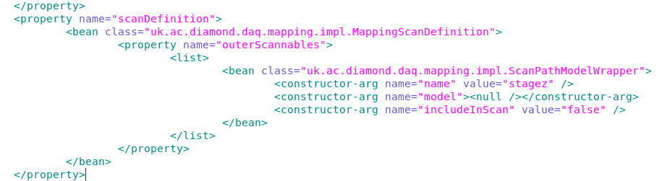
Interface Customization
$(gda_config)/clients/main/_common/mapping.xml
Axis name labels:
Outer scan axes:

Slide 14
GDA perspectives
GDA has three main perspectives you’ll use with Malcolm:
Mapping
DataVis
Used both of these in Part 1
Processing
A perspective is a collection of related views

Slide 15
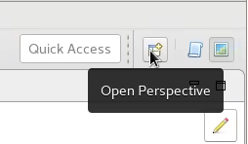
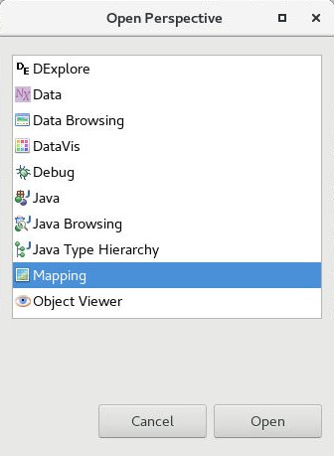
Mapping Perspective
Mapping perspective used for:
Setting up scan ‘map’
Configuring sample metadata
Start/stop/pause controls
Monitoring progress
Viewing results

Slide 16
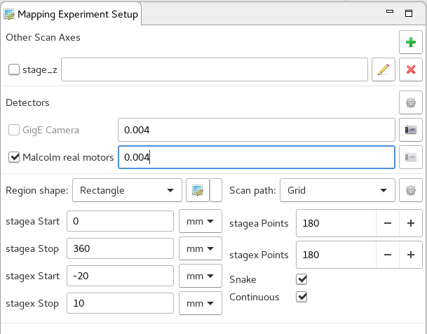
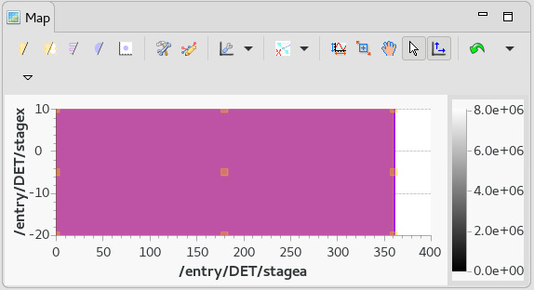
Mapping Experiment Setup
Configure any outer scan axes

Slide 17
Mapping Experiment Setup
Configure any outer scan axes
Select the Malcolm device and enter desired exposure time

Slide 18
Mapping Experiment Setup
Configure any outer scan axes
Select the Malcolm device and enter desired exposure time
Choose desired region shape and scan path

Slide 19
Mapping Experiment Setup
Configure any outer scan axes
Select the Malcolm device and enter desired exposure time
Choose desired region shape and scan path
Configure the map region
Manually

Slide 20
Mapping Experiment Setup
Configure any outer scan axes
Select the Malcolm device and enter desired exposure time
Choose desired region shape and scan path
Configure the map region
Manually, or
By drawing desired shape

Slide 21
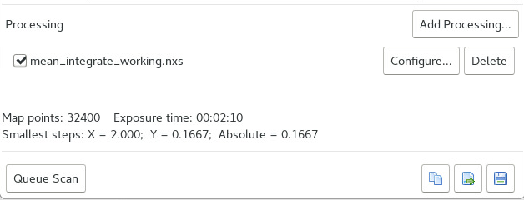
Mapping Experiment Setup
Choose a processing template
Add scan to queue
Map points calculated automatically
Save/load/copy command to clipboard

Slide 22
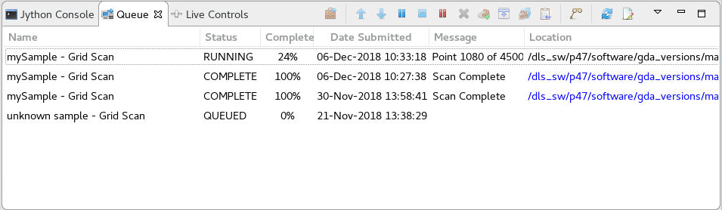
Mapping Queue
Scan ‘jobs’ are put into a queue and started automatically
View status and progress
Re-order / pause / abort jobs
Error messages displayed here

Slide 23
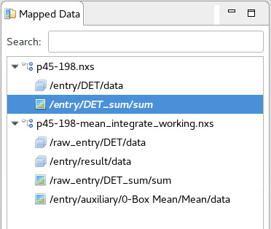
Mapped Data View
Lists the generated NeXus (.nxs) files
The sum dataset is created by summing the pixel values over the whole image
If processing was selected, a processed file is also generated

Slide 24
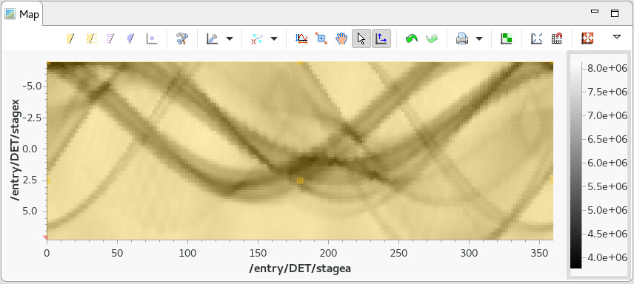
Map View
Example: representation of the sum (total intensity) data set
Displays single pixel per scan point
As the sample is rotated, the camera captures a different angle
This results in an approximate sinewave for each sample ‘stick’

Slide 25
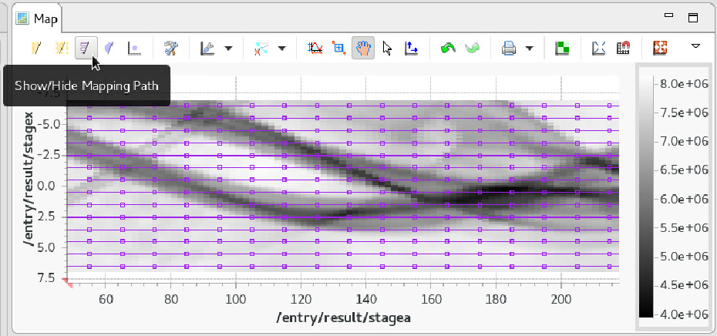
Map View
Scans can be performed over the top of each other
Use case: scan a small area in higher resolution

Slide 26
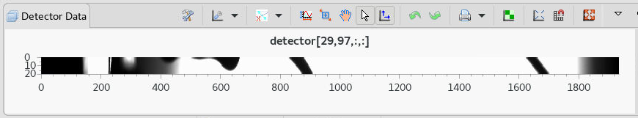
Detector Data View
Click a point in the map view
Detector data view updates to show corresponding detector frame

Slide 27
Live Mapping
The mapping perspective updates raw and processed data as the scan progresses
This is done via a DataServer on ixx-control (localhost on the test rig)
Can check this using http requests in a browser:
http://localhost:8690/tree/?path=<path2nxsfile>
Displays the NeXus tree as XML
http://localhost:8690/info/?path=<path2nxsfile>&dataset=<dataset>
Displays information about the specified dataset e.g. /entry/DET/data
http://localhost:8690/slice/?path=<path2nxsfile>&dataset=<dataset>&slice=[0,0,:,:]
Downloads data in specified slice as zip file
When scan finished, file loaded directly from disk

Slide 28
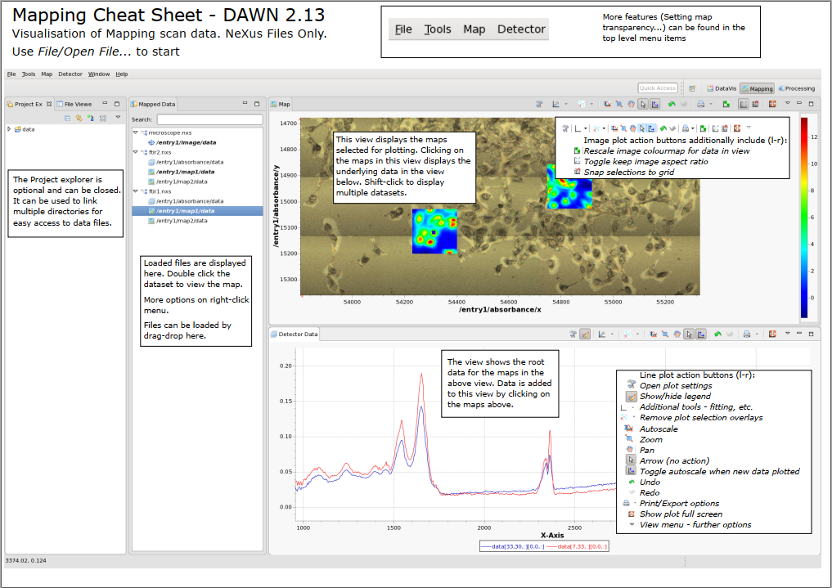
https://dawnsci.org/assets/pages/using_dawn/MappingCheatSheet.pdf

Slide 29
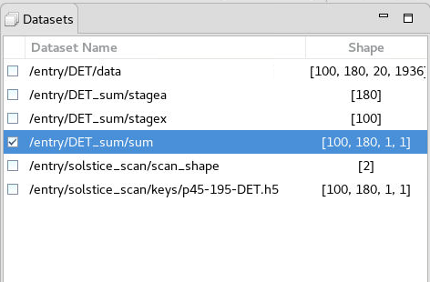
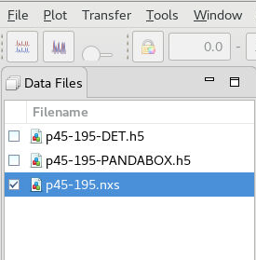
DataVis Perspective
Standalone perspective provided by DAWN
Can be used to open any HDF file
Can also be used at runtime to display additional datasets e.g. UniqueKeys
Use the File menu to load data files and select for viewing
Datasets view shows the available datasets in the selected file and their dimensions

Slide 30
DataVis Perspective
Check the box on both the file AND dataset to activate it for display

Slide 31
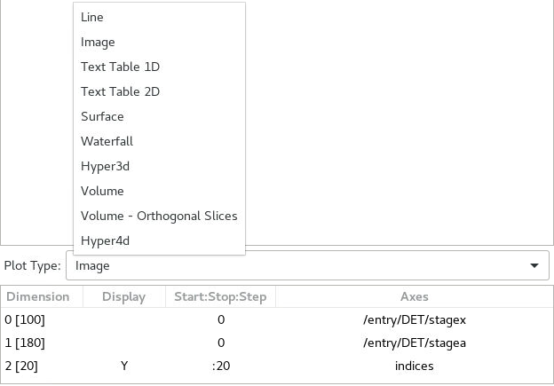
DataVis Perspective
Choose how to display the selected dataset from the dropdown
Assign axes to each dimension

Slide 32
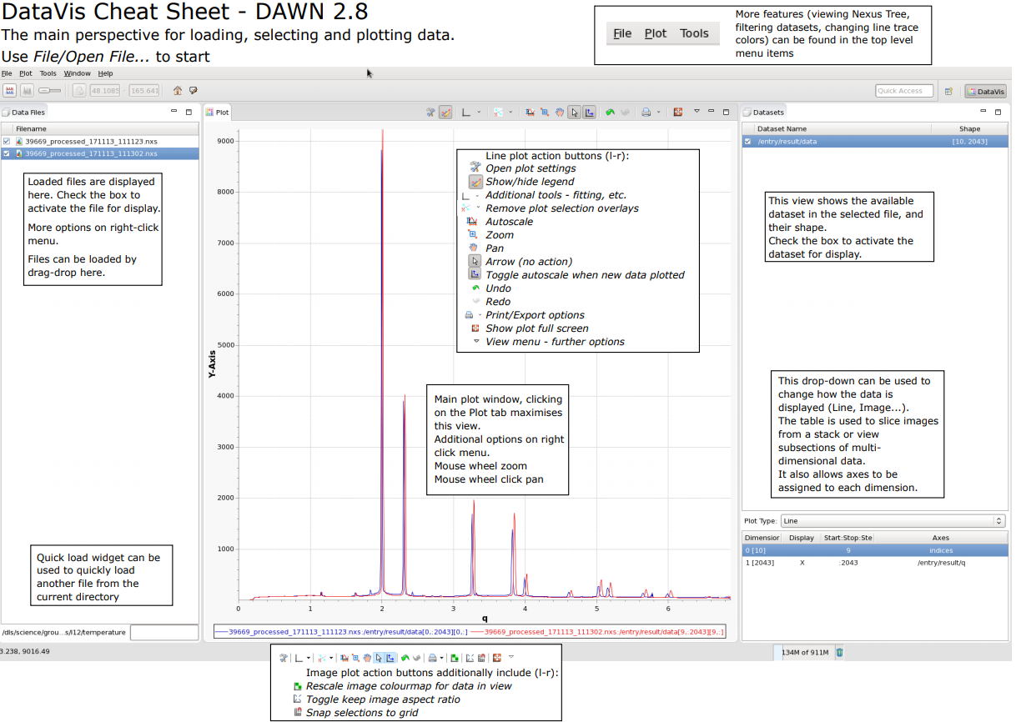
https://dawnsci.org/assets/pages/using_dawn/DataVisCheatSheet.pdf

Slide 33
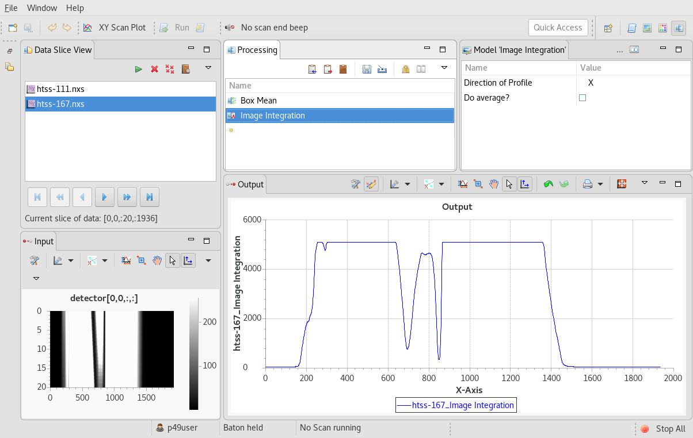
Live Processing
Live setup
Add new processing
Load existing pipeline

Slide 34
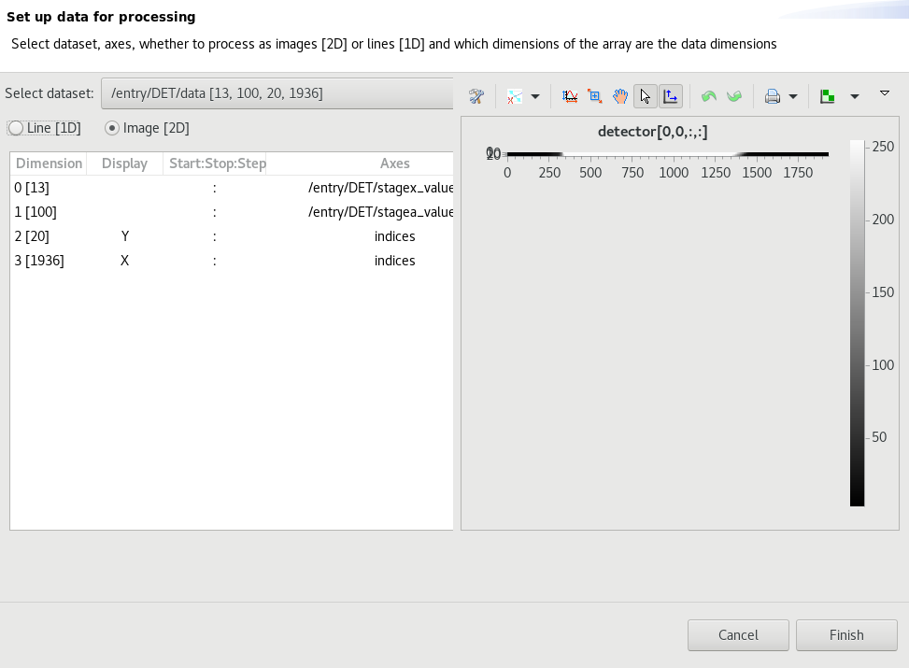
Live Processing

Slide 35
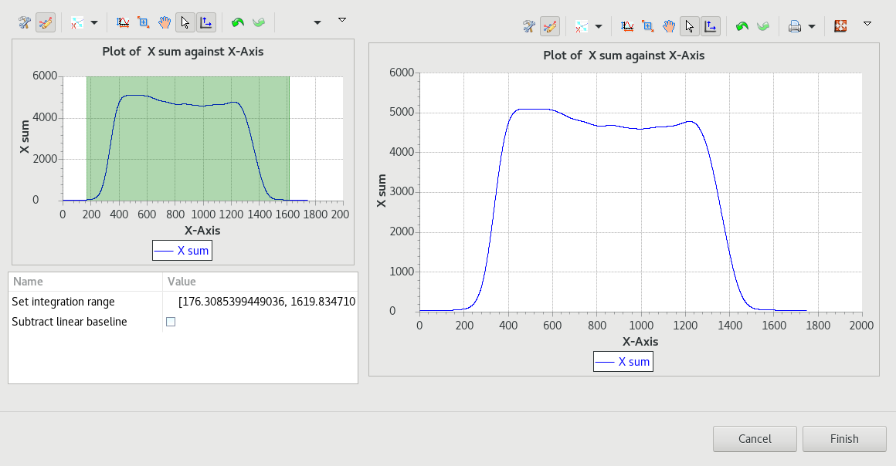
Live Processing
Set range

Slide 36
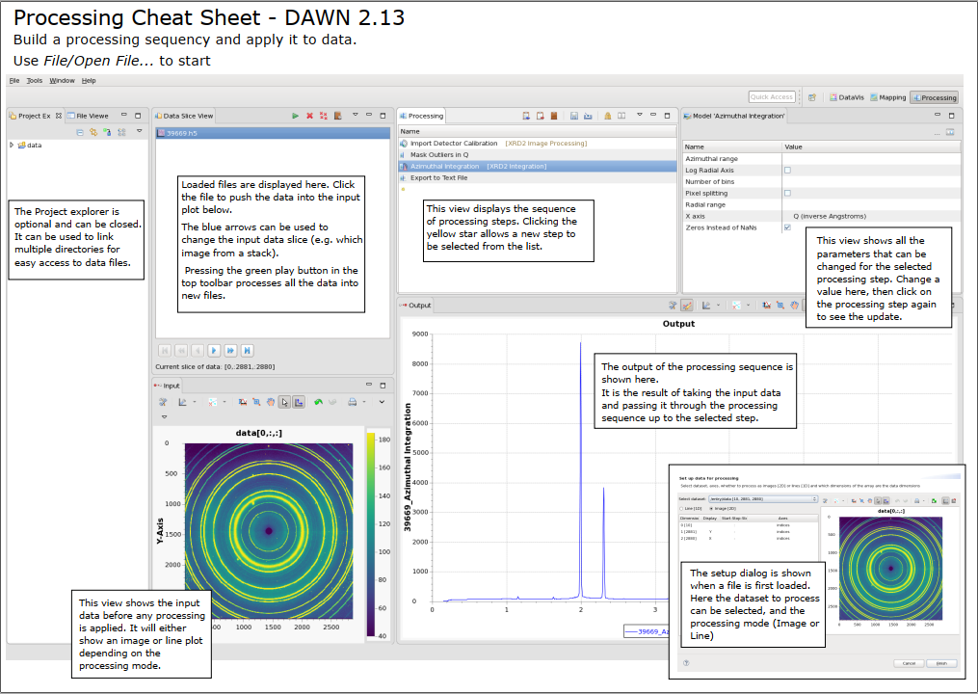
https://dawnsci.org/assets/pages/using_dawn/ProcessingCheatSheet.pdf

Slide 37

Exercise: Make your own mean integration pipeline
Open the mean_integrate.nxs file you used for the live processing in Part 1 and inspect it
Clear the pipeline, and then recreate it using the star button to add processing steps
Save it with a distinct name somewhere obvious
Start a new scan using the old mean_integrate.nxs template, and the one you just created
Hopefully they produce the same result!
Play around with other processing steps (e.g. Gaussian filter)

Slide 38
Live Processing
GDA can submit pipelines to DAWN for live processing
Publish-subscribe mechanism using ActiveMQ
Other subscribers can also be written e.g. using Python
Scan Status Topic
Subscribes
Sends message
Delivers message
GDA server
Scan started
Scan started
DAWN consumer

Slide 39
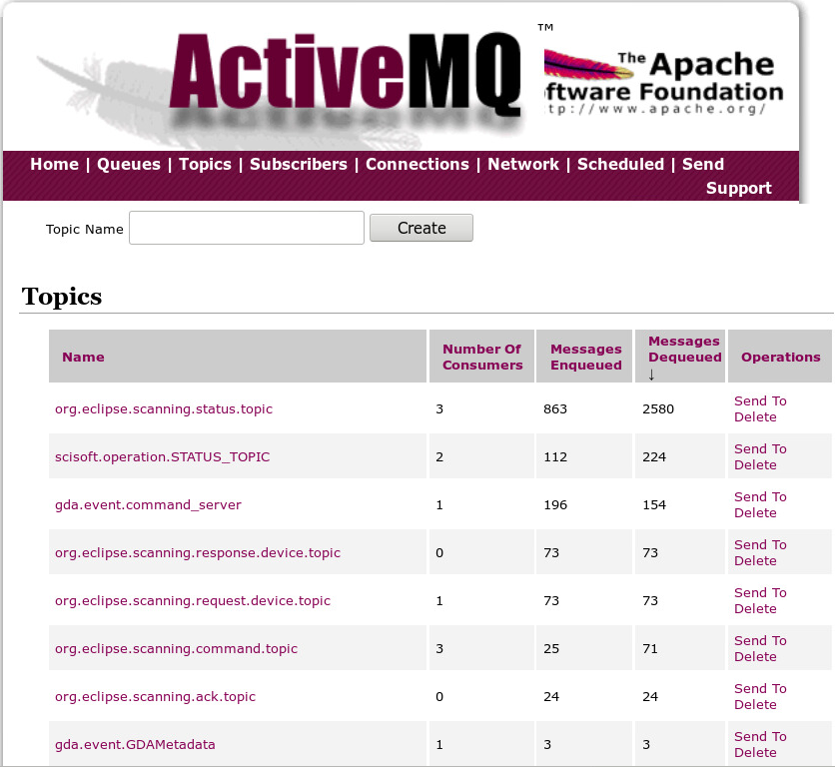
ActiveMQ Web console on port 8161
Scan topic
Processing topic
‘Processing finished’ message triggers final reconstruction

Slide 40
Live Processing - Details
DAWN consumer receives a JSON message on scan start and writes it to disk:
{visit folder}/tmp/operationBean.json
JSON file contains the path to the scan data files
Consumer then starts a new DAWN process on the cluster which reads the JSON file
Log files also stored in {visit folder}/tmp
Note: Test rig is setup slightly differently

Slide 41
Live Processing - Details
On beamlines, the DAWN Consumer and ActiveMQ processes run on ixx-control
On the test rig, ActiveMQ runs under ProcServ:
ioc-connect BL4xP-EA-PRCO-01
Ctrl-X to reboot

Slide 42
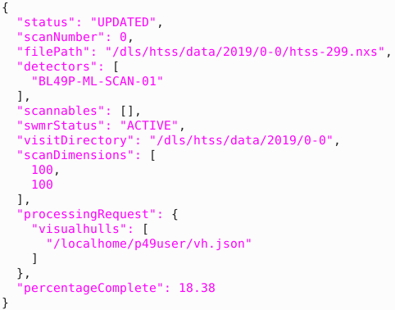
More flexible processing
Status information about the scan is sent to an ActiveMQ topic: gda.messages.scan
A script can subscribe to this topic to do arbitrary processing during or after a scan
See visualhulls for an example
There is a python3 module called scansubscriber to help

Slide 43
Watchdogs
Watchdogs provide a mechanism to pause and resume a scan based on an external condition
General case: ExpressionWatchdog
ring_current >= 1.0 && !portshutter.equals(‘Closed’)
scannable names comparision and literals
logical operators
Scan paused when expression becomes FALSE
Special case: TopupWatchdog
Monitors SR-CS-FILL-01:COUNTDOWN
Configurable warmup and cooloff periods (ms)

Slide 44
Configuring Watchdogs
Create an instance of DeviceWatchdogModel
Give it an ID (name)
Define the properties (dependent on the type of watchdog)
Ensure it’s linked to by the GDA server configuration
ExpressionWatchdog:
<bean id=“noBeam" class="org.eclipse.scanning.api.device.models.DeviceWatchdogModel">
<property name="expression" value="ring_current >= 1.0"
<property name="message" value="Beam has been lost"/>
</bean>
TopupWatchdog:
<bean id=“beamTopup" class="org.eclipse.scanning.api.device.models.DeviceWatchdogModel">
<property name="countdownName" value="machineTopupMonitor"/>
<property name="message" value="Paused during topup"/>
<property name="warmup" value="5000"/>
<property name="cooloff" value="4000"/>
<property name="modeName" value="ringModeMonitor"/>
</bean>

Slide 45
Configuring Watchdogs
Create an ExpressionWatchdog or TopupWatchdog instance and link it to the model
Example: ExpressionWatchdog
<bean id=“noBeam" class="org.eclipse.scanning.api.device.models.DeviceWatchdogModel">
<property name="expression" value="ring_current >= 1.0"
<property name="message" value="Beam has been lost"/>
</bean>
<bean id="expressionWatchdog" class="org.eclipse.scanning.sequencer.watchdog.ExpressionWatchdog“ init-method="activate">
<property name="model" ref=“noBeam"/>
<property name="enabled" value="true" />
</bean>

Slide 46
Watchdogs
Watchdogs are controlled at run time via the Jython console:
enableWatchdogs()
disableWatchdogs()
listWatchdogs()

Slide 47
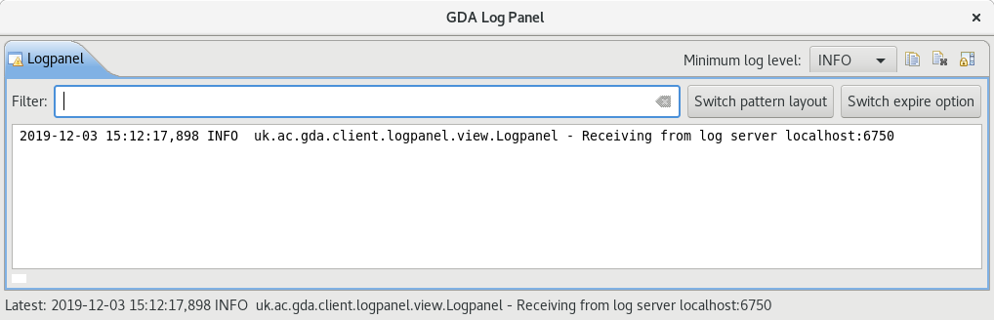
Logs
On the test rig, GDA logs are stored here:
/dls_sw/p4x/software/gda_logs
But can use the GDA log monitor from launcher or:
> module load gdalogpanel
> gdalogpanel
EPICS logs are in the IOC:
/dls/p4x/epics/logs/BL4xP-EA-IOC-01
DAWN processing logs can be found here:
/dls/p4x/epics/logs/BL4xP-EA-PRC0-0x

Slide 48
Practical Exercises
The scripts located in /localhome/p4xuser/training each trigger a problem somewhere in the stack…
Restart the machine to ensure a fresh start and confirm scans are working
Run one of the scripts
Start a new scan from GDA
Try to figure out what goes wrong and how to fix it!
No cheating!

