Slide 1

Hardware Triggered Scanning: Troubleshooting Solutions
Philip Taylor, Emma Arandjelovic
Observatory Sciences Limited

Slide 2
Scenario 1
Symptoms
Scan fails immediately with message:
Error from Malcolm Device Connection: Failed to connect to device 'BL47P-ML-SCAN-01' (ERROR: channel not connected)
Troubleshooting techniques
Check the message from GDA – this indicates a problem with Malcolm
Check the Malcolm web GUI is responding – http://localhost:8008/gui
Problem: Malcolm is not running
Solution
Restart the Malcolm process:
ioc-connect BL4xP-ML-MALC-01
Ctrl-X

Slide 3
Scenario 2
Symptoms
Scan running extremely slowly, possibly eventually failing with a TimeoutError
Troubleshooting techniques
Check the motors are moving at the correct speed
Check the frames are being written to disk (detector EDM screen)
Problem: File writing couldn’t keep up with the frame rate
Solution
Check the HDF chunking settings are valid
If in doubt, set the column and row chunk sizes to 0 (defaults to frame size)

Slide 4
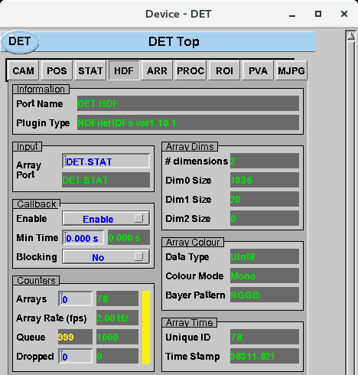
Scenario 2 Screenshot
Click on the HDF plugin tab
Check if input queue filling up
Check if any frames have been dropped

Slide 5
Scenario 3
Symptoms
Scan fails immediately with a message something like:
org.eclipse.scanning.api.malcolm.MalcolmDeviceException: Error from Malcolm Device Connection: NotWriteableError: Field ['BL49P-ML-SCAN-01', 'reset'] is not writeable, maybe because Block state = Aborting, cause:
Troubleshooting techniques
Check the message from GDA – this indicates problem is downstream from Malcolm
Check Malcolm GUI – shows PVs disconnected
Problem: EPICS IOC is not running
Solution
Reboot the EPICS IOC:
ioc-connect BL4xP-EA-IOC-01
Ctrl-X

Slide 6
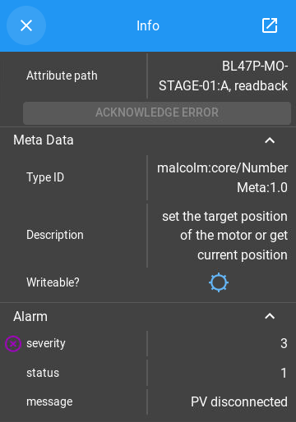
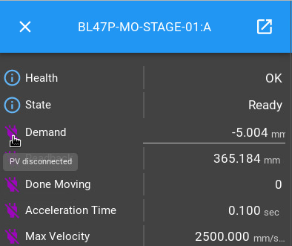
Scenario 3 Screenshots
Check the status of some EPICS devices in the Malcolm web gui

Slide 7
Scenario 4 (I)
Symptoms
Scan fails with error message: org.eclipse.scanning.api.malcolm.MalcolmDeviceException: Error from Malcolm Device Connection: AssertionError: Velocity 499.750124938 invalid for 'stagea' with max_velocity 10.0, cause:
Troubleshooting techniques
Check the motor record for stagea is setup correctly
Problem: VMAX is too small.
Solution
Set VMAX for stagea back to its original value (look in /tmp/ex4_values.txt)
From Training Rig edm screen: Motors -> Under A (right hand side) More -> Motion

Slide 8
Scenario 4 (II)
Symptoms
Scan is very slow and possibly times out
Troubleshooting techniques
Notice that the stagea motor rotates and then everything stops -> something wrong with the stagex
Check the VMAX motor record for stagex
Problem: VMAX too small but this time for stagex
Solution
Same as before. Correct value is in /tmp/ex4_values.txt.
Notice that the same underlying problem has different symptoms for each axis. Can you explain why?
Please run
> sh /tmp/ex4_restore.sh

