Slide 1
Hardware Triggered Scanning: Course 2
Philip Taylor, Emma Arandjelovic
Observatory Sciences Limited

Slide 2
Course Aims
Understand the key concepts behind Malcolm
Get experience in setting up Malcolm from scratch
Understand the different strategies for hardware triggered scanning on beamlines
Learn how to configure Malcolm to run on beamlines

Slide 3
Course Content
Refresher and basic concepts
Blocks, parts, and controllers
Scanning components
Manager and Runnable controllers
Scan Point Generator
Designs
Scanning control
Scan layer
AreaDetector
From the classroom to the beamline
Scanning strategies
EPICS and motion control requirements
Configuring Malcolm to run on beamlines

Slide 4



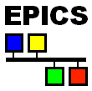
Refresher: Software Stack
Data Analysis WorkbeNch
- Analysis and visualization
Generic Data Acquisition
- Experiment setup and supervision
Malcolm
- Scan configuration
Experimental Physics & Industrial Control System
- Low level control of hardware

Slide 5

Refresher: What is Malcolm?
Generic and extensible framework for scanning
Middle layer between GDA and control system
Implemented in
Creates a s/w map of the h/w layer
https://pymalcolm.readthedocs.io
Web GUI called MalcolmJS
https://malcolmjs.readthedocs.io

Slide 6
Refresher: Blocks
Process
A block is a user-centred view
Examples:
Motion controller
PandA
Detector
‘Hello World’ program
It is an interface to an object’s:
Methods (actions)
Attributes (data)
Block 1
method1()
attribute1
Block 2
method2()
attribute2

Slide 7
Blocks Continued…
A process hosts multiple blocks
Blocks are given a unique MRI
(Malcolm Resource Identifier)
This is used by clients to address the block
A block is just the interface
Contains no code!

Slide 8
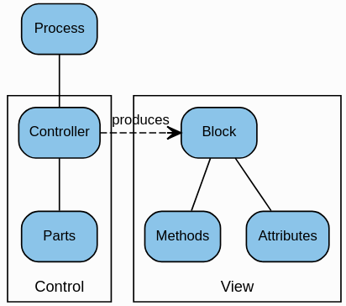
Parts and Controllers
Methods and attributes are contributed in Python Parts
A Controller provides a co-ordinating framework:
It creates a Block View that we interact with
It populates this with its own methods and attributes and also those from the contributed Parts

Slide 9
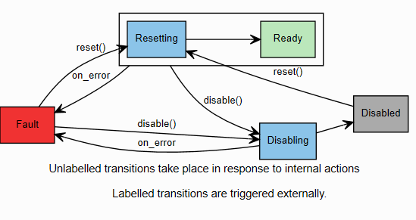
Stateful Controller
Used by blocks in the Hardware Layer
Implements a state machine:

Slide 10

Getting Started
Stop BL4xP-ML-MALC-01 (Ctrl-T then Ctrl-X)
Get the code:
git clone https://github.com/dls-controls/pymalcolm
Run the Hello World example:
./malcolm/imalcolm.py malcolm/modules/demo/DEMO-HELLO.yaml
NB: The examples are based on tutorials which you can also try in your own time: https://pymalcolm.readthedocs.io

Slide 11
Demo 1: Hello World
imalcolm launches an IPython interactive console
In the console, try:
>>> hello = self.block_view("HELLO")
>>> hello.greet("me")
Manufacturing greeting...
'Hello me'
>>> result = hello.greet(“Emma")
Manufacturing greeting...
>>> print(result)
Hello Emma
self is a context we can use to get hold of block views
“HELLO” is the MRI of our block
The hello object is now a view of our HELLO block that we can use to call its methods
The return value is assigned to the variable result

Slide 12
Module Structure
module root
blocks
controllers
includes
parts
- block1.yaml
- block2.yaml
Part1.py
Part2.py
Part3.py
Each item identified using the ‘.’ separator, e.g. demo.blocks.hello_block and demo.parts.HelloPart

Slide 13
Looking Under the Hood
module root
blocks
hello_block.yaml
counter_block.yaml
DEMO-HELLO.yaml
# Create some Blocks
- demo.blocks.hello_block:
mri: HELLO
- demo.blocks.hello_block:
mri: HELLO2
- demo.blocks.counter_block:
mri: COUNTER
# Add a webserver
- web.blocks.web_server_block:
mri: WEB
parts
hellopart.py counterpart.py
Instantiates 3 blocks. Each one defines a unique Malcolm Resource Identifier (MRI)
Web server block starts an HTTP server on port 8008

Slide 14
Hello Block Definition
module root
blocks
hello_block.yaml
counter_block.yaml
demo/blocks/hello_block.yaml:
- builtin.parameters.string:
name: mri
description: Malcolm resource id
- builtin.defines.docstring:
value: Block with a greet() Method
- builtin.controllers.BasicController:
mri: $(mri)
description: $(docstring)
- demo.parts.HelloPart:
name: hello
parts
hellopart.py counterpart.py
Defines parameters to be defined when instantiating the block. Value obtained using $(mri)
Defines the $(docstring) variable which describes the block’s function
Defines the controller which will create the block for us. The BasicController is a simple container for parts
Defines the part which contributes the functionality of the block
name is the (unique) name of the part within the controller

Slide 15
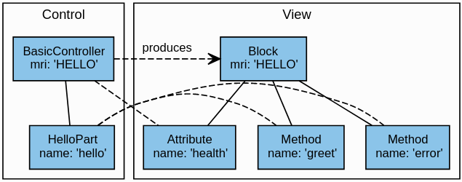
Hello World Structure
The BasicController contributes a ‘health’ attribute
The business logic methods are contributed by our HelloPart

Slide 16
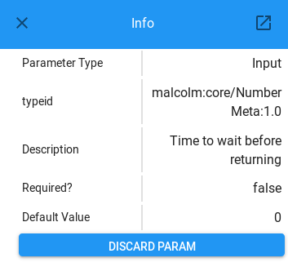
Brief Aside: Annotypes
Library for annotating Python types with metadata
Allow clients to discover parameter type information at runtime

Slide 17
Brief Aside: Annotypes
In the Python part:
from annotypes import Anno, add_call_types
with Anno(“my variable”):
AMyVar = str
add_call_types is a Python decorator which uses our Annotype definitions to provide introspection information
Variable description
Variable name
Variable type

Slide 18
Brief Aside: Annotypes
with Anno(“Description of parameter 1 (a string)”):
AParam1 = str
with Anno(“Description of parameter 2 (an int)”):
AParam2 = int
with Anno(“Description of the return value (a float)”):
AReturn = float
@add_call_types
def myMethod(self, param1, param2):
# type: (AParam1, AParam2) -> AReturn
See: https://github.com/dls-controls/annotypes

Slide 19
Hello Part Definition
module root
blocks
hello_block.yaml
counter_block.yaml
demo/parts/hellopart.py:
with Anno("The name of the person to greet"):
AName = str
with Anno("Time to wait before returning"):
ASleep = float
with Anno("The manufactured greeting"):
AGreeting = str
class HelloPart(Part):
def setup(self, registrar):
# type: (PartRegistrar) -> None
super(HelloPart, self).setup(registrar)
registrar.add_method_model(self.greet)
registrar.add_method_model(self.error)
parts
hellopart.py counterpart.py
Type definition information
Class must extend Part and provide a setup method
The PartRegistrar is a utility object used to register methods and attributes with the block

Slide 20
Hello Part Definition
demo/parts/hellopart.py (continued…):
@add_call_types
def greet(self, name, sleep=0):
# type: (AName, ASleep) -> AGreeting
"""Optionally sleep <sleep> seconds, then
return a greeting to <name>"""
print("Manufacturing greeting...")
sleep_for(sleep)
greeting = "Hello %s" % name
return greeting
def error(self):
"""Raise an error"""
raise RuntimeError("You called error()")
greet method contains the ‘business logic’ of the part
error method can be used to raise an error if something goes wrong
The three Annotypes we defined earlier are used to provide introspection information

Slide 21
Connecting a Client
Start up a second process to connect to the first:
./malcolm/imalcolm.py –c ws://localhost:8008
>>> self.make_proxy("localhost:8008", "HELLO")
>>> self.block_view("HELLO").greet("me")
u'Hello me'
Check the output from the first process to see this is the one doing the actual “work”

Slide 22
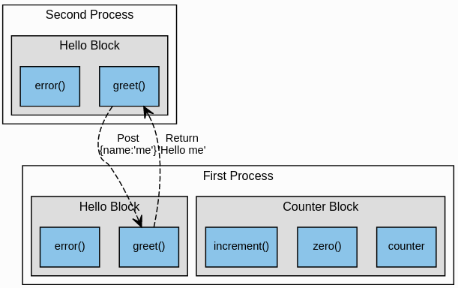
Connecting a Client
The block in the second process simply fires off a request and waits for a response

Slide 23
Demo 2: Adding Attributes
We have seen how to add a method to a block
registrar.add_method_model(<method>)
To add attributes we need a little more information:
registrar.add_attribute_model(
"<attribute_name>",
<attribute_model_instance>,
<method>)
Contains type info for validation
Method called when someone tries to set the value

Slide 24
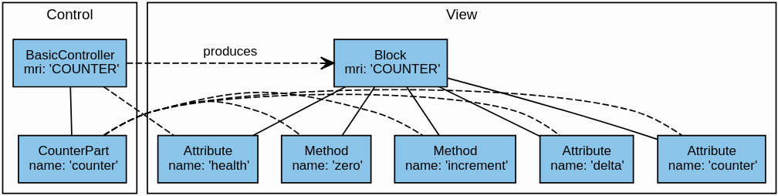
Counter Demo Structure
a writeable attribute counter which keeps the current counter value
a writeable attribute delta which stores the amount to increment by
a method zero() which will set counter = 0
a method increment() which will set counter = counter + delta
Notice the additional attribute ‘health’ contributed by the BasicController

Slide 25
Counter Part Definition
module root
blocks
hello_block.yaml
counter_block.yaml
demo/parts/counterpart.py:
class CounterPart(Part):
counter = None # type: AttributeModel
delta = None # type: AttributeModel
def zero(self):
"""Zero the counter attribute"""
self.counter.set_value(0)
def increment(self):
"""Add delta to the counter attribute"""
self.counter.set_value(self.counter.value +
self.delta.value)
parts
hellopart.py counterpart.py
Define the attributes as type AttributeModel
Use the AttributeModel’s set_value method to update the counter’s value
Use its value attribute to get its value

Slide 26
Counter Part Definition
demo/parts/counterpart.py (continued):
def setup(self, registrar):
# type: (PartRegistrar) -> None
super(CounterPart, self).setup(registrar)
self.counter = NumberMeta(
“float64”, “The current counter value”,
tags=[config_tag(), Widget.TEXTINPUT.tag()]
).create_attribute_model()
self.delta = NumberMeta(
“float64”, “Amount to increment by”,
tags=[config_tag(), Widget.TEXTINPUT.tag()]
).create_attribute_model(
initial_value=1)
Call the parent class setup method
Create a NumberMeta object:
Type, description
Tags indicating usage info
Create the AttributeModel from the meta object, supplying a default initial value if desired

Slide 27
Counter Part Definition
demo/parts/counterpart.py (continued):
registrar.add_attribute_model(
"counter",
self.counter, self.counter.set_value)
registrar.add_attribute_model(
“delta",
self.delta,
self.delta.set_value)
registrar.add_method_model(self.zero)
registrar.add_method_model(self.increment)
Register the attribute models:
Name,
Model,
Method name
If not supplied, the attribute is read-only
Register the method models as before

Slide 28
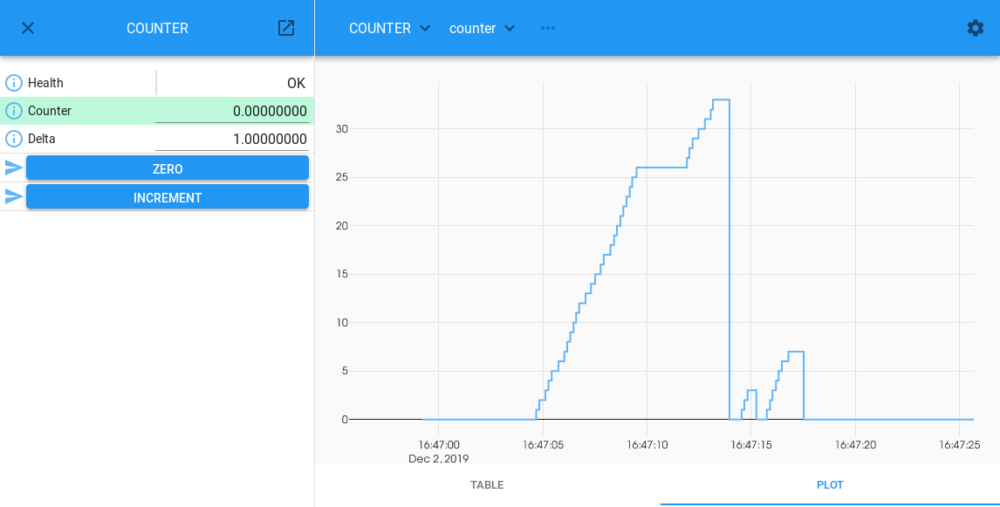
Running the Example

Slide 29
Practical Exercises
Modify the Hello example to throw an error saying “No name supplied!” if the name is an empty string.
Try setting the counter attribute to a non numeric value. What happens?
Modify the Counter example to add a new decrement method which decrements the counter by the delta value.

