Slide 1
Hardware Triggered Scanning: Scanning Components
Philip Taylor, Emma Arandjelovic
Observatory Sciences Limited

Slide 2
Overview
To perform scans, we need to control complex devices such as motion controllers and detectors
This topic will cover how these devices are configured by Malcolm
We will use a simulated motion controller and detector to see how this works in practice
We will also look at how to generate scan trajectories

Slide 3
Block Structure
Blocks like we have created so far make up the lowest level of blocks, known as the Hardware Layer
The Device Layer is a higher level of blocks that synchronise a number of child blocks to create an interface to a device e.g. a detector or motor controller
Example:
Motion Controller Block
Device Layer
X stage block
Y stage block
Co-ordinate system block
Hardware Layer

Slide 4
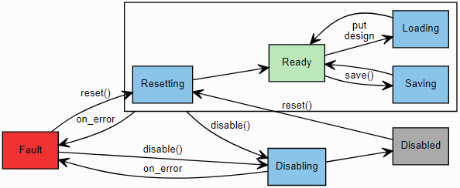
Device Blocks
Device blocks instantiate one or more child blocks
A controller aimed at managing child blocks is called a ManagerController
This provides:
A layout of child blocks
A mechanism to enable / disable child blocks
A mechanism to load / save designs (saved configurations)
State machine:

Slide 5
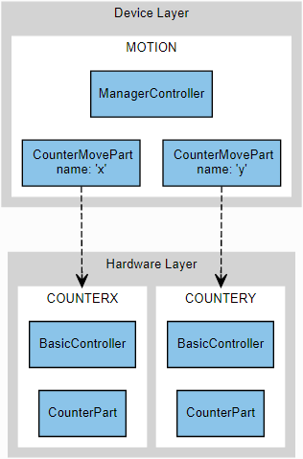
Motion Demo
Two Counter blocks in the hardware layer simulate motor axes (X and Y)
A device block called Motion simulates a motor controller with XMove and YMove methods
The Counter blocks are constructed with BasicControllers
The Motion block is constructed with a ManagerController
See the Motion tutorial: https://pymalcolm.readthedocs.io/en/latest/tutorials/motion.html

Slide 6
Motion Block Definition
demo/blocks/motion_block.yaml (extract):
- builtin.controllers.ManagerController:
mri: $(mri)
config_dir: $(config_dir)
description: $(docstring)
- demo.blocks.counter_block:
mri: $(mri):COUNTERX
- demo.blocks.counter_block:
mri: $(mri):COUNTERY
- demo.parts.CounterMovePart:
name: x
mri: $(mri):COUNTERX
- demo.parts.CounterMovePart:
name: y
mri: $(mri): COUNTERY
Use a ManagerController to construct the block
This takes an additional parameter to specify a directory for saving configurations
Instantiate two Counter blocks
Instantiate two MotorMove parts, one per block

Slide 7
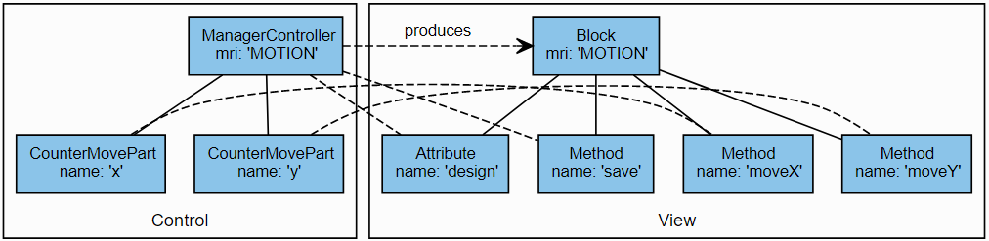

Motion Example Structure
Notice the design attribute and save method are contributed by the ManagerController

Slide 8
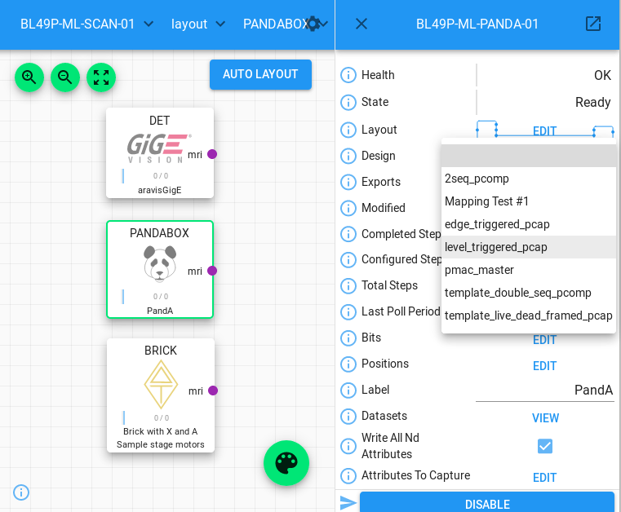
Designs
Recall: Designs allow you to save the layout of a device block and the attributes of its child blocks

Slide 9
Designs continued
Which attributes are saved?
Recall the attribute definition in our Counter part:
self.counter = NumberMeta(
"float64", "The current value of the counter",
tags=[config_tag(), Widget.TEXTINPUT.tag()])
Tags contain important metadata:
Widget tags - choose which widget to display it with
Group tags - create an expander around related attributes
Port tags - create the visual connections between blocks
Config tags - turn on saving/loading
See: https://pymalcolm.readthedocs.io/en/latest/reference/tags.html

Slide 10
How to Create a Device Part
Subclass builtin.parts.ChildPart
This provides access to the child blocks
Create annotypes for any variables we need
Create an __init__() method:
Call super().__init__()
Create a setup() method:
Call super().setup()
Register any additional methods and attributes
Implement the methods to perform the business logic
Use the passed in context to access the child block

Slide 11
Motor Move Part Definition
demo/parts/countermovepart.py (extract):
with Anno("The demand value to move our
counter motor to"):
ADemand = float
@builtin.util.no_save(“counter”)
class CounterMovePart(builtin.parts.ChildPart):
def __init__(self, name, mri):
# type: (APartName, builtin.parts.AMri) -> None
super(CounterMovePart, self).__init__(name, mri, initial_visibility=True, stateful=False)
def setup(self, registrar):
# type: (PartRegistrar) -> None
super(CounterMovePart, self).setup(registrar)
registrar.add_method_model(self.move,
self.name + “Move”, needs_context=True)
Create an Annotype for the demand position
Define attributes in the child block not to be saved
Call super().__init__()
Register the method model in setup, ensuring the name is unique for each part
Tell Malcolm the method needs a Context object for accessing the child block

Slide 12
Part Definition Continued
demo/parts/countermovepart.py (continued):
@add_call_types
def move(self, context, demand):
# type: (builtin.hooks.AContext, ADemand) -> None
child = context.block_view(self.mri)
child.counter.put_value(demand)
Use the passed in context as well as the MRI to create a Block view of the Counter child Block
Set the Block’s counter attribute to the new demand

Slide 13

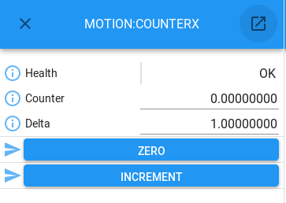
Running the Motion Demo
./malcolm/imalcolm.py malcolm/modules/demo/DEMO-MOTION.yaml
Open http://localhost:8008/
Select the MOTION:COUNTERX block and ‘tear-off’
Repeat for MOTION:COUNTERY
Select the MOTION root block and request new values for X and Y
Watch the counter blocks changing value
Practise saving and loading designs with different delta values

Slide 14
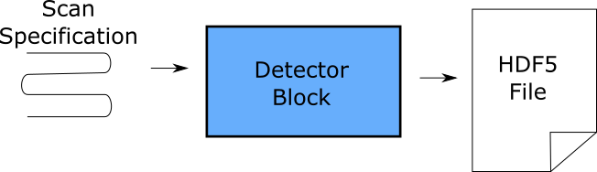
Detector Demo
A dummy detector that takes a scan specification and writes data to an HDF5 file
This will introduce two new concepts:
RunnableController – provides methods and attributes relating to the different steps of a scan
ScanPointGenerator – used to generate n-dimensional scan paths
See the Detector tutorial: https://pymalcolm.readthedocs.io/en/latest/tutorials/detector.html

Slide 15
Runnable Device Blocks
A ‘Runnable’ device block understands what a scan is
It has a state machine that implements the scan process
This is controlled by the user via two important methods:
configure()
Configure all child blocks according to the supplied parameters
run()
Start all child blocks running, provide status monitoring and periodic actions
These are contributed to the block by a RunnableController

Slide 16
Runnable Controller Details
Inherits from ManagerController
Adds to the ManagerController state machine to include the different steps of a scan
Additional attributes:
completedSteps
configuredSteps
totalSteps
Controllers provide hooks, which Parts can register with to run the device specific logic on state transitions

Slide 17
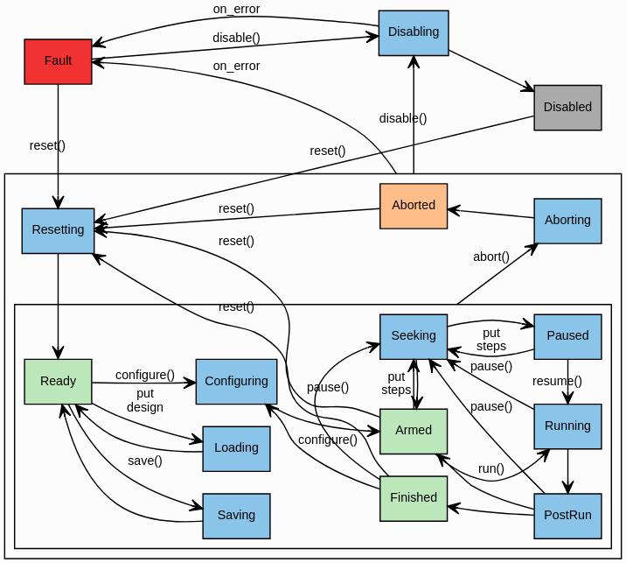
Runnable Controller States
Hooks are run on state transitions
See: https://pymalcolm.readthedocs.io/en/latest/reference/statesets.html#statesets

Slide 18
Hooks Overview
Functions registered to hooks are called automatically by the controller
All functions hooked to the same hook are called concurrently
Examples:
ConfigureHook (part, context, completed_steps, steps_to_do, part_info, generator, axesToMove, **kwargs):
Called at configure() to setup a child block
RunHook (part, context, **kwargs):
Called at run() to start all children running
ResetHook(part)
Called at reset() to return to Ready state

Slide 19
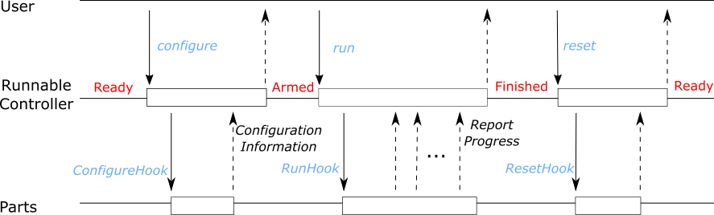
Runnable Device Sequence Diagrams
Note: There are more hooks than are shown here, see https://pymalcolm.readthedocs.io/en/latest/reference/statesets.html for a complete list of hooks.

Slide 20
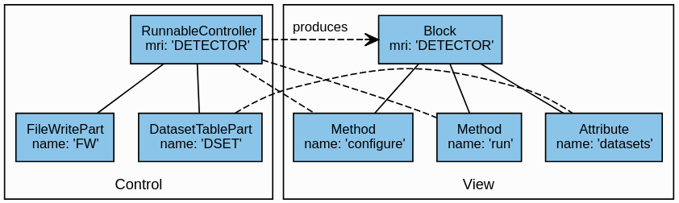
Detector Demo Structure
The DETECTOR block is constructed with a RunnableController
A FileWritePart writes the HDF5 file
Configure hook takes a scan point generator and initialises the scan
Run hook iterates through the generator points and writes the data
A DatasetTablePart collects info (location, size etc.) about the data and exposes it in the datasets attribute

Slide 21
Detector Block Definition
demo/blocks/detector_block.yaml (extract):
- builtin.controllers.RunnableController:
mri: $(mri)
config_dir: $(config_dir)
description: $(docstring)
- builtin.parts.LabelPart:
value: $(label)
- scanning.parts.DatasetTablePart:
name: DSET
- demo.parts.FileWritePart:
name: FW
width: 160
height: 120
Use a RunnableController to construct the block
A LabelPart displays a title on the GUI
A DatasetTablePart reports the datasets written
A FileWritePart writes some dummy data to an HDF5 file

Slide 22
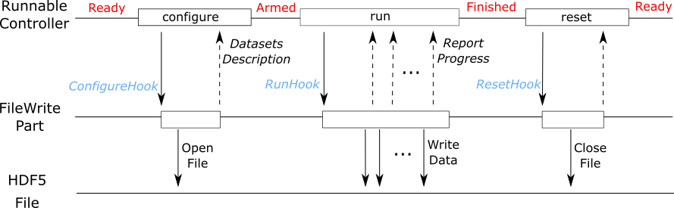
Detector Demo Sequence Diagram
This demo detector saves some generated data to an HDF5 file just as an example.

Slide 23
How to Create a Runnable Device Part
Subclass builtin.parts.Part or builtin.parts.ChildPart
Create an __init__ method:
Call super().__init__()
Implement the on_configure(*params), on_run() and reset() methods to perform the business logic
The on_configure method should prepare the scan
The on_run method should generate the data and report progress to the controller so it can update the block’s currentStep attribute
The reset method should clean up after a scan, even if it failed.
Create a setup method:
Register any additional methods and attributes
Register any hooks with the controller
Inform the controller what extra parameters configure requires

Slide 24
File Write Part: init
demo/parts/filewritepart.py (extract):
class FileWritePart(Part):
def __init__(self, name, width, height):
# type: (APartName, AWidth, AHeight) -> None
super(FileWritePart, self).__init__(name)
# Store input arguments
self._width = width
self._height = height
# The detector image we will modify for each image (0..255 range)
self._blob = make_gaussian_blob(width, height) * 255
# The HDF5 file we will write
self._hdf = None # type: h5py.File
# Configure args and progress info
self._generator = None # type: scanning.hooks.AGenerator
self._completed_steps = 0
self._steps_to_do = 0
# How much to offset unique id value from generator point (for rewind function)
self._uid_offset = 0

Slide 25
Detector Demo Sequence Diagram
This demo detector saves some generated data to an HDF5 file just as an example.

Slide 26
File Write Part: on_configure
demo/parts/filewritepart.py (extract):
def on_configure(self,
completed_steps, # type: scanning.hooks.ACompletedSteps
steps_to_do, # type: scanning.hooks.AStepsToDo
generator, # type: scanning.hooks.AGenerator
fileDir, # type: scanning.hooks.AFileDir
formatName="det", # type: scanning.hooks.AFormatName
fileTemplate="%s.h5", # type: scanning.hooks.AFileTemplate
):
# type: (...) -> scanning.hooks.UInfos
# Store the parameters and create an empty HDF file
self._generator = generator
filename = fileTemplate % formatName
filepath = os.path.join(fileDir, filename)
self._hdf = self._create_hdf(filepath, generator)
# Create the Info objects describing the two datasets…..
infos = [scanning.infos.DatasetProducedInfo(name=…) ,…]
return infos

Slide 27
Detector Demo Sequence Diagram
This demo detector saves some generated data to an HDF5 file just as an example.

Slide 28
File Write Part: on_run
demo/parts/filewritepart.py (extract):
def on_run(self, context):
# type: (scanning.hooks.AContext) -> None
"""On `RunHook` record where to next take data"""
end_of_exposure = time.time() + self._exposure # Start time so everything is relative
last_flush = end_of_exposure
for i in range(self._completed_steps, self._completed_steps + self._steps_to_do):
point = self._generator.get_point(i)
wait_time = end_of_exposure - time.time()
context.sleep(wait_time) # Must use the context parameter to make it
# an interruptible sleep so the scan can be aborted
self.log.debug("Writing data for point %s", i)
self._write_data(point, i)
if time.time() - last_flush > FLUSH_PERIOD:
last_flush = time.time()
self._flush_datasets()
end_of_exposure += point.duration
self.registrar.report(scanning.infos.RunProgressInfo(i + 1))
self._flush_datasets()

Slide 29
Detector Demo Sequence Diagram
This demo detector saves some generated data to an HDF5 file just as an example.

Slide 30
File Write Part: reset
demo/parts/filewritepart.py (extract):
def on_reset(self):
# type: () -> None
if self._hdf:
self._hdf.close()
self._hdf = None

Slide 31
File Write Part: setup
demo/parts/filewritepart.py (continued):
def setup(self, registrar):
# type: (PartRegistrar) -> None
super(FileWritePart, self).setup(registrar)
# Hooks
registrar.hook(scanning.hooks.ConfigureHook, self.on_configure)
registrar.hook((scanning.hooks.PostRunArmedHook,
scanning.hooks.SeekHook), self.on_seek)
registrar.hook(scanning.hooks.RunHook, self.on_run)
registrar.hook((scanning.hooks.AbortHook,
builtin.hooks.ResetHook), self.on_reset)
# Tell the controller to expose some extra configure parameters
registrar.report(scanning.hooks.ConfigureHook.create_info(self.on_configure))

Slide 32
Additional Hooks
More examples:
SeekHook
Used for pause/rewind functionality, to adjust the completed_steps
PostRunArmedHook
Called at the end of run() when there are more steps to be run
(e.g. when the scan is paused)
AbortHook
Called at abort() to stop the current scan
ResetHook
Called at reset() to reset all Parts to a known state

Slide 33
Info Objects
An Info is an object created by a Part and passed to its parent Controller in one of two ways:
Returned from a hooked function
Reported via PartRegistrar.report(info)
We report progress via PartRegistrar.report(info) in the method registered to the RunHook:
def on_run(self, context): … for i in range(…): … self.registrar.report( scanning.infos.RunProgressInfo(i+1))

Slide 34
Info Objects Continued
We return a description of the dataset produced by the Part from the method registered to the ConfigureHook:
def on_configure(self, …): # type: (...) -> scanning.hooks.UInfos … infos = [scanning.infos.DatasetProducedInfo(name=…), …] return infos
DatasetProducedInfo parameters:
name – Dataset name
filename – Filename relative to the fileDir we were given
type – What NeXuS dataset type it produces
rank – The rank of the dataset including generator dims
path – The path of the dataset within the file
uniqueid – The path of the UniqueID dataset within the file

Slide 35
Info Objects Continued
We report additional arguments for hook functions in the setup method:
def setup(self, registrar):
…
registrar.report(
scanning.hooks.ConfigureHook.create_info(self.configure))
create_info scans the on_configure method for the arguments in addition to completed_steps and steps_to_do:
generator
fileDir
formatName
fileTemplate

Slide 36
Detector Demo
A dummy detector that takes a scan specification and writes data to an HDF5 file
This will introduce two new concepts:
RunnableController – provides methods and attributes relating to the different steps of a scan
ScanPointGenerator – used to generate n-dimensional scan paths
See the Detector tutorial: https://pymalcolm.readthedocs.io/en/latest/tutorials/detector.html

Slide 37
Scan Point Generator
To run a continuous scan, we need many parameters:
Demand positions for frame midpoint
Demand positions for frame start and end
Index at which to store the frame
Duration of the frame
A Python module called ScanPointGenerator generates this data for a variety of scan types (e.g. line, spiral, …)
A generator is passed to the configure method to setup the scan
See https://scanpointgenerator.readthedocs.io

Slide 38
Scan Point Generator Example
class scanpointgenerator.LineGenerator
(axes, units, start, stop, size, alternate=False)
- Generate a line of equally spaced N-dimensional points
Parameters:
axes (str/list(str)) – The scannable axes E.g. “x”
units (str/list(str)) – The scannable units. E.g. “mm”
start (float/list(float)) – The first position to be generated. e.g. 1.0
stop (float/list(float)) – The final position to be generated. e.g. 5.0
size (int) – The number of points to generate. E.g. 5
alternate (bool) – Specifier to reverse direction

Slide 39
Preparing the Example
./malcolm/imalcolm.py malcolm/modules/demo/DEMO-DETECTOR.yaml
>>> from scanpointgenerator import LineGenerator, CompoundGenerator
>>> from scanpointgenerator.plotgenerator import plot_generator
>>> yline = LineGenerator("y", "mm", -1, 0, 6)
>>> xline = LineGenerator("x", "mm", 4, 5, 5, alternate=True)
>>> generator = CompoundGenerator([yline, xline], duration=0.5)
>>> plot_generator(generator)
>>> from annotypes import json_encode
>>> json_encode(generator)
Copy the JSON output to the clipboard

Slide 40
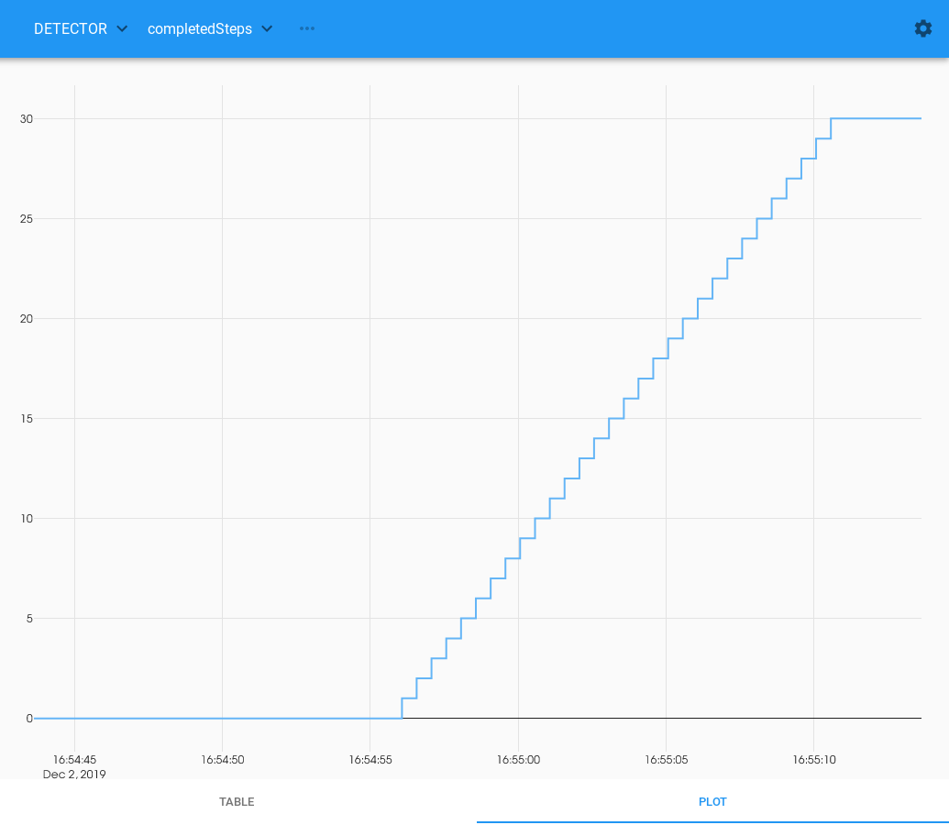
Running the Example
Open http://localhost:8008/gui/DETECTOR
Expand the Configure method and Edit the generator field to paste in the JSON code
Set the fileDir to /tmp
Click Configure
Click Run
Watch the Completed Steps counter increase

Slide 41
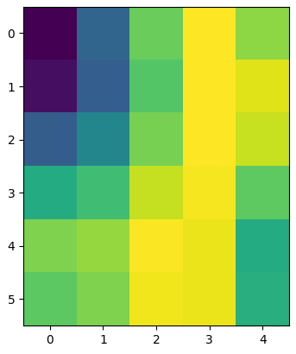
Checking the Results
>>> import h5py
>>> with h5py.File(“/tmp/det.h5”) as f:
….: im = f[“/entry/sum”][:]
….:
>>> im.shape
(6, 5, 1, 1)
>>> from pylab import imshow, show
>>> imshow(im[:, :, 0, 0])
<matplotlib.image.AxesImage at 0x7f11b090>
>>> show()

Slide 42
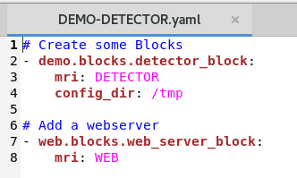
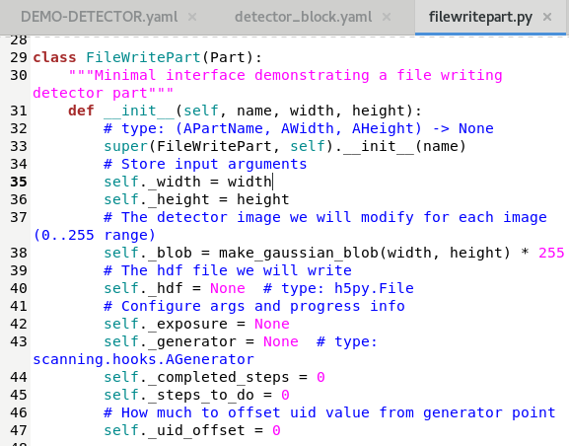
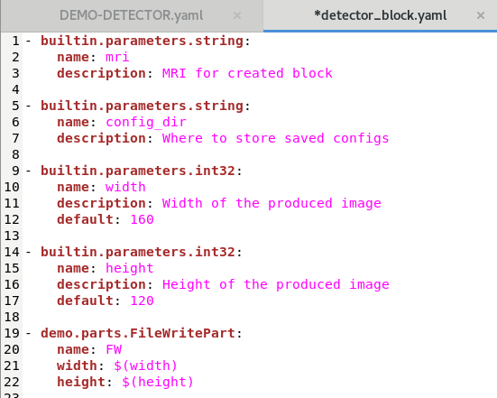
Recap: yaml chains

Slide 43
Recap: yaml chains

Slide 44
Practical Exercises
Modify the Motion demo to add high and low soft limits (values to be provided in DEMO-MOTION.yaml). If a demand is requested out of this range, it should raise an error. Provide default values of 0, meaning soft limits are disabled. Hint 1: Start by modifying the DEMO-MOTION.yaml file and work your way down. Hint 2: Read the docs! See builtin parameter types from second page: https://pymalcolm.readthedocs.io/en/latest/tutorials/motion.html https://pymalcolm.readthedocs.io/en/latest/build/builtin/parameters_api.html
Modify the generator in the Detector demo to create a larger and faster scan.

