Slide 1
Hardware Triggered Scanning: Scanning Control
Philip Taylor, Emma Arandjelovic
Observatory Sciences Limited

Slide 2
Overview
This topic will cover how to co-ordinate multiple device blocks to perform a scan
https://pymalcolm.readthedocs.io/en/latest/tutorials/scanning.html
We will also look at Malcolm’s role in configuring detectors and AreaDetector plugin chains
https://pymalcolm.readthedocs.io/en/latest/tutorials/areadetector.html

Slide 3
Scanning Demo
So far we have created hardware blocks and device blocks
The next step is to co-ordinate device blocks by creating an additional scan layer block
Like the detector, this uses a RunnableController:
configure(params)
– Configure all children, report child datasets
run()
– Start children running simultaneously, monitor status and report progress

Slide 4
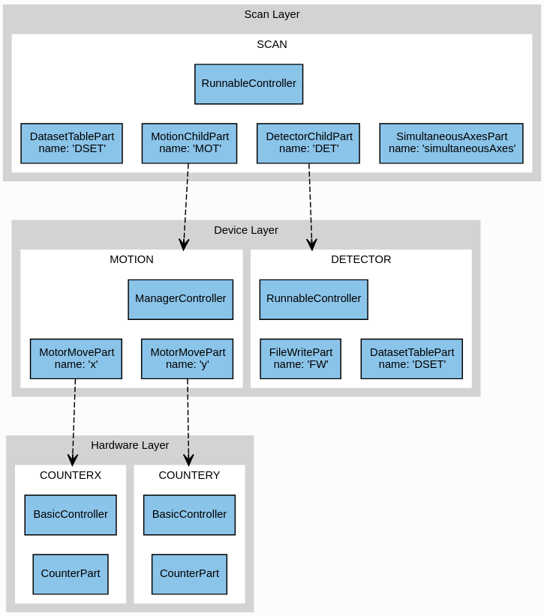
Block
Hierarchy

Slide 5
SCAN Block Functionality
The SCAN block uses two parts to control its children (MOT and DET)
A new SimultaneousAxesPart verifies the requested axes can be scanned simultaneously
A DatasetTablePart reports the child datasets

Slide 6
Process Definition
demo/DEMO-SCANNING.yaml (extract)
- builtin.defines.string:
name: config_dir
value: /tmp
- demo.blocks.motion_block:
mri: MOTION
config_dir: $(config_dir)
- demo.blocks.detector_block:
mri: DETECTOR
config_dir: $(config_dir)
- demo.blocks.scan_1det_block:
mri: SCAN
config_dir: $(config_dir)
label: Mapping x, y with demo det.
Create a config_dir variable that can be shared between blocks
Instantiate the motion and detector device blocks as before
Instantiate a new scan block to sit on top

Slide 7
Scan Block Definition
demo/blocks/scan_1det_block.yaml (Extract)
- builtin.parameters.string:
name: mri
description: MRI for created block
- builtin.parameters.string:
name: config_dir
description: Where to store configs
- scanning.controllers.RunnableController:
mri: $(mri)
config_dir: $(config_dir)
description: Demo scan
- builtin.parts.LabelPart:
value: $(label)
- scanning.parts.DatasetTablePart:
name: DSET
Specify the parameters to be supplied
Use a RunnableController to construct the block
Instantiate a LabelPart and DatasetTablePart as before

Slide 8
Scan Block Continued
demo/blocks/scan_1det_block.yaml
- scanning.parts.SimultaneousAxesPart:
value: [x, y]
- scanning.parts.DetectorChildPart:
name: DET
mri: DETECTOR
initial_visibility: True
- demo.parts.MotionChildPart:
name: MOT
mri: MOTION
initial_visibility: True
Instantiate a new part which checks the requested motion axes are allowed to be scanned simultaneously
Create parts for controlling the child blocks, passing in the MRI for each one

Slide 9
New Hook
As before, we are going to hook into ConfigureHook, RunHook, ResumeHook etc.
New hook: PreConfigureHook
Called at the start of configure()
Use the superclass ChildPart reload() function to load the last saved design to the child block

Slide 10
New configure() Parameter
We are also going to add a new parameter to the configure() method:
exceptionStep #type: int
Raise an exception if the scan gets to this step
How to set this up?
Recall the PartRegistrar object used to register methods and attributes with the parent controller
Call registrar.report(info) to inform it about additional configure parameters

Slide 11
Motion Child Part: setup()
demo/parts/motionchildpart.py (extract):
class MotionChildPart(builtin.parts.ChildPart):
def setup(self, registrar):
# type: (PartRegistrar) -> None
super(MotionChildPart, self).setup(registrar)
registrar.hook(scanning.hooks.PreConfigureHook, self.reload)
registrar.hook((scanning.hooks.ConfigureHook,
scanning.hooks.PostRunArmedHook,
scanning.hooks.SeekHook), self.configure)
registrar.hook((scanning.hooks.RunHook,
scanning.hooks.ResumeHook), self.on_run)
# Tell the controller to expose some extra configure parameters
registrar.report(scanning.hooks.ConfigureHook
.create_info(self.on_configure))

Slide 12
Motion Child Part: on_configure(…)
demo/parts/motionchildpart.py (continued):
@add_call_types
def on_configure(self,
completed_steps, # type: scanning.hooks.ACompletedSteps
steps_to_do, # type: scanning.hooks.AStepsToDo
generator, # type: scanning.hooks.AGenerator
axesToMove, # type: scanning.hooks.AAxesToMove
exceptionStep=0, # type: AExceptionStep
):
# Store the parameters inside the class
self._generator = generator
self._completed_steps = completed_steps
self._steps_to_do = steps_to_do
self._exception_step = exceptionStep
self._axes_to_move = axesToMove
self._movers = {axis: MaybeMover(child, axis) for axis in axesToMove}

Slide 13
Motion Child Part: on_run()
How to be notified when both motors have finished moving?
<method>_async is an asynchronous method which kicks off the specified Method and returns a Future object that can be waited on
These can be used to start a number of long running processes simultaneously
The MaybeMover helper class defines an asynchronous method, maybe_move_async(), which will move the motor if the demand position differs from the current position

Slide 14
Motion Child Part: on_run()
demo/parts/motionchildpart.py:
def on_run(self, context):
# type: (scanning.hooks.AContext) -> None
# Start time so everything is relative
for i in range(self._completed_steps, self._completed_steps + self._steps_to_do):
…
fs = []
for axis, mover in self._movers.items():
mover.maybe_move_async(fs, point.lower[axis])
mover.maybe_move_async(fs, point.upper[axis], move_duration)
# Wait for the moves to complete
context.wait_all_futures(fs)
# Update the point as being complete
self.registrar.report(scanning.infos.RunProgressInfo(i + 1))
# If this is the exception step then blow up
assert i + 1 != self._exception_step, \
"Raising exception at step %s" % self._exception_step

Slide 15

Preparing the Example
./malcolm/imalcolm.py malcolm/modules/demo/DEMO-SCANNING.yaml
>>> from scanpointgenerator import LineGenerator, CompoundGenerator
>>> from annotypes import json_encode
>>> yline = LineGenerator("y", "mm", -1, -0, 6)
>>> xline = LineGenerator("x", "mm", 4, 5, 5, alternate=True)
>>> generator = CompoundGenerator([yline, xline], duration=0.5)
>>> json_encode(generator)
Copy the JSON output to the clipboard

Slide 16
Running the Example
Open http://localhost:8008/gui/SCAN
Expand the Configure method and edit the generator field to paste in the JSON code
Set fileDir to /tmp
Press Configure and then Run
Watch the MOTION counter blocks as they perform the snake scan
Check a new HDF file is written to /tmp/DET.h5 by the DETECTOR device block

Slide 17
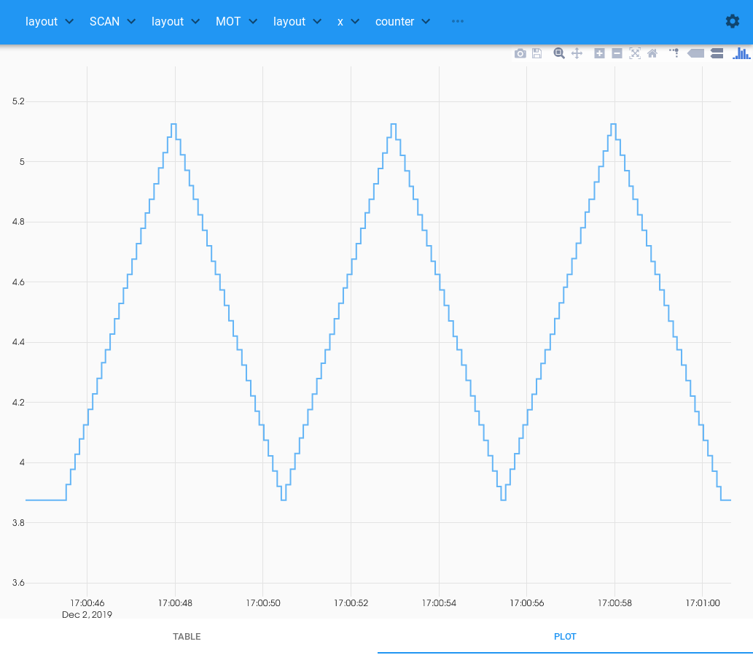
Scanning Demo Screenshot

Slide 18
Controlling Detectors
EPICS AreaDetector is responsible for setting up the detector and writing the data
Malcolm’s role is supervisory:
Configures the plugin chain
Sets up the detector parameters
Starts acquiring
Each detector is a ‘runnable’ device block
The detector driver and plugins are hardware blocks

Slide 19
AreaDetector Demo
We will use the AreaDetector simDetector
Use case: multi-dimensional continuous scan
Read the data from the simulated detector
Calculate statistics
Write them to a HDF5 file

Slide 20
Plugin Chain
DETECTOR: DRV
DETECTOR: POS
DETECTOR: STAT
DETECTOR: HDF
1) simDetector driver creates the NDArrays, each with a unique ID
2) NDPosPlugin tags each array with attributes that define its position within the dataset
3) NDPluginStats attaches statistics calculated from the data to each NDArray
4) NDFileHDF5 plugin writes the data to disk, using the attached attributes

Slide 21
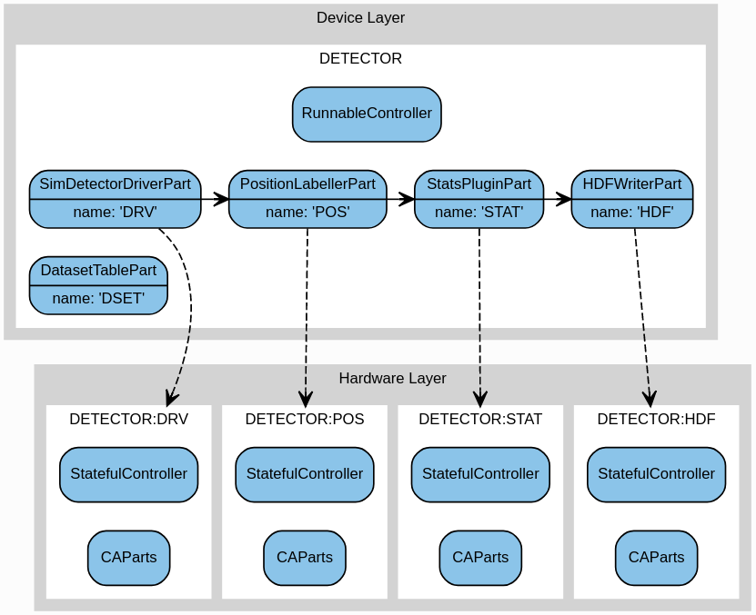
AD Process Structure

Slide 22
Process Definition
demo/DEMO-AREADETECTOR.yaml (Part I)
- builtin.defines.cmd_string:
name: hostname
cmd: hostname –s
- builtin.defines.export_env_string:
name: EPICS_CA_SERVER_PORT
value: 6064
- builtin.defines.export_env_string:
name: EPICS_CA_REPEATER_PORT
value: 6065
- builtin.defines.string:
name: config_dir
value: /tmp
Run the specified shell command and stores the result
Export environment variables needed to talk to EPICS
Define a $(config_dir) variable and set it to /tmp

Slide 23
Process Definition Cont..
demo/DEMO-AREADETECTOR.yaml (Part II)
- demo.blocks.motion_block:
mri: $(hostname)-ML-MOT-01
config_dir: $(config_dir)
- demo.blocks.detector_block:
mri: $(hostname)-ML-DET-01
config_dir: $(config_dir)
label: Interference detector
- ADSimDetector.blocks
.sim_detector_runnable_block:
mri_prefix: $(hostname)-ML-DET-02
config_dir: $(config_dir)
pv_prefix: $(hostname)-AD-SIM-01
label: Ramp detector
drv_suffix: CAM
Instantiate the child motion and detector blocks
Instantiate a sim_detector_runnable_block
Provide PV name information

Slide 24
Detector Device Block
Instantiates a RunnableController
Plus one block and one part for each element in the hardware layer (driver and plugins). For example:
- ADCore.blocks.stats_plugin_block:
mri: $(mri_prefix):STAT
prefix: $(pv_prefix):STAT
- ADCore.parts.StatsPluginPart:
name: STAT
mri: $(mri_prefix):STAT
An include file pulls in commonly used items:
- ADCore.includes.filewriting_collection:
pv_prefix: $(pv_prefix)
mri_prefix: $(mri_prefix)

Slide 25
Hardware Blocks
EPICS PV interface specified using Parts in the ca module
These wrap up related PVs into methods and attributes:
- ca.parts.CALongPart:
name: numImages
description: Number of images to take if imageMode=Multiple
pv: $(prefix):NumImages
rbv_suffix: _RBV
- ca.parts.CAActionPart:
name: stop
description: Stop acquisition
pv: $(prefix):Acquire
value: 0
wait: False

Slide 26
Preparing the Example
From the launcher, run the following and hit ‘Start IOC’:
Utilities -> GDA AreaDetector Simulation
./malcolm/imalcolm.py malcolm/modules/demo/DEMO-AREADETECTOR.yaml
>>> from scanpointgenerator import LineGenerator, CompoundGenerator
>>> scan = self.block_view(“<hostname>-ML-SCAN-01")
>>> yline = LineGenerator("y", "mm", -1, 0, 6)
>>> xline = LineGenerator("x", "mm", 4, 5, 5, alternate=True)
>>> generator = CompoundGenerator([yline, xline], [], [], duration=0.5)
>>> scan.configure(generator, fileDir="/tmp")

Slide 27
Running the Example
Query the scan block’s datasets:
>>> from annotypes import json_encode
>>> print(json_encode(scan.datasets.value ,indent=4))
Note there are now datasets from both detectors, as well as the motor demand positions
Monitor one of the datasets from a new terminal and start the scan from the Malcolm terminal:
h5watch /tmp/INTERFERENCE.h5/entry/uid
>>> scan.run()

Slide 28
Unique IDs
When the scan is finished:
First reset the scan to close the files:
>>> scan.reset()
Print the file contents for the RAMP detector:
h5dump -n /tmp/RAMP.h5
Then look at the UniqueID dataset:
h5dump -d /entry/NDAttributes/NDArrayUniqueId /tmp/RAMP.h5

Slide 29
Unique IDs cont.
Notice the ‘snake scan’ ordering of the frames:
DATASET "/entry/NDAttributes/NDArrayUniqueId" {
DATATYPE H5T_STD_I32LE
DATASPACE SIMPLE { ( 6, 5, 1, 1 ) / ( H5S_UNLIMITED, H5S_UNLIMITED, 1, 1) }
DATA {
(0,0,0,0): 1,
(0,1,0,0): 2,
(0,2,0,0): 3, First row written left-to-right
(0,3,0,0): 4,
(0,4,0,0): 5,
(1,0,0,0): 10,
(1,1,0,0): 9,
(1,2,0,0): 8, Second row written right-to-left
(1,3,0,0): 7,
(1,4,0,0): 6,
……….

Slide 30
Designs
Recall: Designs describe the layout of a device block and the settings of its child blocks
They allow plugin chains to be application specific
They are saved as JSON files in the config_dir
Use the config tag when defining the attribute in the Part to specify that it should be saved
All writeable CAParts are tagged as config attributes by default
This can be disabled by the class author

Slide 31
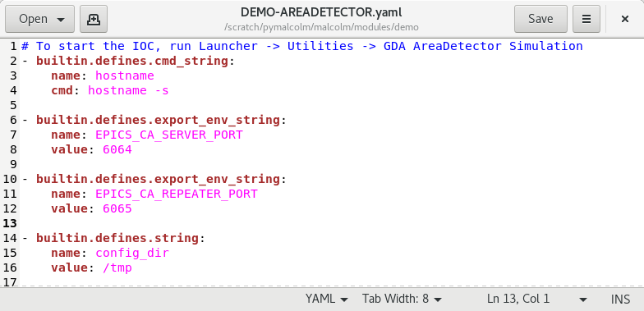
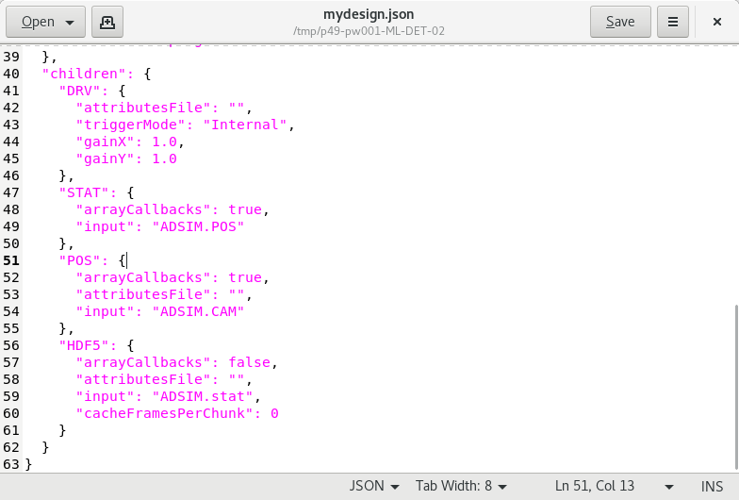
More on Designs
Config dir set in the .yaml file
arrayCallbacks must be true to pass on data

Slide 32
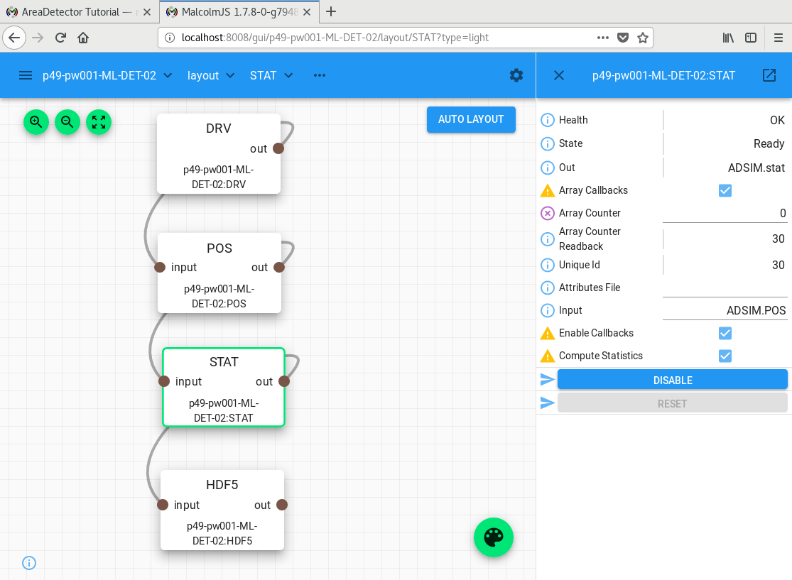
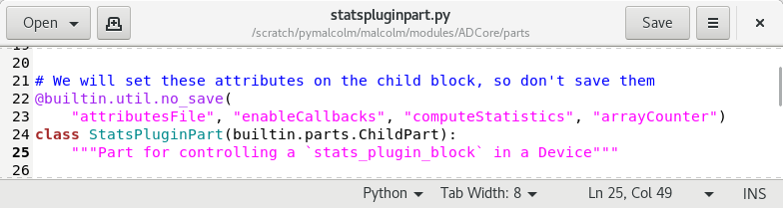
More on Designs
Settings (e.g. plugin chain wiring) are saved by the design
Some plugin attributes are set during configure() so are excluded from the design

Slide 33
Template Designs
Read-only designs provided by Malcolm
Used as starting points for applications
Named with the prefix template_
Example: template_software_triggered:
Sets up the plugin chain correctly
Configures default trigger mode, gains etc.

Slide 34
Scan Level Designs
Device blocks have designs for different scenarios
Scan block design specifies the required combination of device block designs
"children": {
“DETECTOR1": {
"design": " template_software_triggered.json "
},
“DETECTOR2": {
"design": "template_software_triggered.json"
},
"MOTOR": {
"design": “hkl_geometry.json"
}

Slide 35
Initial Designs
Both Manager and Runnable Controllers can take an initial_design parameter
Device layer blocks load their initial_design when Malcolm starts up
Warning: this means EPICS PVs may be written to!
Scan layer blocks load their childrens’ designs at the beginning of every scan
https://pymalcolm.readthedocs.io/en/latest/tutorials/areadetector.html#scan-block-design

Slide 36
Practical Exercises
Experiment with the ‘pause and rewind’ feature to redo part of the scan in the Detector demo. What happens to the UniqueId dataset?
Hint: set the ‘last good step’ attribute, then press ‘pause’

