Slide 1
Hardware Triggered Scanning: From the Classroom to the Beamline
Philip Taylor, Emma Arandjelovic
Observatory Sciences Limited

Slide 2
Overview
This topic will cover the control of real hardware to perform scans, including:
Issues related to motion control
EPICS IOC prerequisites
How to deploy Malcolm on beamlines
Triggering setup for the ‘PMAC as master’ scenario

Slide 3
Motion Control
Setup each Geobrick with the standard DLS config
Make sure to include Prog1 (trajectory scan) and Prog10 (co-ordinate system) motion programs
Take care to limit the maximum velocity and acceleration for programmed linear moves:
ixx16 – max velocity (counts / msec)
ixx17 – max acceleration (counts / msec²)

Slide 4
EPICS Requirements
One or more motion IOCs should be setup to control the Geobricks involved in the scan
Instantiate:
pmacController template from the EPICS pmac module for each Geobrick with prefix BLxxP-MO-BRICK-nn
pmacControllerTrajectory template with the same prefix
pmacCsController template for each co-ordinate system (at least one)
dls_pmac_asyn_motor template for each motor axis
dls_pmac_cs_asyn_motor template for each cs axis

Slide 5
EPICS Requirements Cont.
Malcolm uses the VMAX, ACCL, ERES, EGU and OFF design fields of the motor record
VMAX is used to calculate an appropriate velocity for moving the motors to the start positions

Slide 6
EPICS Requirements Cont.
PandA interface
Recall: PandA box is also a source of AreaDetector data…
Instantiate ADPandABlocks template from the ADPandaBlocks module with prefix BLxxI-MO-PANDA-nn:DRV:
Setup the NDPosPlugin and NDFileHDF5 AreaDetector plugins with prefixes BLxxI-MO-PANDA-nn:POS: and BLxxI-MO-PANDA-nn:HDF5:
Detectors
Setup an additional AreaDetector plugin chain for each detector

Slide 7
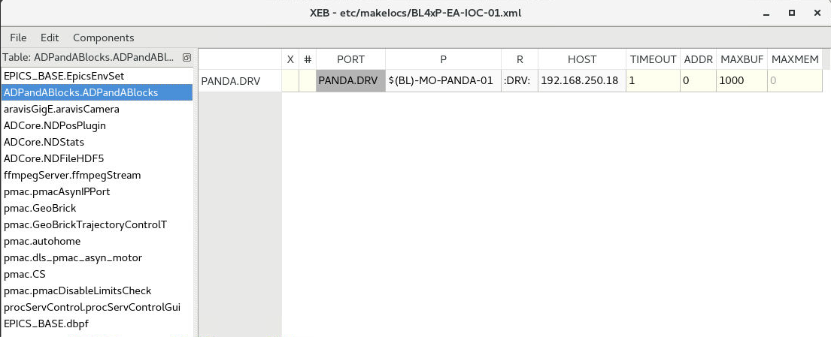
Example IOC Configuration
Typical iocbuilder file: ADPandABlocks setup

Slide 8
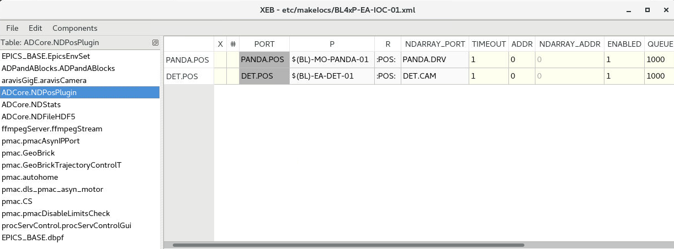
Example IOC Configuration
Typical iocbuilder file: NDPosPlugin setup

Slide 9
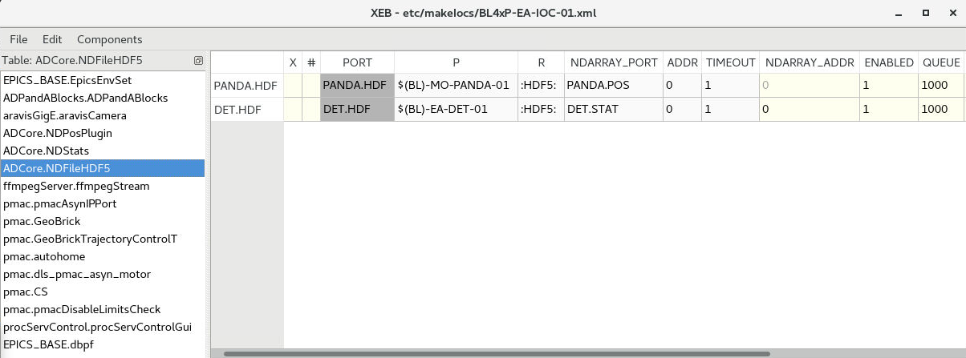
Example IOC Configuration
Typical iocbuilder file: NDFileHDF5 setup

Slide 10
Deploying Malcolm
Create a directory etc/malcolm in the BL IOC
Create a subdir blocks for the BL specific blocks
Create block definitions for each Geobrick and the top level scan block
Create the process definition: etc/malcolm/BLxxI-ML-MALC-01.yaml
See the PMAC tutorial: https://pymalcolm.readthedocs.io/en/latest/tutorials/pmac.html

Slide 11
Geobrick Blocks
Construct using a ManagerController
Use includes files to pull in the correct Blocks and Parts:
# Raw motor Blocks and their corresponding Parts
- pmac.includes.rawmotor_collection:
mri: BLxxvimI-ML-STAGE-01:X
pv_prefix: BLxxI-MO-MAP-01:STAGE:X
scannable: stagex
# Co-ordinate system Block and its corresponding Part
- pmac.includes.cs_collection:
mri_prefix: $(mri_prefix)
pv_prefix: $(pv_prefix)
cs: 1
# Trajectory scan and status Blocks and their corresponding Parts
- pmac.includes.trajectory_collection:
mri_prefix: $(mri_prefix)
pv_prefix: $(pv_prefix)

Slide 12

Geobrick Blocks
Locate the .yaml file for the Malcolm process running on the test rig
Drill down to find the block definition for the Geobrick and inspect it
Continue drilling down through the include statements to find the YAML for the motor records. What additional (runtime) fields of the motor record are accessed by Malcolm?

Slide 13
Scan Block
As in the scanning tutorial, this uses a RunnableController
We add an initial_design parameter to pass to the controller *
- builtin.parameters.string:
name: config_dir
description: Where to store saved configs
- builtin.parameters.string:
name: initial_design
description: Initial design to load for the scan
- scanning.controllers.RunnableController:
mri: $(mri_prefix)
config_dir: $(config_dir)
description: Hardware triggered scan
initial_design: $(initial_design)
* This means multiple instances can be used, each with a different starting configuration

Slide 14
Scan Block Continued
We also need some same part definitions:
LabelPart
Provides a human readable label for the Block. 4 or 5 words that describe the science case for this scan
SimultaneousAxesPart
Defines the superset of all axes that can be supplied as axesToMove at configure()
DatasetTablePart
Reports the datasets that any detectors produce
PmacChildPart
Takes the generator passed to configure(), and produces trajectory scan points that can be passed down to a PMAC Block
DetectorChildPart
Controls a detector (a runnable child block with a datasets Attribute)

Slide 15
Malcolm Process Definition
BL/etc/malcolm/BLxxI-ML-MALC-01.yaml
#!/dls_sw/prod/common/python/RHEL7-x86_64/pymalcolm/4-0/malcolm/imalcolm.py
- builtin.defines.module_path:
name: BLxxI
path: $(yamldir)
- builtin.defines.string:
name: config_dir
value: /dls_sw/ixx/epics/malcolm
- BLxxI.blocks.brick01_block:
mri_prefix: BLxxI-ML-BRICK-01
pv_prefix: BLxxI-MO-BRICK-01
config_dir: $(config_dir)
Make it executable by providing the full path to imalcolm
Define this directory as the BLxxI module
Specify where designs are saved
Instantiate some Geobrick blocks (to be created in the blocks subdir)

Slide 16
Malcolm Process Definition
etc/malcolm/BLxxP-ML-MALC-01.yaml cont…
- ADPandABlocks.blocks. panda_runnable_block:
mri_prefix: BLxxP-ML-PANDA-01
pv_prefix: BLxxP-MO-PANDA-01
hostname: 192.168.250.18
config_dir: $(config_dir)
- BLxxP.blocks.pmac_master_scan_block:
mri_prefix: BLxxP-ML-SCAN-01
config_dir: $(config_dir)
initial_design:
Instantiate a block for the PandA (from the Malcolm ADPandABlocks module)
Instantiate a scan block (to be created in the blocks subdir)

Slide 17
Malcolm Process Definition
etc/malcolm/BLxxP-ML-MALC-01.yaml cont…
# Scan the DLS redirector for IOCs to monitor, optional - system.defines.redirector_iocs: name: iocs yamlname: $(yamlname)
# Define the ServerComms
- system.blocks.system_block:
mri_prefix: $(yamlname)
iocs: $(iocs)
pv_prefix: $(yamlname)
config_dir: $(config_dir)
Define the comms interfaces (web server and pvAccess for GDA) using system_block

Slide 18
Malcolm Modules
To use our newly created beamline specific blocks, we need to declare them
To do this we make the blocks directory a Python package by creating __init__.py
This is run by Python whenever the package is imported
We also create an empty __init__.py in the top level <BL>/etc/malcolm directory

Slide 19
Block Module __init__.py
The __init__.py for the Blocks module needs to map Block names to corresponding .yaml files:
from malcolm.yamlutil import make_block_creator, check_yaml_names
# Create some Block definitions from YAML files
brick01_block = make_block_creator(__file__, "brick01_block.yaml")
another_block = make_block_creator(__file__, “another_block.yaml")
……….
# Expose all of the Block definitions, and nothing else
__all__ = check_yaml_names(globals())

Slide 20
Final Exercise
Create a new Malcolm instance from scratch to do a scan using the motion controller and PandA, but no detector, on the test rig.
We’ll use the IOC that is already running on the testrig.
This IOC is used to control the PMAC and provides PandA AD plugins. It provides:
A Geobrick controller template with PV prefix BLxxP-MO-BRICK-01
Raw axes with PV prefixes BLxxP-MO-STAGE-01:{X,A}
An ADPandABlocks template with PV prefix BLxxP-MO-PANDA-01
Code can be copied from:
https://pymalcolm.readthedocs.io/en/latest/tutorials/pmac.html

Slide 21
Final Exercise Part 1
Create the required directory structure in /scratch
Create a PMAC block in the blocks subdir. It needs:
a builtin.controllers.ManagerController
one pmac.includes.rawmotor_collection per axis
a pmac.includes.cs_collection
a pmac.includes.trajectory_collection
Create a scan block in the blocks subdir. It needs:
a scanning.controllers.RunnableController
an empty scanning.parts.SimultaneousAxesPart
a scanning.parts.DatasetTablePart
a pmac.parts.PmacChildPart for the PMAC
a scanning.parts.DetectorChildPart for the detector and the PandA
Tip: Hard coding prefixes instead of passing them around as in the online tutorials
keeps things a bit simpler for now!

Slide 22
Final Exercise Part 1
Create the process definition BLxxP-ML-MALC-01.yaml
Add a builtin.defines.module_path (set to yamldir) so that you can import your blocks.
Instantiate PMAC and scan blocks
Instantiate an ADPandABlocks.blocks.panda_runnable_block
Don’t forget the comms interfaces
Make it executable
Try to start up Malcolm and fix any errors
Make sure you modify the PV prefixes, host names etc to match your test rig!

Slide 23
Final Exercise Part 1
Problems?
Are your __init__.py files correct?
etc/malcolm/blocks/__init__.py:
from malcolm.yamlutil import make_block_creator, check_yaml_names
brick01_block = make_block_creator(__file__, "brick01_block.yaml")
scan_block = make_block_creator(__file__, "scan_block.yaml")
__all__ = check_yaml_names(globals())

Slide 24
Final Exercise Part 2
Using the web GUI, modify the brick design to assign the motors to any two axes in the CS and save the design
Load the template_live_dead_framed_pcap design onto the PandA block
Setup the scan block:
Give a value to the label (e.g. “small stage tomography”)
Set SimultaneousAxes to the scannable names of the motors in the CS
Save the design using a similar name to the label
Run a scan from the web GUI or console to check it works:
Ensure the scan path is within the physical motor limits for your rig!
Suggest a duration of 0.005 for the CompoundGenerator to ensure a safe velocity
Set the initial_design in your process definition and restart

Slide 25
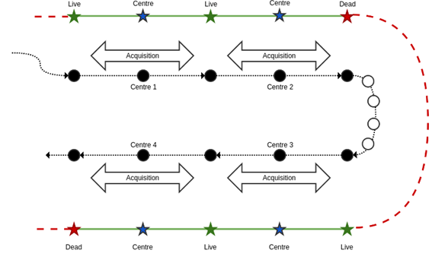
Check signals
Recall the trigger setup:
‘Live’ signal sent at the start of each point
‘Dead’ signal sent at the end of each point if it doesn’t join the next one
We want to capture the average positions at the end of every real frame
Mapping of triggers to their user programs:
NO_PROGRAM = 0 # Do nothing LIVE_PROGRAM = 1 # GPIO123 = 1, 0, 0 DEAD_PROGRAM = 2 # GPIO123 = 0, 1, 0 MID_PROGRAM = 4 # GPIO123 = 0, 0, 1 ZERO_PROGRAM = 8 # GPIO123 = 0, 0, 0

Slide 26
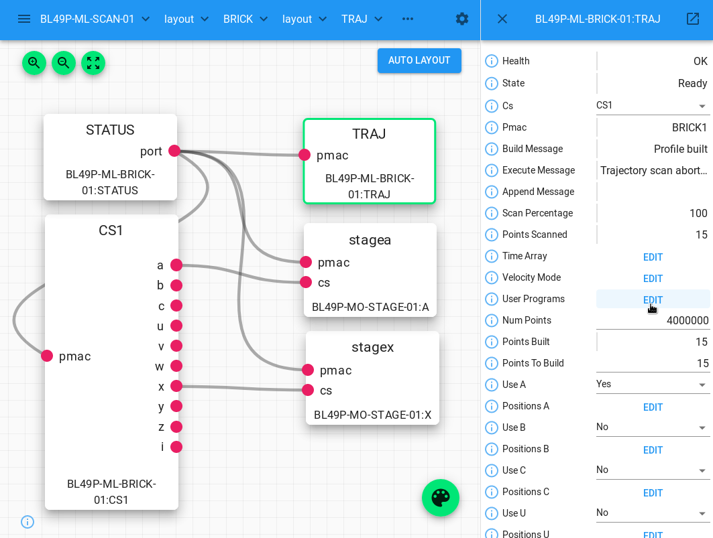
Check signals

Slide 27
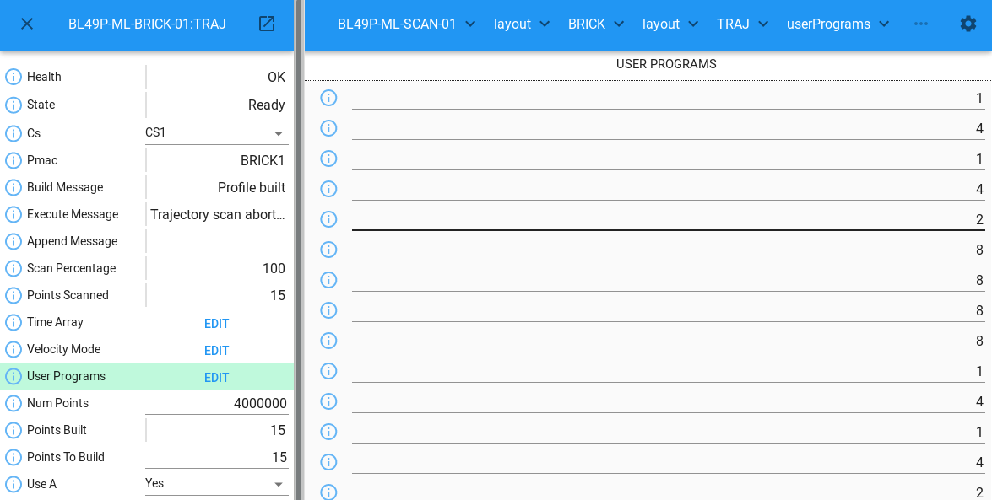
Check signals

Slide 28
PMAC as Master v. PandA as Master
There are two overarching designs to control a scan: PMAC or PandA as Master
The Master is responsible for generating live and dead signals
PMAC as Master is simpler, so start there
Limited to 300 Hz
If you need faster than this, go for PandA as Master

Slide 29
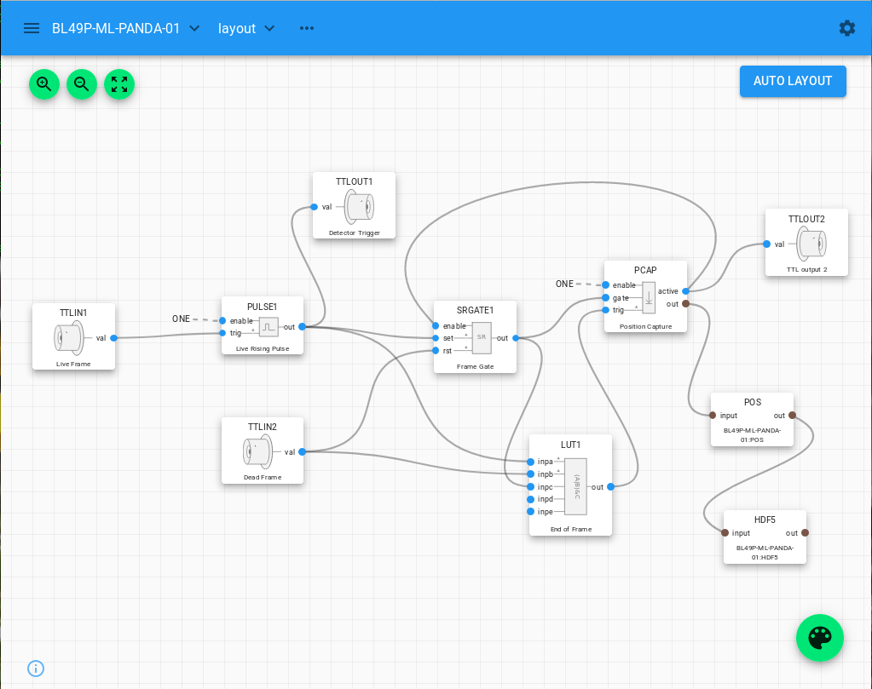
PandA Design (PMAC as master)
‘Live frame’ signal from PMAC comes in to TTLIN1
‘Dead frame’ signal comes in to TTLIN2

Slide 30
PandA Design
Live signal triggers a short pulse sent to the detector on TTLOUT1

Slide 31
PandA Design
The FrameGate is set high by TTLIN1 (live) and reset by TTLIN2 (dead)

Slide 32
PandA Design
A Lookup Table function block determines the end of frame from these signals

Slide 33
PandA Design
Averages encoder positions while the gate is high, transferring it to the client when the trigger signal is asserted

Slide 34
PandA Design
Finally, the values are fed into the PandA AreaDetector chain

Slide 35
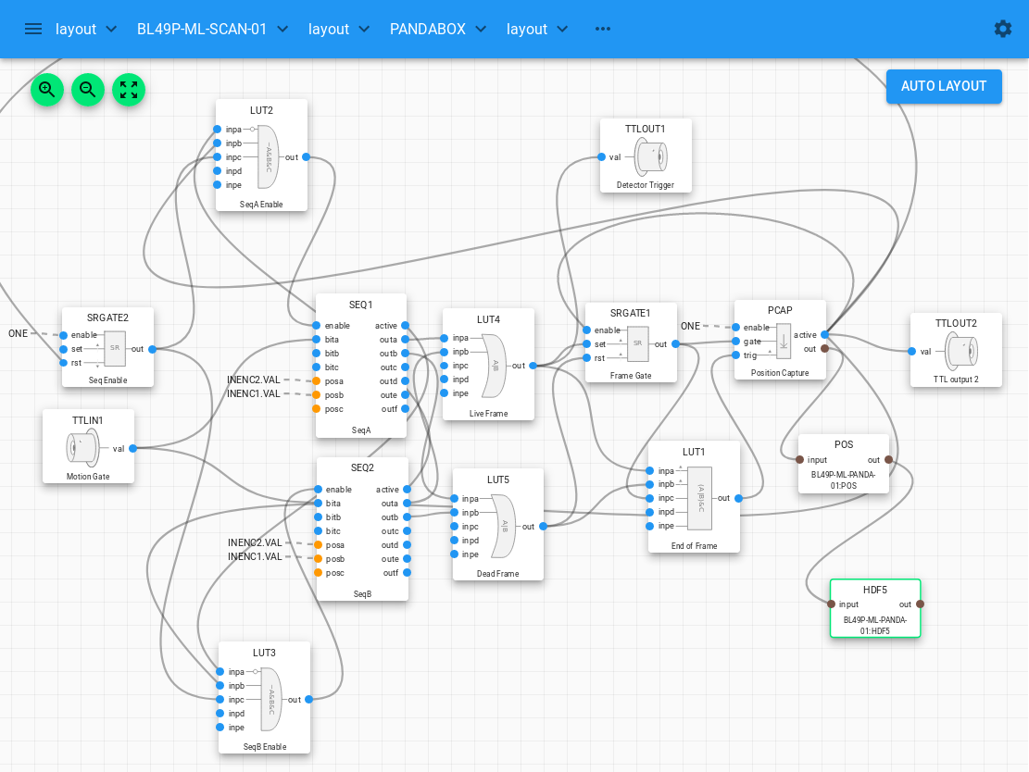
PandA as Master
Same as before

Slide 36
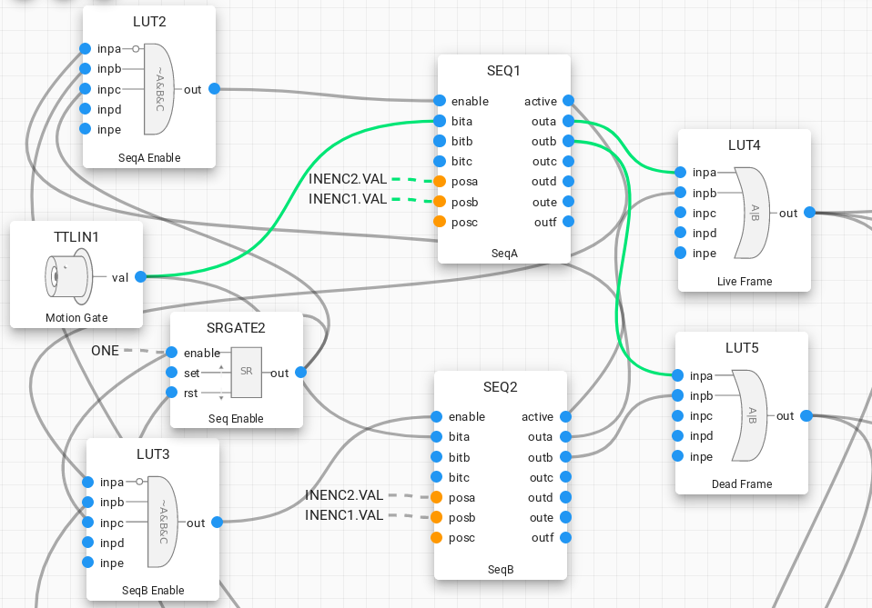
PandA as Master
Sequence table generates the live and dead signals

Slide 37
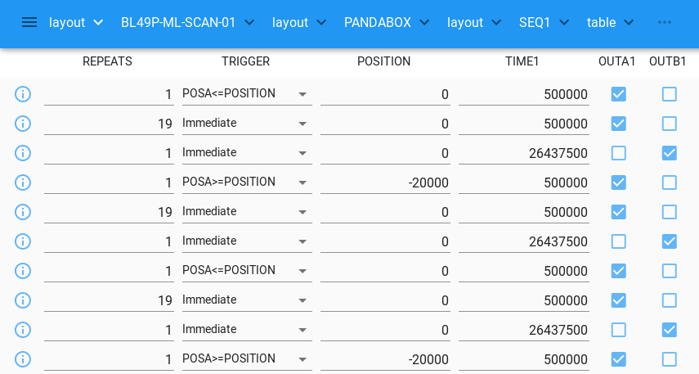
PandA as Master – seq table
Live signal
Dead signal

Slide 38
PandA as Master
Second sequence table used for double buffering for large trajectories

Slide 39
PandA as Master
This is all logic to control the double buffering

Slide 40
PandA as Master
Takes a motion gate signal from the PMAC to use instead of position compare

Slide 41
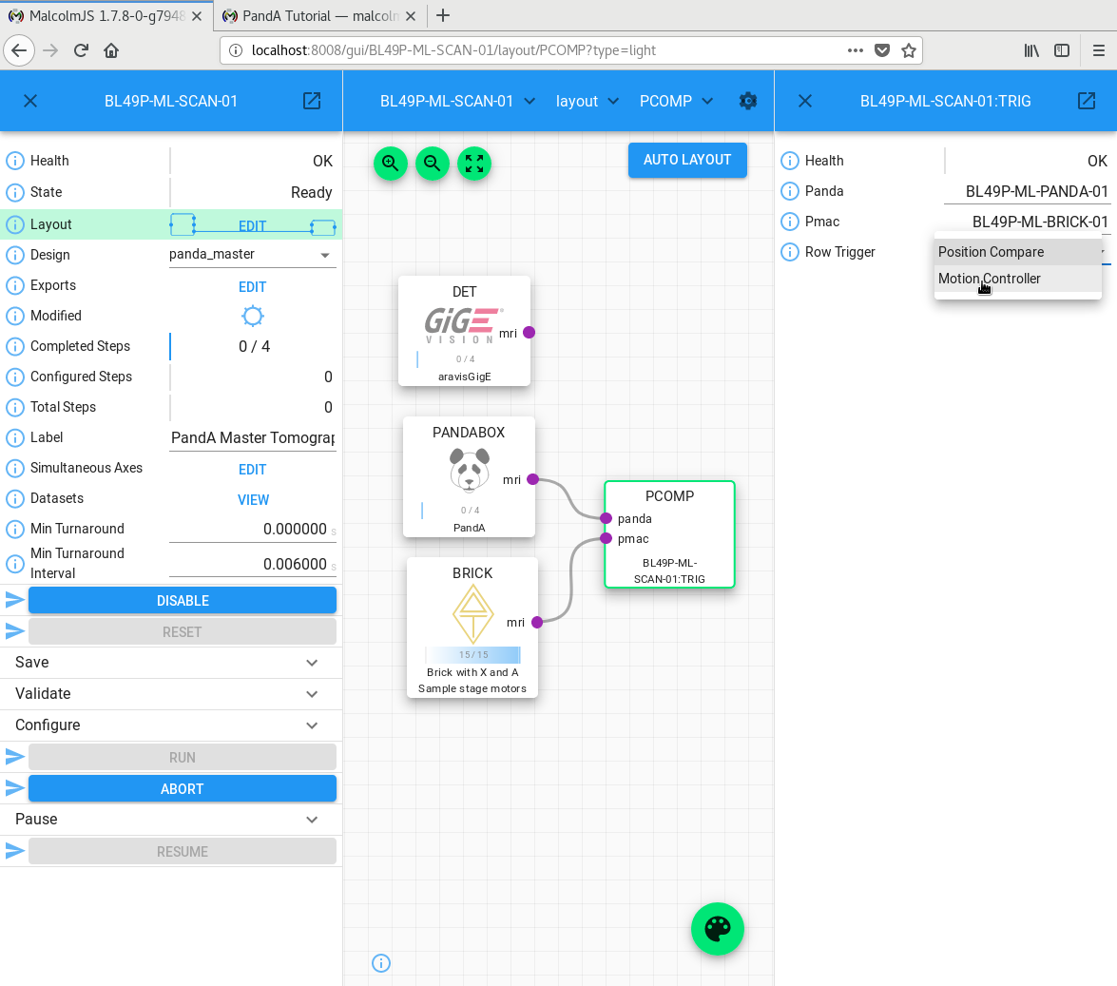
Row trigger
Select between position compare and motion gate on the PCOMP block

