Slide 1

Hardware Triggered Scanning: Exercise Solutions
Emma Arandjelovic
Observatory Sciences Limited

Slide 2
Exercise 1
Modify demo/parts/hellopart.py:
def greet(self, name=None, sleep=0):
# type: (AName, ASleep) -> AGreeting
"""Optionally sleep <sleep> seconds, then return a greeting to <name>"""
print("Manufacturing greeting...")
sleep_for(sleep)
if name == "":
self.error()
greeting = "Hello %s" % name
return greeting

Slide 3
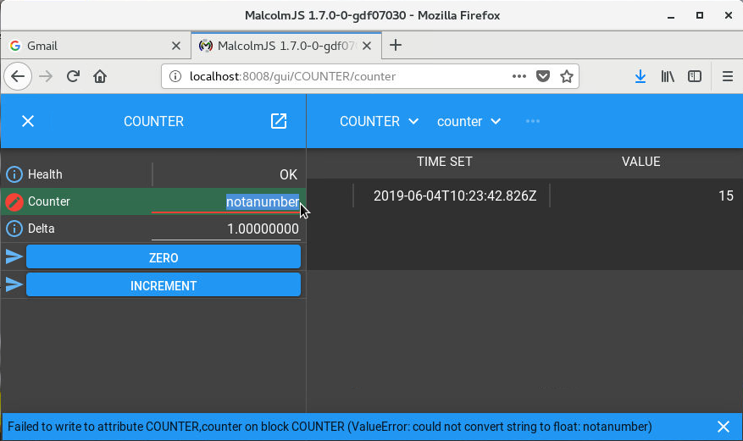
Exercise 2

Slide 4
Exercise 3
Modify demo/parts/counterpart.py to add the new method:
def decrement(self):
"""Subtract delta from the counter attribute"""
self.counter.set_value(self.counter.value - self.delta.value)
Register this new method with the PartRegistrar in the setup method:
registrar.add_method_model(self.decrement)

Slide 5
Exercise 4
Modify motion_block.yaml to create the new parameters and pass them to MotorMovePart:
- builtin.parameters.float64:
name: high_limit
description: High s/w limit
default: 0
- builtin.parameters.float64:
name: low_limit
description: Low s/w limit
default: 0
- demo.parts.MotorMovePart:
name: x
mri: $(mri):COUNTERX
hi: $(high_limit)
lo: $(low_limit)
Provide values for the limits in DEMO-MOTION.yaml:
- demo.blocks.motion_block:
mri: MOTION
config_dir: /tmp
high_limit: 20
low_limit: 0

Slide 6
Exercise 4 (continued)
Modify motormovepart.py to use the new parameter:
with Anno("High s/w limit"):
AHi = float
with Anno("Low s/w limit"):
ALo = float
def __init__(self, name, mri, hi=0, lo=0):
….
self.hi = hi
self.lo = lo
if (hi==0 and lo==0):
self.limits_enabled = False
else:
self.limits_enabled = True
def move(self, context, demand):
….
if (self.limits_enabled and (demand>self.hi or demand<self.lo)):
raise RuntimeError("Motor demand out of range!")

Slide 7
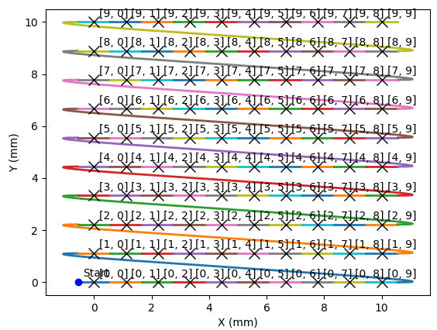
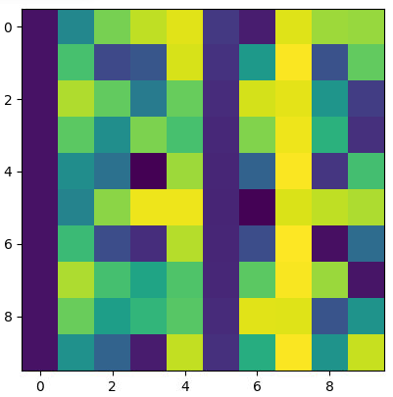
Exercise 5
Example for a 10x10 map:
>>> xline = LineGenerator("x","mm",0,10,10)
>>> yline = LineGenerator("y","mm",0,10,10)
>>> generator = CompoundGenerator([yline,xline],[],[],duration=0.01)
>>> im.shape
(10, 10, 1, 1)

Slide 8
Exercise 6
[p47user@localhost demo]$ h5dump -d /entry/NDAttributes/NDArrayUniqueId /tmp/RAMP.h5
HDF5 "/tmp/RAMP.h5" {
DATASET "/entry/NDAttributes/NDArrayUniqueId" {
DATATYPE H5T_STD_I32LE
DATASPACE SIMPLE { ( 6, 6, 1, 1 ) / ( H5S_UNLIMITED, H5S_UNLIMITED, 1, 1 ) }
DATA {
(0,0,0,0): 1,
(0,1,0,0): 2,
(0,2,0,0): 3,
(0,3,0,0): 4,
(0,4,0,0): 5,
(0,5,0,0): 6,
(1,0,0,0): 7,
(1,1,0,0): 8,
(1,2,0,0): 9, Notice the unique IDs skip the bad frames (‘last good step’ was set to 10)
(1,3,0,0): 10,
(1,4,0,0): 37,
(1,5,0,0): 38,
(2,0,0,0): 39,
(2,1,0,0): 40, …..

