Slide 1
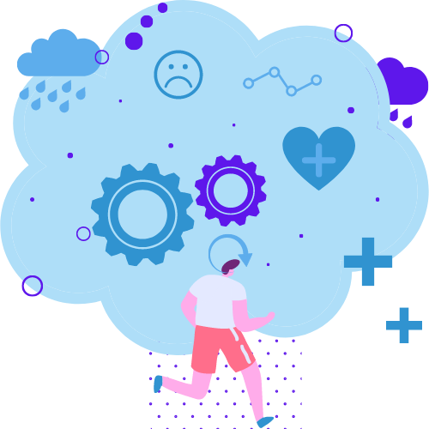

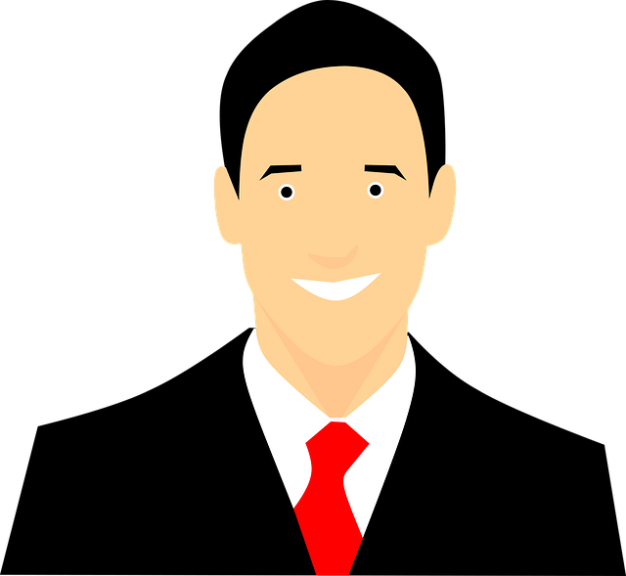

Bob The Bot
Mental health consultant and your personal psychologist
Team:
Rūdolfs Rijkuris
Ronalds Plostnieks
Roberts Eriņš
Laura Trepša

Slide 2
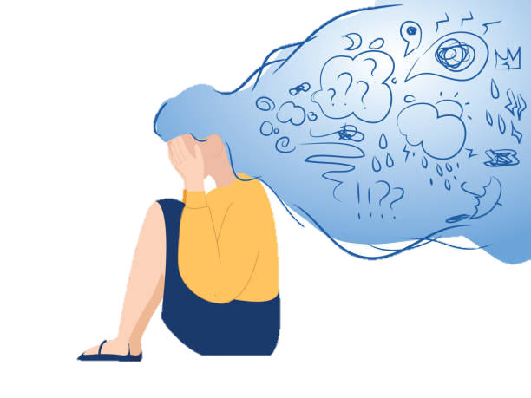
Problem’s explanation
Depression, anxiety, concern greatly influence people's socialization which plays a major role in human mental health. As a result many people find themselves in need of advice for related problems from appropriate specialist, usually psychologist. However, due to overloaded queues it can take months or even longer to get in touch with a specialist, meanwhile the problem is still there.

Slide 3

Problem’s solution
There is comfort in knowing that there are many options for treating depression. These can include psychotherapy (talk therapy), antidepressant medication, and natural approaches, such as eating a nutritious diet, getting regular exercise, and following good sleep habits.
So here is a bot that will be like a psychologist giving advices instead of busy psychologist.

Slide 4
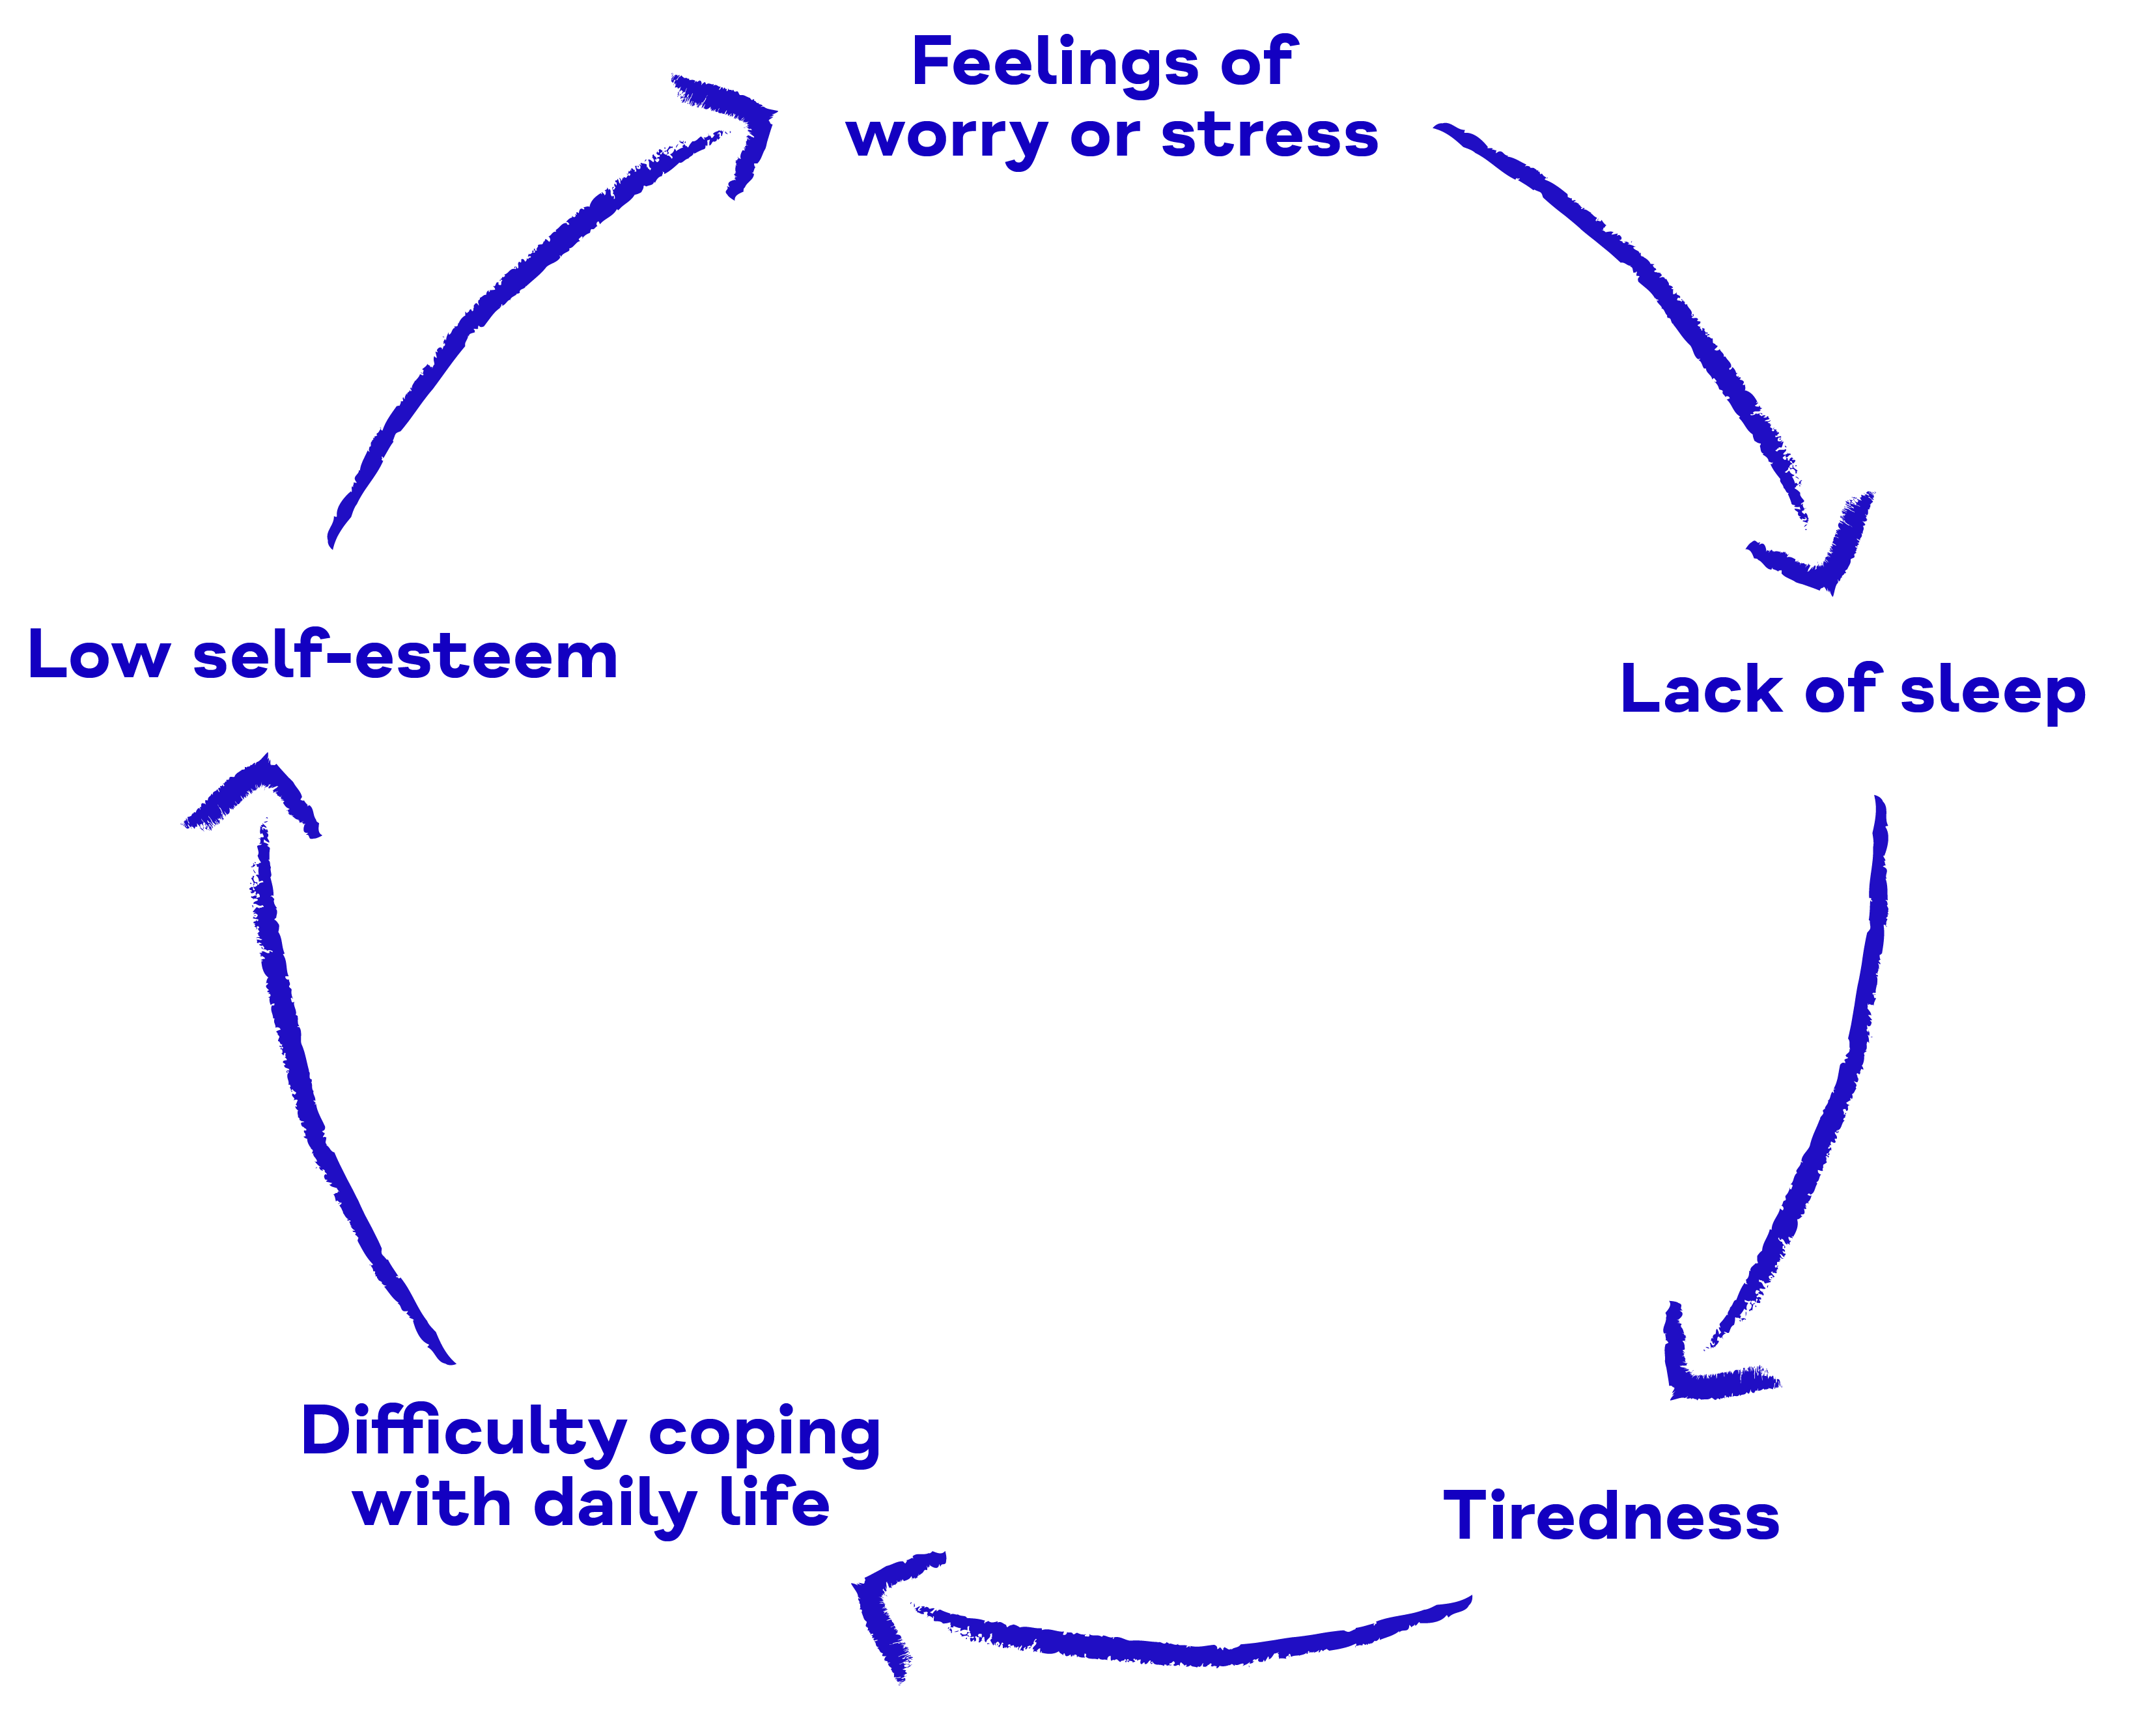

Human’s mental health cycle

Slide 5
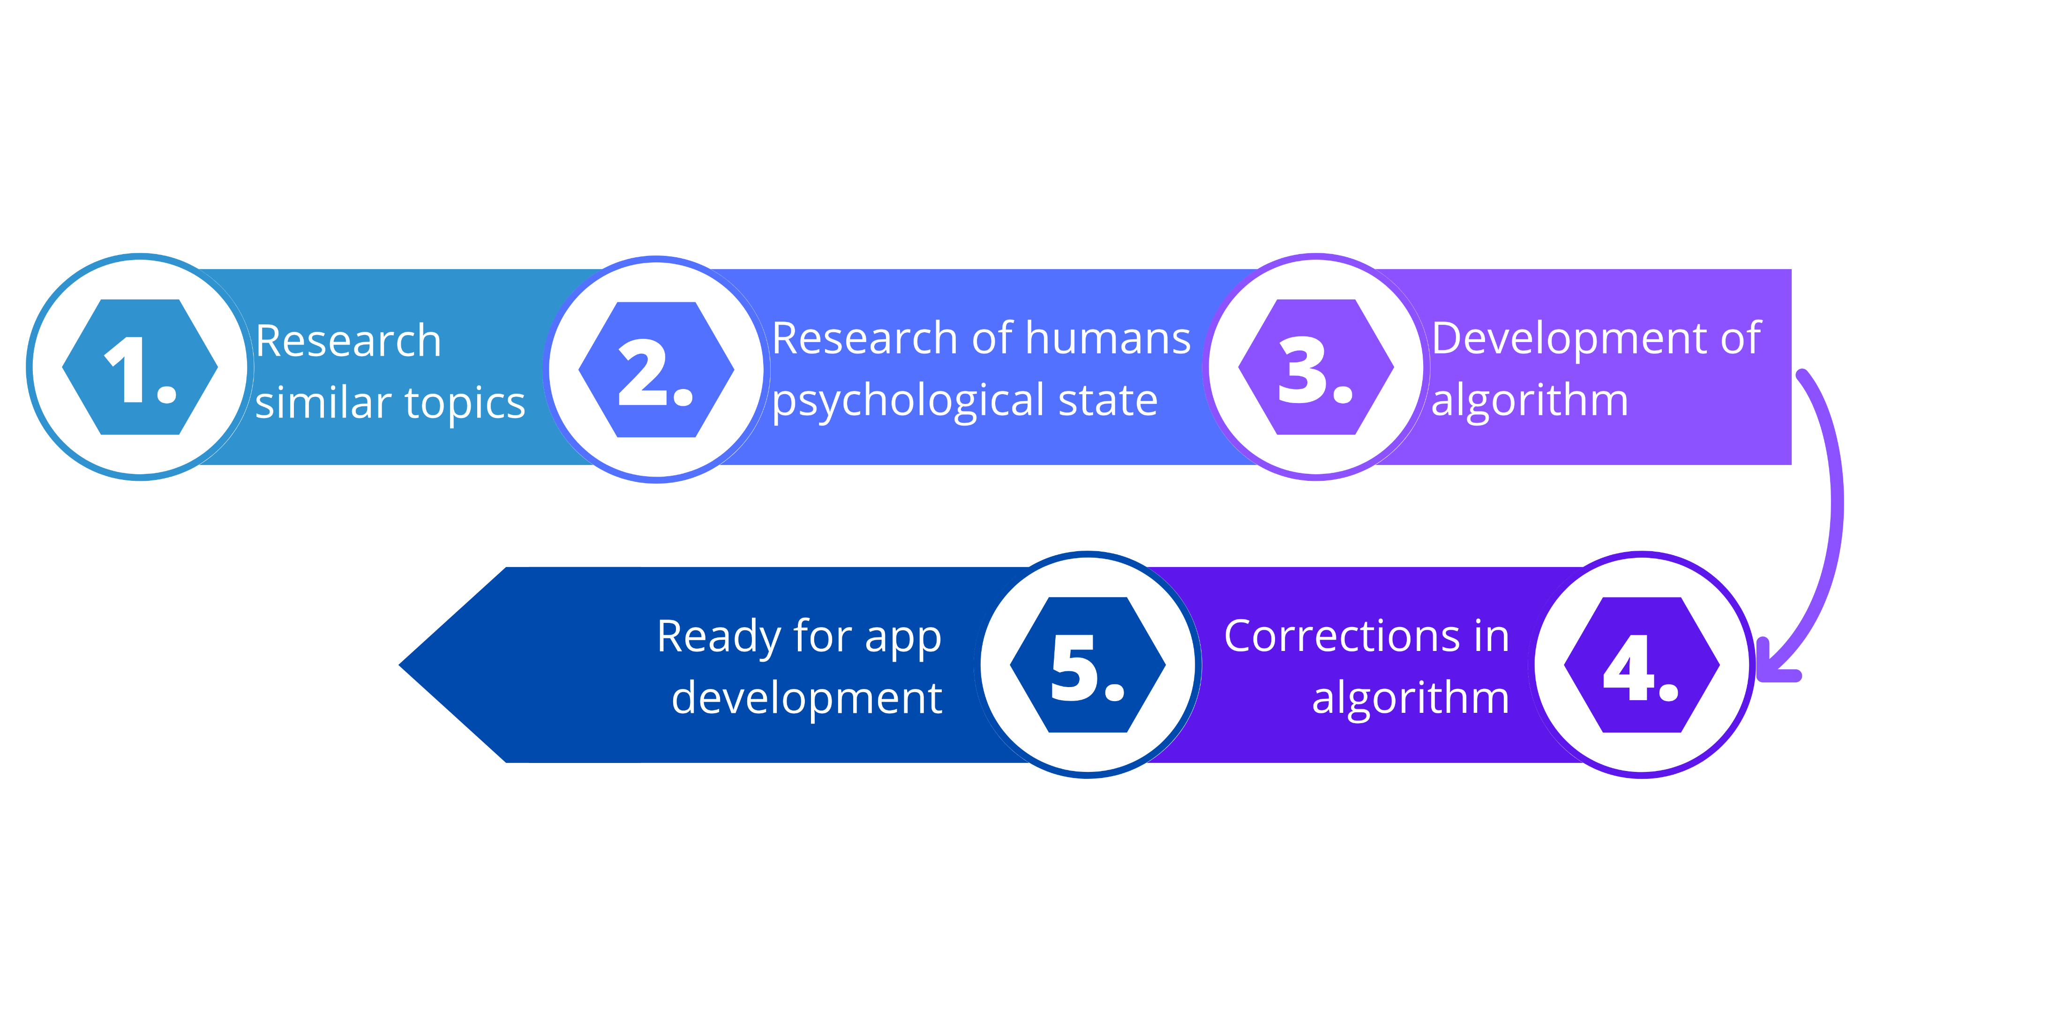

Workflow within the project

Slide 6




Bot‘s functions
Statistics about mentally ill people every year so users feel that they’re not alone
Chatbot will chat with users and make them feel better
Info section for users with suicide crisis hotline numbers if they have an emergency and need to call them
Recommendations for physical activities which usually makes people happier

Slide 7
Thank you for your attention!

