Slide 1
Arad
S 140
T 118
Z 75
A 280
F 239
O 291
R 220
A 236
L 229
A 150
O 146
B 440
S 438
C 366
P 317
S 300
M 299
T 340
S 297
Z 217
B 418
C 455
R 414
D 374
L 369
C 494
M 449

Slide 2
M=5,K=3
(5,5,1)
(0,1)=>(5,4,0)
g=1 h=9
f=10
(0,2)=>(5,3,0)
g=1 h=8
f=9
(0,3)=>(5,2,0)
g=1 h=7 (0,3)
f=8
(1,1)=>(4,4,0)
g=1 h=8
f=9
(0,3)=>(5,5,1)
(0,2)=>(5,4,1)
g=2 h=7 (0,1)
f=9
(0,1)=>(5,3,1)
g=2 h=6 (0,2)
f=8
(0,1)=>(5,3,0)
(0,2)=>(5,2,0)
(0,3)=>(5,1,0)
(2,1)=>(3,3,0)
(0,1)=>(5,2,0)
(0,2)=>(5,1,0)
g=3 h=6 (0,4)
f=9
(0,3)=>(5,0,0)
g=3 h=5
f=8
(2,0)=>(3,3,0)
g=3 h=6 (2,2)
f=9
(0,1)=>(5,2,1)
g=4 h=4 (0,3)
F=8
(0,2)=>(5,3,1)
(1,1)=>(4,4,1)
g=4 h=6
f=10
(2,1)=>(5,4,1)
(0,3)=>(5,4,1)
(2,2)=>(3,3,0)
g=1 h=6
f=7
(3,3)=>(2,2,0)
g=1 h=4
f=5
(1,1)=>(3,3,1)
g=2 h=4
f=6
(2,2)=>(4,4,1)
g=2 h=6
f=8
(3,3)=>(5,5,1)
g=2 h=8
f=10
(1,1)=>(2,2,0)
g=3 h=4
f=7
(2,2)=>(1,1,0)
g=3 h=2
f=5
(3,3)=>(0,0,0)
g=3 h=0
f=3

Slide 3
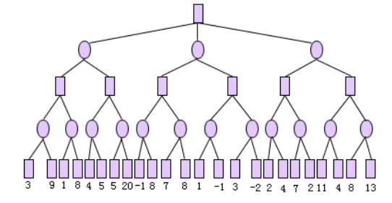
3
3
7, 3
2
3
4
-1, 7
1, 3
2
3
1
4
-1
7
1
3
2
7, 2

