Slide 1







Working with Data
Model Binding, Data Validation and Files in ASP.NET Core
SoftUni Team
Technical Trainers
Software University
https://softuni.bg

Slide 2
Table of Contents
Model Binding
Custom Model Binding
Model Validation
Custom Model Validation
Working with Files
Upload and Download Files

Slide 3
Have a Question?
sli.do #csharp-web

Slide 4

Model Binding

Slide 5
Model Binding (1)
Model binding in ASP.NET Core MVC maps data from HTTP requests to action method parameters.
The parameters may be primitive types or complex types
Implemented abstractly, paving the way for reusability in different apps
The framework binds request data to action parameters by name
The value of each parameter will be searched, using the parameter name
Classes are mapped using the names of the public settable properties
Request URL
PostsController
https://mysite.com/posts/edit/6
public IActionResult Edit(int? id)

Slide 6
Model Binding (2)
Model binding can look through several data sources per Request
Form values – POST Request parameters
Route values – The set of Route values provided by the Routing
Query strings – The query string parameters in the URL
Even in headers, cookies, session, etc. in custom model binders
Data from these sources are stored as name-value pairs
The framework checks each of the data sources for a parameter value
If there is no parameter in the data source, the next in order is checked
The data sources are checked in the order specified above

Slide 7
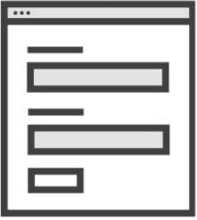
Incoming Request to MVC
Populate
Model State
Instance Created
by Model Binder
Model Binder
Validation
public MyController : Controller {
IActionResult Index(MyInputModel input)
{
if (ModelState.IsValid)
{
return View();
}
}
}
MyInputModel instance

Slide 8
Model Binding (3)
If binding fails, the framework does not throw an error
Every action, accepting user input, should check if binding was successful
This is done through the ModelState.IsValid property
Each entry in the controller's ModelState property is a ModelStateEntry
Each ModelStateEntry contains an Errors property
It's rarely necessary to query this collection, though
Default Model binding works great for most development scenarios
It is also extensible, and you can customize the built-in behavior

Slide 9



Model Binding (4)
You can easily iterate over the errors in the ModelState
public class UsersController : Controller
{
public IActionResult Register(RegisterUserBindingModel model)
{
if(!ModelState.IsValid)
{
foreach (var error in ModelState.Values.SelectMany(v => v.Errors))
{
DoSomething(error);
}
// TODO: Return Error Page
}
return Ok("Success!");
}
}

Slide 10
Model Binding (5)
Built-in Model binding behavior can be directed to a different source
The framework provides several attributes for that
Attribute | Description
[BindRequired] | Adds a model state error if binding cannot occur.
[BindNever] | Tells the model binder to never bind this parameter.
[From{source}] | Used to specify the exact binding source. [FromHeader], [FromQuery], [FromRoute], [FromForm]
[FromServices] | Uses dependency injection to bind parameters from services.
[FromBody] | Use configure formatters to bind data from request body. Formatter is selected based on Content-Type of Request.
[ModelBinder] | Used to override the default model binder, binding source and name.

Slide 11


Custom Model Binder (1)
Custom Model Binding can be completely customized
You need to create a BindingProvider and a Binder
[ModelBinder(BinderType = typeof(StudentEntityBinder))]
public class Student
{
public int Id { get; set; }
public string Name { get; set; }
public int Age { get; set; }
}
public class StudentEntityBinder : IModelBinder
{
public Task BindModelAsync (ModelBindingContext bindingContext)
{
//TODO: Do Magic ...
bindingContext.Result
= ModelBindingResult.Success(model);
return Task.CompletedTask;
}
}

Slide 12
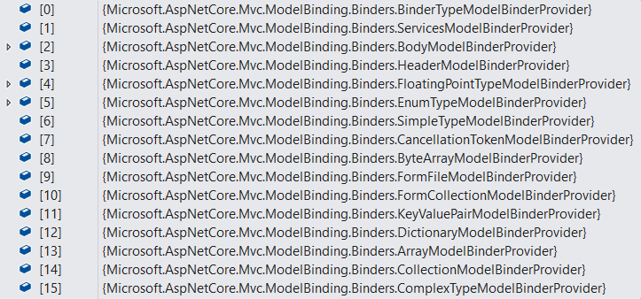
Custom Model Binder (2)
public class StudentEntityBinderProvider : IModelBinderProvider
{
public IModelBinder GetBinder(ModelBinderProviderContext context)
{
if(context == null) throw new ArgumentNullException(nameof(context));
if(context.Metadata.ModelType == typeof(Student))
return new BinderTypeModelBinder(typeof(StudentEntityBinder));
return null;
}
}
public void ConfigureServices(IServiceCollection services)
{
services.AddControllerWithViews(options =>
{
options.ModelBinderProviders
.Insert(0, new StudentEntityBinderProvider()); // Add custom binder to beginning
});
}

Slide 13



Model Validation

Slide 14
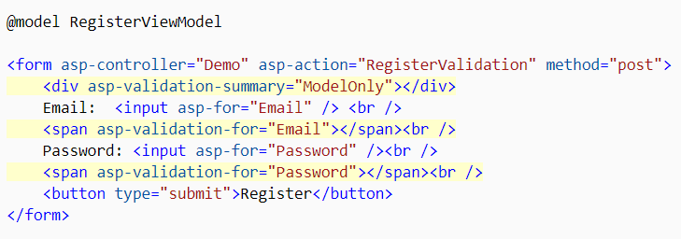
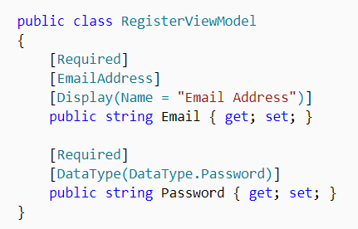
Model Validation (1)
Validation is absolutely necessary before persisting data
The may be potential security threats
There may be malformed data (type, size, data constraints)
In ASP.NET Core MVC, validation happens both on client and server

Slide 15


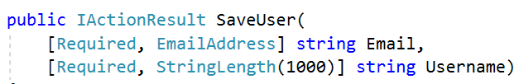
Model Validation (2)
.NET provides us an abstracted validation through attributes
Some attributes configure model validation by constraint
Similar to validation on database fields
Other apply patterns to data to enforce business rules
Credit Cards, Phone Numbers, Email Addresses etc.
Validation attributes make enforcing these requirements simple
They are specified at the property or parameter level

Slide 16
Model Validation (3)
Some of the most popular built-in validation attributes are:
Attribute | Description
[CreditCard] | Validates the property has a credit card format
[Compare] | Validates 2 properties in a model match. (Useful for password confirmation)
[EmailAddress] | Validates the property has an email format.
[Phone] | Validates the property has a telephone format.
[Range] | Validates the property value falls within the given range.
[RegularExpression] | Validates the data matches the specified regular expression.
[Required] | Makes the property required. Value cannot be null.
[StringLength] | Validates that a string property has at most the given maximum length.
[Url] | Validates the property has a URL format.

Slide 17
Custom Model Validation (1)
Validation attributes work for most needs, but not for all
Sometimes you need to implement your own validation attributes
public class IsBefore : ValidationAttribute
{
private const string DateTimeFormat = "dd/MM/yyyy";
private readonly DateTime date;
public IsBefore(string dateInput)
{
this.date = DateTime.ParseExact(dateInput, DateTimeFormat, CultureInfo.InvariantCulture);
}
protected override ValidationResult IsValid(object value, ValidationContext validationContext)
{
if ((DateTime)value >= this.date) return new ValidationResult(this.ErrorMessage);
return ValidationResult.Success;
}
}

Slide 18
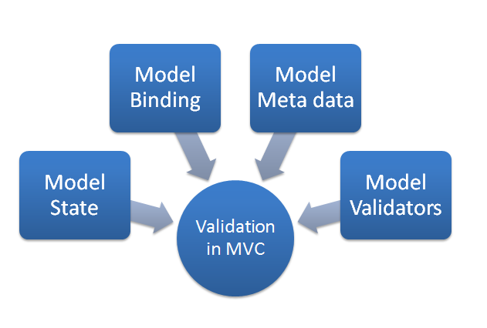
Custom Model Validation (2)
Then you can use it in your model
public class RegisterUserModel
{
[Required]
public string Username { get; set; }
[Required]
[StringLength(20)]
public string Password { get; set; }
[Required]
public string FirstName { get; set; }
[Required]
public string LastName { get; set; }
[IsBefore("01/01/2000")]
public DateTime BirthDate { get; set; }
}

Slide 19
Custom Model Validation (3)
You can also use validation directly in the Binding Model
This is done by using the IValidatableObject interface
public class RegisterUserModel : IValidatableObject
{
public string Username { get; set; }
public string Password { get; set; }
public string ConfirmPassword { get; set; }
public IEnumerable<ValidationResult> Validate(ValidationContext validationContext)
{
if(string.IsNullOrEmpty(Username)) yield return new ValidationResult("Username cannot be empty");
if(string.IsNullOrEmpty(Password)) yield return new ValidationResult("Password cannot be empty");
if(ConfirmPassword != Password) yield return new ValidationResult("Passwords do not match");
}
}

Slide 20
Incoming Request to MVC
Can you create a Model Binder
for MyInputModel?
IActionResult Index(MyInputModel input) {
return View();
}
Validation
ModelBinderProvider 1
Sorry, can't create a Model Binder for that
Value Providers
Default
Route
URL Query
FormData
ModelBinderProvider 2
Model Binder
Yes, I can, here you go
Input Formatters
Will never be checked
[FormBody] (if applicable)
JSON
XML
ModelBinderProvider 3

Slide 21

Uploading and Downloading Files
Files

Slide 22

Uploading Files (1)
ASP.NET Core MVC supports File Upload using simple model binding
For larger files, Streaming is used
Multiple-file upload is also supported
<form method="post" enctype="multipart/form-data"
asp-controller="Files" asp-action="Upload">
<input type="file" name="file"> <button type="submit" value="Upload" />
</form>
<form method="post" enctype="multipart/form-data" asp-controller="Files" asp-action="Upload">
<input type="file" name="files" multiple > <button type="submit" value="Upload" />
</form>

Slide 23


Uploading Files (2)
When uploading files using model binding, your action should accept:
IFormFile (for single file) or IEnumerable<IFormFile> (or List<IFormFile>)
[HttpPost("Upload")]
public async Task<IActionResult> Upload(List<IFormFile> files)
{
var filePath = Path.GetTempFileName(); // Full path to file in temp location
foreach (var formFile in files.Where(f => f.Length > 0))
{
using (var stream = new FileStream(filePath, FileMode.Create))
{
await formFile.CopyToAsync(stream);
}
} // Copy files to FileSystem using Streams
var bytes = files.Sum(f => f.Length);
return Ok(new { count = files.Count, bytes, filePath});
}

Slide 24




Downloading Files (1)
ASP.NET Core abstracts file system access through File Providers
File Providers are used throughout the ASP.NET Core framework
Examples of where ASP.NET Core uses File Providers internally
IHostingEnvironment exposes the app’s content root and web root
Static File Middleware uses File Providers to locate static files
Razor uses File Providers to locate pages and views

Slide 25
Downloading Files (2)
To access physical files, you have to use PhysicalFileProvider
You’ll have to initialize it with your server physical files folder path
Then you can extract information about the File
public IActionResult Download(string fileName)
{
// Construct the path to the physical files folder
string filePath = this.env.ContentRootPath + this.config["FileSystem:FilesFolderPath"];
IFileProvider provider = new PhysicalFileProvider(filePath); // Initialize the Provider
IFileInfo fileInfo = provider.GetFileInfo(fileName); // Extract the FileInfo
var readStream = fileInfo.CreateReadStream(); // Extact the Stream
var mimeType = "application/octet-stream"; // Set a mimeType
return File(readStream, mimeType, fileName); // Return FileResult
} // NOTE: There is no check if the File exists. This action may result in an error

Slide 26

Summary
Model Binding
Custom Model Binding
Model Validation
Custom Model Validation
Working with Files
…
…
…

Slide 27
Questions?
Notes:
27

Slide 28













SoftUni Diamond Partners

Slide 29


Educational Partners

Slide 30
Trainings @ Software University (SoftUni)
Software University – High-Quality Education, Profession and Job for Software Developers
softuni.bg, softuni.org
Software University Foundation
softuni.foundation
Software University @ Facebook
facebook.com/SoftwareUniversity
Software University Forums
forum.softuni.bg
Notes:
30

Slide 31

License
This course (slides, examples, demos, exercises, homework, documents, videos and other assets) is copyrighted content
Unauthorized copy, reproduction or use is illegal
© SoftUni – https://softuni.org
© Software University – https://softuni.bg
Notes:
31

