Slide 1
Facebook Post Status Prediction

Slide 2
Objective:
Development of a machine learning model for determining emotional intelligence in teenagers based on Facebook Status. The model will determine whether a person has mental abnormalities.
Benefits:
Detection of emotional intelligence.
Gives better insight into a person’s abnormalities.
Helps for better treatment.

Slide 3
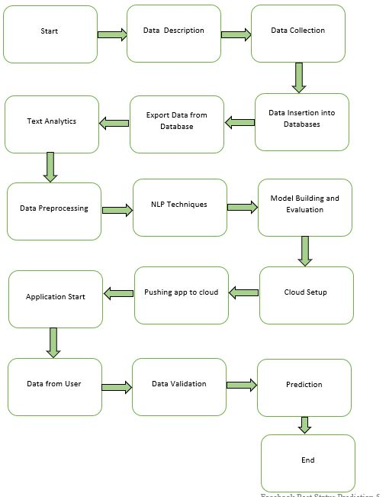
Architecture

Slide 4
Data Insertion in Database:
Table creation :- Table name “train“, “val”, is created in the Cassandra database for inserting the files. If the table is already present, then new files are inserted into the same table.
Insertion of files in the table - If any file has an invalid data type in any of the columns, the file is not loaded in the table.

Slide 5
Model Training:
Data Export from Db :
The accumulated data from db is exported in csv format for model training.
Data Preprocessing
Performing Text Analytics, Checking imbalance in Target labels.
Check for null values in the columns.
Text Preprocessing steps involved removal of stopwords, removal of records with null values if present, removal of punctuations, lemmatizing, doc2vec.
Encode the categorical values with numeric values.
Oversampling Techniques.
Perform Standard Scalar to scale down the values.

Slide 6
Model Selection –
After the Data Preprocessing Steps. We trained four machine learning models Random Forest Classifier, SVC, Logistic Regression, and K-nearest neighbour. We calculate the precision, recall, and accuracy scores for all these models and select the model (SVC) with the best score.

Slide 7
Model Deployment and Prediction:
The model is deployed on the Cloud-based platform.
Pushing application to the Cloud.
Data has been taken from Facebook posts.
Data Validation and Data Pre-processing techniques are applied.
Predicting the result.

Slide 8
Q & A:
Q1) What’s the source of data?
The data for training is provided by Kaggle.
Q 2) What was the type of data?
The data was a combination of Texts and Categorical values.
Q 3) What’s the complete flow you followed in this Project?
Refer slide 3rd for a better Understanding

Slide 9
Q 5) How are logs managed?
We are using different logs as per the steps that we follow in Data Insertion, Model Training log, prediction log etc.
Q 6) What techniques were you using for data pre-processing?
Removal of missing values
Checking imbalance in the target variable.
Removal of stopwords, removal of records with null values if present, removal of punctuations, lemmatizing, doc2vec.
Converting categorical data into numeric values.
Oversampling techniques.
Scaling the data.

Slide 10
Q 7) How training was done or what models were used?
We already had training and Validation data.
We perform text Preprocessing steps on both training and validation data.
The scaling was performed over training and validation data.
Algorithms like Random Forest Classifier, SVC, Logistic Regression, and K-nearest neighbour were used based on the recall, precision, accuracy scores and we saved that best model based on these scores.
Q 8) How was prediction done?
The testing files was taken from Facebook posts. We Perform the same life cycle and perform prediction.

Slide 11
Q 9) What are the different stages of deployment?
When the model is ready, we deploy it in the local environment. Test the model performance. Checking the latency etc.
Finally, We deploy in production.

