Slide 1
Flight Fare Prediction

Slide 2
Objective:
Development of a machine learning model for determining Flight Fare. The model will determine whether there is a decrease or increase in Flight Fare.
Benefits:
Detection of decrease or increase in Flight Fare.
It gives better insight into a Flight Fare.
It helps for Person’s decision to travel or not.

Slide 3
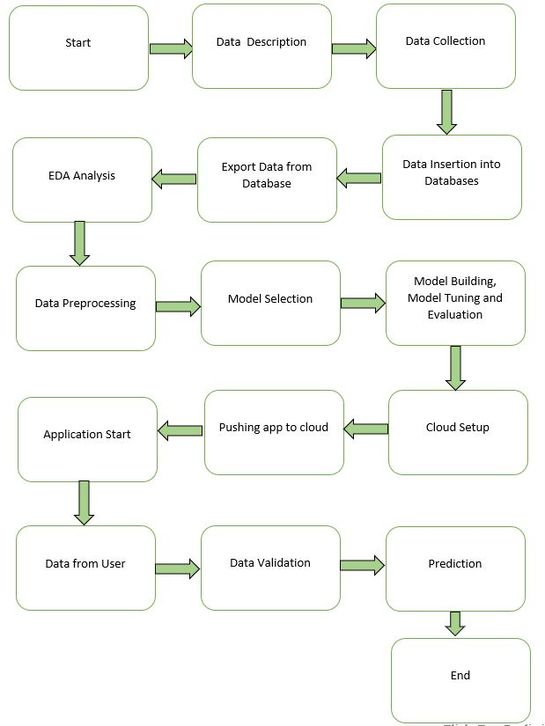
Architecture

Slide 4
Data Insertion in Database:
Table creation:- Table name “Data_Train”, is created in the Cassandra database for inserting the files. If the table is already present, then new files are inserted into the same table.
Insertion of files in the table - If any file has an invalid data type in any of the columns, the file is not loaded in the table.

Slide 5
Model Training:
Data Export from Db :
The accumulated data from db is exported in csv format for model training.
EDA Analysis and Data Preprocessing
Univariate, Bivariate Analysis, Hypothesis Testing, Checking missing values, outliers, and inconsistency in the columns, duplicate records.
Removing unwanted features, duplicate records if present, handling outliers, missing values, and inconsistency in columns.
Feature creation, Feature scaling (only for distance-based models), the transformation of the target variable if it is not normally distributed (only for linear models), removing multicollinearity if present (for linear model).
Splitting preprocessed data into train and validation sets.

Slide 6
Model Selection –
After the Data Preprocessing Steps. We trained 12 machine learning models LinearRegression, Ridge, Lasso, ElasticNet, DecisionTreeRegressor, RandomForestRegressor, BaggingRegressor, AdaBoostRegressor, XGBRegressor, LGBMRegressor, KNeighborsRegressor, SVR. We calculate the R2 Score, and Root Mean Square Error for all these models and select the model (XGBRegressor) with the best score.
Model Interpretation – Model Interpretation using shap summary plot.

Slide 7
Model Deployment and Prediction:
The model is deployed on the Cloud-based platform.
Pushing application to the Cloud.
Data has been taken from https://www.google.com/travel/flights/.
Data Validation and Data Pre-processing techniques are applied.
Predicting the result.

Slide 8
Q & A:
Q1) What’s the source of data?
The data for training is provided by Kaggle.
Q 2) What was the type of data?
The data was a combination of Date, Char, Numeric and Categorical values.
Q 3) What’s the complete flow you followed in this Project?
Refer slide 3rd for a better Understanding

Slide 9
Q 5) How are logs managed?
We are using different logs as per the steps that we follow in Data Insertion, Model Training log, prediction log etc.
Q 6) What techniques were you using for data pre-processing?
Removing unwanted features, duplicate records if present, handling outliers, missing values, and inconsistency in columns.
Feature creation, Feature scaling (only for distance-based models), the transformation of the target variable if it is not normally distributed (only for linear models), removing multicollinearity if present (for linear model).
Splitting preprocessed data into train and validation sets.

Slide 10
Q 7) How training was done or what models were used?
We already had training and Validation data.
Algorithms like LinearRegression, Ridge, Lasso, ElasticNet, DecisionTreeRegressor, RandomForestRegressor, BaggingRegressor, AdaBoostRegressor, XGBRegressor, LGBMRegressor, KNeighborsRegressor, SVR. We calculate the R2 Score, and Root Mean Square Error for all these models and we saved the best model based on these scores.
Interpretating the selected model using shap summary plot.
Q 8) How was the prediction done?
The testing files were taken from https://www.google.com/travel/flights/. We Perform the same life cycle and perform prediction.

Slide 11
Q 9) What are the different stages of deployment?
When the model is ready, we deploy it in the local environment. Test the model performance. Checking the latency etc.
Finally, We deploy in production.

