Slide 1
Malicious URL Detection

Slide 2
Objective:
Development of a transformer-based model that should detect Malicious URLs Detection.
Benefits:
It helps the cyber security team to block Malicious URLs.
To prevent scams.

Slide 3
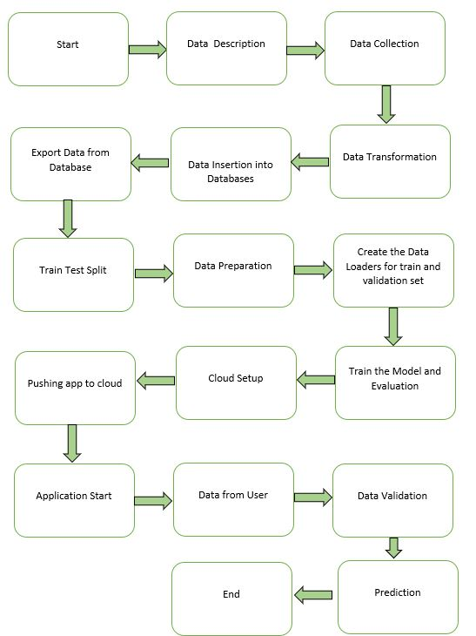
Architecture

Slide 4
Data Insertion in Database:
Table creation :- Table name “balanced_url“ is created in the Cassandra database for inserting the files. If the table is already present, new files are inserted into the same table.
Insertion of files in the table - If any file has an invalid data type in any of the columns, the file is not loaded in the table.

Slide 5
Model Training:
Data Export from Db :
The accumulated data from db is exported in csv format for model training.
Data Preparation
Check for null values in the columns.
Data Preprocessing steps involved the removal of records with null values if present.
Extract the URL domain.
Split URLs into lists of characters.
Replace characters with special characters which are not in the token repository.
Pad the URLs whose length is smaller than 256 and truncate those whose length is larger than 256.
Tokenize the URL array.

Slide 6
Model Building and Training –
After the Data Preparation Steps. We built a Transformer Block with six Encoder Layers. Each Layer consists of four-head attention and point-wise feed-forward networks of size 128 sublayers. Calculate the accuracy Score of the model.

Slide 7
Model Deployment and Prediction:
The model is deployed on the Cloud-based platform.
Pushing application to the Cloud.
URL has been taken from Websites.
Data Validation and Data Preparation techniques are applied.
Predicting the result.

Slide 8
Q & A:
Q1) What’s the source of data?
Kaggle provides the data for training.
Q 2) What was the type of data?
The data was a combination of texts and integers.
Q 3) What’s the complete flow you followed in this Project?
Refer slide 3rd for a better Understanding

Slide 9
Q 5) How are logs managed?
We are using different logs as per the steps that we follow in Data Insertion, Model Training log, prediction log etc.
Q 6) What techniques were you using for data pre-processing?
Removal of missing values.
Extracting URL domain.
Splitting the URL domains into lists of characters.
Replacing characters with special characters which are not in the token repository.
Padding and Truncating the URLs.
Tokenize the URL arrays.

Slide 10
Q 7) How training was done or what models were used?
We split the data into training and validation data.
We perform Data Preprocessing steps on both training and validation data.
Transformer model was used for training and calculated accuracy score and we saved model weights.
Q 8) How was the prediction made?
The testing files were taken from Public URLs. We Perform the same life cycle and perform prediction.

Slide 11
Q 9) What are the different stages of deployment?
When the model is ready, we deploy it in the local environment. Test the model performance. Checking the latency etc.
Finally, We deploy in production.

