Slide 1
News Summarization

Slide 2
Objective:
Development of a deep learning-based model that should perform extractive and abstractive summarization of the news articles from different reading categories.
Benefits:
Text Summarization is a cost-effective and time-saving option for the media and journalists.

Slide 3
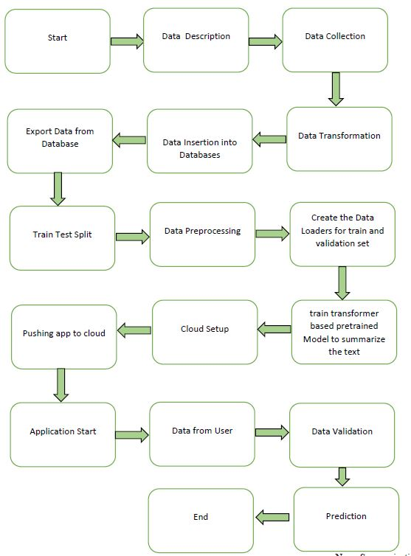
Architecture

Slide 4
Data Insertion in Database:
Table creation :- Table name “extractive_data“, “abstractive_data”, is created in the Cassandra database for inserting the files for extractive and abstractive summarization. If the table is already present, then new files are inserted into the same table.
Insertion of files in the table - If any file has an invalid data type in any of the columns, the file is not loaded in the table.

Slide 5
Model Training:
Data Export from Db :
The accumulated data from db is exported in csv format for model training.
Data Preprocessing
Performing EDA Analysis, Descriptive statistics for article length and summary length.
Check for null values in the columns.
Data Preprocessing steps involved the removal of records with null values if present.
Creating tokenization using T5-base tokenize model for both article and summary by fixing max_length.
Treating input Ids for summary as a label.
Creating Train and Validation set using train test split.
Creating Data Loaders for both training and validation data.

Slide 6
Model Building and Training –
After the Data Preprocessing Steps. We built a T5-Base text generation model and trained it. We calculate the Rouge Score for extractive summarization and the Fact score for abstractive summarization.

Slide 7
Model Deployment and Prediction:
The model is deployed on the Cloud-based platform.
Pushing application to the Cloud.
Data has been taken from News Articles.
Data Validation and Data Pre-processing techniques are applied.
Predicting the result.

Slide 8
Q & A:
Q1) What’s the source of data?
Cornell News Room provides the data for training.
Q 2) What was the type of data?
The data was a Text.
Q 3) What’s the complete flow you followed in this Project?
Refer slide 3rd for a better Understanding

Slide 9
Q 5) How are logs managed?
We are using different logs as per the steps that we follow in Data Insertion, Model Training log, prediction log etc.
Q 6) What techniques were you using for data pre-processing?
Removal of missing values
Tokenize the text and summary using T5-base tokenize model.
Treating input ids for summary as a label.

Slide 10
Q 7) How training was done or what models were used?
We split the data into training and validation data.
We perform Data Preprocessing steps on both training and validation data.
T5-Base text generation model was used for training and calculated Rouge scores (extractive summarization) and Fact score (abstractive summarization), and we saved model weights.
Q 8) How was the prediction made?
The testing files were taken from Public News articles. We Perform the same life cycle and perform prediction.

Slide 11
Q 9) What are the different stages of deployment?
When the model is ready, we deploy it in the local environment. Test the model performance. Checking the latency etc.
Finally, We deploy in production.

