Slide 1
BUCHAREST UNIVERSITY OF ECONOMIC STUDIES · CYBERNETICS, STATISTICS & ECONOMIC INFORMATICS
Architecture and Evaluation of a SIEM Integrating
Unsupervised Anomaly Detection and Knowledge-Grounded Language Models
An AI Threat Engine on Wazuh — anomaly ensemble · hybrid RAG · agentic CVE ingestion · fully local, fully auditable
F1 89.2%
RECALL 95.9%
1,333 VECTORS
CITATIONS 98.3%
100% LOCAL
Graduate: Secărea Diana Maria
Coordinator: prof. univ. dr. Cătălin Boja · Bucharest 2026
Notes:
Good morning. My thesis is titled 'Architecture and Evaluation of a SIEM Integrating Unsupervised Anomaly Detection and Knowledge-Grounded Language Models'. In practice it is an AI Threat Engine that upgrades the open-source Wazuh SIEM with three AI layers: an unsupervised anomaly-detection ensemble, a retrieval-augmented LLM analyst, and an autonomous CVE-ingestion agent. Everything runs locally — no cloud APIs, no data leaves the machine. Headline numbers: F1 89.2%, attack recall 95.9%, 98.3% citation precision.

Slide 2
Roadmap — the loop we'll walk through
detection tells you WHAT · RAG explains WHY · the agent keeps knowledge CURRENT
01 The problem — rule-based SIEMs can't score, explain, or self-update
02 Machine learning — 16 features → dual-model ensemble → tiered verdict
03 Retrieval-augmented generation — grounded, cited explanations from a local LLM
04 Agentic CVE ingestion — the knowledge base maintains itself
05 Evaluation & live demo — reproducible metrics + the system running
AI Threat Engine · Diana Maria Secarea
02
Notes:
Here's the roadmap. First the problem with rule-based SIEMs. Then the three AI contributions in order: the machine-learning ensemble that scores every alert, the retrieval-augmented generation layer that explains and cites, and the agentic component that keeps the knowledge base current. Finally, evaluation and a live demo. The through-line: detection tells you WHAT is anomalous, RAG explains WHY, and the agent keeps the knowledge CURRENT — a closed loop.

Slide 3
Motivation — why add AI to a SIEM?
▸ Alert fatigue is real — a single host produces thousands of alerts/day; analysts triage a fraction
▸ Rules only catch what they name — signature rules miss novel behavior and low-and-slow attacks
▸ Severity ≠ maliciousness — Wazuh level 5 can be routine OR the start of a brute force — context decides
▸ Knowledge is scattered — MITRE, Sigma, CVEs, internal runbooks — nobody can hold it all in their head
▸ SOC expertise is expensive — an explainable AI layer lets one analyst do the work of a tier-1 team
2,171
ALERTS IN STUDY CORPUS
640
ATTACK ALERTS (14 FAMILIES)
0
LABELS NEEDED FOR TRAINING
AI Threat Engine · Diana Maria Secarea
03
Notes:
Why does a SIEM need AI? Four problems: alert fatigue — analysts drown in noise; rules only detect what they explicitly name; severity levels don't measure maliciousness; and the knowledge needed to respond is scattered across MITRE, Sigma, CVE feeds and internal documents. The engine addresses each: anomaly scoring prioritizes, unsupervised learning needs zero labels, and RAG unifies the knowledge.

Slide 4
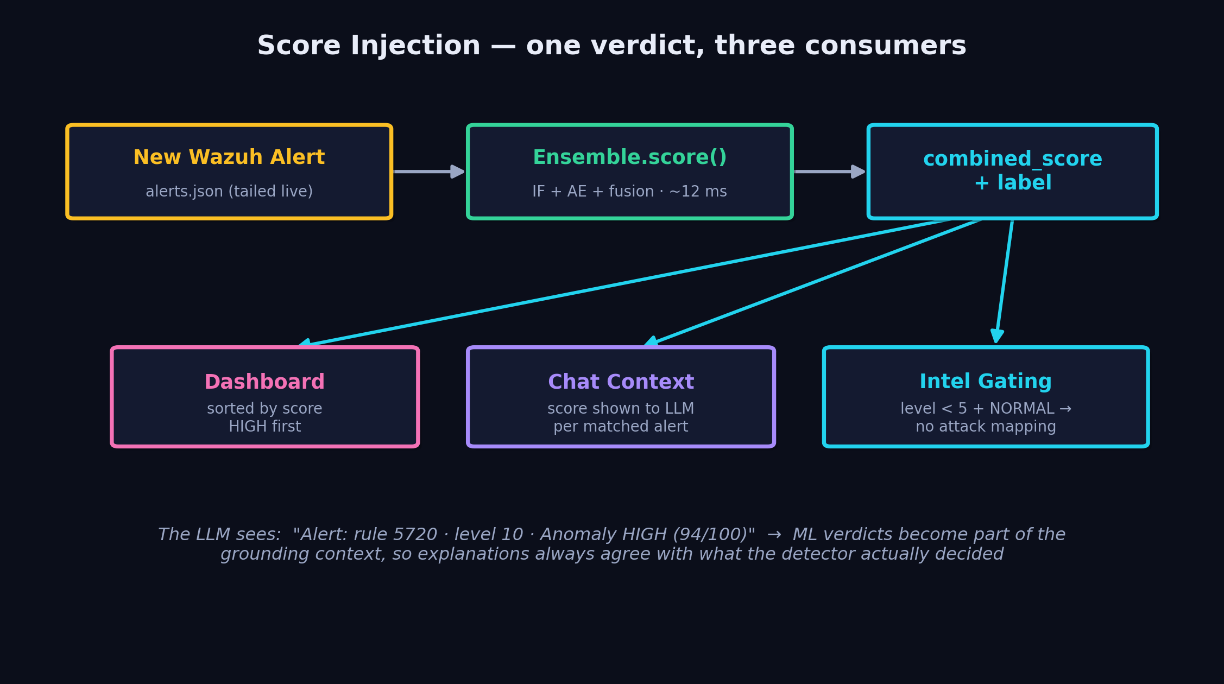
Integration with Wazuh
non-invasive: Wazuh is never modified — the engine reads alongside it
▸ Tap point: alerts.json — the engine tails /var/ossec/logs/alerts/alerts.json in real time (read-only, wazuh group)
▸ Every alert scored in ~12 ms — feature extraction → ensemble → combined score + label attached to the alert
▸ Daily collector + cron — collect_training_data.py snapshots alerts for continuous retraining data
▸ Flask API layer — /api/alerts/scored, /api/chat, /api/knowledge/upload — dashboard and chat consume these
▸ Wazuh metadata becomes features — rule.level, rule.id, groups, MITRE tags feed the ML — the engine builds ON Wazuh's parsing
AI Threat Engine · Diana Maria Secarea
04
Notes:
Integration is deliberately non-invasive. Wazuh keeps doing what it does; the engine tails alerts.json read-only. Each new alert is scored in about 12 milliseconds and the verdict flows to three consumers: the dashboard sorts by score, the chat injects the verdict into LLM context, and low-level NORMAL alerts gate threat-intel retrieval so the LLM never invents attack stories about routine logins.

Slide 5
Technology Stack
every component is open-source and runs on one machine
MACHINE LEARNING
• scikit-learn (IF + MLP AE)
• NumPy · joblib
• StandardScaler pipeline
• custom feature extractor
RAG & LLM
• Ollama · llama3.2 (local)
• Qdrant vector DB (Docker)
• sentence-transformers (dense)
• fastembed BM25 (sparse)
DATA & BACKEND
• PostgreSQL (ledger/audit)
• Flask + SSE streaming
• Docker Compose
• Python 3.13
SECURITY BASE
• Wazuh 4.14 Manager
• MITRE ATT&CK · D3FEND
• Sigma · CISA KEV · CIS
• NVD / OTX feeds
Zero cloud dependencies → suitable for air-gapped SOCs, no per-token cost, GDPR-safe by construction
AI Threat Engine · Diana Maria Secarea
05
Notes:
The stack: scikit-learn for both models — Isolation Forest and an MLPRegressor autoencoder. RAG runs on Qdrant with dual embeddings — dense sentence-transformers plus sparse BM25. The LLM is llama3.2 served by Ollama, fully local. PostgreSQL keeps the audit ledger. The key property: zero cloud dependencies — deployable in air-gapped environments with no per-token cost.

Slide 6
01
PART ONE · unsupervised anomaly detection
Machine Learning

Slide 7
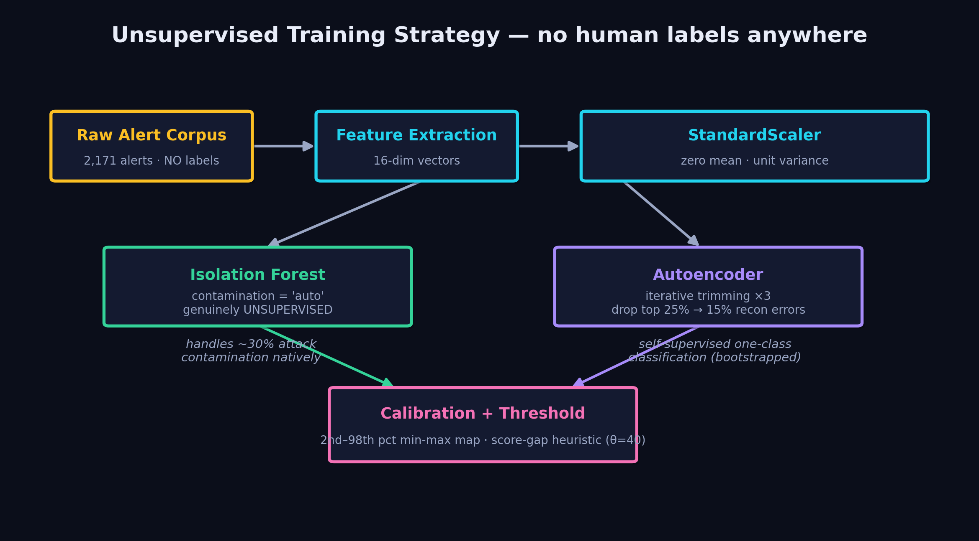
Training Pipeline — unsupervised by design
no human ever labels an alert; the models learn 'normal' from the environment itself
▸ IF: contamination='auto' — fitted on all 2,171 alerts, no label filter — makes no assumption about the anomaly proportion
▸ AE: iterative trimming ×3 — ~30% attacks left in on purpose; train → drop top-25% recon errors → drop 15% → final clean fit
AI Threat Engine · Diana Maria Secarea
07
Notes:
The training strategy is fully unsupervised — this is the methodological core of the thesis. Raw alerts, including the attacks hiding among them, flow through feature extraction and scaling. The Isolation Forest trains with contamination='auto' on all 2,171 alerts with no label filter — it makes no assumption about the anomaly proportion. The autoencoder deliberately leaves about 30% attacks mixed in, then uses iterative trimming: train, discard the worst-reconstructed 25%, retrain, discard 15%, then a final fit on the cleaned set. Without trimming the autoencoder would learn to reconstruct attacks too. No labels at any stage — the literature calls this self-supervised one-class classification. Operationally: deploy on a network you've never seen and it learns that network's normal by itself.

Slide 8
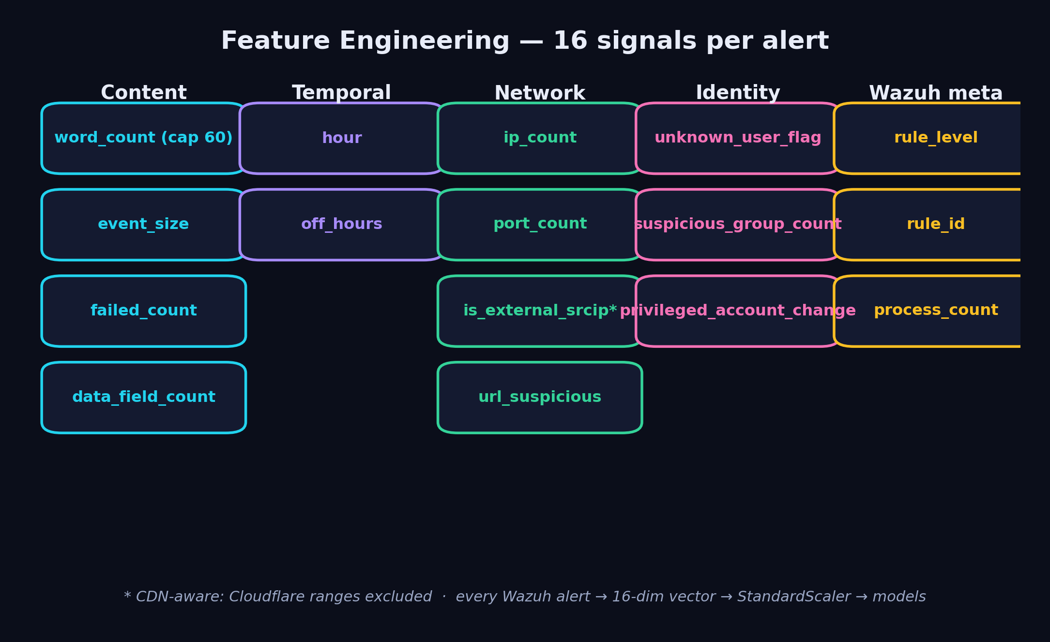
Feature Engineering — 16 signals per alert
domain knowledge distilled into numbers: content, time, network, identity, Wazuh metadata
Iterated 14× against real attack simulations — e.g. MITRE-tag count was REMOVED after it caused false alarms (Wazuh tags benign SSH logins with T1078), and Cloudflare CDN ranges are excluded from the external-IP flag.
AI Threat Engine · Diana Maria Secarea
08
Notes:
Each alert becomes a 16-dimensional vector. Content features like failed-login counts; temporal features like off-hours activity; network features — external source IP with CDN awareness; identity features like privileged account changes; and Wazuh metadata. The set was refined 14 times against attack simulations. A key lesson: I REMOVED the MITRE-tag-count feature because Wazuh attaches MITRE tags to benign events, which poisoned the feature. Feature engineering is iterative and empirical, not guesswork.

Slide 9
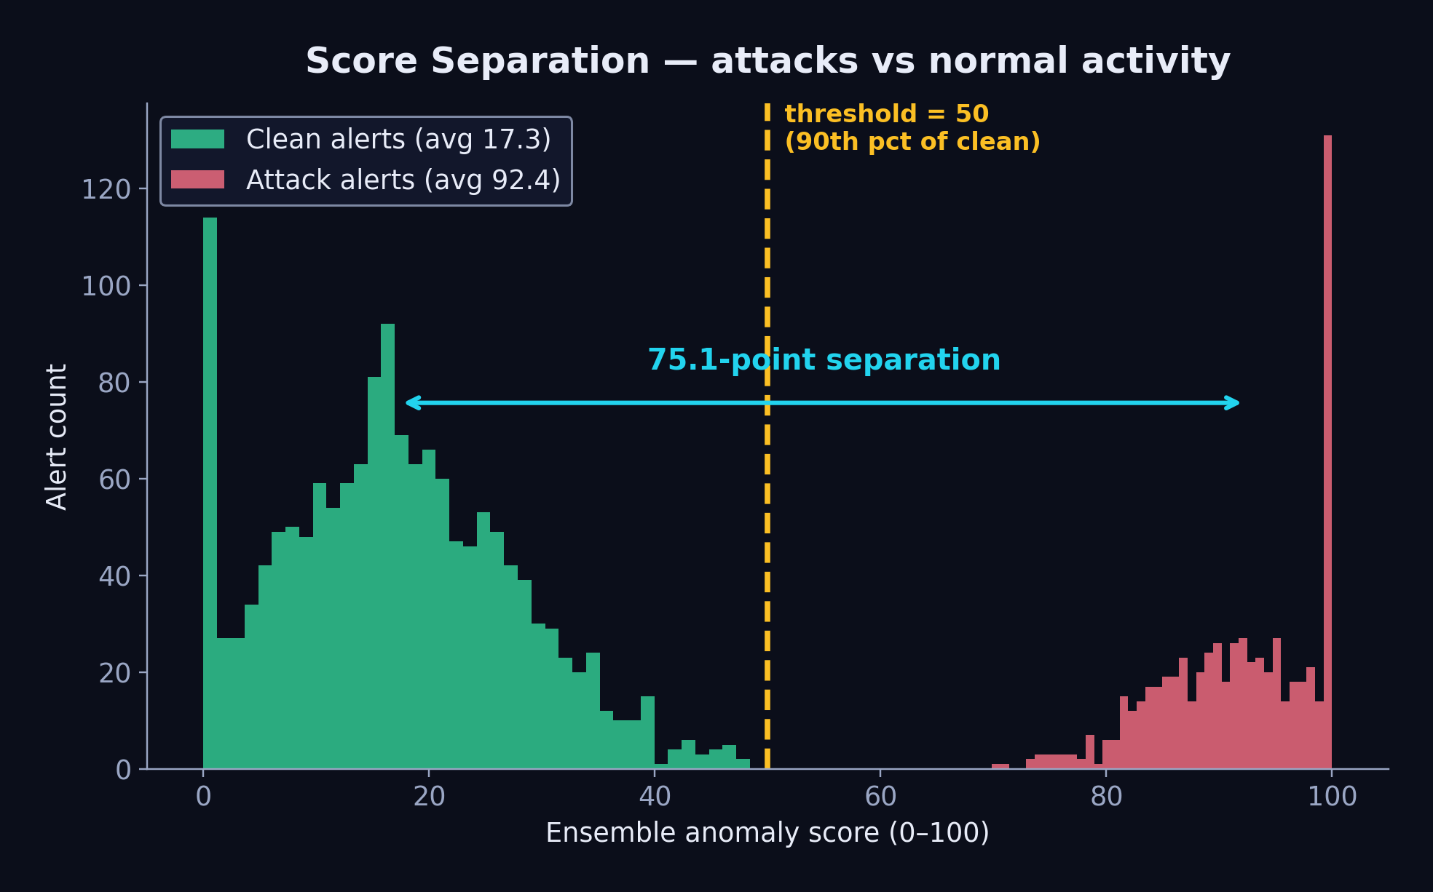
Algorithm 1 — Isolation Forest
▸ Core idea — anomalies are FEW and DIFFERENT → random splits isolate them in short paths
▸ Score — path length → anomaly score, calibrated min-max → 0-100 scale
▸ Threshold — 50 = 90th percentile of clean scores (score-based, not model.predict)
▸ Why chosen — no labels needed · handles mixed feature scales · fast (µs/alert) · robust to irrelevant features
▸ Weakness — axis-parallel splits miss subtle multivariate correlations → that's what the AE covers
75.1-point separation between attack (92.4) and clean (17.3) average scores
AI Threat Engine · Diana Maria Secarea
09
Notes:
First ensemble member: Isolation Forest. The intuition — anomalies are few and different, so random splits isolate them quickly; short isolation path = high anomaly score. I calibrate raw scores to 0-100 and set the threshold at the 90th percentile of clean scores. Why this algorithm? It needs no labels, it's extremely fast, and it's robust to noisy features. Its weakness — axis-parallel splits miss subtle feature correlations — is exactly what the second model compensates for. Note the 75-point score separation: attacks average 92, normal traffic 17.

Slide 10
Algorithm 2 — Autoencoder
▸ Architecture — 16 → 8 → 4 → 8 → 16 bottleneck MLP (sklearn MLPRegressor)
▸ Core idea — trained to reconstruct NORMAL alerts; attacks reconstruct badly → high MSE = anomaly
▸ The 4-dim bottleneck — forces the net to learn the compressed manifold of normal behavior
▸ Why chosen — captures nonlinear feature CORRELATIONS the forest can't · complementary error profile
▸ Training — self-supervised — the input is its own target; iterative trimming purifies the data
16
16
8
8
4
encoder → bottleneck → decoder
reconstruction error (MSE) = anomaly score
AI Threat Engine · Diana Maria Secarea
10
Notes:
Second member: an autoencoder — a bottleneck network 16-8-4-8-16 trained to reconstruct its own input. It only ever sees normal alerts (after iterative trimming), so it learns the compressed manifold of normality. When an attack arrives, reconstruction fails and the MSE spikes. The 4-neuron bottleneck is the point: it forces compression, so the network must learn correlations BETWEEN features — precisely what Isolation Forest's axis-parallel splits cannot capture. The two models fail differently, which is the whole argument for the ensemble.

Slide 11
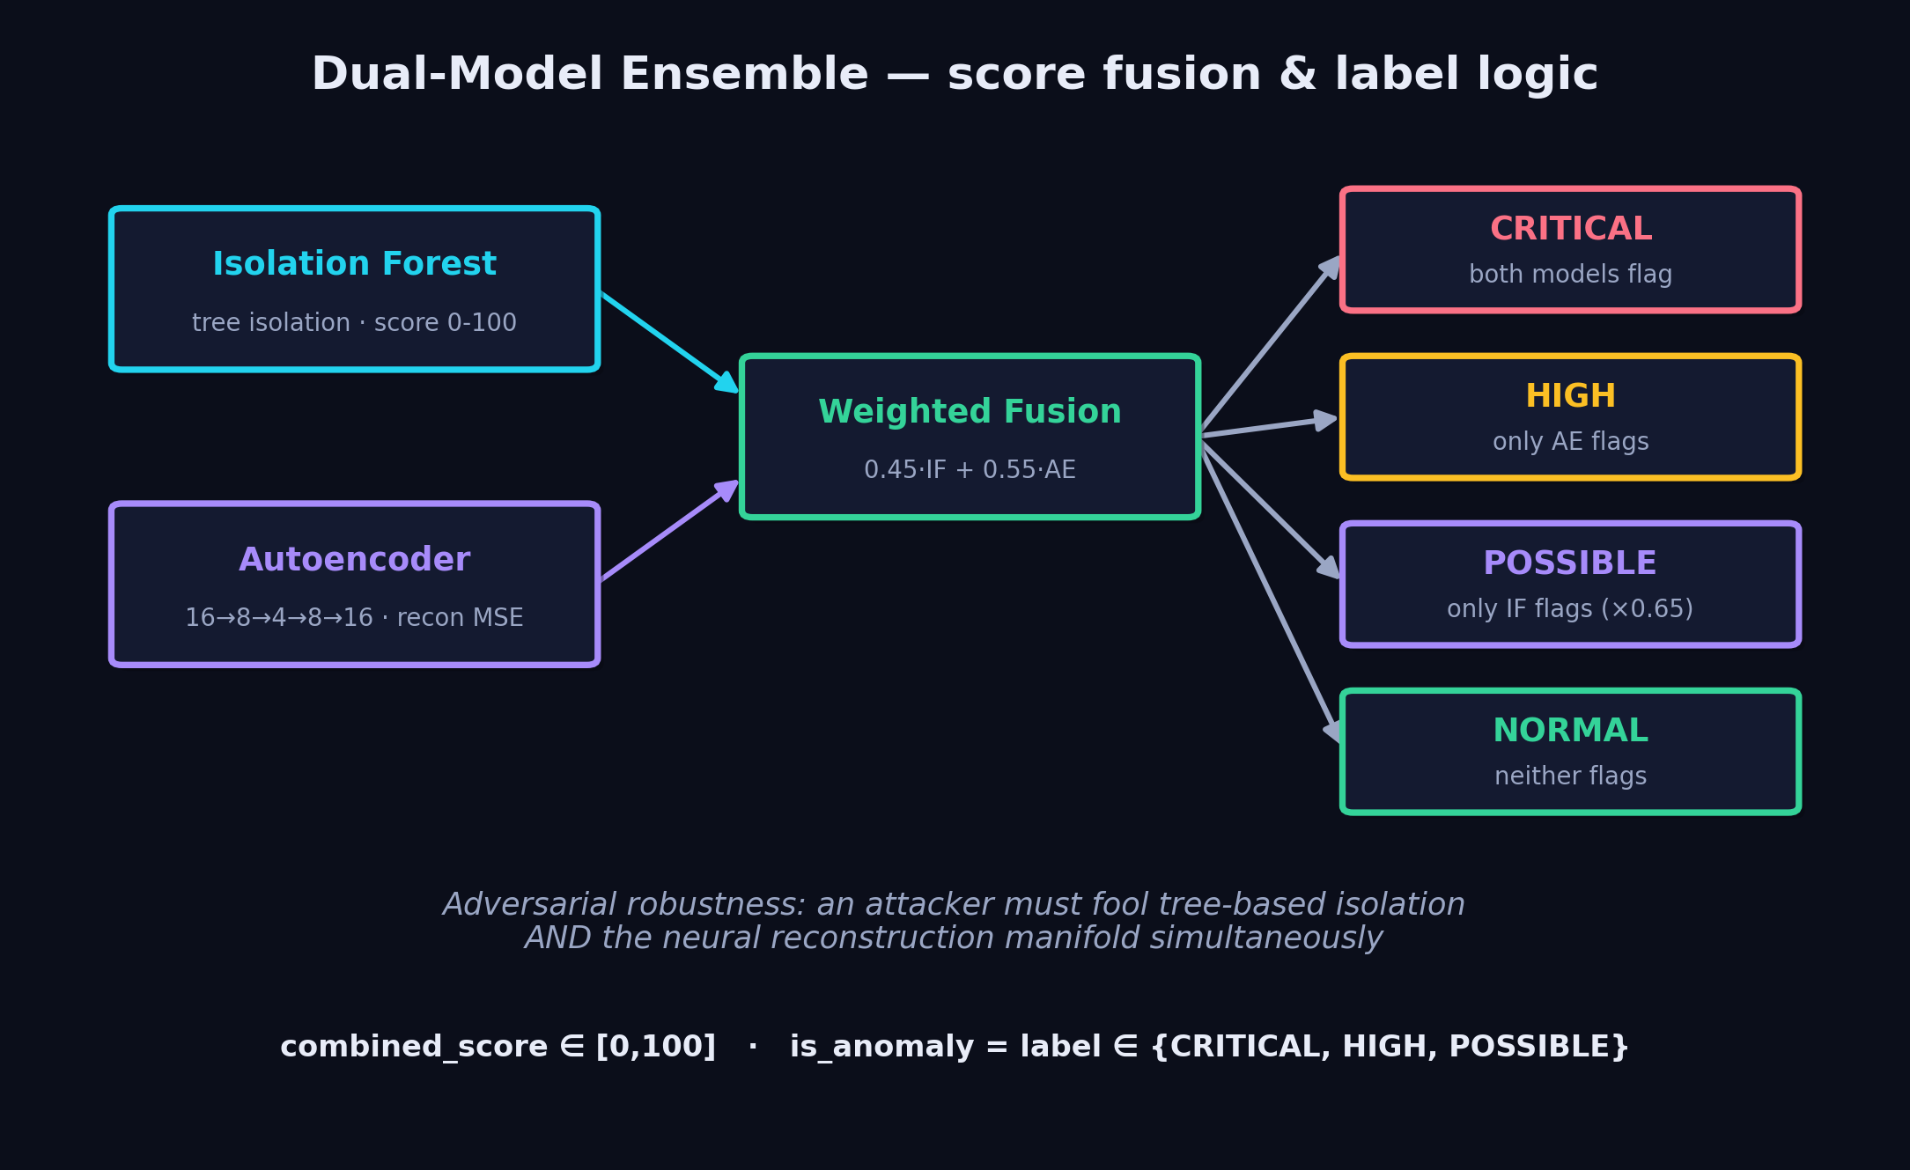
The Ensemble — fusion & label logic
the ensemble is a fixed scoring layer, not a trained model — only IF and AE are trained
AI Threat Engine · Diana Maria Secarea
11
Notes:
The ensemble combines both verdicts. Crucially, the TIER is decided by the two models' BINARY anomaly decisions, not their continuous scores — this preserves each model's calibrated threshold rather than inventing a new one in the combination layer. Both flag → CRITICAL; only the autoencoder → HIGH (the higher-precision model); only the forest → POSSIBLE, dampened ×0.65; neither → NORMAL. The displayed combined score is a weighted average, 0.45 × IF + 0.55 × AE. The ensemble itself is NOT trained — it's a deterministic fusion layer, which keeps it explainable. The security argument: to evade detection an attacker must simultaneously fool tree-based isolation AND a neural reconstruction manifold — and those evasion strategies are contradictory, so a simple attack cannot beat both. Note the honest caveat: on the current evaluation set the AE-only HIGH tier is empty, so the AE's value here is precision, not extra recall.

Slide 12
From Score to Action — injection into system & RAG
▸ Dashboard — every streamed alert carries combined_score + label; UI sorts HIGH first, benign-rule exceptions zero the score
▸ Chat grounding — matched alerts enter the LLM prompt WITH their ML verdict: 'rule 5720 · level 10 · Anomaly HIGH (94/100)'
▸ Retrieval gating — if all matched alerts are level < 5, threat-intel retrieval is SKIPPED and the LLM is told not to map to ATT&CK
▸ Label → language — CRITICAL/HIGH/POSSIBLE/NORMAL is the shared vocabulary between ML, API, UI and LLM — one verdict everywhere
▸ Analyst feedback loop — user-defined benign rules & suspicious groups adjust scoring live, no retrain needed
AI Threat Engine · Diana Maria Secarea
12
Notes:
How do scores reach the rest of the system? Three paths. The dashboard receives every alert with its combined score and label, sorted worst-first. The chat pipeline injects the ML verdict directly into the LLM's context — the model literally reads 'Anomaly HIGH, 94 out of 100' next to each alert. And scores gate retrieval: for low-level NORMAL events we skip threat-intel entirely and instruct the LLM not to invent attack narratives. This anti-hallucination gating came from a real failure mode I observed.

Slide 13
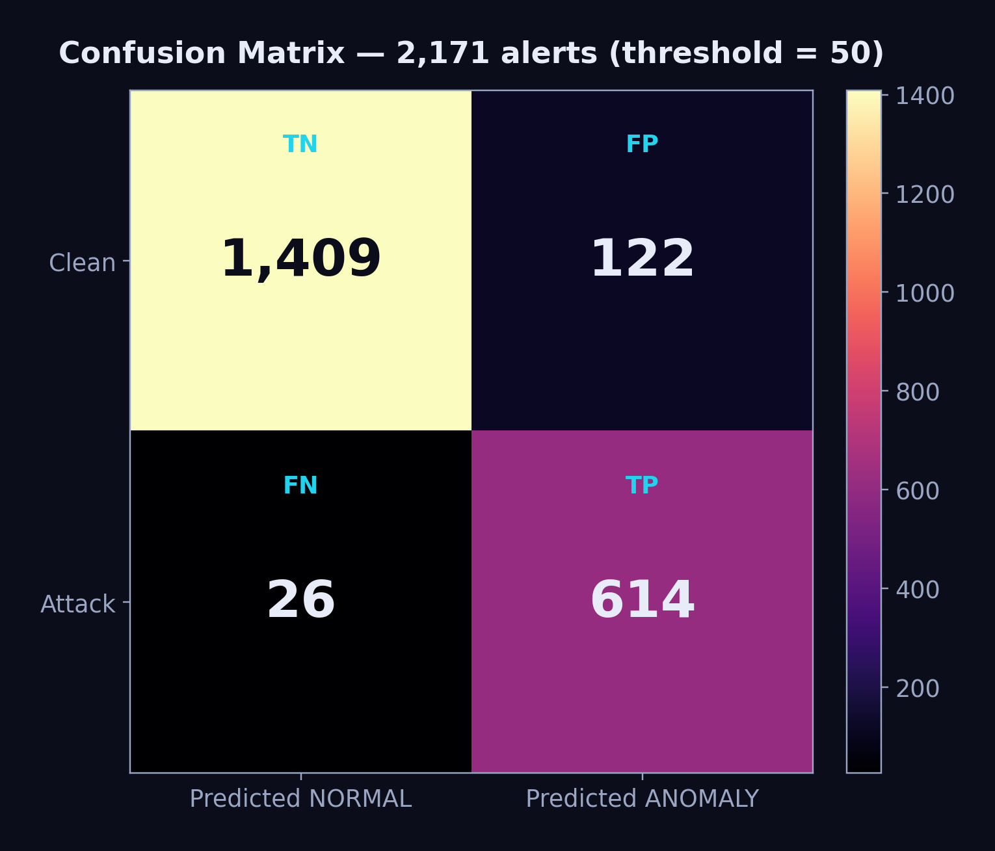
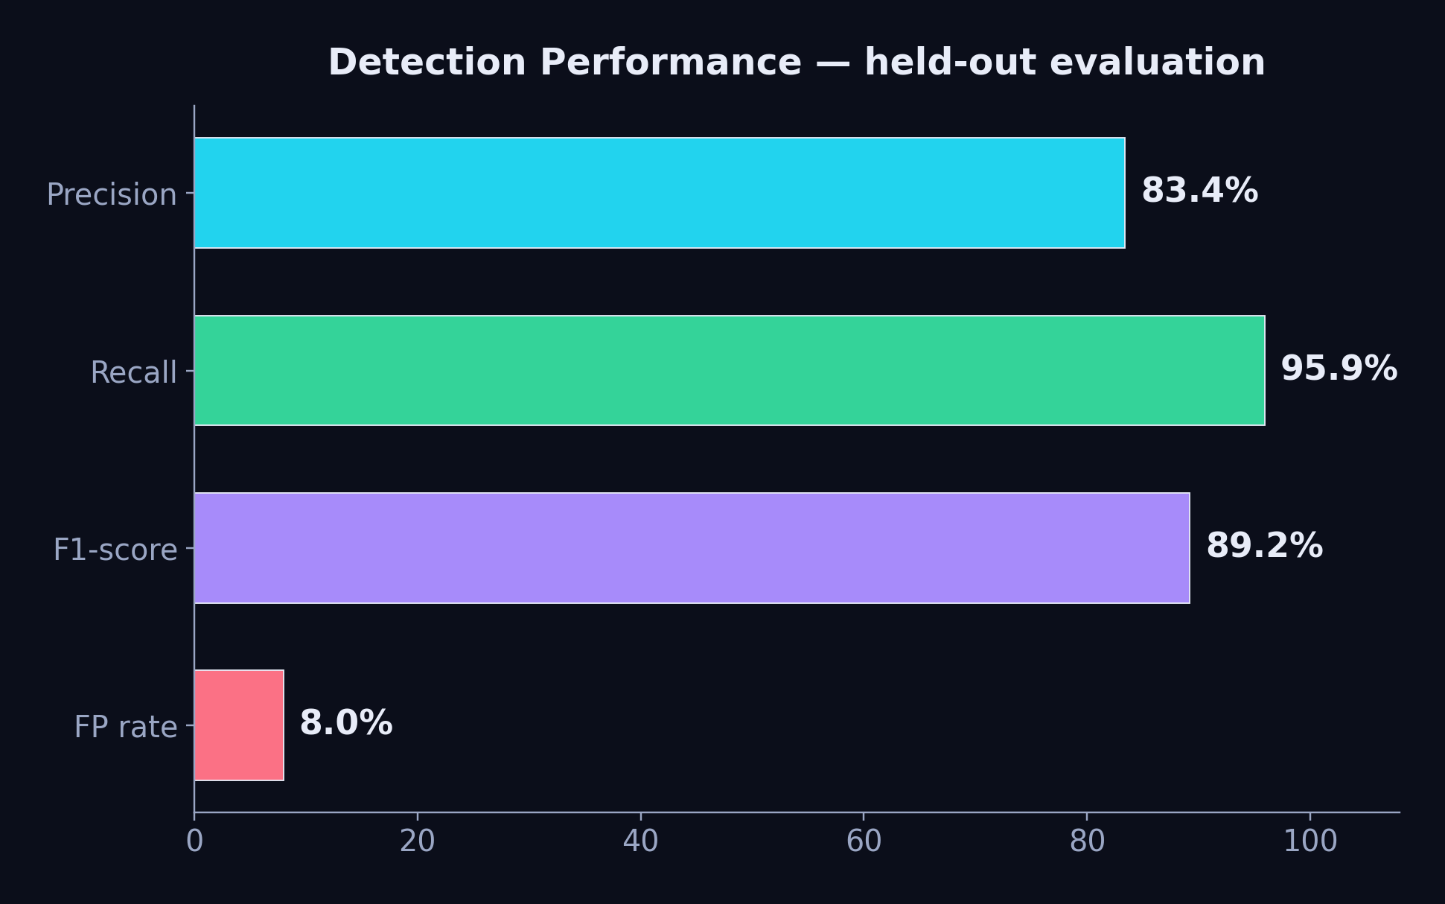
Detection Evaluation
2,171 alerts · 1,531 clean · 640 attack across 14 simulated attack families
100% detection: SSH brute force · web attacks (SQLi, XSS) · C2 & DNS exfil · reverse shells · rootkits · account manipulation. Hardest case: single failed PAM logins (45%) — informationally identical to a typo → future work: temporal window features.
AI Threat Engine · Diana Maria Secarea
13
Notes:
Evaluation on 2,171 alerts: precision 83.4%, recall 95.9%, F1 89.2%, false-positive rate 8%. The confusion matrix: 614 attacks caught, only 26 missed. Entire attack families are at 100% — brute force, web attacks, C2, reverse shells, rootkits. I'm transparent about the failure case: single failed PAM logins are only caught 45% of the time — a lone failed login is informationally identical to a typo. The fix is temporal aggregation features, which I discuss under future work.

Slide 14
02
PART TWO · grounded, cited explanations
Retrieval-Augmented Generation

Slide 15
RAG — the analyst that explains
detection says WHAT is anomalous; retrieval-augmented generation explains WHY and WHAT TO DO
▸ The problem with raw LLMs — hallucination — a bare LLM will invent techniques, CVEs and IPs that don't exist
▸ The RAG answer — retrieve verified knowledge first, then force the LLM to answer FROM it, with citations [1]-[n]
▸ Two grounding sources — 1,333-point threat-intel base (MITRE·Sigma·KEV·CIS·docs) + the live Wazuh alert stream
▸ ML verdicts in the loop — anomaly labels ride along with every alert the LLM sees — detection and explanation stay consistent
▸ User documents quoted verbatim — uploaded runbooks are chunked & indexed; the analyst quotes them word-for-word with the document title
▸ Session memory — multi-turn conversations with per-session history — analysts can drill down naturally
AI Threat Engine · Diana Maria Secarea
15
Notes:
Detection tells you WHAT is anomalous. RAG explains WHY and what to do about it. A bare LLM hallucinates — it will happily invent CVE numbers. RAG fixes this by retrieving verified knowledge first and forcing the model to answer from it with numbered citations. Grounding comes from two sources: the threat-intel knowledge base and the live alert stream — with ML verdicts attached. Uploaded runbooks are quoted verbatim with the document title, so institutional knowledge becomes part of every answer.

Slide 16
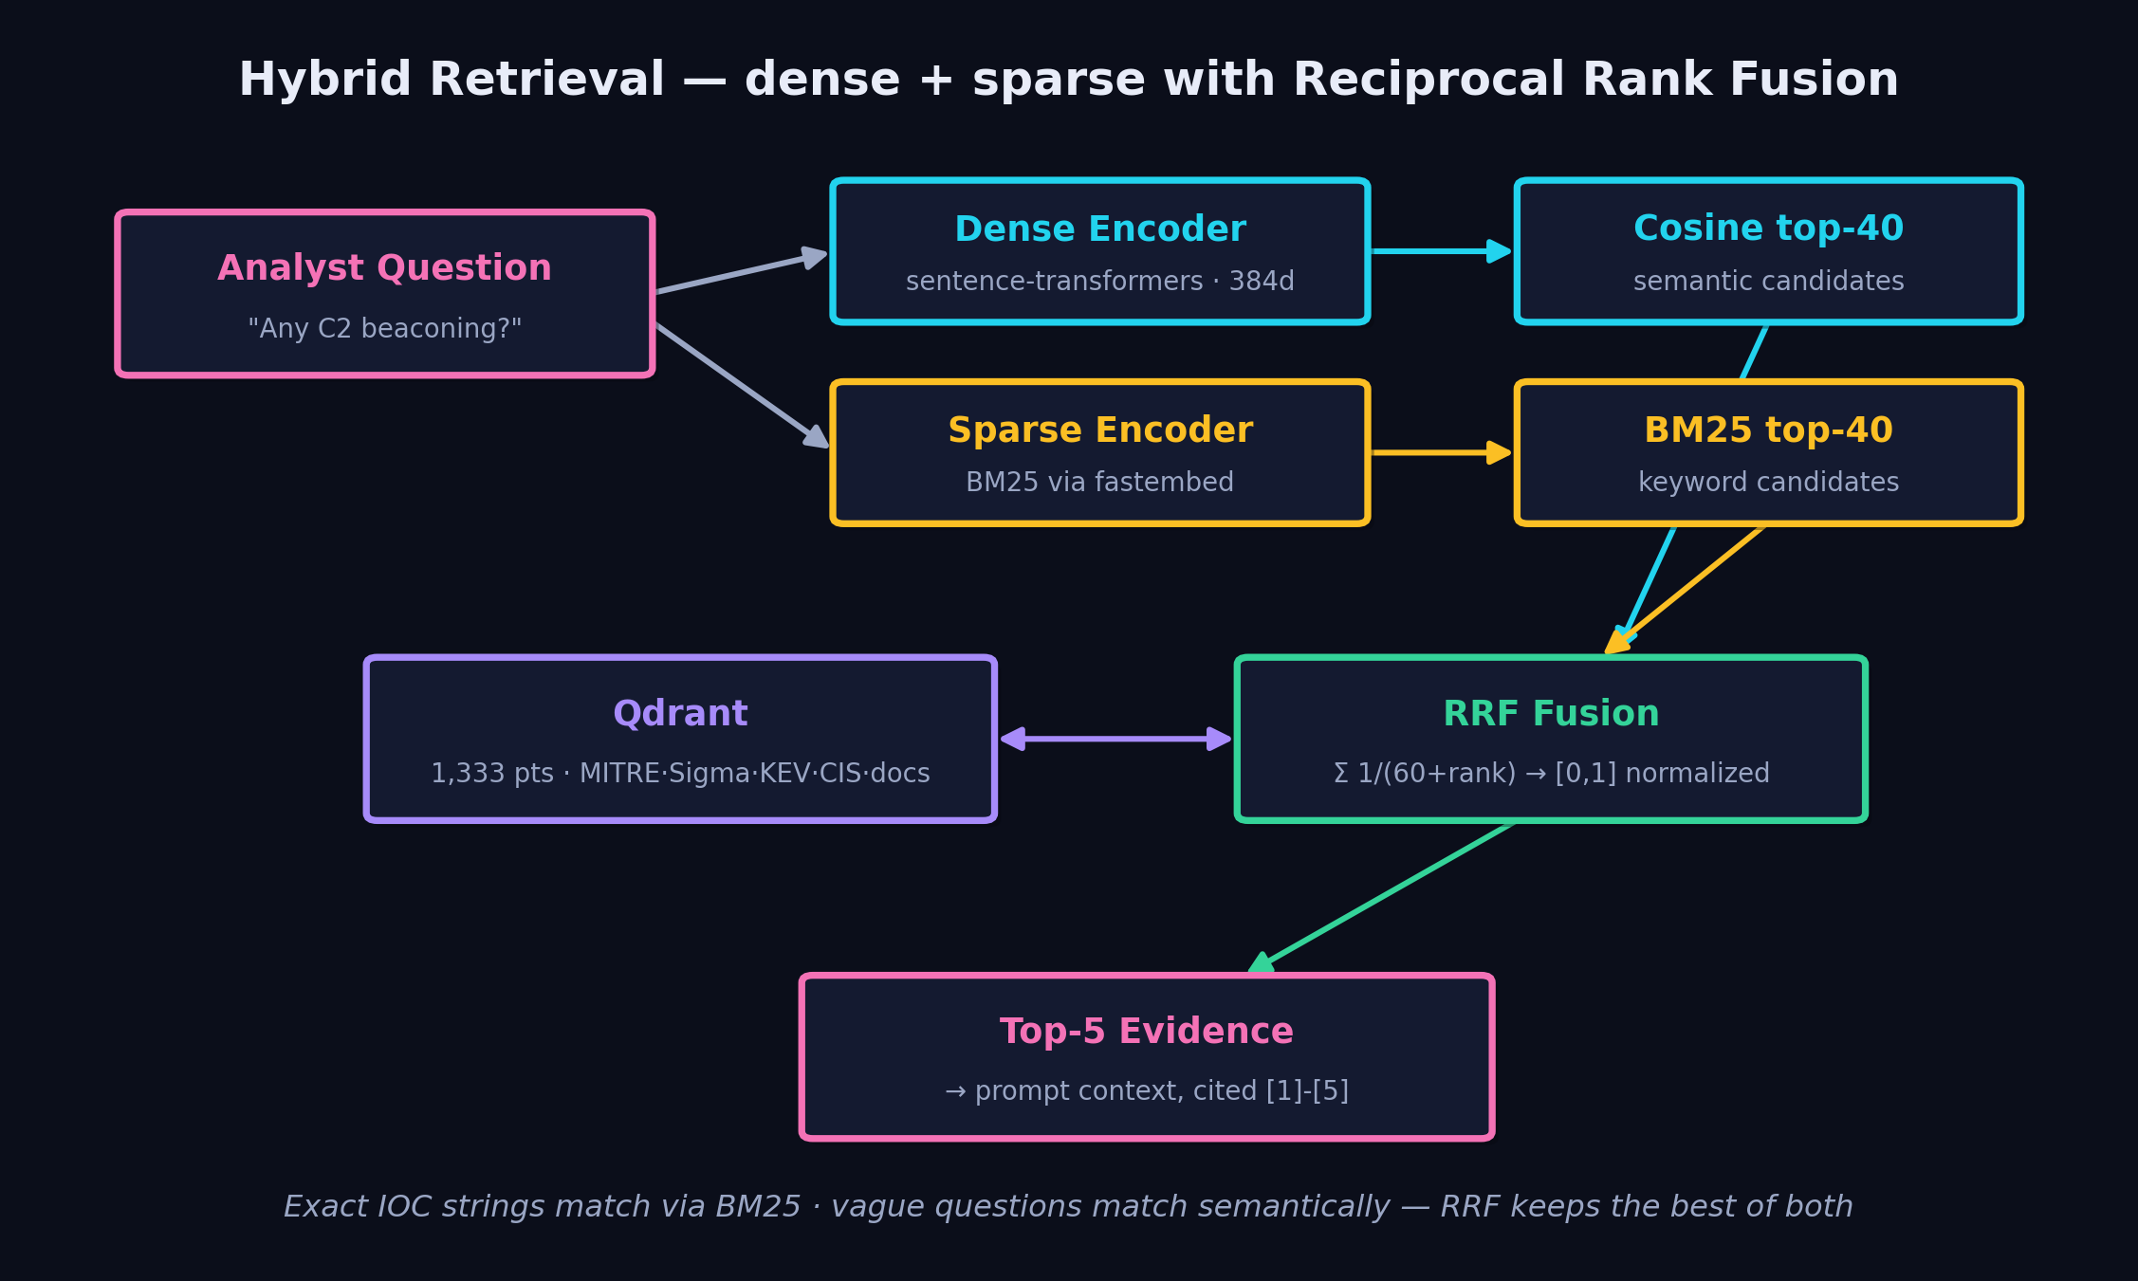
Building the Vector Database
every knowledge item → one 'episode' → dense vector + sparse vector + payload in Qdrant
AI Threat Engine · Diana Maria Secarea
16
Notes:
The knowledge base construction: every item — a MITRE technique, a Sigma rule, a KEV entry, a document chunk — becomes an 'episode' with a summary, tags and entities. Each episode is embedded TWICE: a 384-dimensional dense vector for semantic meaning, and a sparse BM25 vector for exact keywords. At query time both retrievers fetch 40 candidates each and Reciprocal Rank Fusion merges the rankings — normalized to [0,1]. Why hybrid? Security queries are bimodal: 'CVE-2021-44228' needs exact matching, while 'is someone stealing data' needs semantics. RRF gets both without tuning weights.

Slide 17
PostgreSQL — the system's memory & conscience
vectors answer 'what is similar?' — Postgres answers 'what happened, when, and why?'
threat_intel relational mirror of every indexed knowledge item (incl. user uploads) — joinable, queryable
cve_decisions one row per CVE the agent ever judged: base score, boost, final, decision, LLM reasoning
ingestion_log one row per agent run: cursor used, rollup counts, status — full run traceability
pending_review view the 4-6 quarantine queue an analyst reviews — the human-in-the-loop surface
Design principle: Qdrant is disposable (re-indexable), Postgres is the source of truth — every automated decision is auditable and reversible.
AI Threat Engine · Diana Maria Secarea
17
Notes:
Why Postgres next to a vector DB? Different questions. Qdrant answers 'what is similar' — Postgres answers 'what happened and why'. Four structures: threat_intel mirrors every indexed item relationally; cve_decisions records every judgment the agent ever made including the LLM's reasoning; ingestion_log gives per-run traceability; and the pending_review view is the human-in-the-loop surface. The design principle: the vector index is disposable and re-buildable — Postgres is the permanent source of truth.

Slide 18
Answer Generation with grounded knowledge
PROMPT ANATOMY
SYSTEM: analyst persona + citation rules
+ anti-hallucination: low-level NORMAL alerts
must NOT be mapped to attack techniques
+ quote user documents verbatim, cite [n]
=== Threat Intelligence Context ===
[1]-[5] retrieved episodes (RRF top-5)
=== Wazuh Alert Logs (matches) ===
alerts + ensemble verdicts (HIGH 94/100)
USER: the analyst's question
→ llama3.2 · streamed via SSE, token by token
▸ Level-gated retrieval — intel only fetched when an alert is level ≥ 5
▸ Citations enforced — [n] markers verified against sources in eval
▸ Sources returned to UI — every reply ships its evidence chips
▸ Refusal is a feature — no evidence → say so, never invent
▸ Streaming UX — SSE tokens — answers appear as they're generated
AI Threat Engine · Diana Maria Secarea
18
Notes:
The prompt is assembled in layers: a system prompt with the analyst persona, citation rules, and two anti-hallucination guards — never map routine events to attack techniques, and quote user documents verbatim. Then the retrieved intel block, numbered 1 to 5; then matched alerts WITH their ensemble verdicts; finally the user's question. Answers stream token-by-token over SSE, and each reply returns its sources so the UI shows evidence chips. Crucially, refusal is a feature — when there's no evidence, the model says so.

Slide 19
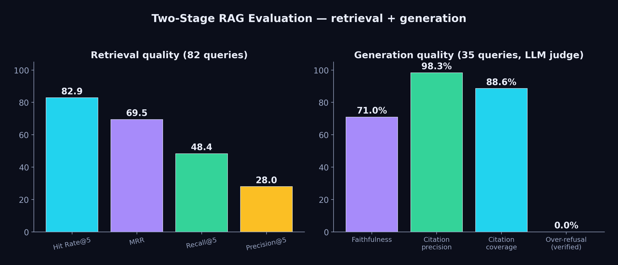
Evaluating the RAG — two stages
retrieval quality and generation quality are different failure modes — measure both
Honest findings: cross-encoder reranking HURT domain retrieval (removed) · weak categories identified (APT, C2 recall) · over-refusal regex flagged 8/35 but manual verification showed 0 true refusals — metrics need human validation.
AI Threat Engine · Diana Maria Secarea
19
Notes:
RAG evaluation runs in two stages because retrieval and generation fail differently. Retrieval on 82 queries: hit rate 82.9%, MRR 0.695. Generation on 35 queries with an LLM judge: faithfulness 0.71, citation precision 98.3% — when the model cites source 3, source 3 really supports the claim. I report negative results too: cross-encoder reranking actually hurt domain retrieval so I removed it, and the over-refusal metric needed manual verification — the regex flagged 8 cases but human inspection confirmed zero true refusals. Metrics without validation lie.

Slide 20
03
PART THREE · the knowledge base maintains itself
Agentic CVE Ingestion

Slide 21
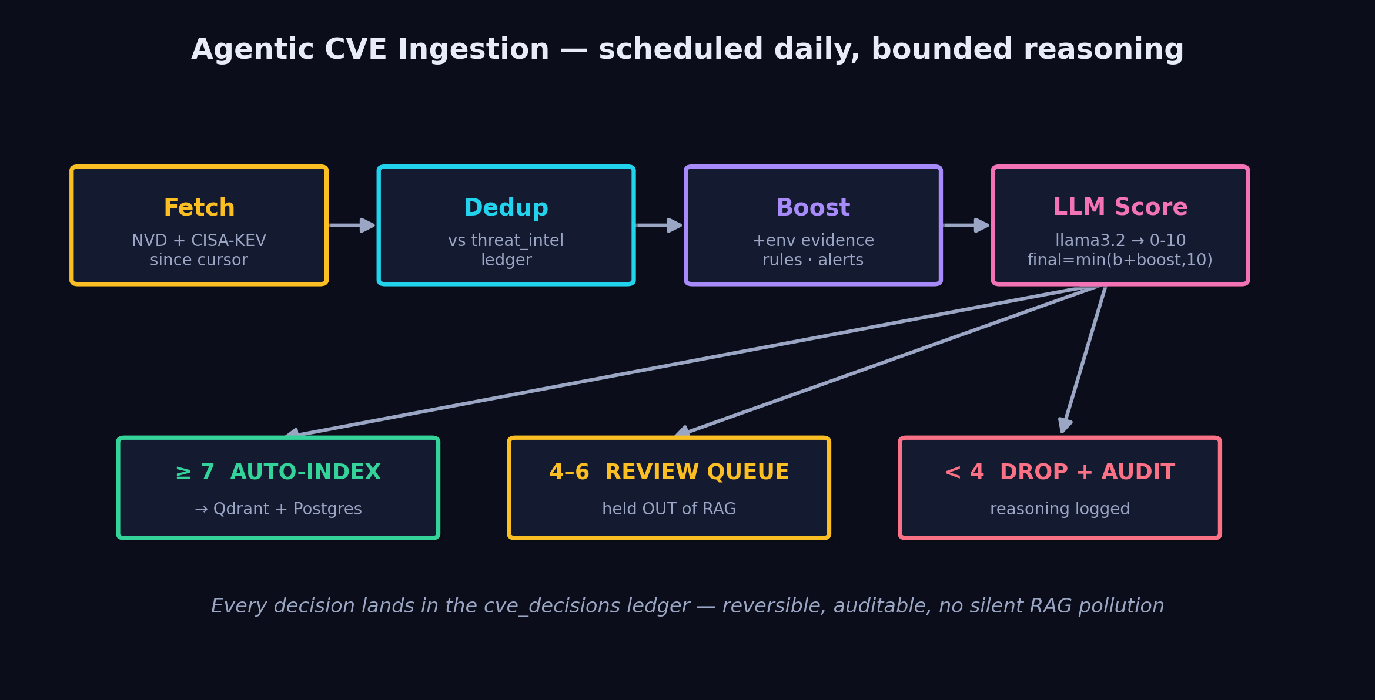
Agentic Workflow — autonomous CVE ingestion
the knowledge base updates itself daily — with bounded reasoning and full audit
Design: fixed control flow, ONE bounded LLM step (relevance 0-10) · environment boost from local rules & alert history · LLM failure → conservative score 5 → review queue, never silent drop · duplicates skipped against the Postgres ledger.
AI Threat Engine · Diana Maria Secarea
21
Notes:
The agentic component: a scheduled agent that keeps the knowledge base current. Daily: fetch new CVEs from NVD and CISA-KEV, dedup against the ledger, add an environment boost — if the CVE touches software we actually run or matches our alert history — then ONE bounded LLM call scores relevance 0 to 10. Three bands: 7+ auto-indexes into RAG, 4-6 quarantines for human review, below 4 drops with logged reasoning. The design philosophy: agentic doesn't mean unbounded — fixed control flow, one LLM decision, every outcome auditable and reversible. If the LLM is down, CVEs route to review — fail-safe, not silent.

Slide 22
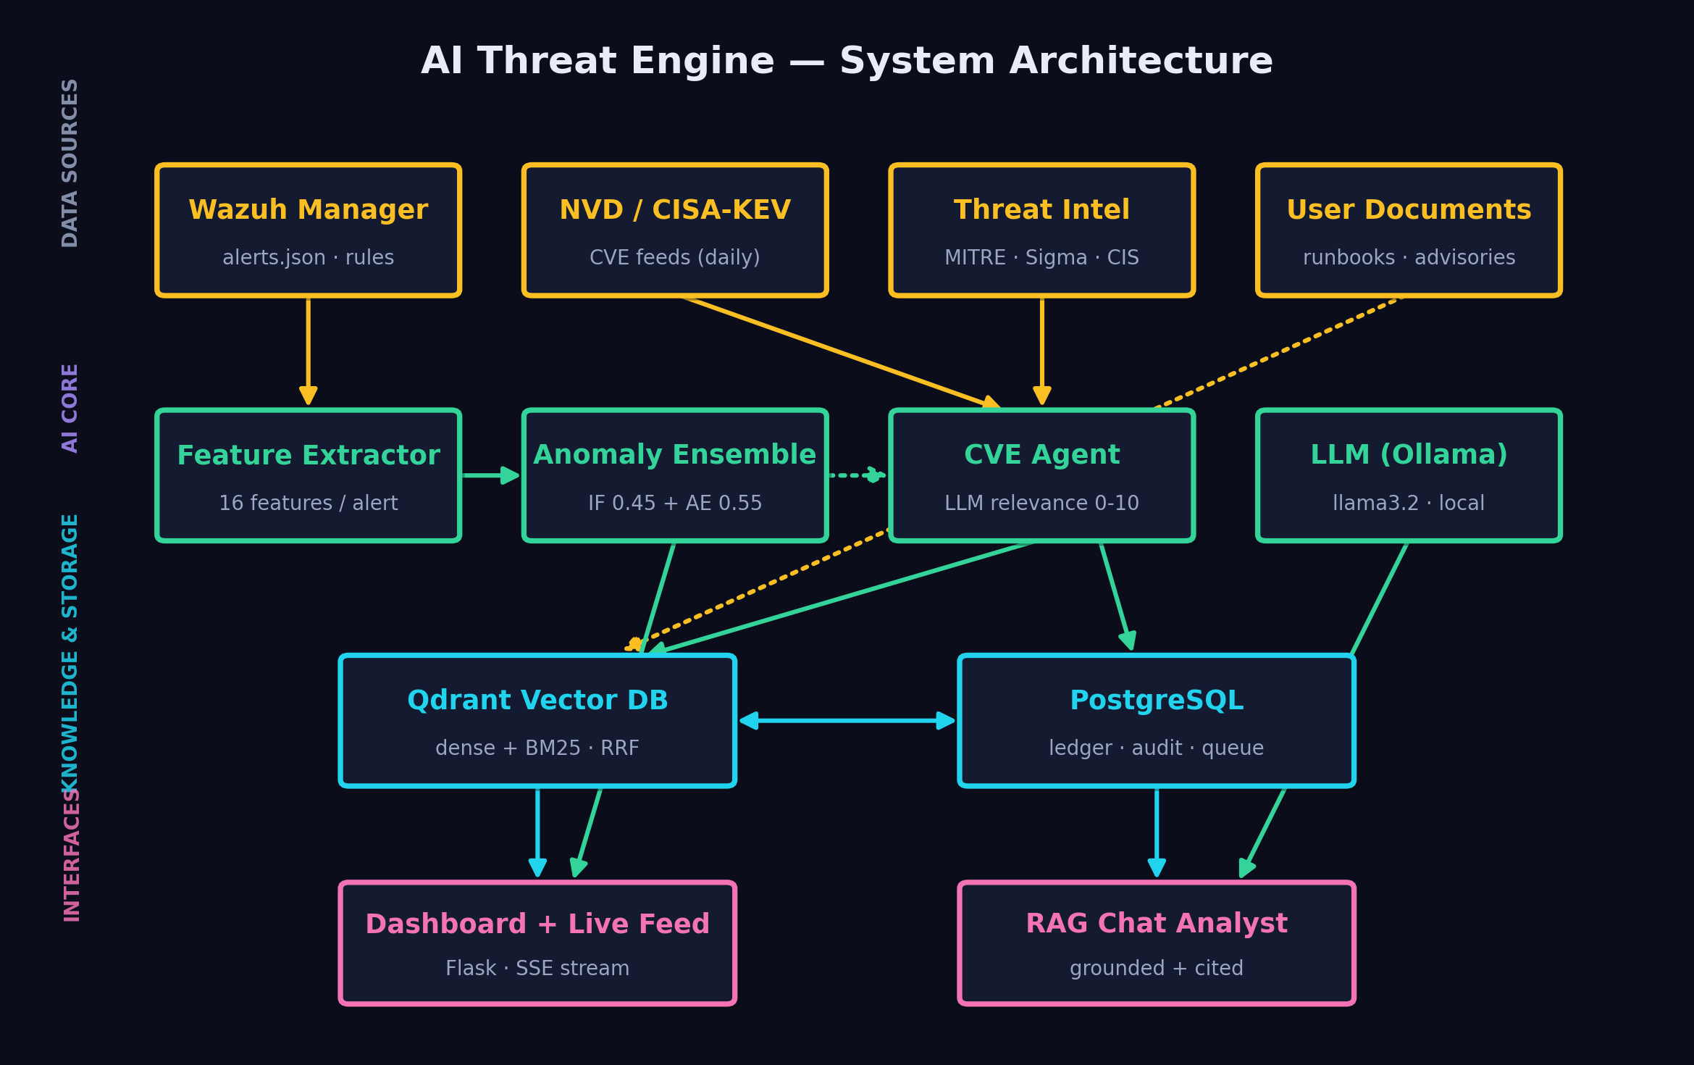
The Whole System — architecture
AI Threat Engine · Diana Maria Secarea
22
Notes:
Everything together. Four layers. Data sources: Wazuh alerts, CVE feeds, threat-intel corpora, user documents. AI core: feature extraction into the anomaly ensemble, the CVE agent, and the local LLM. Storage: Qdrant for similarity, Postgres for truth. Interfaces: the live dashboard and the RAG chat analyst. Notice the arrows meet in the middle — ML verdicts flow into RAG context, agent decisions flow into the knowledge base, and every automated action lands in the audit ledger. Detection, explanation and knowledge maintenance reinforce each other — that's the thesis contribution.

Slide 23
Live Demo — the system running
ordered most-important-first: real attack → detection → grounded explanation → the ML → the agent
▶ Real attack + attack-origin map
Populate Map + Test the Shield — 14 families through the real Wazuh pipeline, scored live
💬 Grounded RAG explanation
ask the analyst, click a source citation → open the exact indexed chunk in Qdrant
🧠 How the score was made
the ML Engine page: 16 features → Isolation Forest + Autoencoder → fused tier
🤖 Autonomous CVE agent
run it live — fetch → dedup → boost → LLM-score → index / queue / drop
AI Threat Engine · Diana Maria Secarea
23
Notes:
Now I'll switch to the running system. I'll go in order of impact. First a real attack — I trigger 14 attack families as actual commands and you watch them get detected and mapped live. Then I ask the AI analyst to explain one, and click a citation to see the exact source it quoted. Then the ML Engine page shows HOW that anomaly score was produced — the two models and the fusion. Finally the CVE agent runs and maintains its own knowledge base. If anything lags, that's local CPU inference — it catches up.

Slide 24
Results at a glance
95.9%
ATTACK RECALL
89.2%
ENSEMBLE F1
8.0%
FALSE-POSITIVE RATE
75.1
SCORE SEPARATION (PTS)
82.9%
RAG HIT RATE@5
98.3%
CITATION PRECISION
~12 ms
SCORING LATENCY
14/14
ATTACK FAMILIES DETECTED
▸ Every number is reproducible — evaluation scripts, datasets and charts ship with the code
▸ Honest limitations — PAM single-login detection 45% · faithfulness judged by same-family LLM · FP rate has headroom
AI Threat Engine · Diana Maria Secarea
24
Notes:
Results: 95.9% recall, F1 89.2, 8% false positives, 75-point score separation, 82.9% RAG hit rate, 98.3% citation precision, 12-millisecond scoring, all 14 attack families detected. Every number is reproducible — the evaluation harness ships with the code. And the limitations are stated openly: single failed logins remain hard, generation faithfulness was judged by a same-family LLM, and the FP rate has headroom.

Slide 25
Future Work & Conclusion
▸ Temporal features — rolling-window aggregates (failures/IP/10 min) to catch low-and-slow and single-event attacks
▸ Learned ensemble weights — grid-search fusion weights on a validation split instead of fixed 0.45/0.55
▸ Stronger judge model — independent LLM for generation eval; PR-curve driven threshold selection
▸ Query expansion for weak categories — LLM-rewritten queries to lift APT / C2 retrieval recall
▸ Cloud deployment — Oracle ARM VM · Docker Compose · API gateway with auth + rate limiting (designed)
A SIEM that detects without labels, explains with citations, and updates its own knowledge — auditable, local, and reproducible end-to-end.
Thank you — questions welcome.
AI Threat Engine · Diana Maria Secarea
25
Notes:
Future work: temporal window features for the last hard detection case; learned ensemble weights; an independent judge model for generation eval; query expansion for the weak retrieval categories; and the cloud deployment that's already designed. To conclude: this is a SIEM that detects without labels, explains with citations, and maintains its own knowledge — fully local, fully auditable, and reproducible end to end. Thank you.

Slide 26
Training Data — two complementary sources
the model learns 'normal' locally and 'malicious' from the real world
▸ Source 1 — Daily Wazuh collection — collect_training_data.py runs via cron: reads alerts.json, filters by date, dedups by fingerprint (ts+rule+agent+msg), merges daily snapshots
▸ Teaches the baseline — authentication, rootcheck, SCA, network monitoring — what THIS deployment's normal looks like
▸ Source 2 — WordPress plugin — a live site under real attack for 2 weeks: brute force, SQLi probes, XSS payloads, automated scanning
▸ Teaches malicious patterns — genuine attack behavior the local host would rarely produce on its own
2,171
TOTAL ALERTS (D_train)
1,534
BENIGN
637
ATTACK
182
HELD-OUT TEST SET (D_test)
AI Threat Engine · Diana Maria Secarea
26
Notes:
Training data comes from two complementary sources. Source one: a daily collector, run by cron, that reads the live alerts file, filters by date, deduplicates with a fingerprint of timestamp, rule, agent and message, and merges daily snapshots — this teaches the model what THIS deployment's normal looks like. Source two: a WordPress security plugin on a live website under real attack for two weeks — brute force, SQL injection, XSS, scanning — giving genuine malicious patterns the local host rarely produces. Combined: 2,171 alerts for training, 1,534 benign and 637 attack, plus a held-out test set of 182. The union is the point: local data defines normal, external data supplies real attacks.

Slide 27
Why These Two — algorithm comparison
IF + AE were selected after evaluating the leading unsupervised alternatives for SIEM scoring
Method | Weakness for SIEM | Verdict
Isolation Forest | random splits can miss subtle low-dim patterns | SELECTED — best in ensemble
Autoencoder (MLP) | needs GPU / tuning; interpretability is poor | SELECTED — best in ensemble
One-Class SVM | O(n²)–O(n³) training; impractical at SIEM scale | Rejected — scalability
Local Outlier Factor | O(n²) kNN; no persistable model to score new points | Rejected — no persistence
Gaussian Mixture | assumes Gaussian; poor on non-Gaussian security data | Rejected — distribution assumption
DBSCAN | eps/min_samples sensitive; produces no anomaly score | Rejected — no scoring output
Linear-time scoring, model persistence, no distribution assumptions, and native anomaly scores — only IF + AE satisfy all four.
AI Threat Engine · Diana Maria Secarea
27
Notes:
Why these two specifically? I evaluated the leading unsupervised methods against the constraints of SIEM alert scoring: linear-time scoring, a persistable model that can score new points without retraining, no distribution assumptions, and a native anomaly score. One-Class SVM fails on scalability — cubic training. Local Outlier Factor has no persistable model. Gaussian Mixture assumes Gaussian data, which security data isn't. DBSCAN produces no score at all. Only Isolation Forest and the autoencoder satisfy every constraint, and — critically — they fail in opposite ways, which is what makes them a genuine ensemble rather than two copies of the same idea.

Slide 28
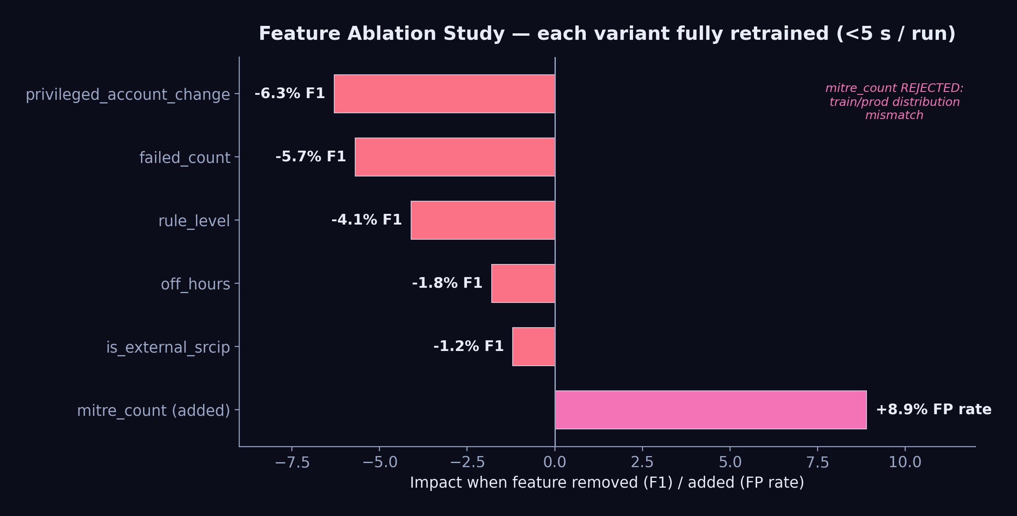
Feature Ablation — which signals actually matter
each variant fully retrained (<5 s on ~2,000 samples) and re-evaluated on the full unlabeled set
▸ Top 3 features — privileged_account_change (−6.3% F1) · failed_count (−5.7%) · rule_level (−4.1%)
▸ mitre_count REJECTED — +8.9% FP rate — train/prod distribution mismatch (Wazuh tags benign SSH logins with MITRE IDs)
AI Threat Engine · Diana Maria Secarea
28
Notes:
To prove the feature set is earned, not guessed, I ran an ablation study — removing or adding one feature at a time and fully retraining, which takes under five seconds. Three features carry most of the discriminative power: privileged_account_change, worth 6.3 F1 points — remove it and new-user and promiscuous-mode attacks drop to zero detection; failed_count, the credential-attack signal; and rule_level, a severity prior. The instructive negative result: adding a semantically obvious feature — MITRE technique count — actually made things worse, plus 8.9% false positives, because Wazuh tags benign SSH logins with MITRE IDs, so the feature's distribution differs between training and production. Plausible is not the same as useful.

Slide 29
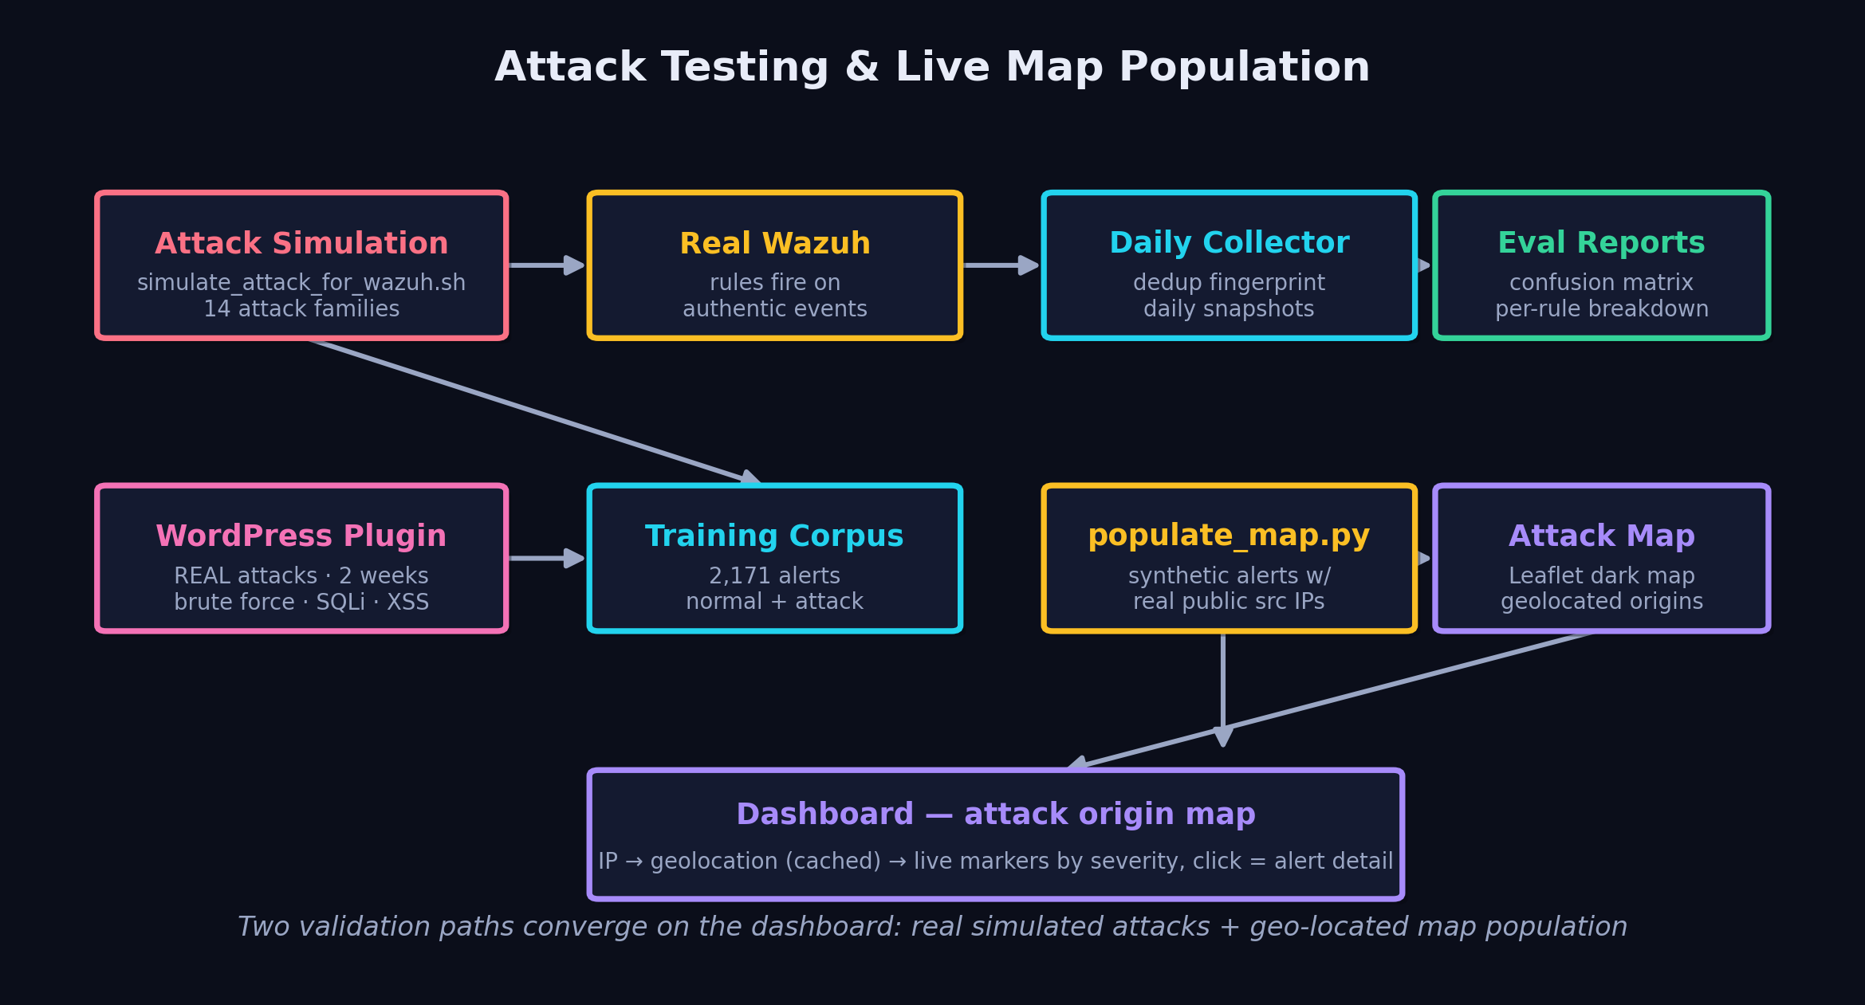
Attack Testing & live map population
the pipeline is validated end-to-end against real, executed attacks — not synthetic feature vectors
▸ simulate_attack_for_wazuh.sh — runs 14 attack families as real commands → Wazuh detects → ensemble scores (trojanized files, rootkit hidden files, PAM/SU failures, port changes, MITRE-tagged events T1548/T1078/T1110/T1014)
▸ populate_map.py — injects synthetic alerts with real public source IPs → geolocated → Leaflet dark world map of attack origins
AI Threat Engine · Diana Maria Secarea
29
Notes:
This is how the whole pipeline is validated. The attack-simulation framework — simulate_attack_for_wazuh.sh — executes 14 attack families as REAL commands on the host: trojanized-file signatures on /bin/passwd, kernel-rootkit hidden files in /tmp, PAM and SU authentication failures, listening-port changes, and MITRE-tagged events like T1548 sudo caching, T1078 valid accounts, T1110 password guessing, T1014 rootkit. Real Wazuh detects them, and the ensemble scores the authentic alerts — no synthetic feature vectors. Separately, populate_map.py injects alerts carrying real public source IPs, which the dashboard geolocates and plots on a dark Leaflet world map, so an analyst sees where attacks originate. Two validation paths, both converging on the dashboard.

Slide 30
Design Choices — RAG over fine-tuning
why retrieval, why MiniLM, why RRF instead of a cross-encoder
Dimension | Fine-tune | RAG
Knowledge update | hours–days | seconds
Freshness | frozen | live
Traceability | opaque | cited
Privacy | sent to model | stays local
Cost | GPU training | embed + search
▸ Embedding: all-MiniLM-L6-v2 — 384-dim, ~8 ms CPU — 5× faster than mpnet, keeps 90%+ quality; bigger models impractical on CPU
▸ Chunking: 512 tokens, 25% overlap — won a [128/256/512/1024] sweep on Recall@5 — smaller fragments concepts, larger dilutes the vector
▸ RRF, not cross-encoder — ms-marco reranker HURT the domain (doesn't know rule 5710 ↔ SSH); RRF trusts rank position, no learned bias
▸ k = 5 retrieved — maximizes Hit Rate within llama3.2's 8K window; k≥10 triggers 'lost in the middle'
AI Threat Engine · Diana Maria Secarea
30
Notes:
Four design choices worth defending. First, RAG over fine-tuning: knowledge updates in seconds not days, answers are traceable and cited, and documents stay local — decisive for confidential security data. Second, the embedding model: all-MiniLM-L6-v2, 384 dimensions, about 8 milliseconds on CPU — five times faster than mpnet while keeping over 90% of the quality; the SOTA models are impractical on CPU. Third, chunk size 512 tokens with 25% overlap won a systematic sweep on Recall@5 — 128 fragments a concept, 1024 dilutes the embedding. Fourth, RRF instead of a cross-encoder: the ms-marco reranker actually hurt domain retrieval because it doesn't know rule 5710 relates to SSH; RRF makes no learned judgment, it just trusts rank position from two independent retrievers. And k=5 maximizes hit rate within llama's 8K context before the lost-in-the-middle effect sets in.

