Slide 1
BACHELOR THESIS DEFENSE
Architecture and Evaluation of a SIEM
Integrating Unsupervised Anomaly Detection
and Knowledge-Grounded Language Models
Secărea Diana Maria
Coordinator: prof. univ. dr. Cătălin Boja
Bucharest University of Economic Studies · Faculty of Cybernetics, Statistics and Economic Informatics
Economic Informatics Program · Bucharest 2026
Notes:
Good morning. I will present my thesis: an AI threat-hunting engine built on the Wazuh SIEM — unsupervised anomaly detection plus a knowledge-grounded LLM copilot. Everything I show is implemented, deployed and evaluated; there will also be a short live demo.

Slide 2
Rule-based SIEMs leave analysts drowning in alerts while novel attacks pass undetected
▪ Alert fatigue is structural: SOCs average ~4,490 alerts/day; ~67% are never investigated for lack of analyst bandwidth.
▪ Rules only match the known. A zero-day or custom tool produces events no rule ID covers — detection is reactive by design.
▪ Static thresholds misfire. “8 failed logins in 120 s” fits no specific environment → false-positive floods.
▪ Alerts arrive context-free. “Possible kernel rootkit (rule 521)” still requires manual research into T1014, indicators, remediation.
Research question
Can unsupervised anomaly scoring
+ retrieval-grounded reasoning
reduce triage time and improve
analyst trust — on a real,
running Wazuh deployment?
Approach: score every alert, explain every score
Industry SOC statistics [7]; WEF Global Risks Report 2024 [4]; Wazuh documentation [2] — thesis §2
Notes:
Three problems motivate the work: alert fatigue (most alerts never get looked at), the structural blindness of signature detection to novel attacks, and the missing context when an alert does fire. My research question: can unsupervised ML plus grounded RAG fix triage on a real deployment — not a toy dataset.

Slide 3
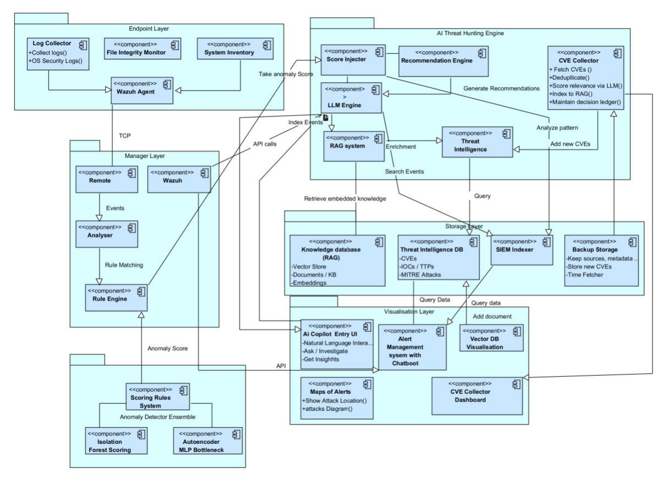
The AI Threat-Hunting Engine extends Wazuh end-to-end: score → explain → keep knowledge fresh
1 · Anomaly ensemble
Isolation Forest + Autoencoder score every alert 0–100, fused into confidence tiers
2 · RAG copilot
local LLM grounded in MITRE ATT&CK, YARA, Sigma, CVEs — cited answers in the dashboard
3 · CVE ingestion agent
scheduled agent fetches, scores and routes new CVEs; PostgreSQL keeps the audit ledger
Figure 3.1.1 — Architecture of the proposed system (thesis, p. 9). Endpoint & manager layers = Wazuh; engine, storage, visualisation layers = this work.
Notes:
This is the architecture figure from the thesis. Left half is standard Wazuh: agents, manager, rule engine. Everything else is my contribution — the AI Threat Hunting Engine with the ensemble scorer, the RAG system with LLM, the CVE collector agent, a storage layer with Qdrant vectors + PostgreSQL audit, and the visualisation layer with dashboards. Three cooperating layers: score, explain, stay current.

Slide 4
A fully local, open-source stack: security data never leaves the machine
Detection (ML)
Explanation (RAG)
Platform
▪ scikit-learn — Isolation Forest
▪ MLP Autoencoder 16→8→4→8→16
▪ NumPy · pandas · joblib artefacts
▪ 16-feature extractor (custom)
▪ Qdrant vector DB — HNSW
▪ all-MiniLM-L6-v2 embeddings (384-d)
▪ BM25 sparse (fastembed) + RRF
▪ Ollama · llama3.2 — local LLM
▪ Wazuh 4.14.1 SIEM (fork base)
▪ Flask API + dashboards :5000
▪ PostgreSQL 17 — audit ledger
▪ Docker Compose · Python 3.13 · WSL2
Why local? Alerts contain confidential system data — no third-party API, no per-token cost
Thesis §4.1 Technologies Used
Notes:
Deliberately boring, deliberately local stack. Detection: scikit-learn ensemble. Explanation: Qdrant with hybrid dense+sparse retrieval and a local llama3.2 through Ollama — because SIEM alerts are confidential, nothing goes to external APIs. Platform: fork of Wazuh, Flask dashboards, Postgres for auditability, all in Docker on one Linux box.

Slide 5
Two models that fail differently: extremes get isolated, unusual combinations fail to reconstruct
Isolation Forest
random cuts isolate
extreme features
CRITICAL · both flag
Wazuh alert
16 features
z-scaled
Fusion
0.45·IF + 0.55·AE
calibrated 0–100
HIGH · only AE
Autoencoder 16→8→4→8→16
reconstruction error flags
odd combinations
POSSIBLE · only IF ×0.65
NORMAL · neither
▪ Evading both is contradictory: blending into density (fools IF) makes you statistically average — easy to reconstruct; mimicking the normal manifold (fools AE) needs common feature values — easy to isolate.
▪ Tiers carry meaning, not just a number: agreement = act now; single-model flags = review when time allows. 91.3% of detected attacks land in CRITICAL.
Isolation Forest: Liu, Ting & Zhou (2008) [20]; autoencoders: Michelucci (2022) [23] — thesis §3.2
Notes:
The core design: one alert, sixteen features, two unsupervised models with opposite failure modes. IF isolates extreme single features fast; the AE learns to reconstruct normal alerts, so unusual combinations reconstruct badly even when no single feature is extreme. Fusion is weighted 45/55 with tier logic from the binary decisions. Key defense point: the evasion strategies against the two models contradict each other — you cannot be statistically average and statistically common at the same time.

Slide 6
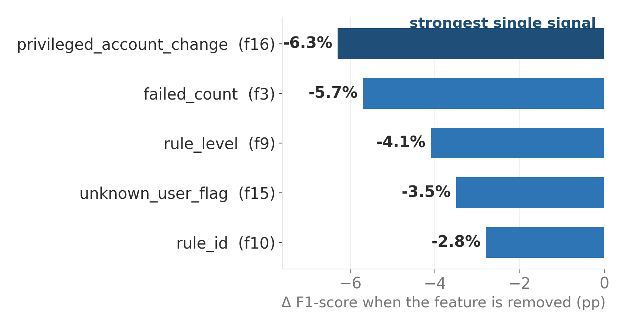
All 16 features are ablation-tested: privilege changes, failed logins and rule severity carry the signal
What the ablation shows
▪ Retrain from scratch per variant (< 5 s on ~2,200 alerts) — not approximated.
▪ privileged_account_change: without it, new-user/promiscuous-mode attacks drop to 0% detection.
▪ failed_count: the brute-force burst signal; CIS-aware zeroing avoids compliance-scan false positives.
Counter-example: adding mitre_count → +8.9% false positives (training/production drift) — removed
Ablation study — thesis §3.2 and Appendix 5 (baseline: 16 features, F1 = 89.2%, FPR = 8.0%)
Notes:
Feature engineering was validated, not guessed: remove one feature, retrain fully, measure. Privileged-account-change is the strongest signal — attacker persistence. The honest part examiners like: a feature that looked obviously useful, MITRE technique count, made the model worse — Wazuh tags benign events with MITRE in production but not in my training data, so I removed it. Distribution shift, addressed empirically.

Slide 7
Zero labels, contaminated data: iterative trimming makes ~30% attack contamination trainable
Baseline vs. label-free
Round 1 — train AE on ALL 2,171 alerts → drop top 25% reconstruction errors
clean-only (baseline)
unsupervised (final)
False-positive rate
8.83%
6.2% ▼
Round 2 — retrain on the remainder → drop top 15% errors
Precision
83.7%
85.8% ▲
Recall
95.7%
90.3%
F1-score
89.3%
88.0%
Round 3 — final fit on the clean estimate → calibrate on 2nd–98th percentiles → 0–100
Training only on “verified clean” data assumes a labelling capability production does not have. The final model trades ~5 pts of recall for fewer false alarms and zero labelling cost.
Rationale: attacks reconstruct badly, so the worst-reconstructed tail is where they hide. The model bootstraps its own clean set — no analyst labelling, self-correcting on retrain.
Tables 4.2.1–4.2.2, D_train = 2,171 alerts (1,534 benign / 637 attack) — thesis §4.2
Notes:
The training story is the methodological heart. Production logs are never guaranteed clean, so I train on everything: IF with contamination auto, AE with three rounds of iterative trimming — train, drop the worst-reconstructed quarter, retrain, drop 15%, final fit and percentile calibration. Right table: versus the supervised-ish baseline I lose some recall but gain precision and cut the FPR to 6.2% — and it needs no labels, which is the honest production scenario.

Slide 8
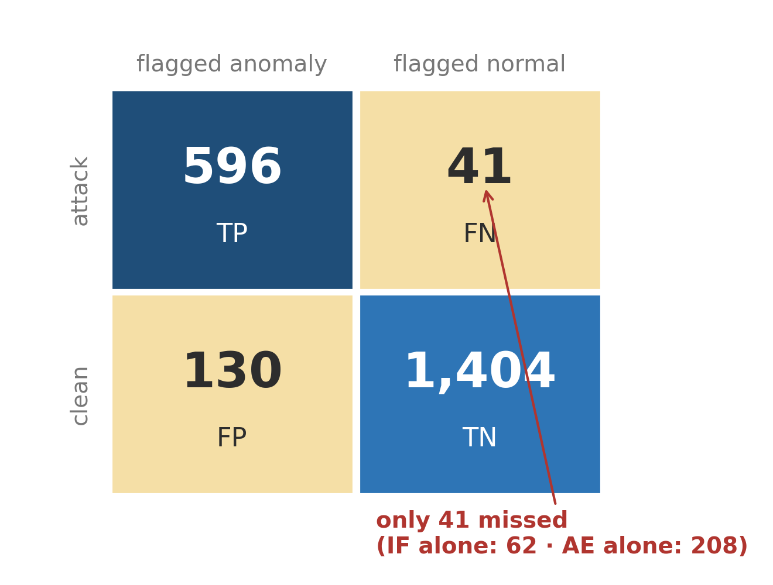
The ensemble misses the fewest attacks: 41 vs 62 (IF alone) and 208 (AE alone)
On 2,171 real alerts
▪ Ensemble: precision 82.1% · recall 93.6% · F1 87.5%
▪ Standalone AUC: IF 0.942 — the workhorse; AE 0.748 — the second opinion that cuts false alarms.
▪ Real data, real attacks: months of live Wazuh telemetry + a WordPress site attacked in the wild for two months.
Design intent: fewest missed attacks beats the prettiest F1 — misses are what hurt a SOC
Figure 4.2.7 (ensemble confusion matrix), Table 4.2.4, Figure 4.2.6 (ROC) — thesis §4.2
Notes:
Results on the full evaluation set. The exhibit is the ensemble confusion matrix: 596 attacks caught, 41 missed — versus 62 missed by IF alone and 208 by AE alone. That is the number that matters for a security system. Precision 82%, so roughly one in five flags is a false alarm — acceptable for triage where the cost asymmetry favours recall. Data is real: my own deployment plus a genuinely attacked WordPress site.

Slide 9
The RAG copilot grounds a local LLM in a self-updating threat knowledge base — every choice ablated
dense · cosine
alert /
analyst query
MiniLM-L6-v2
384-d embedding
RRF fusion
top k = 5
llama3.2 · grounded prompt
“answer ONLY from context, cite [Source], refuse if absent”
sparse · BM25
Each design decision was measured, not assumed
▪ Chunking: 512 tokens + 25% overlap — beats 128/256/1024 — Recall@5 48.4%, Hit-Rate 82.9%, MRR 0.695
▪ k = 5 context chunks — best hit-rate inside llama3.2's 8K window; k=10+ dilutes attention (lost-in-the-middle)
▪ RRF instead of a cross-encoder — ms-marco re-ranker degraded domain queries; rank fusion needs no learned judgement
▪ Self-updating corpus — scheduled CVE agent: fetch NVD/CISA-KEV → dedup → LLM relevance 0–10 → ≥7 index · 4–6 human queue · <4 drop
Tables 3.3.2 (chunk ablation), 4.3.2 (top-k), §4.3 stage 5 (RRF vs cross-encoder), CVE agent §4.3 — thesis
Notes:
The explanation side. Hybrid retrieval: the same query runs through dense semantic search and sparse BM25 keyword search — semantics matches 'SSH brute force' to 'multiple failed authentications', BM25 nails exact CVE IDs and rule numbers — fused with reciprocal rank fusion. The LLM is forced to answer only from retrieved context with citations, and to refuse when the context is empty. Every knob was ablated: chunk size, k, and the re-ranker I removed because it hurt. The corpus self-updates through the scheduled CVE agent with a human review queue for mid-confidence items.

Slide 10
Two stores, two questions: Qdrant finds what is similar, PostgreSQL records what is true
Qdrant — vector store · “what is similar?”
PostgreSQL — audit ledger · “what is true?”
▪ Data: text → 384-d embeddings (MiniLM) + BM25 sparse vectors
▪ Index: HNSW approximate nearest-neighbour, sub-linear
▪ Query: hybrid dense + sparse, fused with RRF
▪ Holds: verified threat intel + alert episodes only
▪ Answers: “which knowledge means the same as this alert?”
▪ Data: 5 relational tables + raw JSONB snapshots
▪ Guarantees: ACID, keys, constraints — the cve_decisions ledger
▪ Governance: medium-confidence CVEs quarantined, never in RAG
▪ Durability: full original payload survives model/index change
▪ Answers: “what exactly happened, and is it consistent?”
Bridge: cve_decisions.qdrant_id links each audited fact to its searchable vector — a foreign key across paradigms
Thesis §3.2 (embedding model, HNSW, PostgreSQL audit helper); schema.sql + scheduled_agent/schema_additions.sql
Notes:
A deliberate two-database design, because they answer different questions. Qdrant is the vector store: text becomes 384-dimensional embeddings plus sparse BM25 vectors, indexed with HNSW for fast approximate nearest-neighbour, queried as a hybrid fused by reciprocal rank fusion — it answers 'what is semantically similar'. PostgreSQL is the relational audit layer: five tables plus raw JSONB snapshots, with ACID guarantees and constraints — it answers 'what exactly happened and is the record consistent'. Similarity search can't run on a B-tree, and audit guarantees can't run on a vector index — so I use both. The bridge is one column: cve_decisions dot qdrant_id links an audited decision to its vector point — effectively a foreign key that crosses the two paradigms. And governance: only verified intelligence reaches Qdrant; medium-confidence items are quarantined in Postgres.

Slide 11
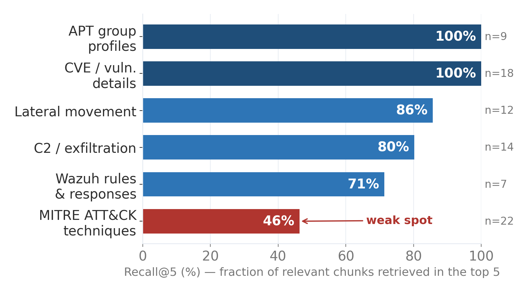
Retrieval works where it matters: CVEs and APT profiles near-perfect; MITRE techniques are the weak spot
Over 82 annotated queries
▪ Overall: Hit-Rate 82.9% · MRR 0.695 at k=5 — the right source is usually ranked at or near the top.
▪ Strong: CVEs & APT profiles (100%) — distinctive, narrow vocabulary embeds cleanly.
▪ Weak: MITRE techniques (46%) — one query maps to many overlapping sub-techniques.
Honest finding: a cross-encoder re-ranker HURT domain queries → removed. RRF needs no learned judgement.
Appendix 3–4 (retrieval by category), §4.3 — thesis; hybrid dense+sparse+RRF over all 82 queries
Notes:
Before generation, does retrieval even find the right evidence? On 82 human-annotated queries, hit-rate 82.9%, MRR 0.695 — the correct source is usually at or near the top. The chart breaks it down by category: CVEs and APT profiles are essentially perfect because their vocabulary is distinctive. The weak spot is MITRE technique queries at 46% recall — one query legitimately maps to many overlapping sub-techniques, so 'the' relevant chunk is ambiguous. The honest engineering finding: I tried a cross-encoder re-ranker and it made domain queries worse — a model trained on web search doesn't know rule 5710 relates to SSH — so I removed it. RRF just trusts rank position from two independent retrievers and needs no learned judgement.

Slide 12
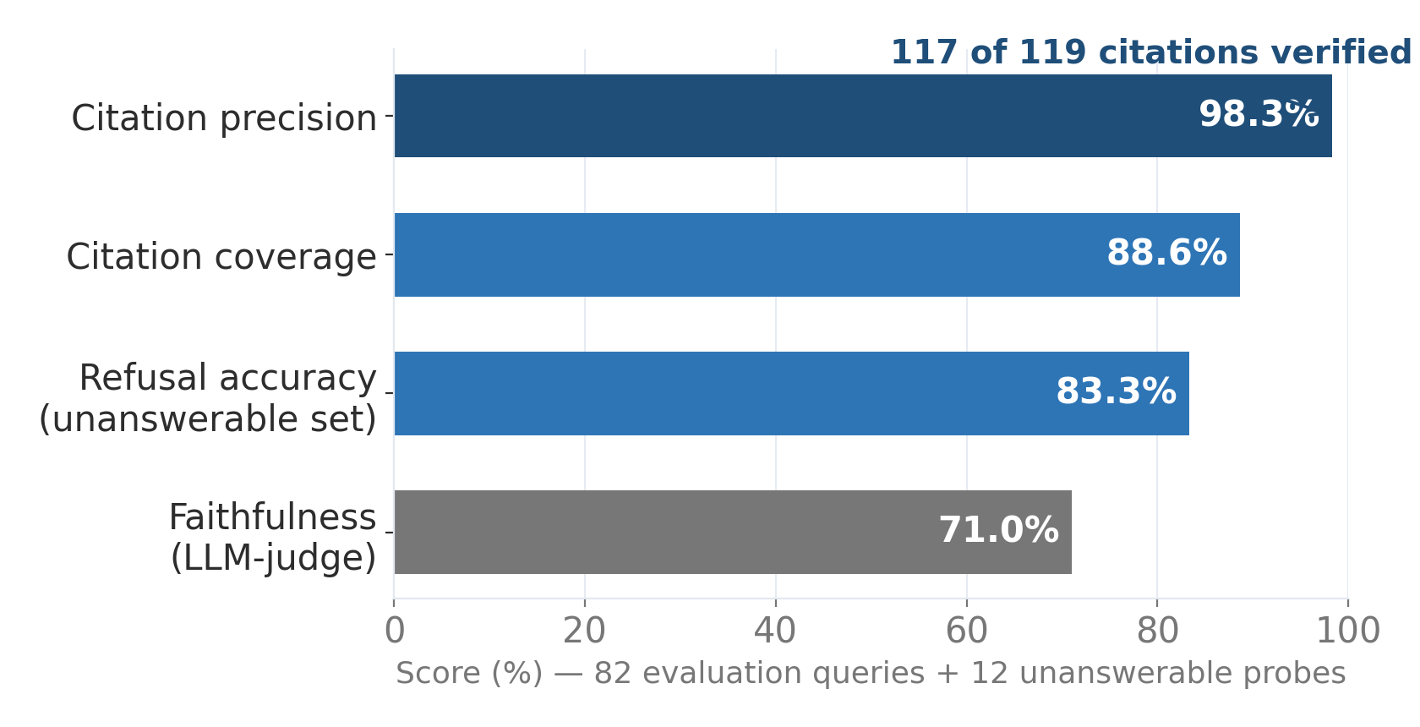
Generation is verifiably grounded: 98.3% citation precision — and it refuses to invent threats
Why it matters
▪ Every claim is auditable: inline [Source] tags map to retrieved chunks — 117/119 verified correct.
▪ Asked about a fake CVE / APT group: refused all 6 fabricated-intelligence probes instead of hallucinating.
▪ Never over-refuses: 0 of 82 answerable queries wrongly declined — calibrated, not just cautious.
▪ Retrieval base: Hit-Rate 82.9% · MRR 0.695 at k=5 on 82 annotated queries.
Figure 4.3.6 (generation evaluation), §4.3 refusal-behaviour set — thesis; RAGAS-style claim decomposition [27]
Notes:
Does the copilot actually stay grounded? Citation precision 98.3% — of 119 citations the model produced, 117 point at a chunk that really supports the sentence. Faithfulness 0.71 — the rest is mostly generic background, not contradictions. The security-critical result: on purpose-built unanswerable probes — a fake CVE, an invented APT group — it refused every fabricated-intelligence question rather than making threat intel up, and it never refused a question it could answer.

Slide 13
The knowledge base updates itself: a bounded agent scores and routes every new CVE — daily, audited
Fetch
NVD + CISA-KEV
since last cursor
Dedup
vs threat_intel
Postgres ledger
Boost
+ environment evidence
local rules · alert history
LLM Score
llama3.2 → relevance 0–10
final = min(base + boost, 10)
≥ 7 AUTO-INDEX
indexed → Qdrant + Postgres
4–6 REVIEW QUEUE
held OUT of RAG · human decides
< 4 DROP + AUDIT
reasoning logged, never silent
Every decision lands in the cve_decisions ledger — reversible, auditable, no silent RAG pollution
One bounded LLM step; on failure → conservative score 5 → review queue, never a silent drop.
Scheduled CVE ingestion agent — thesis §4.3; Postgres cve_decisions ledger + pending_review view
Notes:
This is the third contribution: the knowledge base maintains itself. A scheduled agent runs daily with a deliberately fixed control flow — Fetch new CVEs from NVD and CISA-KEV since the last cursor, Dedup against the Postgres ledger, Boost relevance with local evidence (my own Wazuh rules and alert history), then exactly ONE bounded LLM step that scores relevance 0 to 10. The score routes the CVE: 7 or above auto-indexes into Qdrant and Postgres, 4 to 6 is held OUT of the RAG and queued for a human, below 4 is dropped but its reasoning is logged. The safety properties matter: only one LLM call so it can't spiral, and if the LLM fails it defaults to a conservative 5 which routes to human review — never a silent drop. Every decision is written to the cve_decisions audit ledger, so the whole thing is reversible and there's no silent pollution of the knowledge base.

Slide 14
Conclusions
1. Unsupervised detection works on real telemetry: the IF+AE ensemble reaches recall 93.6% with the fewest missed attacks (41), trained with zero labels on contaminated data.
2. Grounded explanation is measurable, not aspirational: 98.3% citation precision, refusal of fabricated threats, 0 over-refusals — the copilot earns analyst trust.
3. The knowledge base maintains itself: a scheduled agent scores and routes new CVEs into the RAG index with a human review queue and full audit ledger in PostgreSQL.
Honest limits: ~2,200 training alerts; per-alert scoring (no UEBA yet); local LLM latency. Next: entity-level behaviour analytics, supervised comparison baseline, domain-tuned re-ranker.
github.com/Diana-Secarea/advanced-ai-siem · diana.secarea1111@gmail.com · feedback welcome
Notes:
Three takeaways. One: unsupervised anomaly detection is viable on real SIEM telemetry — best recall of the three configurations, no labels needed. Two: LLM explanation can be held to measurable grounding standards — and passes. Three: the knowledge base stays fresh autonomously, with humans only where confidence is medium. Full implementation is public on GitHub. I'll stop here — happy to take questions. [This slide stays on screen during Q&A.]

Slide 15
Appendix — References (selection cited in this deck)
References
[2] Wazuh Inc., “Wazuh Documentation”, https://documentation.wazuh.com/, 2024.
[4] World Economic Forum, “The Global Risks Report 2024”, Geneva, 2024.
[7] E. & L. S. Okafor, “Unsupervised Learning Framework for Cyber Threat Detection, Anomaly Identification, and Alert Prioritization”, Applied Sciences, 2026.
[20] F. T. Liu, K. M. Ting, Z.-H. Zhou, “Isolation Forest”, IEEE International Conference on Data Mining, 2008.
[23] U. Michelucci, “An Introduction to Autoencoders”, arXiv:2201.03898, 2022.
[25] P. Lewis et al., “Retrieval-Augmented Generation for Knowledge-Intensive NLP Tasks”, NeurIPS 2020.
[27] Y. Gao et al., “Retrieval-Augmented Generation for Large Language Models: A Survey”, arXiv:2312.10997, 2023.
[29] N. Reimers, I. Gurevych, “Sentence-BERT: Sentence Embeddings using Siamese BERT-Networks”, EMNLP 2019.
[31] Qdrant Solutions GmbH, “Qdrant Documentation”, 2026.
[32] D. M. Secărea, “AI-SIEM Threat Engine”, https://github.com/Diana-Secarea/advanced-ai-siem, 2026.
Full bibliography (32 entries): thesis pp. 44–46.
Notes:
Appendix slide — navigate here only if a reference question comes up.

